Slide 1
Vermont Department of Mental Health
Melissa Bailey, Commissioner
Notes:
VISION
Mental health will be a cornerstone of health in Vermont. People will live in caring communities with compassion for and a determination to respond effectively and respectfully to, the mental-health needs of all citizens. Vermonters will have access to effective prevention, early intervention, and mental-health treatment and supports as needed to live, work, learn, and participate fully in their communities.
Mission
It is the mission of the Vermont Department of Mental Health to promote and improve the mental health of Vermonters.
A key organizing function for DMH is the operations of the central office
The Designated Agency (DA) community-based mental health service delivery system holds the organizing functions for the state funded system of care in the communities.
The final organizing function of the DMH is supporting access to acute inpatient psychiatric care for persons needing involuntary hospitalization at the VPCH and within the 5 designated hospitals system of inpatient care.

Slide 2
Agenda
DMH Overview and Budget Snapshot
DMH Organization
Provider Agencies
Departmental Programs and system of care
Initial Priorities to address current challenges

Slide 3
Overview of Department and Responsibilities
Budget $220 M
Oversees 10 Designated Agencies and 2 Specialized Service Agencies through quality review designation and collaboration
35,000+ people served through the DA/SSA system with even more served by Emergency Services and Crisis Teams
Vermont Psychiatric Care Hospital and Middlesex Therapeutic Care Residence (25 and 7 beds)
265 staff, 200 at the facilities, 65 at Central Office
Oversee several contracts such as forensic psychiatrist, psychiatric consultation with primary care, child and adolescent psychiatric fellowship at UVM
Partners with sister departments, hospitals, other community providers, One Care, police departments, courts etc…
Responsible statutorily of the overall mental health system for all Vermonters

Slide 4
18 V.S.A § 7201
§ 7201. Mental health
The department of mental health, as the successor to the division of mental health services of the department of health, shall centralize and more efficiently establish the general policy and execute the programs and services of the state concerning mental health, and integrate and coordinate those programs and services with the programs and services of other departments of the state, its political subdivisions, and private agencies, so as to provide a flexible comprehensive service to all citizens of the state in mental health and related problems.

Slide 5
Central Office Organization
Overall Operations supported by ~65 positions
Administrative Support Unit
Financial Services Unit
Legal Services Unit
Research & Statistics Unit
Clinical Care Management Unit
Operations, Policy, & Planning Unit
Quality Management Unit
Children, Adolescent and Family Unit (CAFU)
Adult Mental Health Services Unit
Notes:
Central Office above less than 70 positions

Slide 6
Vermont Psychiatric Care Hospital and Middlesex Secure Residential
VPCH – 25 bed capacity
Middlesex – 7 bed capacity
About 206 classified positions between the two facilities with additional contracted positions for medical services and traveling nurses to operate 24/7 facilities with 3 shifts.

Slide 7
FY19 Proposed Expenses

Slide 8
Designated Providers
Designated Agencies
Clara Martin Center
Counseling Services of Addison County
Health Care and Rehabilitation Services of Southeastern Vermont
Howard Center
Lamoille County Mental Health Services
Northwest Counseling and Support Services
Northeast Kingdom Human Services
Rutland Mental Health Services
United Counseling Service
Washington County Mental Heath Services
Designated Hospitals
Brattleboro Retreat
Central Vermont Medical Center
Rutland Regional Medical Center
University of Vermont Medical Center
Windham Center
Vermont Psychiatric Care Hospital (State-run)
White River Junction VA Medical Center
Specialized Services Agencies
Pathways Vermont
Northeastern Family Institute
State Secure Residential
Middlesex Therapeutic Community Residence

Slide 9
Provider Capacity for Inpatient, Crisis and Residential Beds
Designated Agencies
Adult Crisis Beds: 38 beds
Youth Crisis Beds: 12 beds
Adult Intensive Residential: 42 beds
Designated Hospitals
Adult – Level 1 involuntary: 45 beds*
Adult – Non-Level 1 (involuntary and voluntary): 154 beds
Children and Youth: 28 beds
Peer Service Agencies
Adult Crisis Beds: 2 beds
Adult Intensive Residential: 5 beds
State Secure Residential
Middlesex Therapeutic Community Residence: 7 beds*
*45 level 1 plus 7 secure residential = 52 beds replacing the 54 VSH beds

Slide 10
Designated Providers
CMC | Clara Martin Center
CSAC | Counseling Services of Addison County
HCRS | Health Care and Rehabilitation Services of Southeastern VT
HC | Howard Center
LCMH | Lamoille County Mental Health Services
NCSS | Northwest Counseling and Support Services
NKHS | Northeast Kingdom Human Services
RMHS | Rutland Mental Health Services
UCS | United Counseling Service
WCMH | Washington County Mental Heath Services
NFI | Northeastern Family Services (SSA)
PV | Pathways Vermont (SSA)

Slide 11
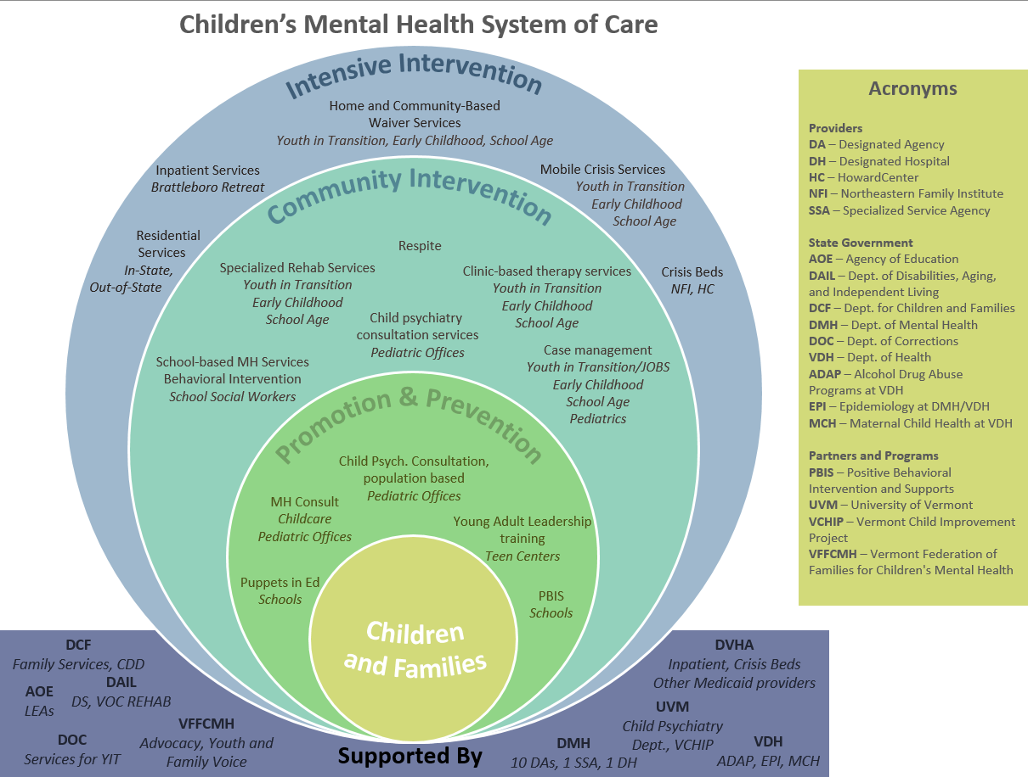

Slide 12
Most Common Adverse Family Experiences in Vermont
Divorce / separated parents - 32,252, 26%
Not having enough food to eat or stable housing - 30,710, 25%
Living with someone who has a drug or alcohol problem -17,973, 15%
Living with someone who is very depressed, mentally ill, or suicidal - 13,458, 11%
These 4 AFEs also are more common in Vermont than in the nation

Slide 13
Why Should We Care about Adverse Family Experiences?
Carrying a burden of adverse family experiences:
Increases risky behaviors by teens
Impacts school success
Impacts long-term health outcomes
Contributes to costs in health care, jails, special education and child welfare, just to name a few . . .

Slide 14
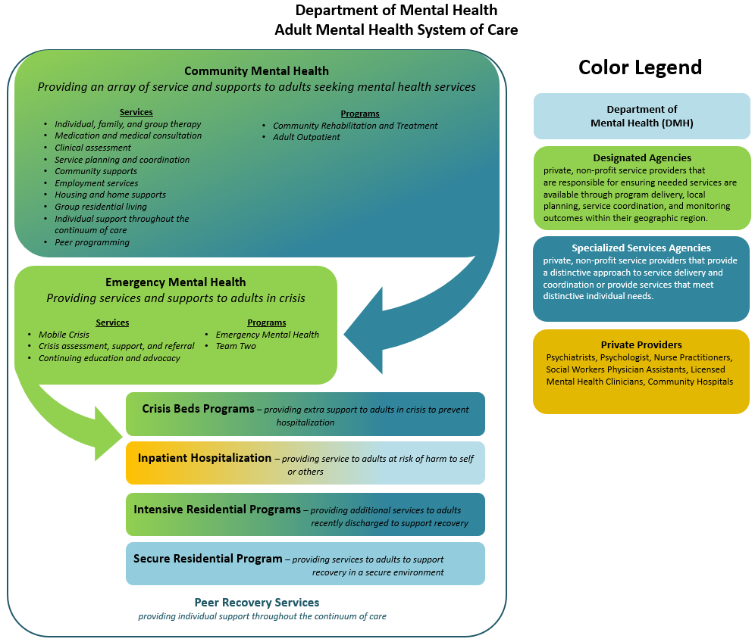

Slide 15
Community Programs
Program | Description
Adult Outpatient (AOP) | Provides services for adults who do not have prolonged serious disabilities but who are experiencing emotional, behavioral, or adjustment problems severe enough to warrant professional attention
Community Rehabilitation and Treatment (CRT)* | Provides services for adults with severe and persistent mental illness
Children and Families (C&F)* | Provide services to children and families who are undergoing emotional or psychological distress or are having problems adjusting to changing life situations.
Emergency Services | Serves individuals who are experiencing an acute mental health crisis. These services are provided on a 24-hour a day, 7-day-per-week basis with both telephone and face-to-face services available as needed.
Advocacy and Peer Services | Broad array of support services provided by trained peers (a person who has experienced a mental health condition or psychiatric disability) or peer-managed organizations focused on helping individuals with mental health and other co-occurring conditions to support recovery
*mandated service population
Notes:
The note on mandated services only applies to seriously, emotionally disturbed (SED) children, not children broadly.

Slide 16
People Served by Program

Slide 17
Initial priorities to address current challenges
Implementing Strengthening Families Framework
Working with child care and schools to be trauma informed and have tools to work with children and families who experience trauma
Implementing Building Flourishing Communities
Working with Department for Children and Families to implement evidence based early childhood and family mental health
Integrating children and family services across the Agency of Human Services
Payment reform to create flexibility and focus on outcomes and quality

Slide 18
Initial priorities to address current challenges
Increase capacity for forensics, level 1 beds and secure residential
Examine licensing and rules regarding emergency involuntary procedures and involuntary treatment
Assure crisis beds are fully utilized and explore alternatives that people are more willing to access
Expand mobile crisis outreach to assure community outreach and appropriately address crisis in community so individuals can be diverted, when appropriate from the ED
Continue to explore or build geriatric psychiatric capacity
Supportive housing that can adequately support people coming out of inpatient or prevent some individuals needing inpatient or crisis services
Adding resources to assure training in evidence based practices
Peer services to be expanded and supported
Expand mental health treatment court

Slide 19
Thank You!
Questions and discussion

