Slide 1




Alcohol and Drug Abuse Programs
Evaluation of the Vermont Hub and Spoke
February 12, 2018

Slide 2
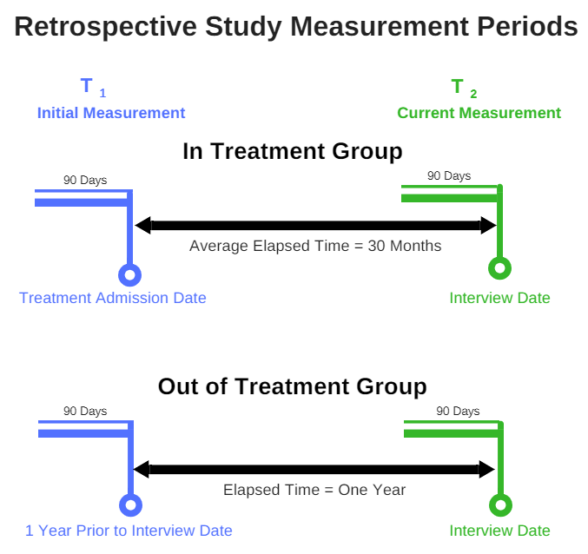
Study Measurement Periods
N = 80 people
N = 20 people
Notes:
Average time in treatment was 30 months.

Slide 3
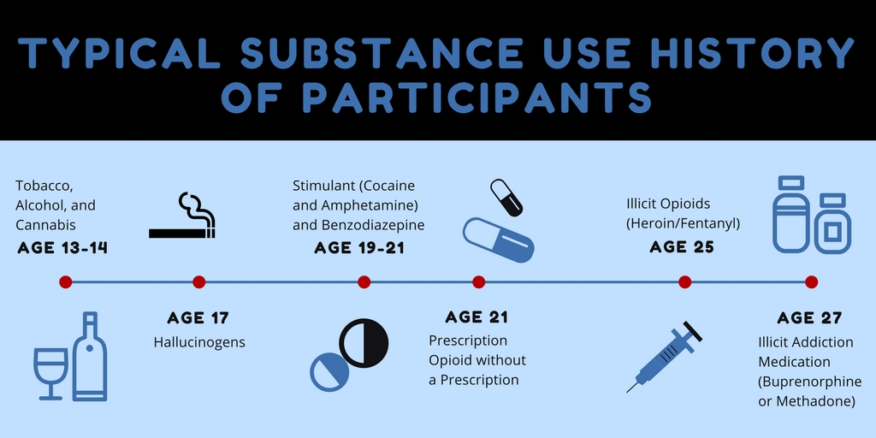
Study participants trajectory of substance use

Slide 4
Self-Reported Changes in Opioid Use: T1 to T2
Opioid use decreased substantially for people in both hubs and spokes. Those not in treatment continued to use at high levels.
Measure | In Treatment
 | Change in Ave Days Used
Days of Opioid Use | -96%
Days of Opioid Injection | -92%
The out of treatment group is excluded because there were no significant changes
Designates statistically significant change
“The hub was really good in a lot of ways because of the structure, the discipline. It makes you get back on track if you want to get back on track.” – Hub Patient
“The main support is always they focus on your health and your wellbeing. They always try to make sure you’re safe. That’s the number one thing, and then your substance abuse, to not using.” – Spoke Patient

Slide 5
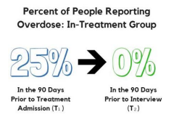
Self-Reported Changes in Functioning: T1 to T2
There were significant decreases in the number of ED visits, arrests, and days of illegal activity. No study participants overdosed in the 90 days prior to the interview. Days of school or training increased but there was not a significant change in days of work.
Measure | In Treatment Group (n=80)
Number of ED Visits | -89%
OD in the previous 90 days | -100%
Number of police stops or arrests | -90%
Days of illegal activity | -90%
The out of treatment group is excluded because there were no significant changes
Designates statistically significant change

Slide 6
Evaluation Recommendations
Increase access to MAT in spokes
Add hubs to decrease hub census per location
Develop an addiction workforce plan
Establish a workgroup to improve clinical treatment
  Increase mental health services
  Provide services for family members/significant others
  Provide vocational services
  Review and update as needed system protocols and procedures

Slide 7
Study Limitations
Sample sizes are small
Participants self selected
All data is self-report
This was not a controlled research trial and the out of treatment group are not a true control group
Sample results should be used in combination of other studies and data

