Slide 1
Coronavirus disease (COVID-19)
EMS Response
Vermont Department of Health
Division of Emergency Preparedness, Response & Injury Prevention
Notes:
This presentation will review the Vermont EMS response to Coronavirus disease also known as COVID-19.

Slide 2
Coronavirus disease (COVID-19)
Notes:
Coronavirus disease (COVID-19) is a new strain of virus that was discovered in 2019 and has not been previously identified in humans.

Slide 3
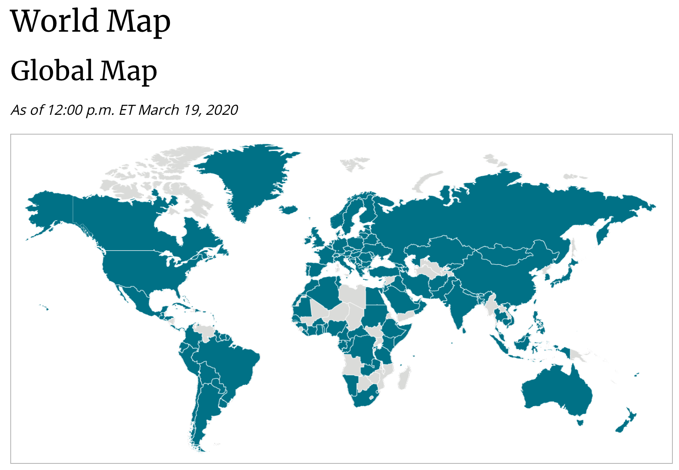
Notes:
Covid 19 has been detected in the U.S. and in most countries worldwide. Cases of COVID-19 in the U.S. include imported cases in travelers, cases among close contacts of a known case, and community-acquired cases where the source of the infection is unknown.

Slide 4
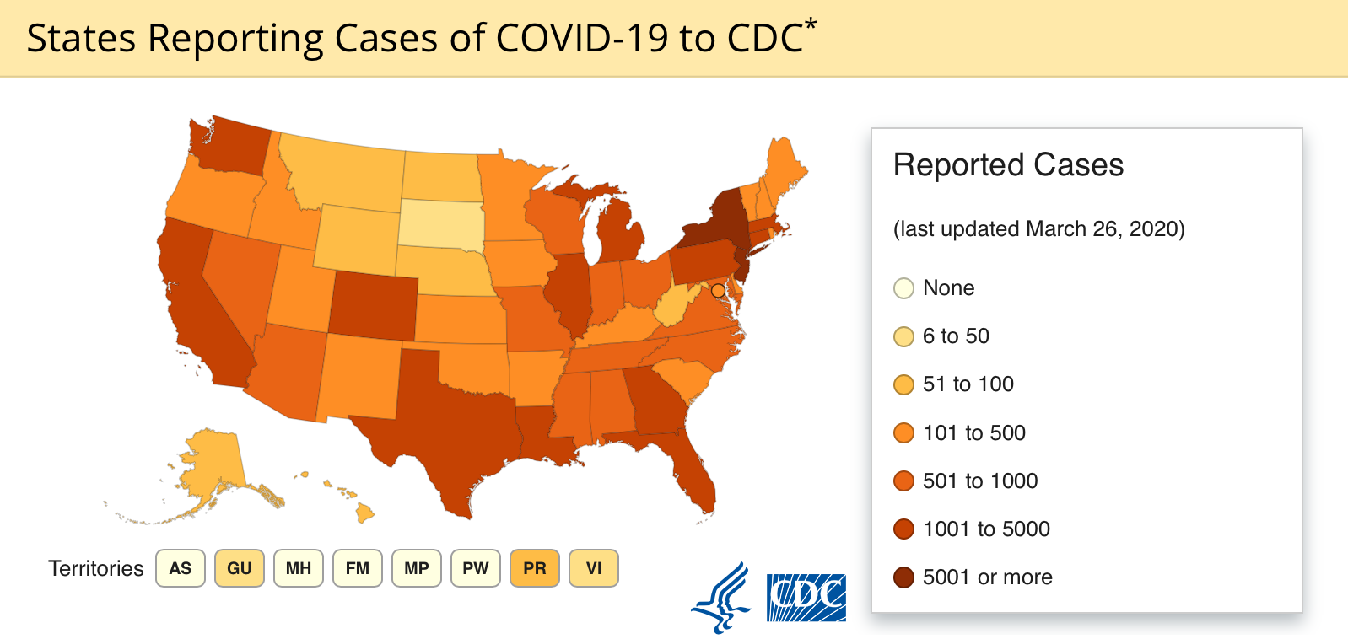
Notes:
The number of known cases in the U.S. continues to grow quickly with cases reported in almost all states. Most U.S. states are experiencing sustained community spread. On March 11, 2020, the World Health Organization publicly characterized COVID-19 as a pandemic.

Slide 5
Notes:
Reported COVID-19 illnesses have ranged from mild to severe, including death. The current understanding is that most patients with COVID-19 have mild illness, with severe illness occurring in only 15-20% of patients. Frequently reported signs and symptoms at illness onset of hospitalized patients with COVID-19 include:
Fever, cough, myalgia, and shortness of breath.
Less commonly reported symptoms include sore throat, headache, cough with sputum production and/or hemoptysis, nausea and diarrhea.

Slide 6
Risk Factors
Notes:
Risk factors for serious disease associated with COVID-19 include older age and comorbidities such as heart disease, lung disease, and diabetes.

Slide 7
Notes:
COVID-19 has posed many challenges to the safe and effective delivery of emergency medical services in Vermont. The complex and unprecedented demands we will all face in the weeks to come will require hard work, creative thinking, and most of all teamwork. In support of the brave men and women on the front lines of this pandemic, Vermont EMS has published two new protocols: Covid-19 Assessment & Transport, and Covid-19 Field Triage Guidance.

Slide 8

Notes:
The purpose of the Covid-19 Assessment & Transport protocol is to minimize the risk of exposure and spread of Coronavirus.

Slide 9
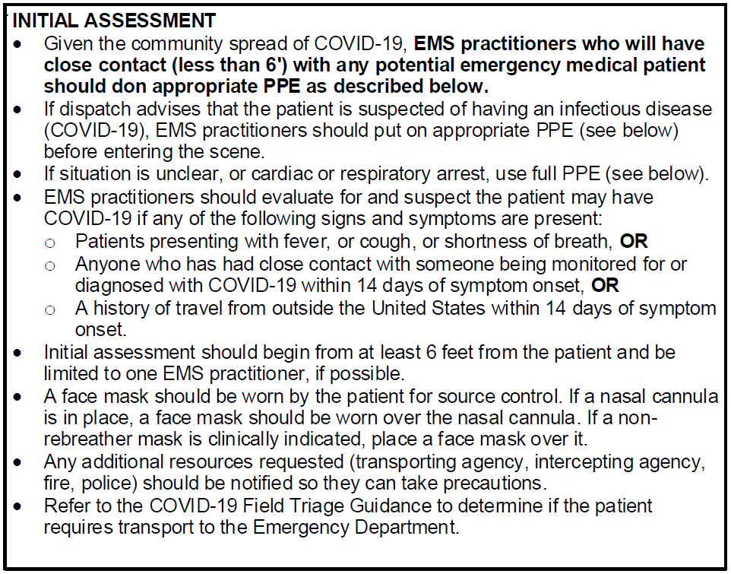
Notes:
The protocol starts with an initial assessment

Slide 10
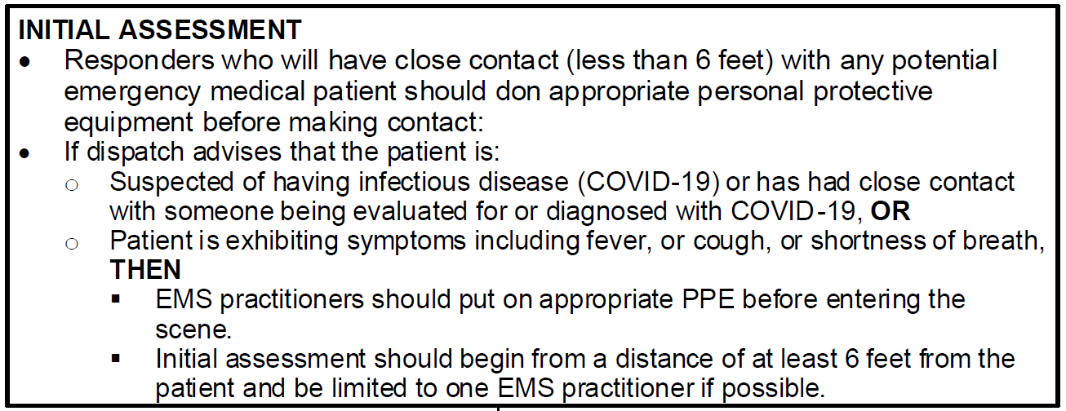
Notes:
Initial Assessment:
Responders who have close contact (less than six feet) with any potential emergency medical patient should don appropriate personal protective equipment before making contact.
If dispatch advises that the patient is:
Suspected of having infectious disease (COVID-19) or has had close contact with someone being evaluated for or diagnosed with COVID-19, OR
The Patient is exhibiting symptoms including fever, cough or shortness of breath
THEN
▪ EMS practitioners should put on appropriate PPE before entering the scene.
▪ Initial assessment should begin from a distance of at least 6 feet from the patient and be limited to one EMS practitioner if possible.

Slide 11
Notes:
If dispatch advises that the patient is:
Suspected of having infectious disease (COVID-19) or has had close contact with someone being evaluated for or diagnosed with COVID-19, OR
The Patient is exhibiting symptoms including fever, cough or shortness of breath
THEN
▪ EMS practitioners should put on appropriate PPE before entering the scene.
▪ Initial assessment should begin from a distance of at least 6 feet from the patient and be limited to one EMS practitioner if possible.

Slide 12
Use full PPE for Cardiac or Respiratory Arrest
Notes:
If the situation is unclear, or the patient has cardiac or respiratory arrest, use full PPE

Slide 13
Notes:
Be advised, Vermont 9-1-1 call-takers are screening all EMS-related calls for any indications of possible COVID-19 virus based on travel or contact history and symptoms: including fever, trouble breathing or cough. If any risk factors are present, 911 will Alert EMS dispatch, including any First Responders and EMS personnel, of the potential for infectious disease before the responders arrive on scene using the following wording:
UNKNOWN MEDICAL CONCERN, CALL DISPATCH. The message to be relayed to responders over the phone will be as follows:
The patient may have an infectious disease. The specific travel, contact or symptom risk factors will then be shared along with instructions to use full personal protective equipment (PPE). If you hear, “Unknown Medical Concern, Call Dispatch”, but are unable to contact dispatch, assume the concern is infectious disease and use full PPE.

Slide 14
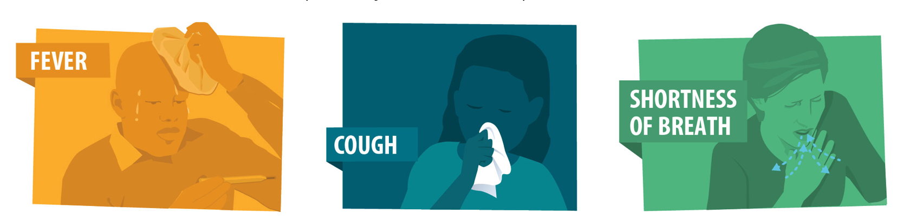
Notes:
Whether 911 notifies EMS or not, EMS should assess patients for any symptoms concerning for COVID-19 such as fever, cough or shortness of breath. If any of these symptoms are present EMS practitioners should put on appropriate PPE before entering the scene. The initial assessment should begin from a distance of at least 6 feet from the patient and be limited to one EMS practitioner, if possible, in order to avoid exposing multiple crew members to potential virus.
Please understand that we have entered the community transmission phase of this pandemic, therefore, while it is still important to know travel and sick contact history, any patient that has a flu-like illness (Fever, cough, shortness of breath) should be treated as a possible COVID-19 patient in regards to what PPE you wear while caring for the patient.

Slide 15
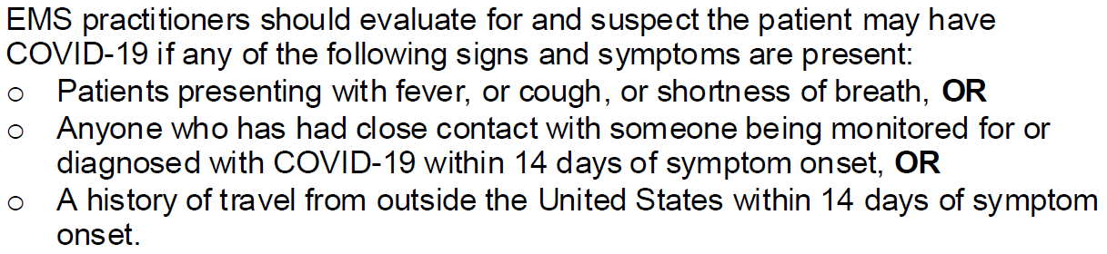
Notes:
After checking for signs and symptoms such as fever, cough or shortness of breath, ask the patient if they have any contact or travel history.
You may ask, “Have you had close contact with someone who has or is being monitored for COVID-19 in the last 14 days?”
“Have you traveled outside of the United States in the last 14 days?”
If the answer is yes, query them about where they have travelled. The list of high-risk areas seems to change daily, so please refer to the CDC web site for the most up to date list.

Slide 16
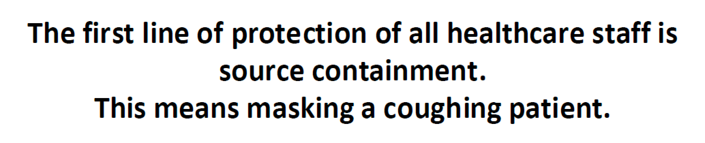
Notes:
A word about personal protective equipment (PPE)
The first line of protection is source containment. This means put a regular surgical mask on a coughing patient. This is a huge first step in staying safe!

Slide 17
Notes:
Any additional resources requested (transporting agency, intercepting agency, fire, police) should be notified so they can take precautions.
Refer to the COVID-19 Field Triage Guidance to determine if the patient requires transport to the Emergency Department.
We will talk about this protocol in the next section.

Slide 18
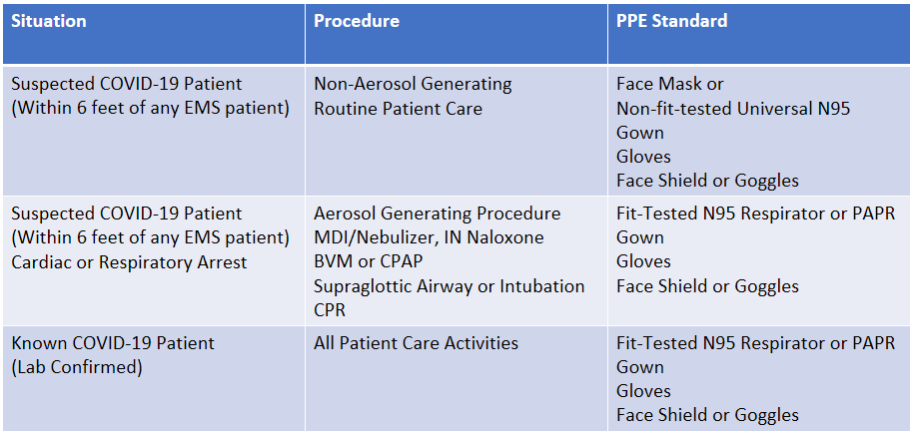
Notes:
We are currently following a PPE conservation strategy which is in alignment with recommendations from the CDC and the World Health Organization (WHO).
The current recommendations for PPE are as follows:
For a known COVID-19 Patient (Lab confirmed), OR, for any aerosol generating procedures (including MDI, nebulizer, CPAP, BVM, SGA, ETI, Cardiac Arrest naloxone administration), use full PPE including a N95 respirator mask or PAPR, Gown, Gloves and Face Shield or Goggles
For a suspected but unknown COVID patient, use a regular surgical mask or “Universal N95” mask, gown gloves and face shield or goggles.
Please note: Due to current condition of community spread of COVID-19, any EMS patient could have the virus. It is important to routinely wear a mask, gloves, and eye protection for ALL EMS patients for whom you will have any contact closer than 6 feet.
Please be aware that the “Universal N95” masks, also known as industrial N95 masks are not respirators. These masks are not fit-tested and are used just like a regular surgical mask. They are now in the supply chain for hospitals and EMS agencies. Do not confuse these with the true fit-tested N95 fit-tested respirators.
Check with your Training Officer or Service Head to be sure you know what PPE your agency has available.
Bottom line, any patient with a fever, cough or trouble breathing, you should be wearing a surgical mask, gown gloves and eye protection. For aerosolizing procedures or CPR, or if you are transporting a known COVID patient, an in an interfacility transfer, use a N95 respirator or PAPR
When the supply chain is restored, fit-tested EMS clinicians should return to use of N95 respirators for patients with known or suspected COVID-19.

Slide 19
Notes:
Drivers should wear PPE if providing patient care. After completing patient care and before entering an isolated driver’s compartment, the driver should remove and dispose of PPE and perform hand hygiene to avoid contaminating the compartment.
If the ambulance does not have an isolated driver’s compartment, the driver should remove the face shield or goggles, gown and gloves and perform hand hygiene. An N-95 respirator or face mask should continue to be used during transport.
After transfer of care, EMS practitioners should remove and discard PPE and perform hand hygiene. Used PPE should be discarded in accordance with routine procedures.
All personnel should avoid touching their face while working.

Slide 20
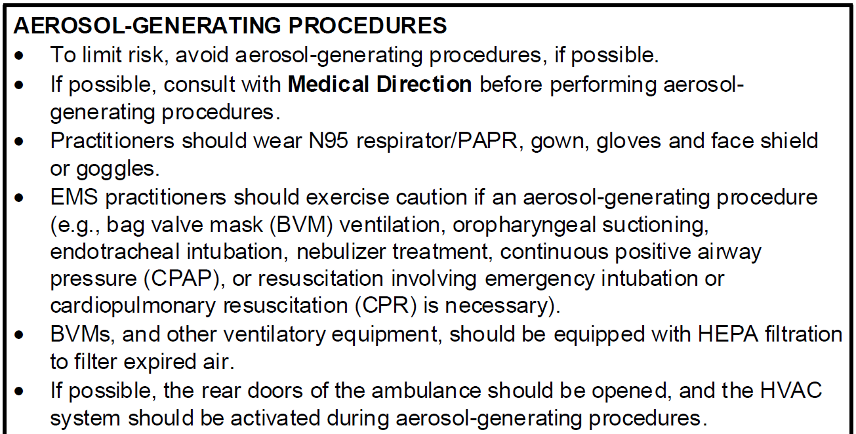
Notes:
A word about AEROSOL-GENERATING PROCEDURES
To limit risk, avoid aerosol-generating procedures, if possible.
If possible, consult with Medical Direction before performing aerosol-generating procedures.
Practitioners should wear a N95 respirator, gown, gloves and face shield or goggles.
EMS practitioners should exercise caution if an aerosol-generating procedure such as BVM, suctioning, intubation, nebulizer treatment, CPAP, or CPR

Slide 21
Notes:
EMS practitioners should exercise caution if an aerosol-generating procedure such as BVM, suctioning, intubation, nebulizer treatment, CPAP, or CPR.
BVMs and other ventilatory equipment should be equipped with HEPA filtration devices if possible.
Open the rear doors of the ambulance and turn up the HVAC during aerosol-generating procedures if possible,

Slide 22
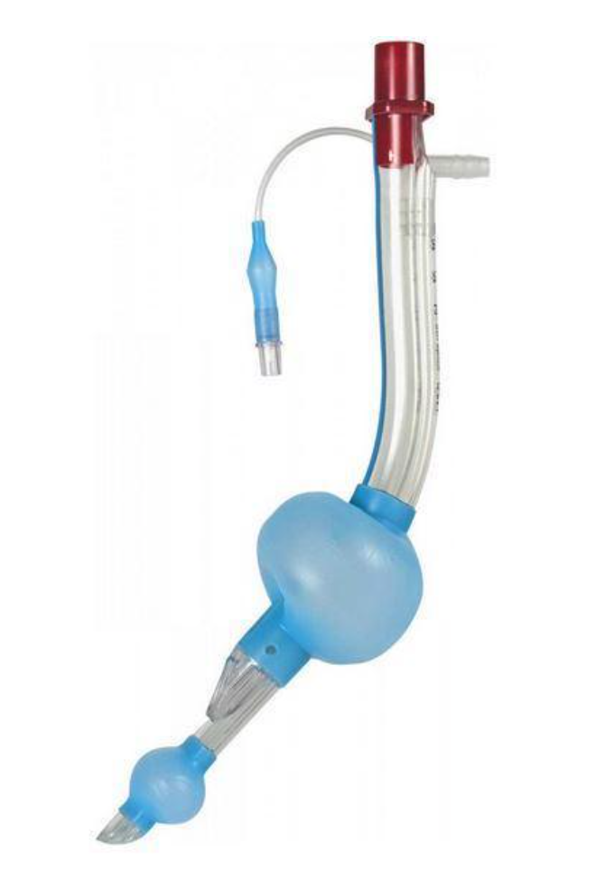
Supraglottic Airways
Consider use of Supraglottic airway (SGA) preferentially over endotracheal intubation
Use of a SGA is considered a high-risk aerosolizing procedure
It is critically important to plug the side/gastric port of a SGA to prevent large volume spread of airborne pathogens
Notes:
Consider use of a supraglottic airway preferentially over endotracheal intubation.
Use of a SGA (King or i-Gel) is considered a high-risk aerosolizing procedure.
It is critically important to plug the side/gastric port of a SGA to prevent large volume spread of airborne pathogens.

Slide 23
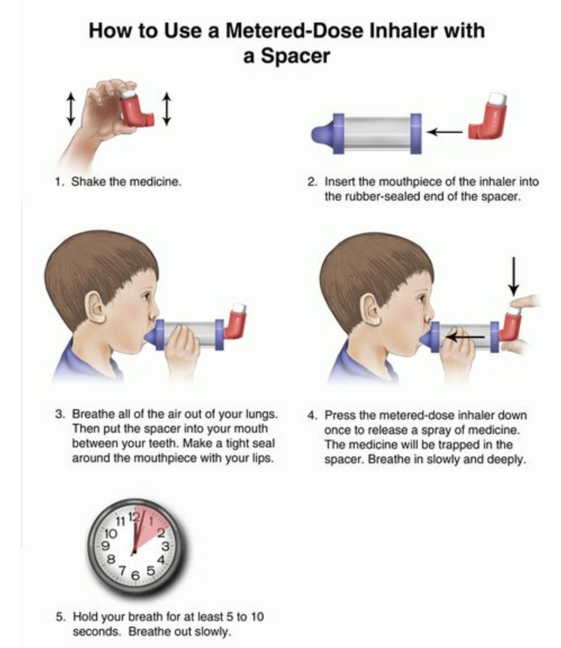
Avoid Aerosolized Procedures
Consider use of Metered-Dose Inhaler to administer albuterol or combi-vent instead of administering via nebulization which generates a large amount of aerosolized air.
Notes:
Consider use of a Metered-Dose Inhaler to administer albuterol or combi-vent instead of administering via nebulization which generates a large amount of aerosolized air.

Slide 24
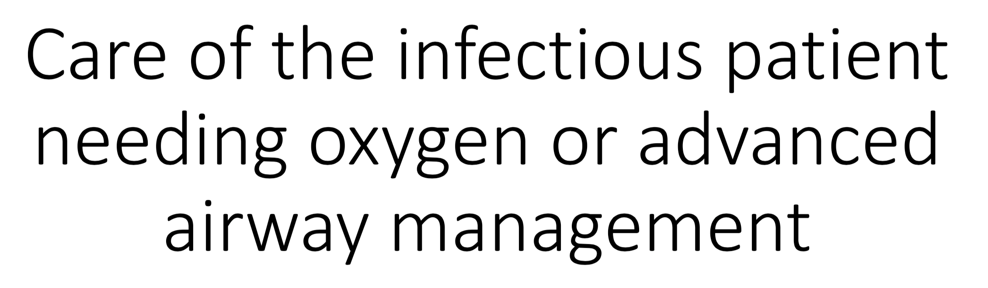
Notes:
A few thoughts about the care of the infectious patient needing oxygen or advanced airway management. (Obviously, these are patients who are being transported).

Slide 25
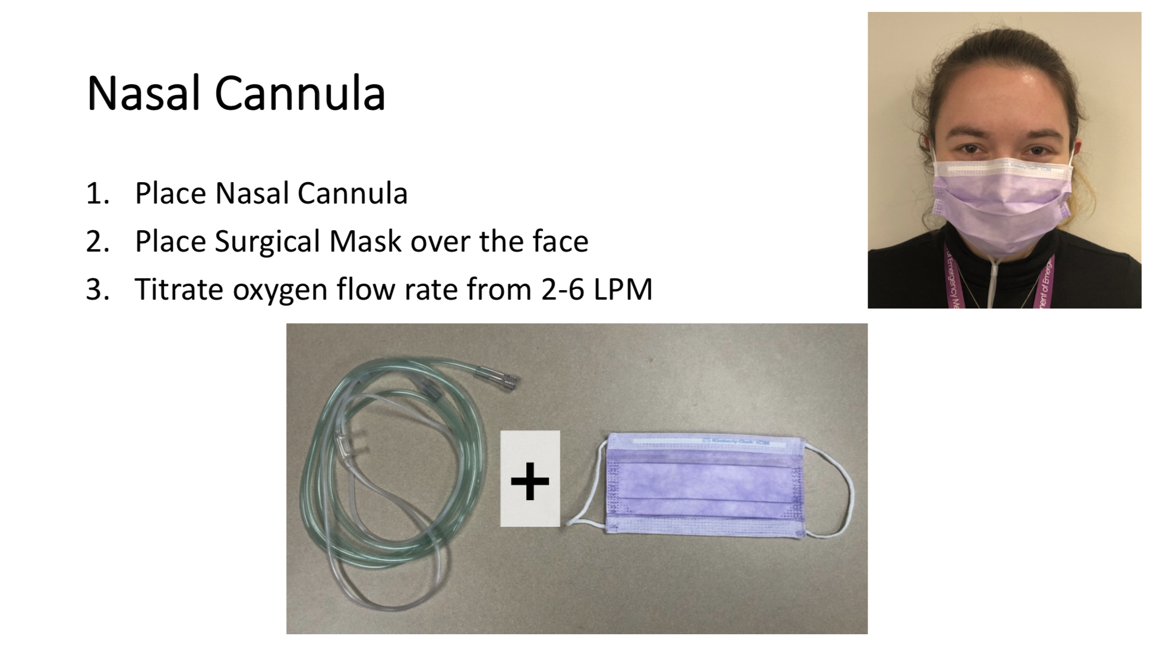
Notes:
If the patient needs a nasal cannula:

Slide 26
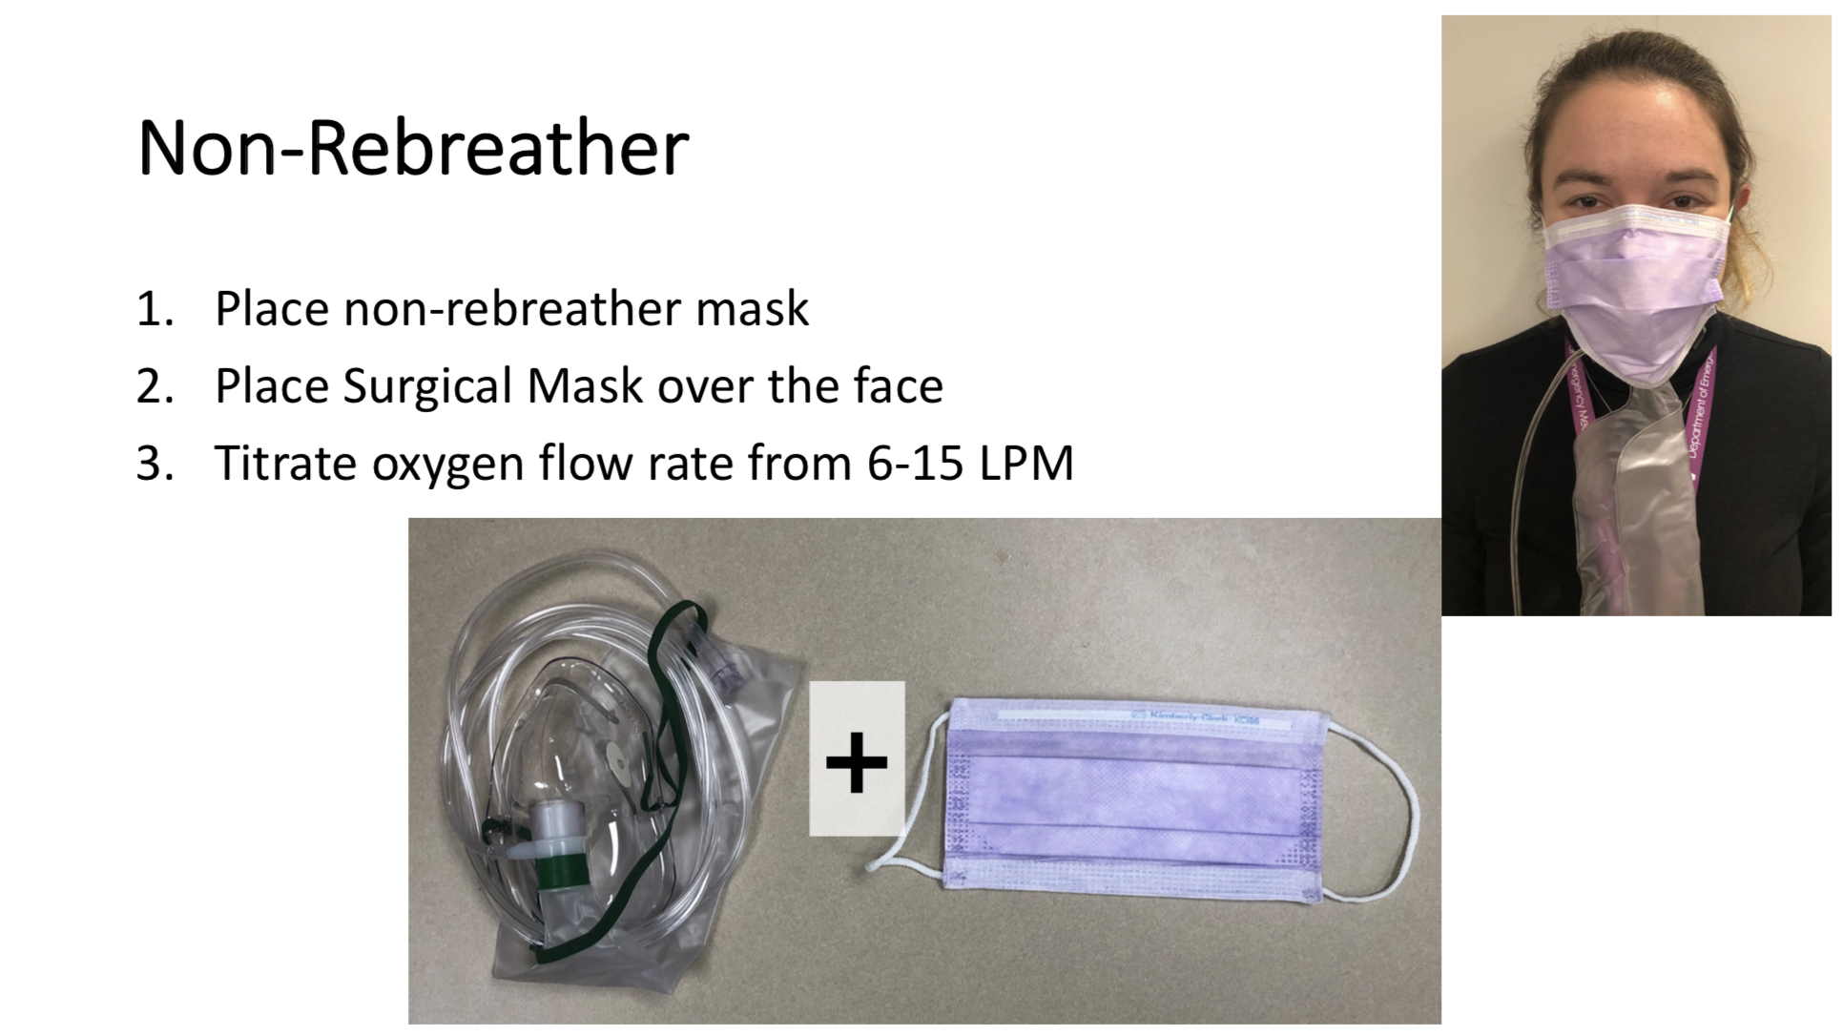
Notes:
If the patient needs a non-rebreather

Slide 27
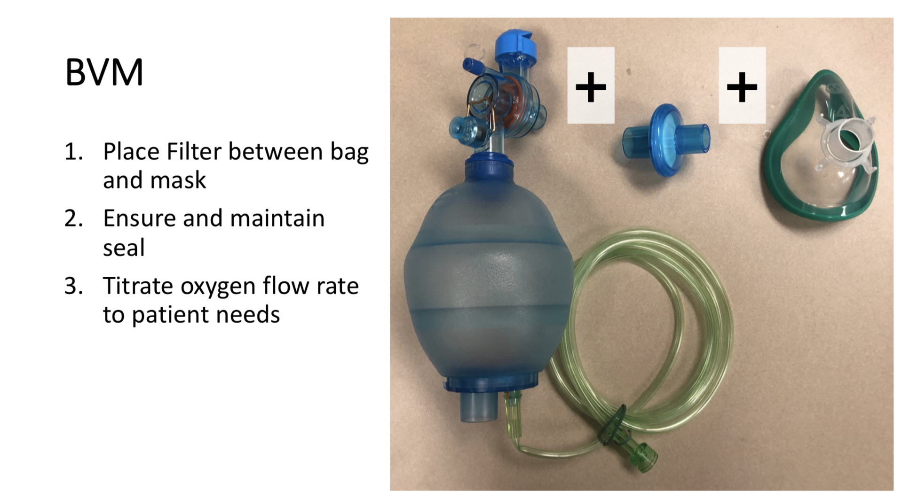
Notes:
If the patient needs BVM:
Place an HEPA filtration device between bag and mask if available.

Slide 28
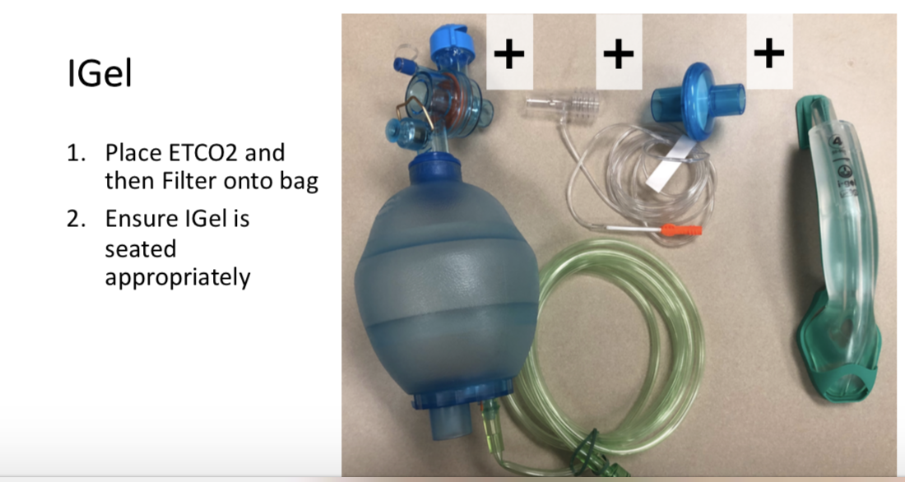
Notes:
Try to avoid intubation if possible. Use of a supraglottic device such as a King Airway or i-gel is preferred if possible. Again be sure to use a HEPA filtration device if available. It is critically important to plug the side/gastric port of a SGA to prevent large volume spread of airborne pathogens

Slide 29
Transport
Notes:
TRANSPORT
EMS practitioners should notify the receiving healthcare facility if they suspect COVID-19 so that appropriate precautions may be taken prior to arrival. Share any known details regarding signs/symptoms, travel, or contact history.
During transport, limit the number of practitioners in the patient compartment to essential personnel to minimize possible exposures.
Keep the patient separated from other people as much as possible.
Family members and other contacts of suspect patients should not ride in the
ambulance. If unavoidable, they should wear a face mask.
Isolate the ambulance driver from the patient:
Close the door/window between these compartments before bringing the patient on board.
Tape opening with plastic if there is no door or window that can close.
Use non-recirculated mode to ventilate ambulance.
Open the outside air vents in the driver area and turn on the rear exhaust
ventilation fans to the highest setting.
Follow local protocol upon arrival to the Emergency Department for patient hand-off. Carefully doff PPE.

Slide 30
Decontamination
Notes:
Follow the check list in the protocol for the proper decontamination of the ambulance

Slide 31
Preparation & Communication
Notes:
This section of the protocol provides guidance and resources on preparation and communication involving the assessment and transport of COVID-19 patients. There are several links for additional information. Please review in detail.
EMS agencies will be contacted by the Vermont Department of Health if their providers have been in contact with a case. EMS providers wearing all recommended PPE per protocol are considered to be low risk. If providers were not wearing PPE and are concerned about exposure, please call 802-863-7240.
EMS agencies can refer to the link for additional information. Interim U.S. Guidance for Risk Assessment and Public Health Management of Healthcare Personnel with Potential Exposure in a Healthcare Setting to Patients with Coronavirus Disease 2019 (COVID-19)
EMS units should have an adequate supply of PPE. A link is provided for More information about optimizing N95 stores: https://www.cdc.gov/coronavirus/2019-ncov/hcp/respirators-strategy/index.html.
If your facility is experiencing PPE shortages, use the link provided to make a request: https://www.surveygizmo.com/s3/5504100/COVID-Resource-Request-Form
Ensure an adequate supply of disinfectants approved for SARS-CoV-2, more information is available at this link: https://www.epa.gov/pesticide-registration/list-n-disinfectants-use-against-sars-cov-2

Slide 32
Donning & Doffing
  PPE Donning - https://youtu.be/Re2667Ho5UA
  PPE Doffing - https://youtu.be/Zlwefwlg6fo
Notes:
EMS units should have infection control policies and procedures in place, including education for safely donning and doffing PPE. Attached are links for videos that UVM HealthNet Regional Transport Service produced and shared with Vermont EMS. Please review these in detail and practice donning and especially doffing. Doffing is a high-risk activity for self-contamination and must be done with extreme attention to detail.
PPE Donning - https://youtu.be/Re2667Ho5UA
PPE Doffing - https://youtu.be/Zlwefwlg6fo
Ensure EMS providers are medically cleared, trained, and fit tested for N95s.

Slide 33
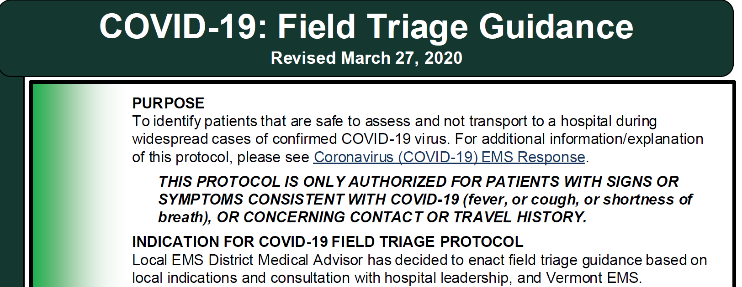
Notes:
Now we will discuss the COVID-19 Field Triage Guidance.
The purpose of this protocol is to identify patients that are safe to assess and not transport to a hospital during widespread cases of confirmed COVID-19 virus. Local indications may include hospitals exceeding maximum census, significant overcrowding, use of surge plans or alternative care sites, or other conditions associated with a pandemic.
This protocol is only authorized for patients suffering signs or symptoms consistent with COVID-19, including fever and or symptoms of lower respiratory illness (cough or shortness of breath), or patients who have had close contact with someone being evaluated for or diagnosed with COVID-19 or with a travel history to a CDC designated level 2 or 3 region.
The protocol may only be utilized when enacted by the EMS District Medical Advisor based on local indications and consultation with hospital leadership and Vermont EMS.

Slide 34
Notes:
Initial Assessment:
Responders who have close contact (less than six feet) with any potential emergency medical patient should don appropriate personal protective equipment before making contact.
If dispatch advises that the patient is:
Suspected of having infectious disease (COVID-19) or has had close contact with someone being evaluated for or diagnosed with COVID-19, OR
The Patient is exhibiting symptoms including fever, cough or shortness of breath
THEN
▪ EMS practitioners should put on appropriate PPE before entering the scene.
▪ Initial assessment should begin from a distance of at least 6 feet from the patient and be limited to one EMS practitioner if possible.

Slide 35
Notes:
If dispatch advises that the patient is:
Suspected of having infectious disease (COVID-19) or has had close contact with someone being evaluated for or diagnosed with COVID-19, OR
The Patient is exhibiting symptoms including fever, cough or shortness of breath
THEN
▪ EMS practitioners should put on appropriate PPE before entering the scene.
▪ Initial assessment should begin from a distance of at least 6 feet from the patient and be limited to one EMS practitioner if possible.

Slide 36
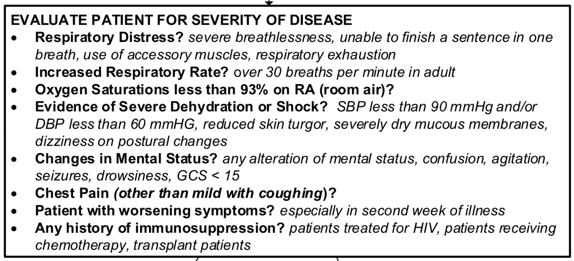
Notes:
The next step is to EVALUATE PATIENT FOR SEVERITY OF DISEASE
Ask the following Questions: Does the patient have…
Respiratory Distress?
Increased Respiratory Rate?
Oxygen Saturations less than 93% on RA (room air)?
Evidence of Severe Dehydration or Shock?
Changes in Mental Status?
Chest Pain (other than mild with coughing)?
Patient with worsening symptoms? especially in second week of illness
Any history of immunosuppression?

Slide 37
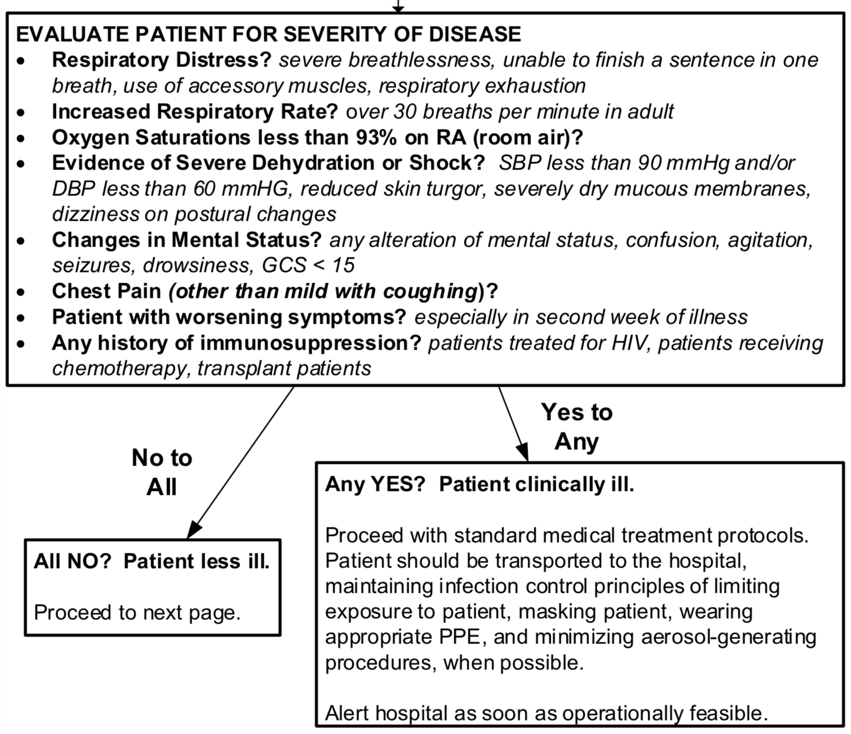
Notes:
If the answer is No to All of these questions, the patient is less ill, proceed to the second page of the protocol.
If the answer is Yes to Any of these questions, the patient is clinically ill and should be transported to the Emergency Department following standard infection control and EMS protocols. EMS clinicians should notify the receiving healthcare facility that the patient has an exposure history and signs and symptoms suggestive of COVID-19 so that appropriate infection control precautions may be taken prior to patient arrival.

Slide 38
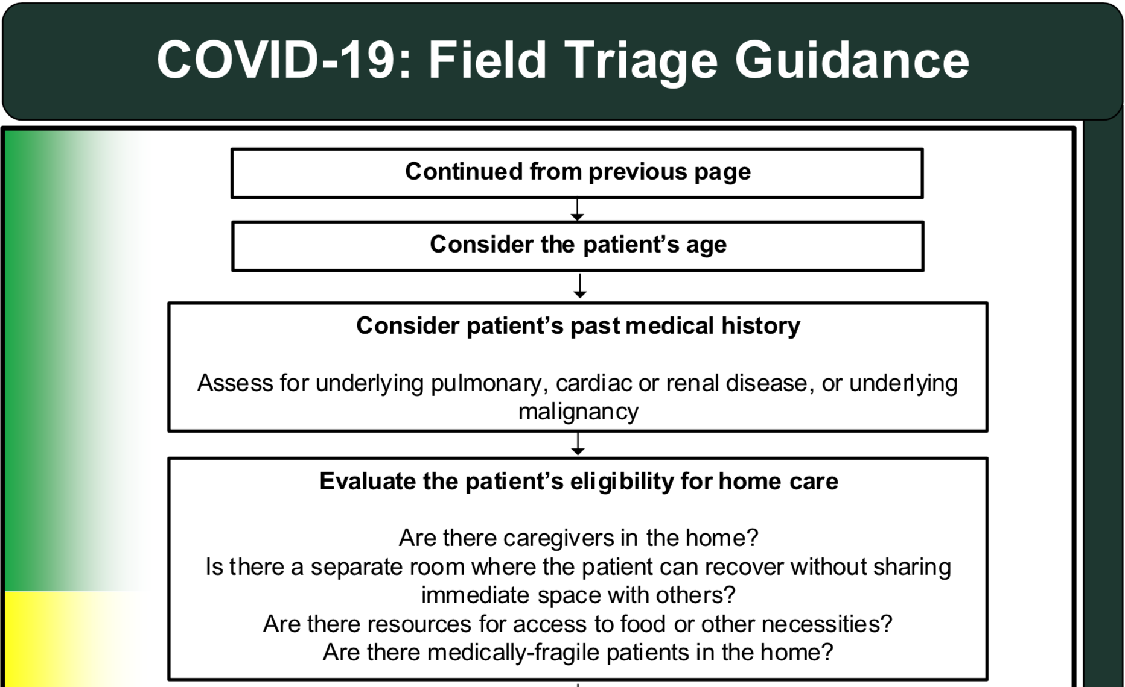
Notes:
If the patient appeared less ill, continue with the protocol. The next step is to consider the patients age, medical history, such as underlying pulmonary, cardiac, renal disease, diabetes or malignancy, and then to evaluate the patient’s eligibility for home care. Determine if there are caregivers in the home, if there is a separate room available where the patient can recover without sharing immediate space with others, resources for food and other necessities and if there are other medically-fragile patients in the home. Once you have gathered this information, the next step is to contact Medical Direction.

Slide 39
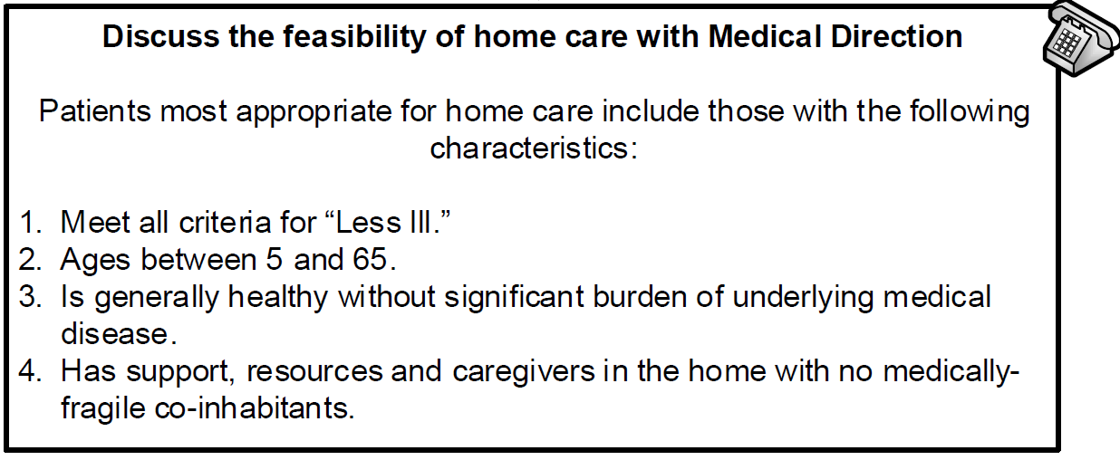
Notes:
Discuss the feasibility of home care with Medical Direction
Patients most appropriate for home care include those with the following characteristics:
Meet all criteria for being “Less Ill.”
Age is between 5 and 65
Is generally healthy without significant burden of underlying medical
disease.
Has support, resources and caregivers in the home with no medically-
fragile co-inhabitants.

Slide 40
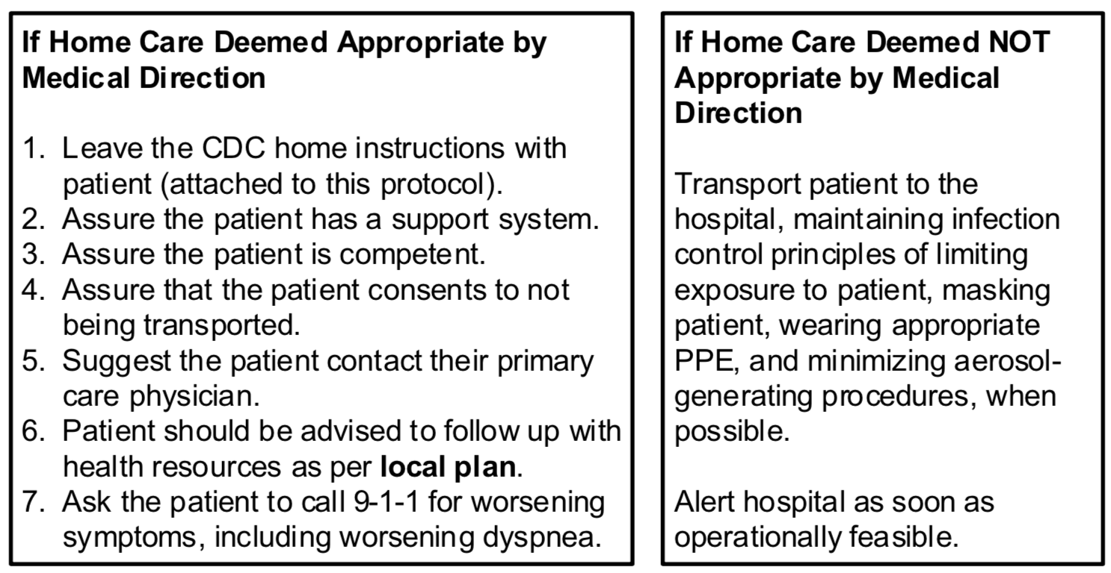
Notes:
Based on your conversation, Medical Direction will determine if the patient is appropriate for home care or if they require transport.
If Home Care is Deemed Appropriate by Medical Direction
Leave the CDC home instructions with patient (attached to this protocol).
Assure the patient has a support system.
Assure the patient is competent.
Assure that the patient consents to not being transported.
Suggest the patient contact their primary care physician.
The Patient should be advised to follow up with health resources as per your local plan.
Ask the patient to call 9-1-1 for worsening symptoms, including difficulty breathing.
If Home Care is Deemed NOT Appropriate by Medical Direction
Transport the patient to the hospital, maintaining infection control principles of limiting exposure to patient, masking the patient, wearing appropriate PPE, and minimizing aerosol- generating procedures, when possible.
Alert the receiving hospital of your situation prior to arrival.

Slide 41
Local Plan
Notes:
The “Local Plan” is an important part of this Covid-19 Field Triage Guideline and will vary by EMS region and hospital system.
The local plan may involve follow up or referral to a primary care physician, re-check using community Paramedicine, or referral to a drive-up testing site for example.
Work with your District Medical Advisor, District Leadership and Anchor Hospital to develop your local Covid-19 field triage plan.

Slide 42
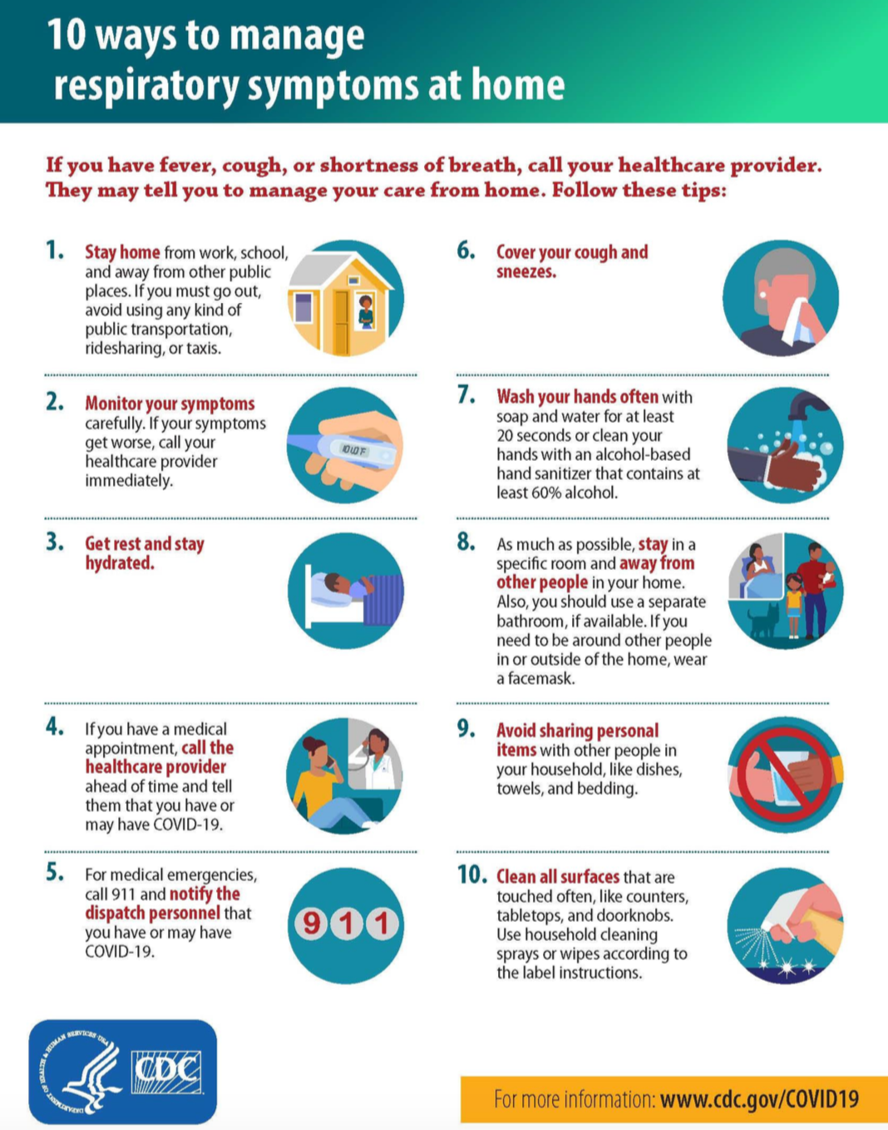
Notes:
Patients who are not being transported should be given home care instructions. Use the attached CDC instructions or other equivalent.

Slide 43
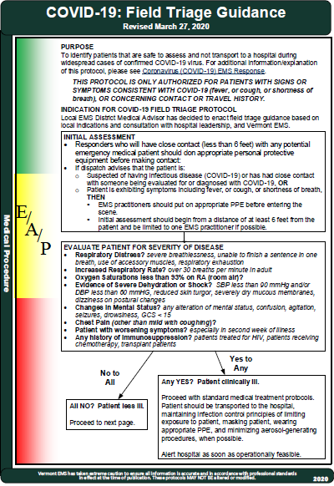
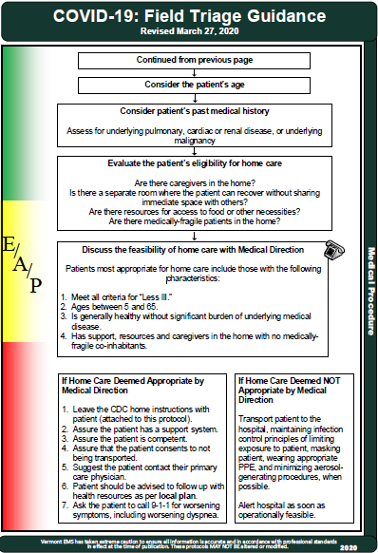
Notes:
Please review the full protocol.

Slide 44
Notes:
Thank you for your excellent work.
You are on the front lines and your efforts are greatly appreciated.
Wear your mask, gloves and eye protection and Stay Safe!

