Slide 1
How to Promote Infant Safe Sleep: Key Messages from Vermont Research
Vermont Department of Health
Division of Maternal and Child Health
2018
Notes:
Notes:
This presentation, “How to Promote Infant Safe Sleep: Key Messages and Resources,” from the Division of Maternal and Child Health in the Vermont Department of Health, is designed to inform healthcare providers about the issue of infant safe sleep.

Slide 2
Introduction
The American Academy of Pediatrics (AAP) recommends a safe sleep environment that can reduce the risk of all sleep related infant deaths.
However, these recommendations are often misunderstood or rejected by parents, especially those receiving inconsistent messages from health care professionals, family members, or the media.
Each year in Vermont, about 3-4 infants die due to unsafe sleep environments.

Slide 3
Learning Objectives
By the end of this presentation, participants will be able to:
Recognize the trends in national and Vermont safe sleep data.
Be familiar with the current American Academy of Pediatrics (AAP) guidelines for infant safe sleep, and underlying rationale.
Appreciate Vermont parents’ safe sleep experiences and needs for information and support.
Identify effective strategies and resources for health care professionals to educate and support parents on infant safe sleep.

Slide 4
Defining SUID
Sudden unexpected infant death (SUID) is the death of an infant less than 1 year of age that occurs suddenly and unexpectedly, and whose cause of death is not immediately obvious before investigation. There are 3 types of SUID:
Types of SUID
Sudden Infant Death Syndrome (SIDS)
The sudden death of an infant less than 1 year of age that cannot be explained after a thorough investigation is conducted, including a complete autopsy, examination of the death scene, and a review of the clinical history
Unknown Cause
The sudden death of an infant less than 1 year old that remains undetermined because one or more parts of the investigation was not completed
Accidental Suffocation & Strangulation in bed
Suffocation by soft bedding
Overlay (a person rolls on top of infant while asleep)
Wedging or entrapment between two objects
Strangulation
Notes:
Notes:
Many people are familiar with the term Sudden Infant Death Syndrome (SIDS), but may not know how it relates to the broader term sudden unexpected infant death (SUID; also sometimes known as sudden unexpected death in infancy, or SUDI).
There has been confusion about the terms SUID and SIDS . The term SIDS is used when, after a thorough investigation by OCME and also law enforcement, no other cause of death can be determined.
References:
For more information, see: National Institutes of Health. Common SIDS and SUID Terms and Definitions website. https://www1.nichd.nih.gov/sts/about/SIDS/Pages/common.aspx. Accessed April 18, 2018.

Slide 5
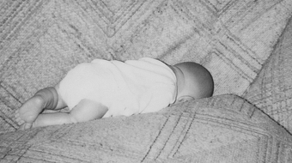
Determining Cause of Death
SUID cases are investigated to determine the circumstances and factors contributing to unexplained infant deaths. Unsafe sleep practices are a factor in a majority of cases diagnosed as SIDS, accidental suffocation, and unknown cause.
“Fig. 3. The infant mannequin is positioned where a 2-month-old infant was found dead on a couch... The infant had moved into the space between the cushion and back. He had been sleeping on the couch with a sibling. His death was attributed to accidental suffocation.”
Notes:
References:
Pictures and captions are from: Kemp JS, Unger B, Wilkins D, Psara RM, Ledbetter TL, Graham MA, Case M, Thach BT. Unsafe sleep practices and an analysis of bedsharing among infants dying suddenly and unexpectedly: Result of a four-year, population-based, death-scene investigation study of sudden infant death syndrome and related deaths. Pediatrics. 2000 Sep; 106(3); E41.

Slide 6
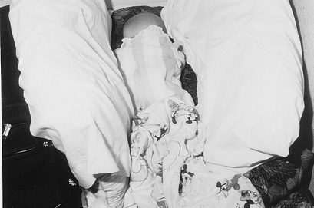
Determining Cause of Death
SUID cases are investigated to determine the circumstances and factors contributing to unexplained infant deaths. Unsafe sleep practices are a factor in a majority of cases diagnosed as SIDS, accidental suffocation, and unknown cause.
“Fig. 4. The infant mannequin is positioned where a 4-month-old infant was found on a makeshift bed … This was the first time this infant had been placed prone for sleep. The proximity of pillows had the potential to make it difficult to get access to fresh air by head lifting and turning. The death was attributed to accidental suffocation.”
Notes:
References:
Pictures and captions are from: Kemp JS, Unger B, Wilkins D, Psara RM, Ledbetter TL, Graham MA, Case M, Thach BT. Unsafe sleep practices and an analysis of bedsharing among infants dying suddenly and unexpectedly: Result of a four-year, population-based, death-scene investigation study of sudden infant death syndrome and related deaths. Pediatrics. 2000 Sep; 106(3); E41.

Slide 7
Notes:
Another example of how the technique of death scene reenactment can inform our understanding of how the infant died within an unsafe sleep environment

Slide 8
Notes:
Another example of how the technique of death scene reenactment can inform our understanding of how the infant died within an unsafe sleep environment. This also illustrates the dangers of sleeping with an infant on a couch.

Slide 9
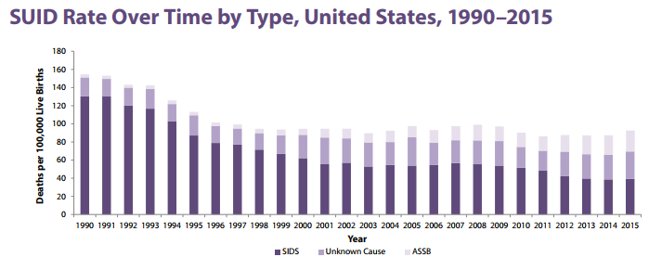
SUID in the United States
SIDS rates have decreased since the 1990s thanks to efforts like the Back to Sleep campaign, but thousands of preventable sleep-related infant deaths still occur each year.
Notes:
Notes:
As shown in the first graph, the SUID rate declined during the 1990s, and it has fluctuated around 90 deaths per 100,000 live births since.
The distribution of types of deaths reported have shifted since about 2000, with deaths reported as SIDS decreasing and deaths reported as ASSB and unknown cause increasing. The reason for this shift is currently unknown, but may be attributable to stricter adherence to SIDS definitions or more complete death scene investigation and autopsy data.
SIDS remains the leading cause of death among infants under 1 year old.
References:
SUID Rate Over Time by Type graph is from: Centers for Disease Control. Sudden Unexpected Infant Death (SUID) website. https://www.cdc.gov/sids/pdf/sudden-unexpected-infant-death.pdf. Accessed April 18, 2018.
Breakdown of SUID by Cause, 2015 graph: Centers for Disease Control. Sudden Unexpected Infant Death and Sudden Infant Death Syndrome website. https://www.cdc.gov/sids/data.htm. Accessed April 18, 2018.

Slide 10
SUID in the United States
~3,600 cases of SUID in 2016, about one in four due to ASSB
CDC website cdc.gov/sids/data/htm
Notes:
Notes:
As shown in the first graph, the SUID rate declined during the 1990s, and it has fluctuated around 90 deaths per 100,000 live births since.
The distribution of types of deaths reported have shifted since about 2000, with deaths reported as SIDS decreasing and deaths reported as ASSB and unknown cause increasing. The reason for this shift is currently unknown, but may be attributable to stricter adherence to SIDS definitions or more complete death scene investigation and autopsy data.
SIDS remains the leading cause of death among infants under 1 year old, however researchers are continuing to work on increasing the accuracy of the findings in the manner of death.
References:
SUID Rate Over Time by Type graph is from: Centers for Disease Control. Sudden Unexpected Infant Death (SUID) website. https://www.cdc.gov/sids/pdf/sudden-unexpected-infant-death.pdf. Accessed April 18, 2018.
Breakdown of SUID by Cause, 2015 graph: Centers for Disease Control. Sudden Unexpected Infant Death and Sudden Infant Death Syndrome website. https://www.cdc.gov/sids/data.htm. Accessed April 18, 2018.

Slide 11
SUID in Vermont
The rate of SUID cases in Vermont has been consistently lower than the US rate, and the state of Vermont is on track to reach the Healthy Vermonters 2020 target value of .57 with regard to SUIDs per 1,000 live births.
From 2010-2014, there were 16 SUID cases in Vermont, half of which were due to ASSB.
Notes:
References:
Graph from: Vermont Department of Health. Sudden Unexpected Infant Death Data Brief from VDH website. http://www.healthvermont.gov/sites/default/files/documents/pdf/HSVR_injury_SUID.pdf. Accessed April 18, 2018.

Slide 12
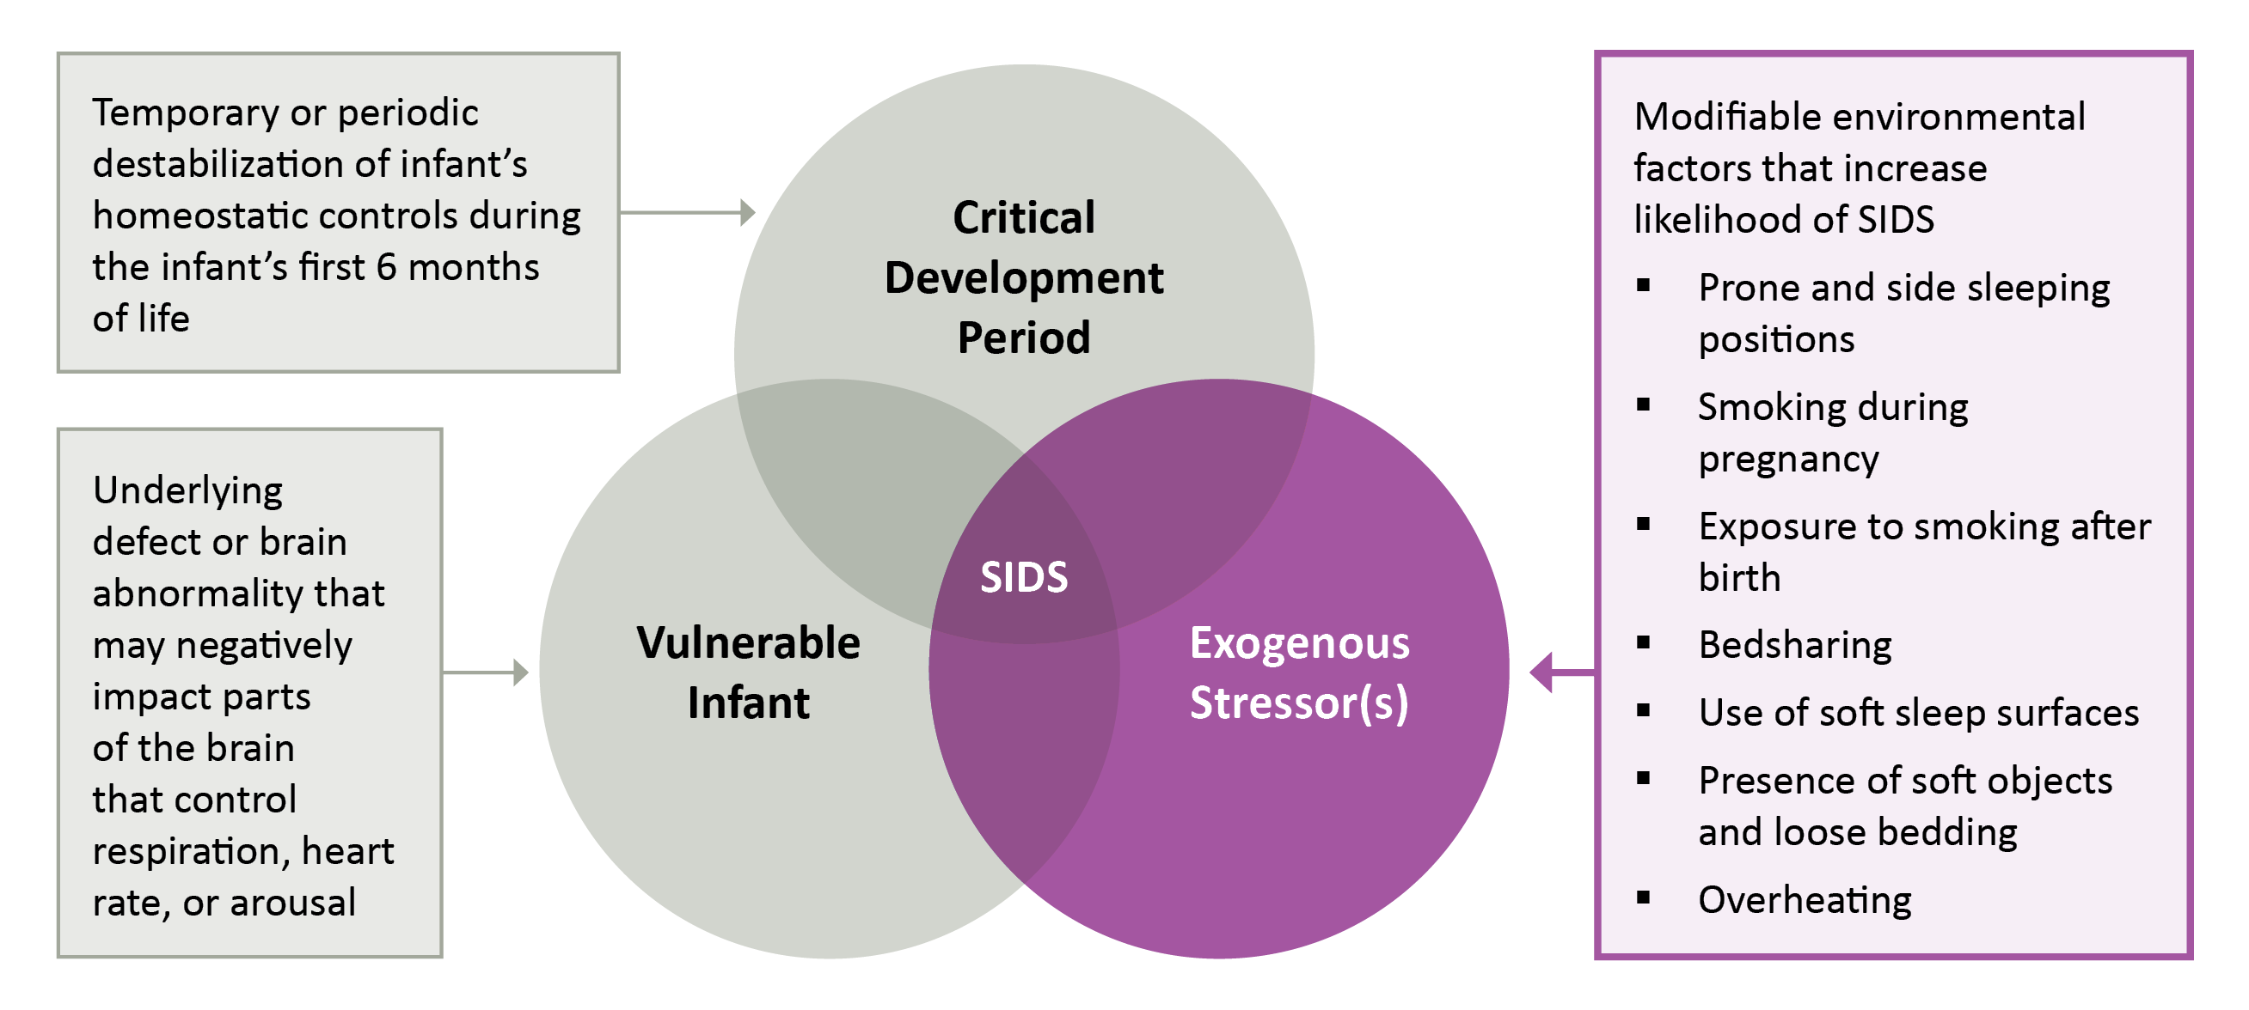
The Triple-Risk Model for SIDS
The Triple-Risk Model is the current consensus explanation for the multiple factors that may converge and lead to SIDS. Importantly, safe sleep practices can help prevent exogenous stressors and therefore SIDS.
Notes:
Notes:
It is important to understand what current research says about why SUID cases occur, so that they may be prevented. SIDS is the most common type of SUID and is the leading cause of death among infants under 1 year old. Therefore, it is worth reviewing the Triple-Risk Model for SIDS, which posits the underlying factors that lead to SIDS.
(As for the other two types of SUID, ASSB cases are clearly attributable to factors that would lead to strangulation or suffocation, and unknown causes, unfortunately, remain unexplained.)
References:
National Institutes of Health. Research on Possible Causes of SIDS website. https://www1.nichd.nih.gov/sts/campaign/science/Pages/causes.aspx. Accessed April 18, 2018.

Slide 13
AAP Recommendations are Based on Best Available Evidence
AAP recommendations have changed over time
Recommendations have evolved based on evidence (e.g. improved understanding of relative risk, better data from death scene investigations, and unintended consequences like plagiocephaly).
Notes:
Notes:
The National Institute for Child and Human Development (NICHD) partners with the American Academy of Pediatrics (AAP) for their national Safe to Sleep campaign. For over twenty years, the American Academy of Pediatrics (AAP) has offered guidelines to help parents, caregivers, and providers to keep infants safe when they sleep.

Slide 14
AAP Recommendations are Based on Best Available Evidence
With greater understanding comes greater nuance, and therefore complexity.
Parents and caregivers need the assistance of health care professionals to explain that recommendations are based on best available evidence and to generate personal strategies for how they can adopt safe sleep practices for their homes and other sites such as relatives’ homes and child care.
Notes:
Notes:
The National Institute for Child and Human Development (NICHD) partners with the American Academy of Pediatrics (AAP) for their national Safe to Sleep campaign. For over twenty years, the American Academy of Pediatrics (AAP) has offered guidelines to help parents, caregivers, and providers to keep infants safe when they sleep.

Slide 15
AAP Guidelines: Levels of Evidence
The 2016 AAP recommendations are grouped into three levels:
Recommendations are based on high-quality scientific evidence indicating high certainty of substantial net benefit, and unlikely to change with future study.
Recommendations are based on evidence available to determine effects of recommendations, but there is limited confidence in the estimates.
Recommendations based on consensus and expert opinion

Slide 16
AAP A-Level Recommendations
A-level recommendations, 2016
Back to sleep for every sleep.
Use a firm sleep surface.
Breastfeeding is recommended.
Room-sharing with the infant on a separate sleep surface is recommended.
Keep soft objects and loose bedding away from the infant’s sleep area.
Consider offering a pacifier at naptime and bedtime.
Avoid smoke exposure during pregnancy and after birth.
Avoid alcohol and illicit drug use during pregnancy and after birth.
Avoid overheating.
Pregnant women should seek and obtain regular prenatal care.
Infants should be immunized in accordance with AAP and CDC recommendations.
Do not use home cardiorespiratory monitors as a strategy to reduce the risk of SIDS.
Health care providers, staff in newborn nurseries and NICUs, and child care providers should endorse and model the SIDS risk-reduction recommendations from birth.
Media and manufacturers should follow safe sleep guidelines in their messaging and advertising.
Continue the “Safe to Sleep” campaign, focusing on ways to reduce the risk of all sleep-related infant deaths, including SIDS, suffocation, and other unintentional deaths. Pediatricians and other primary care providers should actively participate in this campaign.
Notes:
Notes:
The AAP guidelines and supporting evidence can be found in their 2016 Policy Statement and Technical Report. A webinar describing the 2016 updated recommendations is also available.
References:
2016 AAP Policy Statement: Task Force on Sudden Infant Death Syndrome. SIDS and other sleep-related infant deaths: updated 2016 recommendations for a safe infant sleeping environment. Pediatrics. 2016 Nov;138(5).
2016 AAP Technical Report: Moon RY, Task Force on Sudden Infant Death Syndrome. SIDS and Other Sleep-Related Infant Deaths: Evidence Base for 2016 Updated Recommendations for a Safe Infant Sleeping Environment. Pediatrics. 2016 Nov;138(5).
Webinar on SIDS and Other Sleep Related Deaths: American Academy of Pediatrics. SIDS and Other Sleep Related Infant Deaths: Updated Recommendations website. https://www.youtube.com/watch?v=sdWGmhCyAak&feature=youtu.be. Accessed April 18, 2018.

Slide 17
AAP B & C-Level Recommendations
B-level recommendations, 2016
Avoid the use of commercial devices that are inconsistent with safe sleep recommendations.
Supervised, awake tummy time is recommended to facilitate development and to minimize development of positional plagiocephaly.
C-level recommendations, 2016
Continue research and surveillance on the risk factors, causes, and pathophysiologic mechanisms of SIDS and other sleep-related infant deaths, with the ultimate goal of eliminating these deaths entirely.
There is no evidence to recommend swaddling as a strategy to reduce the risk of SIDS.
Notes:
Notes:
In summary, there are many ways to reduce the number of sleep-related infant deaths. Some of these recommendations have a greater amount and higher-quality of research supporting their relation to reducing sleep-related infant deaths. Be aware that these recommendations are based in the most current evidence available, and that parents may need your assistance in navigating their varied and changing nature.

Slide 18
Parents want and need healthcare providers to help with safe sleep
Parents view healthcare providers as their most trustworthy information source on safe sleep.
Parents need help to understand the safe sleep guidelines, which can be confusing.
Parents have different knowledge, experiences, and challenges with regard to safe sleep practices, and seek guidance appropriate to their individual circumstances.
Parents perceive that providers disagree on the relative safety of bedsharing, particularly when discussing breastfeeding.
JSI research findings for Vt Department of Health, 2017: healthvermont.gov/safesleep
Notes:
Refer to findings from JSI research for Vt Dept. Health, 2017: healthvermont.gov/safesleep

Slide 19
Healthcare providers are essential to promoting safe sleep and preventing SUID
The hospital is a critical opportunity for healthcare providers to model, fix, and reinforce safe sleep practices.
Research demonstrates that:
Parents who see their baby placed supine in the nursery are almost twice as likely to continue this practice at home.
When the correct behavior is modeled and follow up with a conversation on safe sleep recommendations, adoption of safe behaviors is increased even more significantly.
Notes:
References:
Colson ER, Joslin SC. Changing nursery practice gets inner-city infants in the supine position for sleep. Arch Pediatr Adolesc Med. 2002;156(7):717-20.

Slide 20
In-Hospital Newborn Falls/Drops
Newborns experience in-hospital falls at a rate of approximately 1.6–4.14/10,000 live births, resulting in an estimated 600–1600 falls per year in the United States.
The most common reason for these falls is the mother (or partner or other adult) falling asleep and dropping the newborn.
The challenge during this time is to support mother-baby bonding and breastfeeding in the hospital while ensuring the safety of the newborn.
Notes:
Notes:
In addition, healthcare providers should also be aware of the risk of newborns falling while in the hospital. Families are often reluctant to report falls, and hospital staff rarely discuss them, which means many healthcare providers are unaware of how often falls occur.
References:
More data available from: Helsley L, McDonald JV, Stewart VT. Addressing in-hospital ‘falls’ of newborn infants. Jt Comm J Qual Patient Saf. 2010;36(7);327-33.
See also: Ainsworth RM, Summerlin-Long S, Mog C. A comprehensive initiative to prevent falls among newborns. Nurs Womens Health. 2016;20(3);247-57.
Image from: Minnesota Hospital Association. Newborn Falls/Drops in the Hospital Setting website. Accessed April 23, 2018 at: https://www.mnhospitals.org/Portals/0/Documents/ptsafety/falls/MHA-6-20-11.pdf.

Slide 21
Potential Interventions to Prevent Newborn Falls/Drops
Educate health care providers and parents about the risk of newborn falls/drops.
Establish a no co-sleeping policy, reinforced through a parent contract and written and verbal reminders.
Assess maternal clinical status (e.g. limited mobility due to difficult delivery or Caesarean section, taking medication with sedative side effects).
Designate and implement level of supervision (constant, frequent, intermittent) based on risk.
Staff training with crib audits for QI.
Recommend naps to decrease adult fatigue.
Encourage continuation of safe sleep and fall prevention practices at home.
Notes:
References:
For more information, see: Minnesota Hospital Association. Newborn Falls/Drops in the Hospital Setting website. Accessed April 23, 2018 at: https://www.mnhospitals.org/Portals/0/Documents/ptsafety/falls/MHA-6-20-11.pdf.
Image from: Ainsworth RM, Summerlin-Long S, Mog C. A comprehensive initiative to prevent falls among newborns. Nurs Womens Health. 2016;20(3);247-57.

Slide 22
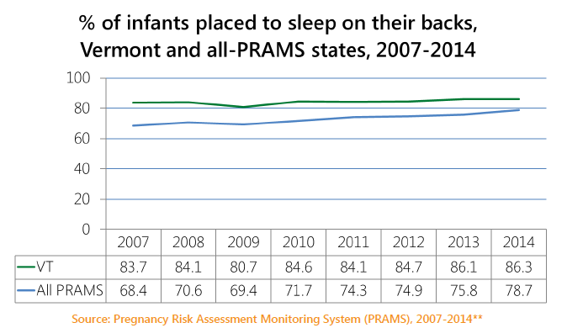
Safe Sleep Practices in VT
About 1 out of 5 babies are not sleeping in a supine position
Notes:
Notes:
The rest of this presentation shares research focused on parents in Vermont, and takeaways on how to promote safe sleep among Vermonter parents and caregivers. The two graphs on this slide present data from the Pregnancy Risk Assessment Monitoring System (PRAMS) on the most common position babies are laid down to sleep in (response options were: on the side, back, or stomach), and how often the baby sleeps in the same bed with someone else (response options were: always, often, sometime, rarely, or never).
References:
Graphs are from: Vermont Department of Health. Division Of Maternal & Child Health Brief: Safe Sleep. 2017. Available at: http://www.healthvermont.gov/sites/default/files/documents/pdf/DB.NPM5_.Safe%20sleep.pdf. Accessed May 31, 2017.
For ongoing updates on Vermont PRAMS data: http://www.healthvermont.gov/health-statistics-vital-records/population-health-surveys-data/pregnancy-risk-assessment-and
For more information on PRAMS Methodology: Centers for Disease Control and Prevention. PRAMS website. 2018. Available at: https://www.cdc.gov/prams/methodology.htm#n2. Accessed April 24, 2018.

Slide 23
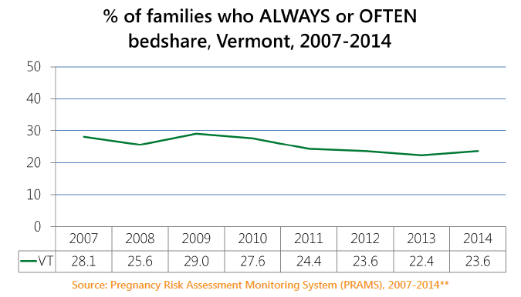
Safe Sleep Practices in VT
About 1 in 4 families report bed-sharing frequently
Notes:
Notes:
The rest of this presentation shares research focused on parents in Vermont, and takeaways on how to promote safe sleep among Vermonter parents and caregivers. The two graphs on this slide present data from the Pregnancy Risk Assessment Monitoring System (PRAMS) on the most common position babies are laid down to sleep in (response options were: on the side, back, or stomach), and how often the baby sleeps in the same bed with someone else (response options were: always, often, sometime, rarely, or never).
VT PRAMS data do not indicate associations between safe sleep practices and demographics (e.g. education, WIC status)
References:
Graphs are from: Vermont Department of Health. Division Of Maternal & Child Health Brief: Safe Sleep. 2017. Available at: http://www.healthvermont.gov/sites/default/files/documents/pdf/DB.NPM5_.Safe%20sleep.pdf. Accessed May 31, 2017.
For ongoing updates on Vermont PRAMS data: http://www.healthvermont.gov/health-statistics-vital-records/population-health-surveys-data/pregnancy-risk-assessment-and
For more information on PRAMS Methodology: Centers for Disease Control and Prevention. PRAMS website. 2018. Available at: https://www.cdc.gov/prams/methodology.htm#n2. Accessed April 24, 2018.

Slide 24
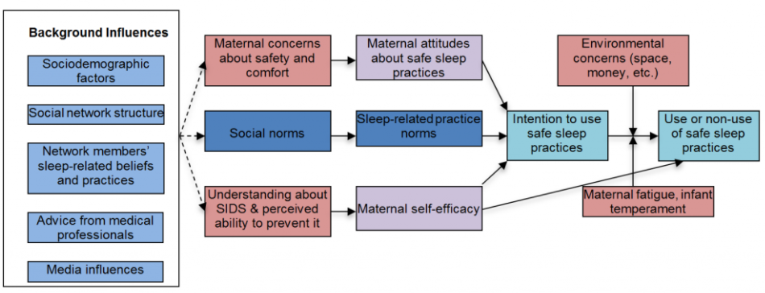
Many factors affect adherence to safe sleep practices
Dr. Rachel Moon’s theoretical model of influences on
Parents’ safe sleep practices
Notes:
Notes:
When thinking about how to promote safe sleep, it can be helpful to think about what drives safe sleep behavior. Behavior change models, such as the example shown here, map out the relationship between different factors like knowledge, attitudes, social norms, self-efficacy, situational context, intention, and behavior. The purpose of the model shown here is to broaden how you think about the behavior of following safe sleep guidelines, and what healthcare providers might be able to change.
References:
Model from: Moon, RY. Rachel Y. Moon, MD website. Available at: https://research.med.virginia.edu/chrc/current-projects/rachel-y-moon-md/. Accessed April 24, 2018.

Slide 25
Results from Vermont-Specific Research on Safe Sleep

Slide 26
Vermont-Specific Research
The Vermont Department of Health contracted with John Snow, Inc. (JSI) to conduct formative research to inform a Vermont infant safe sleep campaign. This research was conducted from March to November 2017.
The next several slides describe five key themes from four focus groups conducted with VT parents of infants under 1 year of age (Brattleboro, Burlington, Morrisville, St. Johnsbury; total N=55).
These themes, which may resonate with your experiences as providers and perhaps as parents, suggest ways healthcare providers can deliver safe sleep guidance more effectively.

Slide 27
THEME 1
Parents worry about safe sleep.
“His place to sleep is safe but just that possibility that he could stop breathing and we don’t know why is scary to me.”
“I sleep better when he’s in my arms.”
Notes:
Notes:
Here are some additional quotes related to this theme:
“I’m an anxious person, so when I was nursing 4-5 times a night all through his newborn stage I was really serious about not sleeping with him because I was so afraid.”
“I used to worry about it when he was little but now we co-sleep.”

Slide 28
Parents worry about safe sleep.
Most focus group participants described themselves as worried about infant sleep safety, regardless of their infant sleep practices (i.e. follow guidelines or not).
Parents viewed scare tactics as unnecessary and did not appreciate the presumption that they were inadequately concerned.
Notes:
Notes:
Here are some additional quotes related to this theme:
“I’m an anxious person, so when I was nursing 4-5 times a night all through his newborn stage I was really serious about not sleeping with him because I was so afraid.”
“I used to worry about it when he was little but now we co-sleep.”

Slide 29
THEME 2
Parents are confused by the guidelines.
“Since the day my son was born he would sleep on his side. The doctor said it was fine.”
“After they can pick their head up, they should be able to have a blanket.” “In 10 more years, they’ll say lay them on their stomachs again.”
“It switches all the time from back to stomach. I get information from different people – the doctor, the nurses, case workers, and the pediatrician – all different.”
“If crib bumpers are so dangerous why do they sell them? They should be illegal.”
Notes:
Again these are direct quotes from parents and caregivers around the AAP safe sleep guidelines.
The vast majority of parents knew the basic safe sleep guidelines, but some were confused about certain aspects, particularly around how developmental milestones fit into the guidelines around using blankets and crib bumpers.

Slide 30
Parents are confused by some guidelines.
The vast majority of parents knew the basic safe sleep guidelines, but some were confused about certain aspects, particularly:
How the guidelines mapped onto developmental milestones such as the baby being able to lift their head or roll over.
Items in/on the crib, such as blankets and crib bumpers.
Swaddling
Notes:
Notes:
Here are some additional quotes related to this theme:
“In 10 more years, they’ll say lay them on their stomachs again.”
“It switches all the time from back to stomach. I get information from different people – the doctor, the nurses, case workers, and the pediatrician – all different.”
“If crib bumpers are so dangerous why do they sell them? They should be illegal.”

Slide 31
THEME 3
Parents face challenges following the guidelines.
“My other baby will sleep on his belly on my chest and he won’t sleep any other way. I’ll just sit there with him on my chest for hours.”
“At 2-3 weeks old, we decided the bassinet didn’t work, so we took him in the bed.”
Notes:
Notes:
Here are some additional quotes related to this theme:
“My son sleeps with me, because of domestic violence.”
“I co-sleep. I never intended to co-sleep. He started in a crib, but late night feedings are awful. It’s conflicting because I know what’s best and I know he is supposed to be in his own crib, but he won’t sleep in a crib and will not sleep through the night. It’s hard for me going with what’s best and recommended, versus what’s best for me and the baby.”
“We had a bad experience with formula, sleeping on her back, she’d choke in her sleep (the nurse just pat her on the back) but she’d choke and turn blue.”
“They say no bumpers in the crib, but my baby would get his arm or leg stuck in the crib bars.”

Slide 32
Parents face challenges following the guidelines.
Parents described having difficulty (baby will not sleep/stop crying) when attempting to follow safe sleep guidelines. They felt they had to choose between sleep and safety.
“There are too many stipulations on what safe sleep has to look like versus actual parenting.”
Notes:
Notes:
Here are some additional quotes related to this theme:
“My son sleeps with me, because of domestic violence.”
“I co-sleep. I never intended to co-sleep. He started in a crib, but late night feedings are awful. It’s conflicting because I know what’s best and I know he is supposed to be in his own crib, but he won’t sleep in a crib and will not sleep through the night. It’s hard for me going with what’s best and recommended, versus what’s best for me and the baby.”
“We had a bad experience with formula, sleeping on her back, she’d choke in her sleep (the nurse just pat her on the back) but she’d choke and turn blue.”
“They say no bumpers in the crib, but my baby would get his arm or leg stuck in the crib bars.”

Slide 33
THEME 4
Parents develop their own “safe sleep” practices.
“There’s ways around it. I put the pool noodles under the sheets to separate the baby and me.”
Notes:
Notes:
Here are some additional quotes related to this theme:
“He started out in a Pack ‘N Play next to me but late night feedings happened so we breastfed and coslept at the same time.”
“Every baby is different. They want to sleep in a certain way, and it can change. Next month maybe she will want to be in Pack ‘N Play. It’s based on what their needs are.”

Slide 34
Parents develop their own “safe sleep” practices.
With little guidance on what to do when faced with safe sleep challenges, parents develop their own version of “safe sleep” that addresses the needs of their baby and particular context.
“I somehow have to integrate my 3 year old who is super attached to me. If I’m near the baby he wants to take his toys and is territorial. The baby is safer sleeping in my bed away from the 3 year old so he can’t push the bassinet.”
Notes:
Notes:
Here are some additional quotes related to this theme:
“He started out in a Pack ‘N Play next to me but late night feedings happened so we breastfed and coslept at the same time.”
“Every baby is different. They want to sleep in a certain way, and it can change. Next month maybe she will want to be in Pack ‘N Play. It’s based on what their needs are.”

Slide 35
THEME 5
Parents want assistance that is respectful and relevant to them.
“We switched doctors because we felt we couldn’t be honest with the doctor anymore… Why should you have a doctor you can’t be honest with if they are going to be judgmental?”
Notes:
Notes:
Here are some additional quotes related to this theme:
“I’ve put a lot of thought into it and I think it comes back to intuition about what is going to work. Even though there is pamphlet after pamphlet and wise tales, it comes down to a mom’s intuition.”
“One of my pediatricians said to let them cry it out and I don’t agree with that, so we switched.”
“You have to lie to the doctor. I agree so they leave me alone.”
“You can’t trust the doctor. They are mandated reporters and they will call DCF. I almost didn’t come because I didn’t want to tell everyone I co-sleep and get reported to Child Services.”
“We switched doctors because we felt we couldn’t be honest with the doctor anymore… Why should you have a doctor you can’t be honest with if they are going to be judgmental?”
“It would be nice to talk to the pediatrician and have them say, this isn’t recommended but if this is what works for you this is what you could do to make it safer.”
“Maybe have a person who can consult on breastfeeding and someone in safe sleep and how I can learn more and tips can be helpful. My oldest and youngest sleep great on her back but with the breathing issue with my second, she sleeps on her stomach and it opens her airways and I wouldn’t have known that if it weren’t for someone telling me that.”

Slide 36
Parents want assistance that is respectful and relevant to them.
Parents felt they knew what the safe sleep guidelines were, but did not how to implement them successfully.
Parents asked for additional guidance and support that treated them as good, competent parents with unique babies and situations.
“As moms, we all want our babies to be at their safest. It’s important for me to be able to trust my instincts.”
Notes:
Notes:
Here are some additional quotes related to this theme:
“I’ve put a lot of thought into it and I think it comes back to intuition about what is going to work. Even though there is pamphlet after pamphlet and wise tales, it comes down to a mom’s intuition.”
“One of my pediatricians said to let them cry it out and I don’t agree with that, so we switched.”
“You have to lie to the doctor. I agree so they leave me alone.”
“You can’t trust the doctor. They are mandated reporters and they will call DCF. I almost didn’t come because I didn’t want to tell everyone I co-sleep and get reported to Child Services.”
“We switched doctors because we felt we couldn’t be honest with the doctor anymore… Why should you have a doctor you can’t be honest with if they are going to be judgmental?”
“It would be nice to talk to the pediatrician and have them say, this isn’t recommended but if this is what works for you this is what you could do to make it safer.”
“Maybe have a person who can consult on breastfeeding and someone in safe sleep and how I can learn more and tips can be helpful. My oldest and youngest sleep great on her back but with the breathing issue with my second, she sleeps on her stomach and it opens her airways and I wouldn’t have known that if it weren’t for someone telling me that.”

Slide 37
Interviews with families of New Vermonters
JSI, Inc. interviewed two New American mothers (one from Bhutan and one from Burundi)
These mothers had concerns similar to the focus group participants.
The mothers voiced concern and desire for the babies’ safety.
The mothers had a good understanding of the AAP guidelines, and described how they follow them, although with some modifications.

Slide 38
Interviews with families of New Vermonters
Co-sleeping was a cultural norm associated with safety and bonding, and leaving the baby to sleep alone was perceived as risky.
New American mothers felt they were not necessarily getting information or support from healthcare professionals.
Different messaging should be explored for non-native populations
Develop low-literacy level materials that are translated into key languages

Slide 39
Reflections on the Research
Do these focus group themes resonate with your own experience as a health care provider?
Worry about safe sleep
Confusion about some guidelines
Confusion about safe sleep and breastfeeding
The challenge to achieve both safety AND sleep
Safe sleep guideline ‘compromises’
Desire for respectful, individualized guidance
Notes:
Notes:
From talking with parents, it is clear that promoting safe sleep is trickier than simply describing the guidelines and assuming parents will follow them. Take a moment to consider how this research relates to your own experiences, and opportunities to improve current safe sleep promotion efforts.

Slide 40
Reflections on the Research
What are the current processes and materials you have in place to promote safe sleep?
Can these be adjusted to better address the current safe sleep knowledge gaps, challenges, and concerns?
Consider processes in all practice settings – inpatient, community clinics, individual practice sites.
Notes:
Notes:
From talking with parents, it is clear that promoting safe sleep is trickier than simply describing the guidelines and assuming parents will follow them. Take a moment to consider how this research relates to your own experiences, and opportunities to improve current safe sleep promotion efforts.

Slide 41
Vermont Infant Safe Sleep Campaign

Slide 42
VT Infant Safe Sleep Campaign
Parents need to feel that the AAP guidelines are important and achievable, even if they encounter difficulties. Health care providers need to be responsive to parents’ issues with the challenges of infant safe sleep.
VDH is reaching out to heath care providers, community organizations, parents and caregivers to support education on infant safe sleep.
Using the information from the JSI research project, VDH has created brochures, videos, an enhanced website, and other outreach tools for families, health care providers, and others who work with families: healthvermont.gov/safesleep
Notes:
Notes:
The Vermont Department of Health funded this formative research to inform a Vermont infant safe sleep campaign that would better address parents’ needs.

Slide 43
VT Safe Sleep Campaign Video
Notes:
NOTE: 30 second overview video

Slide 44
How would you make this sleep environment safe?
Notes:
30 second Video of a crib with no toys, bumper pads or other objects.

Slide 45
Bedsharing is risky
Be careful to not fall asleep on a couch or armchair – it can be as dangerous as a bed, because the baby can get stuck in the cushions.
Notes:
Notes: 30 second Video of baby asleep on couch and being moved by the mother
The fourth question was, “What’s risky about my baby sleeping in bed with me?”

Slide 46
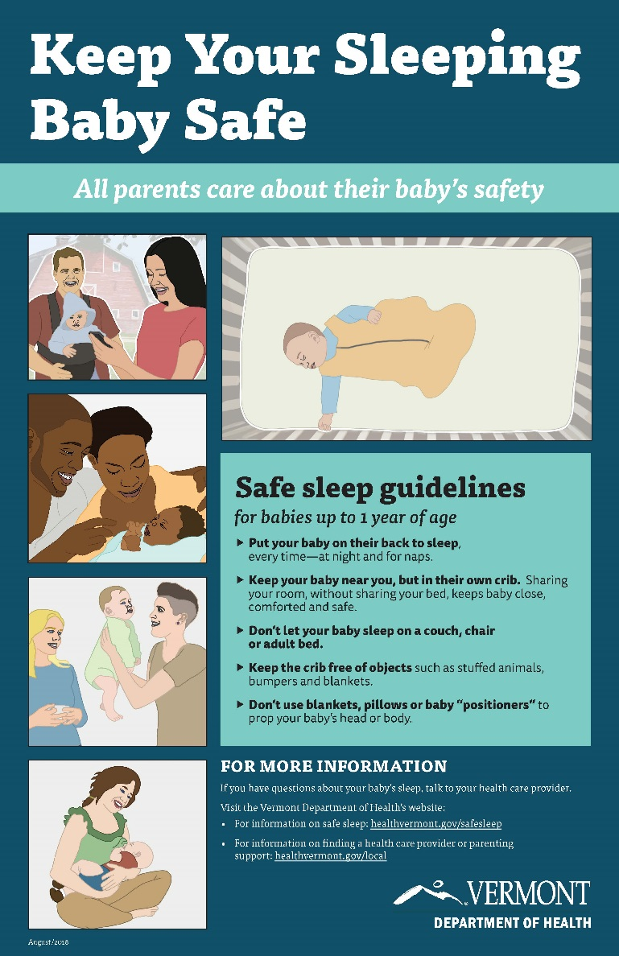
Elements of VT’s Safe Sleep Campaign
Brochures and posters for parents, hospital birthing units, and provider offices.
Revised VDH website and Facebook advertisements.
healthvermont.gov/safesleep
Slide decks for education of parents and health care providers.
Coordination with Vermont Birth Hospitals on in-patient policies and procedures for staff training and education of parents.
Evaluation using measures such as Facebook metrics (short term) and PRAMS survey (long term).
Notes:
PRAMS: Pregnancy Risk Assessment Monitoring System: http://www.healthvermont.gov/health-statistics-vital-records/population-health-surveys-data/pregnancy-risk-assessment-and

Slide 47
How to Talk with Parents about Infant Safe Sleep
Use non-judgmental, open-ended questions to elicit parents’ safe sleep knowledge and practices.
Address the challenge of sleep by describing normal sleep patterns and offering tips to get the baby to sleep.
Discuss questions/concerns about the AAP guidelines, which are often beyond the ‘basics’.
Notes:
Notes:
The remainder of this presentation offers guidance to providers on how to talk with parents about safe sleep, based on the focus group research results. This slide offers an overview of five tips for your conversations with parents. The following slides will go into more detail about each of these five tips.

Slide 48
How to Talk with Parents about Infant Safe Sleep
Address the challenge of safe sleep by helping parents make a plan to overcome the barriers in implementing safe sleep practices.
Encourage parents to stick with it, by affirming their ability to work towards full implementation of safe sleep practices through a strengths-based approach.
Notes:
Notes:
The remainder of this presentation offers guidance to providers on how to talk with parents about safe sleep, based on the focus group research results. This slide offers an overview of five tips for your conversations with parents. The following slides will go into more detail about each of these five tips.

Slide 49
Use a Nonjudgmental and Supportive Approach
The AAP recommends that doctors have open and nonjudgmental conversations with families about their sleep practices.
Ask open-ended questions about safe sleep practices like, “What are your plans for where the baby sleeps once you get home?” or “How are things going with sleep?”

Slide 50
Use a Nonjudgmental and Supportive Approach
Acknowledge and sympathize with struggles parents face in understanding and implementing safe sleep
Affirm parents’ desire to be good, competent caregivers, and offer your support towards that end
Be aware of and sensitive to family or cultural norms that may be contradictory to the AAP guidelines – invite dialogue to the extent possible

Slide 51
Address the Challenge of Sleep
Give a realistic sense of sleep expectations (e.g. how long newborns sleep at a time, when babies begin to sleep through the night, and how much variation there is in sleep patterns).
Let parents know that babies need time to adjust to a safe sleep environment, and that it will probably also take some trial and error to figure things out. Not all things will work all the time.

Slide 52
Address the Challenge of Sleep
You can offer some tips to help get baby to sleep:
Keep the lights low in the evening and lights off during nighttime feedings.
Calm down with 30 minutes of quiet time before bed.
Create and follow a consistent bedtime routine: give baby a warm bath, read a book, sing a song to your baby.
Wait a few minutes before responding to a baby’s fussing to see if they will be able to calm themselves.

Slide 53
Discuss Concerns About Guidelines
Ask what questions or concerns they have about the guidelines – some common ones include:
Question/Concern | Potential response
“Won’t my baby choke if I put him/her on the back to sleep?” | “That’s a good question. Babies naturally swallow or cough up fluids, and may actually have an easier time when they’re on their backs! When in the back sleep position, their windpipe lies on top of their esophagus – so if anything comes up from their tummy, it has to work against gravity to get into their windpipe and cause them to choke.”
“I don’t want my baby to sleep without a blanket – it gets so cold in the winter!” | “Of course you want your baby to be snug and warm. However, blankets are a risk because they can cover your baby’s face and make it difficult for him/her to breathe. It’s safer to keep your baby warm (but not too warm!) by dressing your baby in layers or using a sleep sack.”
“I don’t really see the point in following the guidelines because they change all the time.” | “I understand how they can be difficult to follow – I have to keep up with what the evidence says! The first big recommendation of ‘back is best’ started in the 1990s and led to a 50% drop in the SIDS rate. Since then, there have been updates based on research, like the need for tummy time. I’m happy to talk with you about what the key guidelines are.”
Notes:
References:
For other Frequently Asked Questions see: National Institutes of Health. Frequently Asked Questions (FAQs) About SIDS and Safe Infant Sleep website. Available at: https://www1.nichd.nih.gov/sts/about/Pages/faq.aspx. Accessed April 24, 2018.

Slide 54
Address Challenges of Safe Sleep
Help parents make a plan to address any challenges they are facing (or anticipating) – some common ones include:
Question/Concern | Potential response
“My baby starts crying as soon as I put them down in the crib.” | “I hear that a lot. Like I said, it takes time for babies to learn how to sleep in new environments, and you can help your baby get more comfortable sleeping in the crib with some of those tips we discussed. Can you start by getting the baby used to the crib during nap times?”
“Sometimes I’ll accidentally fall asleep while feeding my baby in bed.” | “If you’re really tired when feeding, try to minimize the risks in case you do fall asleep.. If you’re feeding in bed, remove anything soft like pillows and blankets so you can reduce the risk of suffocation. Falling asleep on a couch or armchair is as dangerous as a bed, because the baby can get stuck in the cushions. And if you wake up and realize you’ve fallen asleep, move the baby to the crib then.”
“I’m not sure we can afford a crib.” | “I know of a crib giveaway program at [community group, hospital, etc.]. Let me give you that information.”
Notes:
References:
For other Frequently Asked Questions see: National Institutes of Health. Frequently Asked Questions (FAQs) About SIDS and Safe Infant Sleep website. Available at: https://www1.nichd.nih.gov/sts/about/Pages/faq.aspx. Accessed April 24, 2018.

Slide 55
Encourage Parents to Stick with It
Encourage parents to follow the guidelines as fully and as long as possible (up to the 1-year mark) to keep the risk of SUID as low as possible.
Acknowledge that parents may encounter ‘hiccups’ in successful safe sleep practices, such as when the baby is sick/teething/traveling.
Affirm parents’ ability to continue/work towards full implementation of safe sleep practices through a strengths-based approach (i.e. focus on their potential and capacities rather than limits).

Slide 56
Professional Resources
“Building on Campaigns with Conversations: An Individualized Approach to Helping Families Embrace Safe Sleep & Breastfeeding,” by the National Institute for Children’s Health Quality (NICHQ), is a free series of learning modules designed to help health professionals gain the knowledge and skills to promote safe sleep and breastfeeding effectively.
National Action Partnership to Promote Safe Sleep: NAPPSS
Vermont Department of Health: healthvermont.gov/family/babies/safe-sleep-health-professionals
American Academy of Pediatrics: aap.org
Notes:
Notes:
In addition to the guidance provided in this presentation, there are other resources you may find helpful to promote safe sleep.
References:
Bronheim, S. Building on Campaigns with Conversations: An individualized approach to helping families embrace safe sleep and breastfeeding. Washington, DC: National Center for Education in Maternal and Child Health. 2017. Available at: https://www.ncemch.org/learning/building/index.php. Accessed April 24, 2018. This is a free series of learning modules designed to help health professionals gain the knowledge and skills to promote safe sleep and breastfeeding effectively. This is a well researched resource: Building on Campaigns with Conversations is a new approach to supporting caregivers to help overcome barriers to safe sleep and breastfeeding. It is part of a greater trend in public health promotion—utilizing an individualized approach that takes into account each family’s needs, beliefs, and the context of their lives. This training on the Conversations Approach is based on Ajzen’s Theory of Planned Behavior and follows current recommendations from the American Academy for Pediatrics (AAP) for safe sleep and optimal breastfeeding for healthy infants.
National Action Partnership to Promote Safe Sleep https://www.nichq.org/project/national-action-partnership-promote-safe-sleep-improvement-and-innovation-network-nappss
Vermont Department of Health newly revised webpage for health care providers and parents and caregivers: healthvermont.gov/safesleep

Slide 57
Resources for Parents
Vermont Department of Health: healthvermont.gov/safesleep
Vermont Department of Health District Offices: healthvermont.gov/local
American Academy of Pediatrics: healthychildren.org
Help Me Grow VT: 2-1-1 x6, helpmegrowvt.org
March of Dimes: MarchofDimes.org
Notes:
www.healthvermont.gov/safesleep: Vermont Department of Health newly revised webpage for health care providers and parents and caregivers.
www.healthvermont.gov/local: Contact information for the local Vermont Department of Health District offices. There are twelve VDH offices statewide and each employ a Maternal and Child Health Public Health nurse who can assist with referrals for families for issues such as connecting with a medical home, services such as WIC, and parenting classes.
www.healthychildren.org is the official parenting website of the American Academy of Pediatrics
www.helpmegrow.vt: Help Me Grow Vermont is a statewide system for improving access to existing resources and services for expectant parents and families with young children through age eight. The HMG VT contact center is at Vermont 211, which is staffed M-F, 9AM – 6PM. 211 and HMG provide information for parents on overall parenting services (such as infant safe sleep) and also developmental screening and also Vermont’s Universal Developmental Screening Registry.
www.marchofdimes.org: March of Dimes website contains parenting advice and safe sleep information under “Caring for your Baby” section.

Slide 58
References
Ainsworth RM, Summerlin-Long S, Mog C. A comprehensive initiative to prevent falls among newborns. Nurs Womens Health. 2016;20(3);247-57.
American Academy of Pediatrics. SIDS and Other Sleep Related Infant Deaths: Updated Recommendations website. https://www.youtube.com/watch?v=sdWGmhCyAak&feature=youtu.be. Accessed April 18, 2018.
Bronheim, S. Building on Campaigns with Conversations: An individualized approach to helping families embrace safe sleep and breastfeeding. Washington, DC: National Center for Education in Maternal and Child Health. 2017. Available at: https://www.ncemch.org/learning/building/index.php. Accessed April 24, 2018.
Centers for Disease Control and Prevention. PRAMS website. 2018. Available at: https://www.cdc.gov/prams/methodology.htm#n2. Accessed April 24, 2018.
Centers for Disease Control. Sudden Unexpected Infant Death (SUID) website. https://www.cdc.gov/sids/pdf/sudden-unexpected-infant-death.pdf. Accessed April 18, 2018.
Centers for Disease Control. Sudden Unexpected Infant Death and Sudden Infant Death Syndrome website. https://www.cdc.gov/sids/data.htm. Accessed April 18, 2018.
Colson ER, Joslin SC. Changing nursery practice gets inner-city infants in the supine position for sleep. Arch Pediatr Adolesc Med. 2002;156(7):717-20.
Heitmann, R. et al. Improving safe sleep modeling in the hospital though policy implementation. Matern Child Health J (2017) 21:1995-2000.
Helsley L, McDonald JV, Stewart VT. Addressing in-hospital ‘falls’ of newborn infants. Jt Comm J Qual Patient Saf. 2010;36(7);327-33.
Kemp JS, Unger B, Wilkins D, Psara RM, Ledbetter TL, Graham MA, Case M, Thach BT. Unsafe sleep practices and an analysis of bedsharing among infants dying suddenly and unexpectedly: Result of a four-year, population-based, death-scene investigation study of sudden infant death syndrome and related deaths. Pediatrics. 2000 Sep; 106(3); E41.
Minnesota Hospital Association. Newborn Falls/Drops in the Hospital Setting website. Accessed April 23, 2018 at: https://www.mnhospitals.org/Portals/0/Documents/ptsafety/falls/MHA-6-20-11.pdf.
Moon RY, Task Force on Sudden Infant Death Syndrome. SIDS and Other Sleep-Related Infant Deaths: Evidence Base for 2016 Updated Recommendations for a Safe Infant Sleeping Environment. Pediatrics. 2016 Nov;138(5).
Moon, RY. Rachel Y. Moon, MD website. Available at: https://research.med.virginia.edu/chrc/current-projects/rachel-y-moon-md/. Accessed April 24, 2018.
National Institutes of Health. Common SIDS and SUID Terms and Definitions website. https://www1.nichd.nih.gov/sts/about/SIDS/Pages/common.aspx. Accessed April 18, 2018.
National Institutes of Health. Frequently Asked Questions (FAQs) About SIDS and Safe Infant Sleep website. Available at: https://www1.nichd.nih.gov/sts/about/Pages/faq.aspx. Accessed April 24, 2018.
National Institutes of Health. Research on Possible Causes of SIDS website. https://www1.nichd.nih.gov/sts/campaign/science/Pages/causes.aspx. Accessed April 18, 2018.
Task Force on Sudden Infant Death Syndrome. SIDS and other sleep-related infant deaths: updated 2016 recommendations for a safe infant sleeping environment. Pediatrics. 2016 Nov;138(5).
Vermont Department of Health. Division Of Maternal & Child Health Brief: Safe Sleep. 2017. Available at: http://www.healthvermont.gov/sites/default/files/documents/pdf/DB.NPM5_.Safe%20sleep.pdf. Accessed May 31, 2017.
Vermont Department of Health. Sudden Unexpected Infant Death Data Brief from VDH website. http://www.healthvermont.gov/sites/default/files/documents/pdf/HSVR_injury_SUID.pdf. Accessed April 18, 2018.

