Slide 1
Help Your Baby to Go to Sleep, Safe and Sound
Vermont Department of Health
Division Maternal and Child Health
2018
Notes:
Slides created July 2018

Slide 2
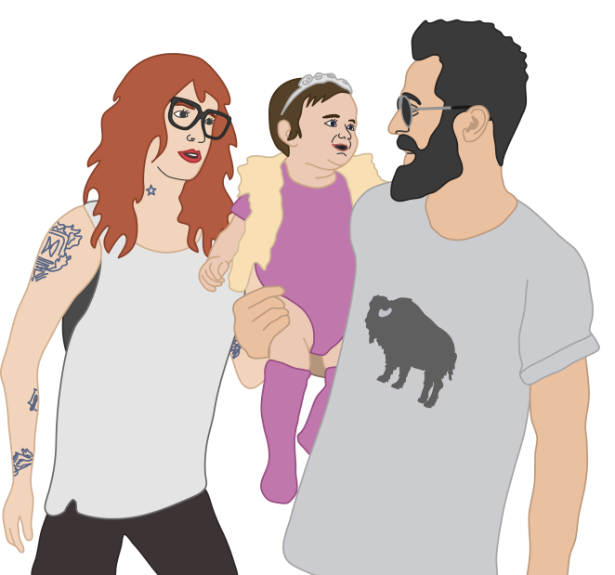
Introduction
Babies depend on parents and caregivers to keep them safe while they sleep.
Today we will discuss how to best keep your baby safe while sleeping, according to guidance from the American Academy of Pediatrics (AAP).
We will also talk about tips to get your baby to sleep and resources.

Slide 3
What is SUID?
Sudden Unexpected Infant Death (SUID)
Any sudden and unexpected death of an infant under 1 year of age.

Slide 4
Two Examples of SUID
Sudden Infant Death Syndrome (SIDS)
The sudden death of an infant under 1 year of age that cannot be explained even after a full investigation.
Accidental Suffocation and Strangulation in Bed (ASSB)
Infant death caused by suffocation or asphyxiation in a sleeping environment. Examples include suffocation by soft bedding or being trapped between a mattress and bed frame.

Slide 5
Confusion between Infant Safe Sleep and SIDS
Sometimes infant safe sleep is discussed along with Sudden Infant Death Syndrome (SIDS).
SIDS is when a sudden infant death cannot be explained even after a thorough investigation.
Researchers are still working to fully understand the causes of SIDS.
This presentation is about infant safe sleep and helping parents to know how to place their baby for sleep in a way that will reduce the risk of accidental suffocation.

Slide 6
How Common is SUID?
In the United States, there were about 3,600 cases of SUID in 2016. One in four cases were due to accidental suffocation and strangulation in bed (ASSB).
In Vermont, there are abut 4-6 events every year where a baby dies in an unsafe sleep environment.
Notes:
Notes:
You may wonder how often sudden unexpected infant deaths occur. The cases are not common, but when they do occur, each death is a tragedy.
References:
Centers for Disease Control. Sudden Unexpected Infant Death and Sudden Infant Death Syndrome website. https://www.cdc.gov/sids/data.htm. Accessed October 2018.
Vermont Department of Health. Sudden Unexpected Infant Death Data Brief from VDH website. http://www.healthvermont.gov/sites/default/files/documents/pdf/HSVR_injury_SUID.pdf. Accessed April 18, 2018.

Slide 7
You can reduce the risk of SUID
Unsafe sleep practices are a factor in a majority of cases diagnosed as ASSB and SIDS.
You can prevent Accidental Suffocation and Strangulation in Bed by making sure nothing can get in the way of your baby’s breathing.
Although the causes of SIDS are still being researched, parents can help protect their babies by following the AAP guidelines.
Notes:
Notes:
We often talk about “risk reduction” for baby safety. For example, you can protect your baby and reduce the “risk” of injury by using a car seat. You can also reduce the risk of accidental suffocation by using safe sleep practices, which we will be talking about in this presentation.
Research examining SUID cases has found that many of them were preventable.
References:
Kemp JS, Unger B, Wilkins D, Psara RM, Ledbetter TL, Graham MA, Case M, Thach BT. Unsafe sleep practices and an analysis of bedsharing among infants dying suddenly and unexpectedly: Result of a four-year, population-based, death-scene investigation study of sudden infant death syndrome and related deaths. Pediatrics. 2000 Sep; 106(3); E41.

Slide 8
What research has been done on reducing the risk of SUID?
The most highly respected research has been conducted by the American Academy of Pediatrics (AAP), an national organization of pediatricians.
AAP has a working task force to review the research on sudden infant deaths and to develop recommendations to prevent sleep-related infant deaths.
The AAP’s recommendation to place infants to sleep on their back has led to a more than 50% decrease in SIDS since 1994.
AAP recommendations have changed over time to reflect the best available research.

Slide 9
Key AAP Recommendations to Reduce SUID Risk, 2016
Sleep-related recommendations for babies up to one year of age
Put your baby on her back to sleep for every sleep.
Room-share with your baby by setting up a crib or bassinette for him in your room.
Don’t sleep with your baby in the same bed or in a chair, couch, or other area.
Use a safety approved crib with a firm sleep surface.
Keep soft objects and loose bedding away from the baby’s sleeping space.
Avoid overheating your baby.
Notes:
Notes:
The American Academy of Pediatrics has a set of guidelines that can help prevent Sudden Unexpected Infant Death. Some of these guidelines are focused on safe sleep practices, and some recommendations are not sleep-specific but also reduce the risk of SUID. You should be aware of all of these guidelines, but for the after this slide we will focus on sleep-related recommendations.
References:
2016 AAP Policy Statement: Task Force on Sudden Infant Death Syndrome. SIDS and other sleep-related infant deaths: updated 2016 recommendations for a safe infant sleeping environment. Pediatrics. 2016 Nov;138(5).
2016 AAP Technical Report: Moon RY, Task Force on Sudden Infant Death Syndrome. SIDS and Other Sleep-Related Infant Deaths: Evidence Base for 2016 Updated Recommendations for a Safe Infant Sleeping Environment. Pediatrics. 2016 Nov;138(5).

Slide 10
Key AAP Recommendations to Reduce SUID Risk, 2016
Other recommendations
Avoid exposing your baby to tobacco smoke. If you or other family members are smokers, this is a good time to consider quitting – call 802-QUITS.
Avoid alcohol use and illicit drugs
during pregnancy and after birth.
Immunize your baby according to the AAP recommendations.
Breastfeed your baby.
Notes:
Notes:
The American Academy of Pediatrics has a set of guidelines that can help prevent Sudden Unexpected Infant Death. Some of these guidelines are focused on safe sleep practices, and some recommendations are not sleep-specific but also reduce the risk of SUID. You should be aware of all of these guidelines, but for the after this slide we will focus on sleep-related recommendations.
References:
2016 AAP Policy Statement: Task Force on Sudden Infant Death Syndrome. SIDS and other sleep-related infant deaths: updated 2016 recommendations for a safe infant sleeping environment. Pediatrics. 2016 Nov;138(5).
2016 AAP Technical Report: Moon RY, Task Force on Sudden Infant Death Syndrome. SIDS and Other Sleep-Related Infant Deaths: Evidence Base for 2016 Updated Recommendations for a Safe Infant Sleeping Environment. Pediatrics. 2016 Nov;138(5).

Slide 11
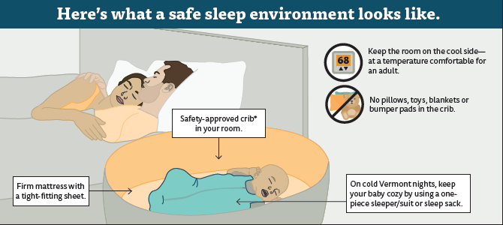
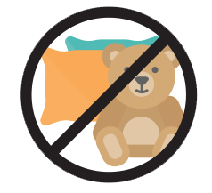
INDICATE 68 degrees Do not overheat baby
No soft objects or loose bedding
Baby on back

Slide 12
How would you make this sleep environment safe?
Notes:
30 second Video of a crib with no toys, bumper pads or other objects.

Slide 13
Some of you may be wondering…
Do I really have to do all of these things all the time?
Why can’t I let my baby sleep on his/her tummy?
Can I really not put anything in the baby’s sleep area? Not even blankets or crib bumpers?
What’s risky about my baby sleeping in bed with me?
Notes:
Notes:
These are common questions that parents have about following the safe sleep guidelines, and this presentation will address each of these questions in turn.

Slide 14
Make safety a habit
We have discussed ways you can reduce the risk, or probability, of SUID.
The more frequently and thoroughly you follow the safe sleep guidelines, the better you can avoid the risk of your baby possibly being suffocated.
Notes:
Notes:
The first question was, “Do I really have to do all of these things all of the time?”
Although SUID cases are uncommon, thousands of cases occur each year in the United States, many of which are preventable. Just like you make sure your baby wears a seatbelt in the car every time, even though you don’t expect to get into a car crash, following safe sleep guidelines as a habit can help keep your baby safe. Even if you survive a car ride without wearing a seatbelt, it is riskier to do so. Especially because your baby sleep so much, it is best to always avoid unsafe sleep practices that are known to be linked to Sudden Unexpected Infant Death.

Slide 15
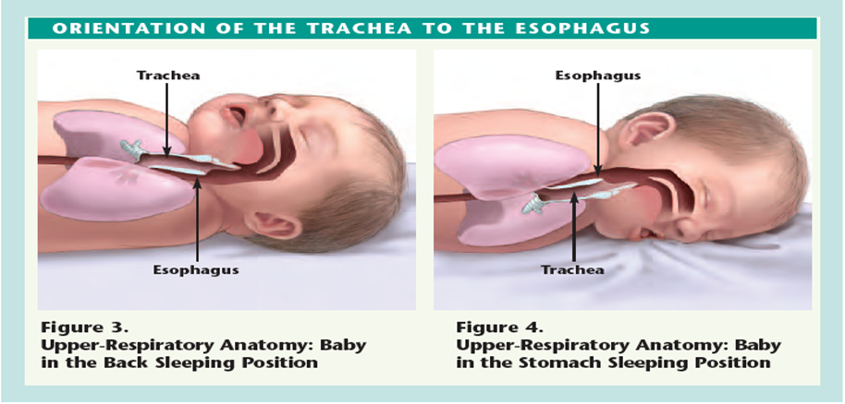
Back is best
Babies have an easier time coughing up fluids when on their backs, because it is harder for food or spit to go upwards to where the windpipe is.

Slide 16
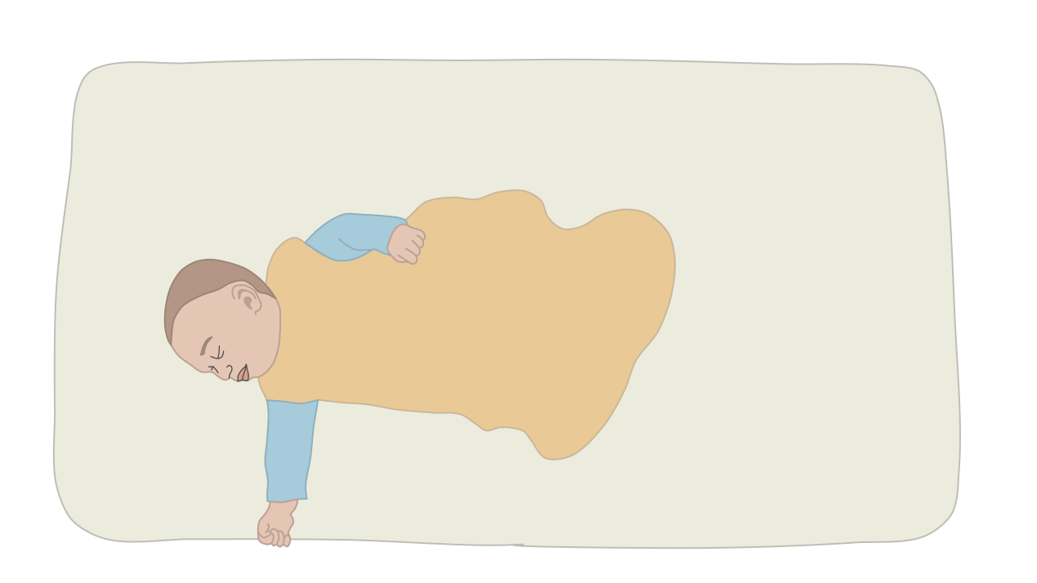
Back is best
When your baby can roll over on his/her own during sleep (around 4-6 months), you do not need to turn the baby back over. However, continue to place your baby on their back at the beginning of each sleep time.
Notes:
Notes:
The second question was, “Why can’t I let my baby sleep on his/her tummy?”

Slide 17
Keep the crib clear
Baby toys and pillows in a crib may look cute, but these are items that may block your baby’s breathing and increase the risk of accidental suffocation.
Crib bumpers—even mesh ones—are a risk – so they should not be used.
Don’t use the crib for storage, such as for clothing or other household items.
Notes:
Notes:
The third question was, “Can I really not put anything in the baby’s sleep area? Not even blankets or crib bumpers?

Slide 18
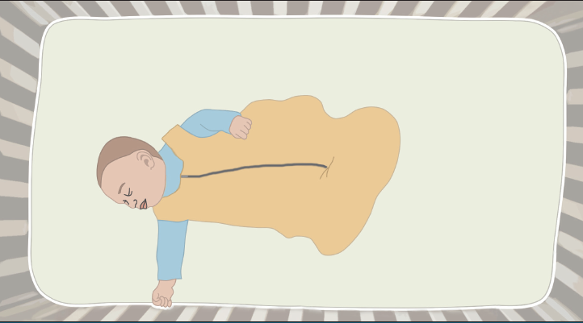
Keep the crib clear
Wedges or positioners that keep your baby in a certain sleep position may claim to prevent SIDS, but the evidence does not support this claim (and in fact some positioners have been associated with injury and death).
Instead of blankets, dress your baby in layers or use a sleep sack – be careful not to overheat your baby.
Notes:
Notes:
The third question was, “Can I really not put anything in the baby’s sleep area? Not even blankets or crib bumpers? If you use a blanket, be sure it is tucked in firmly and comes up to the level of the baby’s chest.

Slide 19
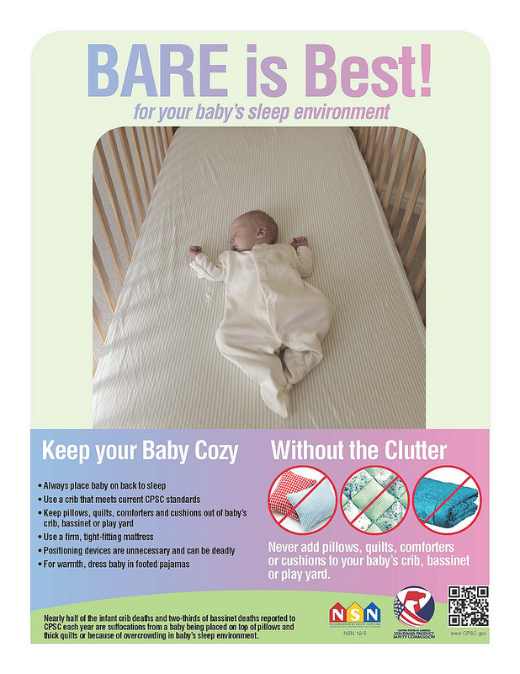
Always use a safety approved crib
Use a crib or bassinette that meets the safety standards of the Consumer Product Safety Commission. www.cpsc.gov
The CSPC is a great resource for all infant product safety concerns.
Notes:
There are several products such as baby positioners or cardboard boxes that are marketed to parents. You should research these products before you buy them to be sure they are safe – a great reference is the Consumer Products Safety Commission.

Slide 20
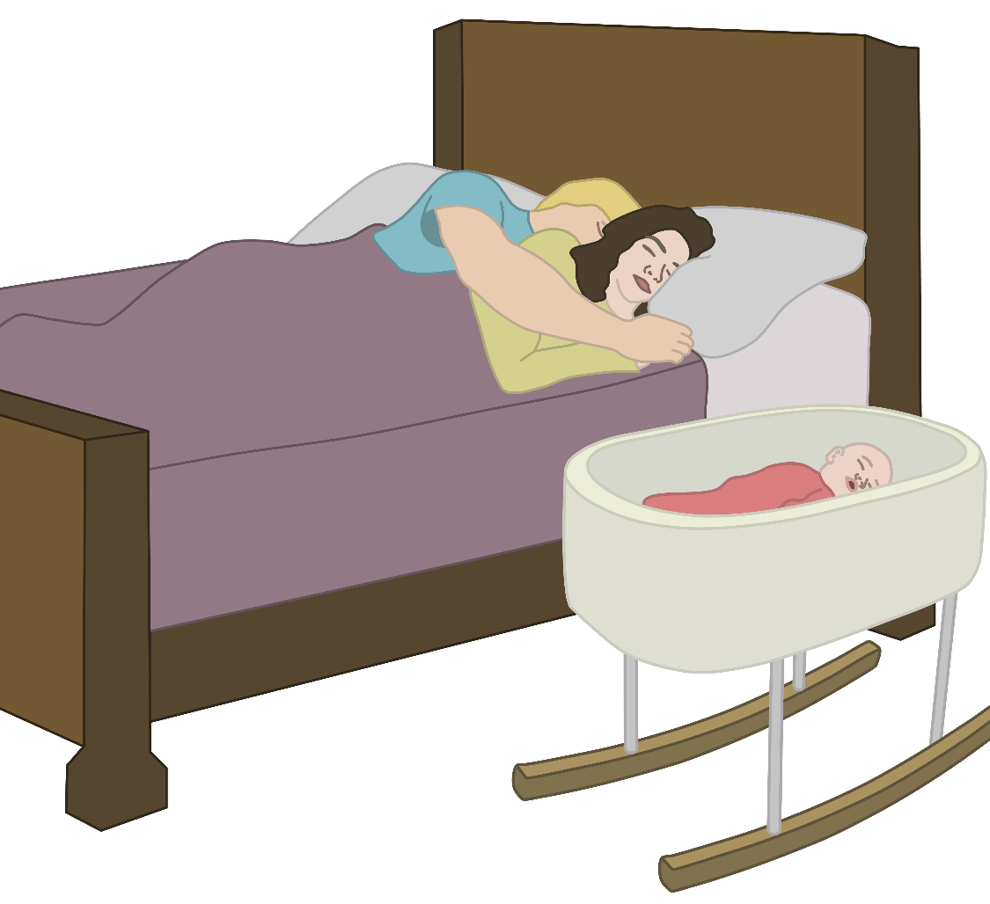
Bedsharing is risky
The AAP recommends room-sharing without bed-sharing, such as using a bassinet placed next to or near the parents’ bed.
Pillows, sheets, blankets, and even other people in the bed can move accidentally over the baby’s face and obstruct the baby’s breathing. Also, the baby can get stuck between the bed mattress and bed frame or wall.
Notes:
Notes: Explain definition of room sharing and bed-sharing.
The fourth question was, “What’s risky about my baby sleeping in bed with me?”

Slide 21
Bedsharing is risky
Be careful to not fall asleep on a couch or armchair – it can be as dangerous as a bed, because the baby can get stuck in the cushions.
Notes:
Notes: 30 second Video of baby asleep on couch and being moved by the mother
The fourth question was, “What’s risky about my baby sleeping in bed with me?”

Slide 22
What if my baby has trouble sleeping in a safe sleep environment?
Babies usually need time to adjust to sleeping in a new environment.
You may need to use some problem solving and experimenting to figure out how to keep your baby safe, while also letting everyone get some sleep
If you are using a licensed child care, your baby will be used to a safe sleep environment in that setting
Notes:
Notes:
So far this presentation has covered the safe sleep recommendations and the reasons for them. However, parents can find it challenging to get their babies to sleep, and that includes getting them to sleep according to the safe sleep guidelines.

Slide 23
What to expect with baby and sleep…
Newborn babies’ sleep patterns are unpredictable, but you can expect they will wake up many times day and night. This is normal and healthy.
After about 6 weeks, your baby may begin to sleep more at night than during the day.
At about 3 months, your baby may sleep for longer stretches of time.
At about 6 months, your baby may sleep up to 6 hours at night.
Notes:
Notes:
Getting your baby to sleep can be challenging. It’s important to know what to expect when it comes to their sleep patterns.
References:
California WIC program, California Department of Health. Getting to know your baby: Birth to 6 months. http://www.healthvermont.gov/sites/default/files/documents/2016/11/cyf_WIC-BB-GettingToKnowYourBabyBooklet.pdf. Accessed April 24, 2018.
AAP Healthy Children: https://www.healthychildren.org/English/ages-stages/baby/sleep/Pages/default.aspx
https://www.marchofdimes.org/baby/safe-sleep-for-your-baby.aspx

Slide 24
Six Tips to Get Your Baby to Sleep

Slide 25
Keep the lights low in the evening and lights off during nighttime feedings.
1

Slide 26
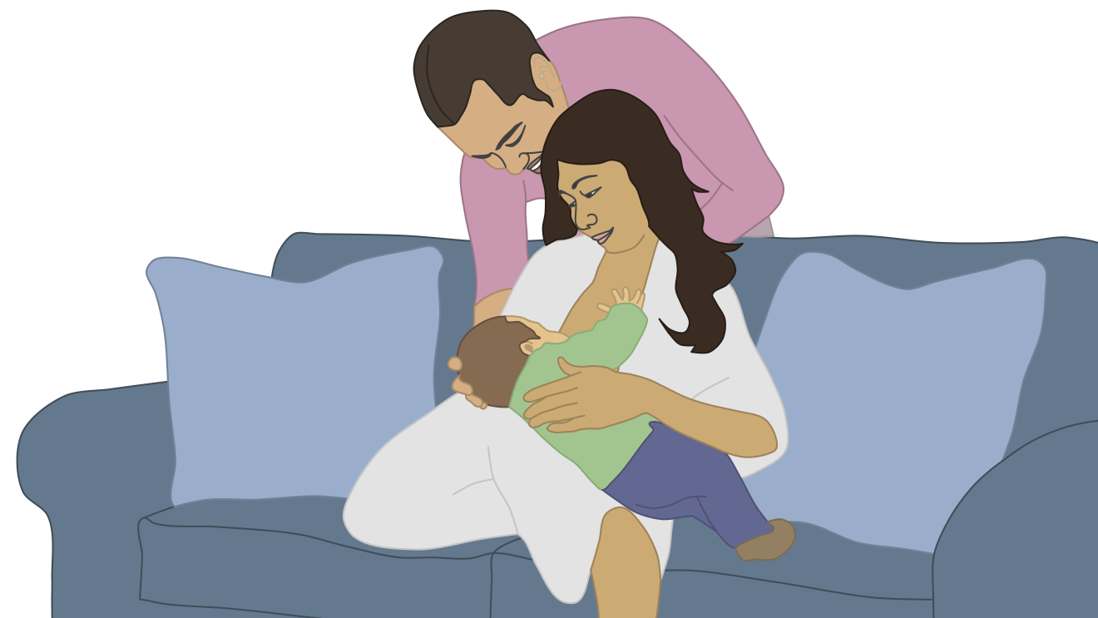
Calm down with 30 minutes of quiet time before bed.
2

Slide 27
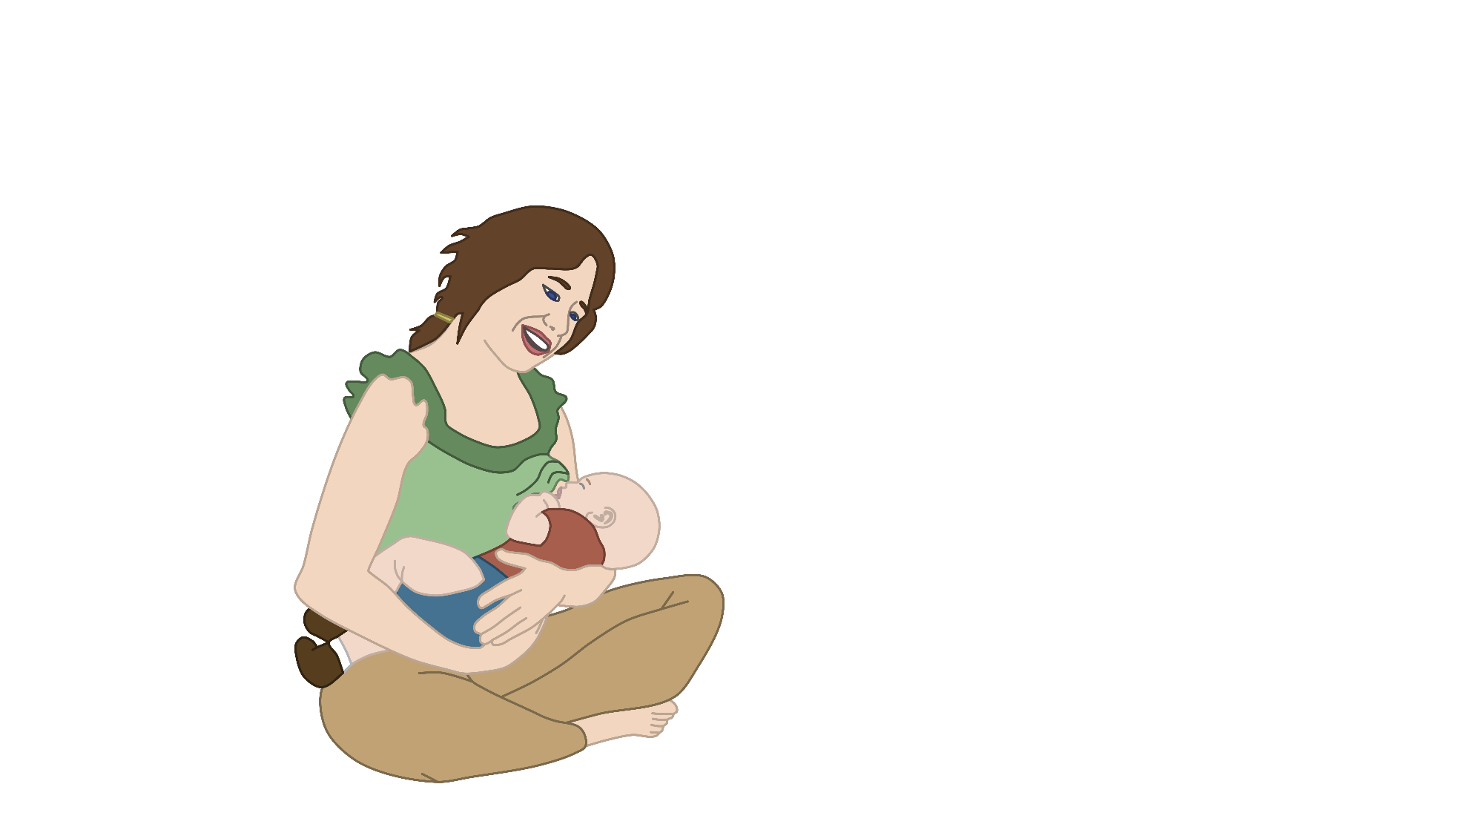
Create and follow a consistent bedtime routine: give baby a warm bath, read a book, sing a song.
3

Slide 28
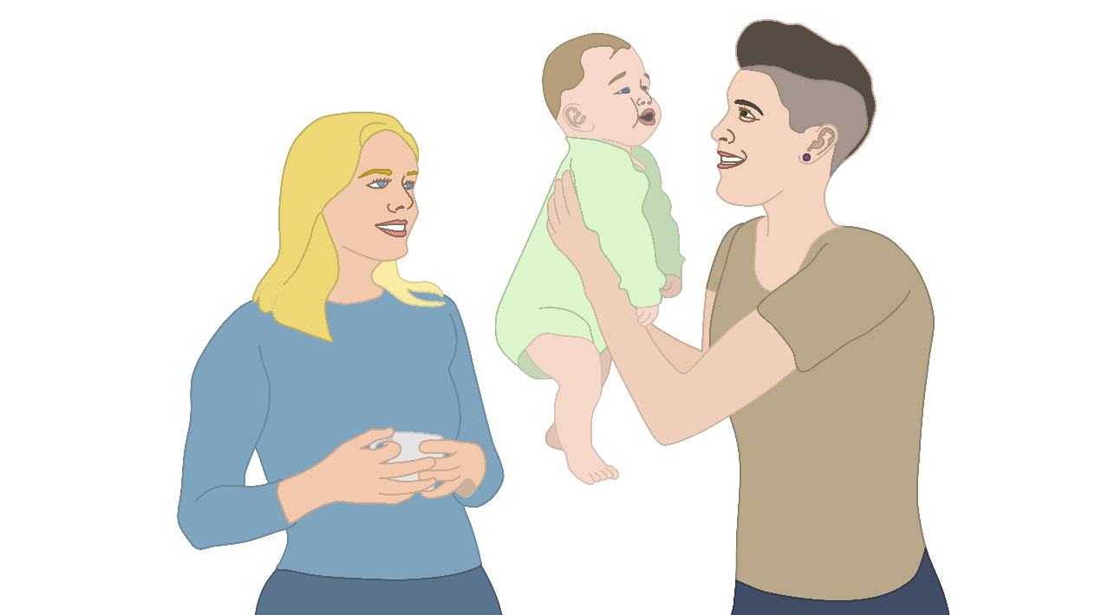
Make daytime play time – so your baby learns that nighttime is for sleep.
4

Slide 29
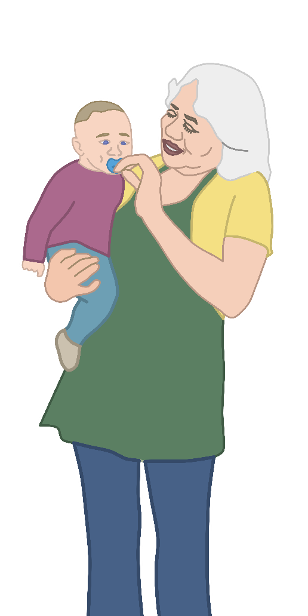
Pacifiers can help sooth a baby. If you are breastfeeding, wait
until your milk supply is well established before using a pacifier.
5

Slide 30
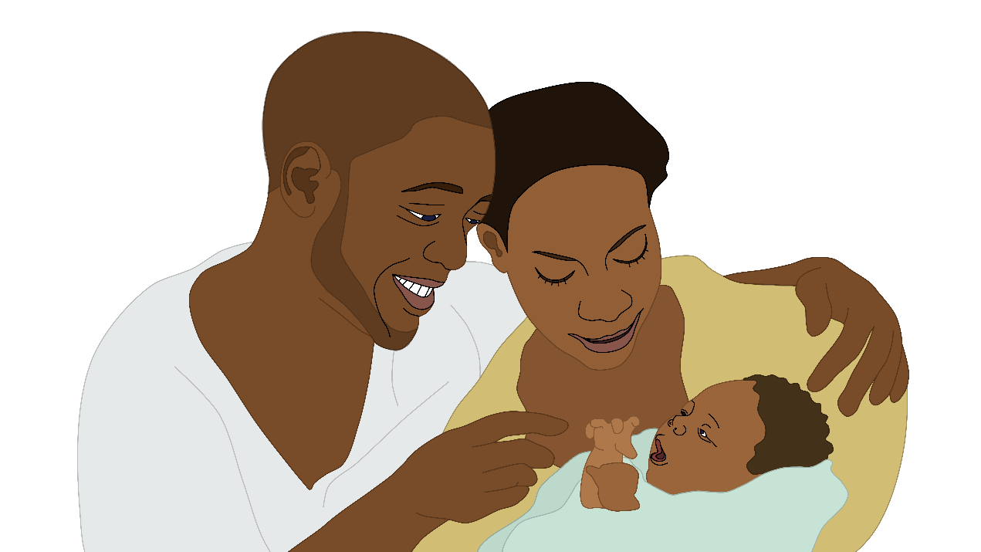
After your baby gets a bit older, put your baby to bed while drowsy but still awake.
6
Notes:
Newborns and young babies may often be in a deep sleep after a feeding and so this makes it easier to put them for sleep in their porto crib or crib. For older babies, starting at about 4 months, parents can start putting the baby to sleep while drowsy but still somewhat awake – this will help the baby learn how to fall asleep by himself.

Slide 31
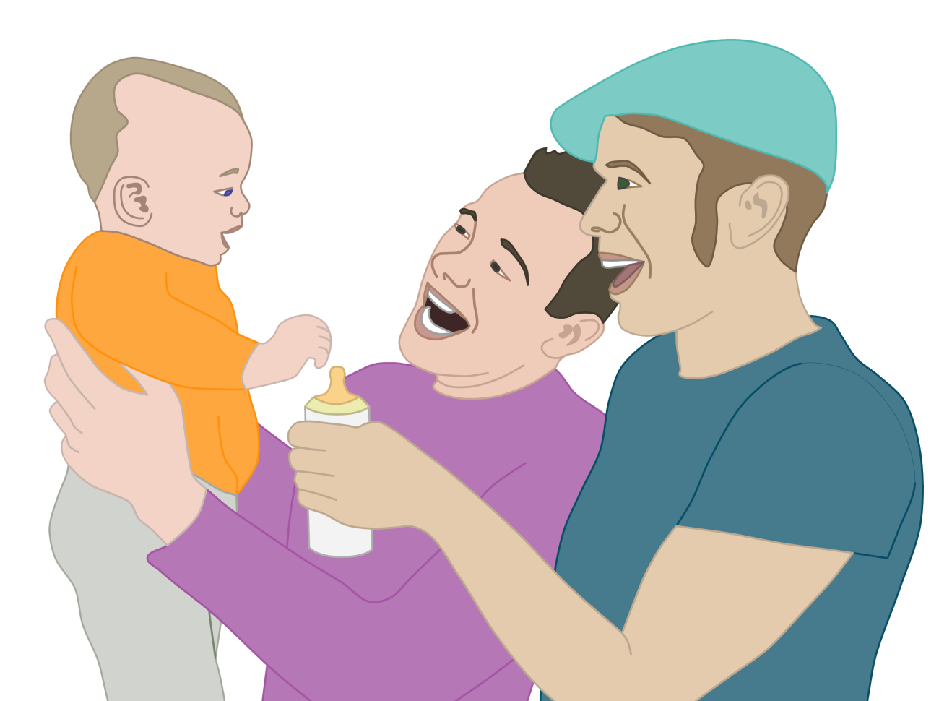
Stick with Safe Sleep
Follow the guidelines as fully and as long as possible (up to the 1-year mark) to keep the risk of SUID as low as possible.
At times this may be difficult, such as when the baby is sick or teething, or if you are traveling—you should always work towards practicing the safe sleep guidelines.
Notes:
Notes:
Because it can be difficult to get babies to sleep in general, following safe sleep practices can sometimes feel extra challenging. Still, for your baby’s safety, try to follow safe sleep practices as frequently and thoroughly as you can. It may take some problem solving and persistence, but you can accomplish both sleep and safety.

Slide 32
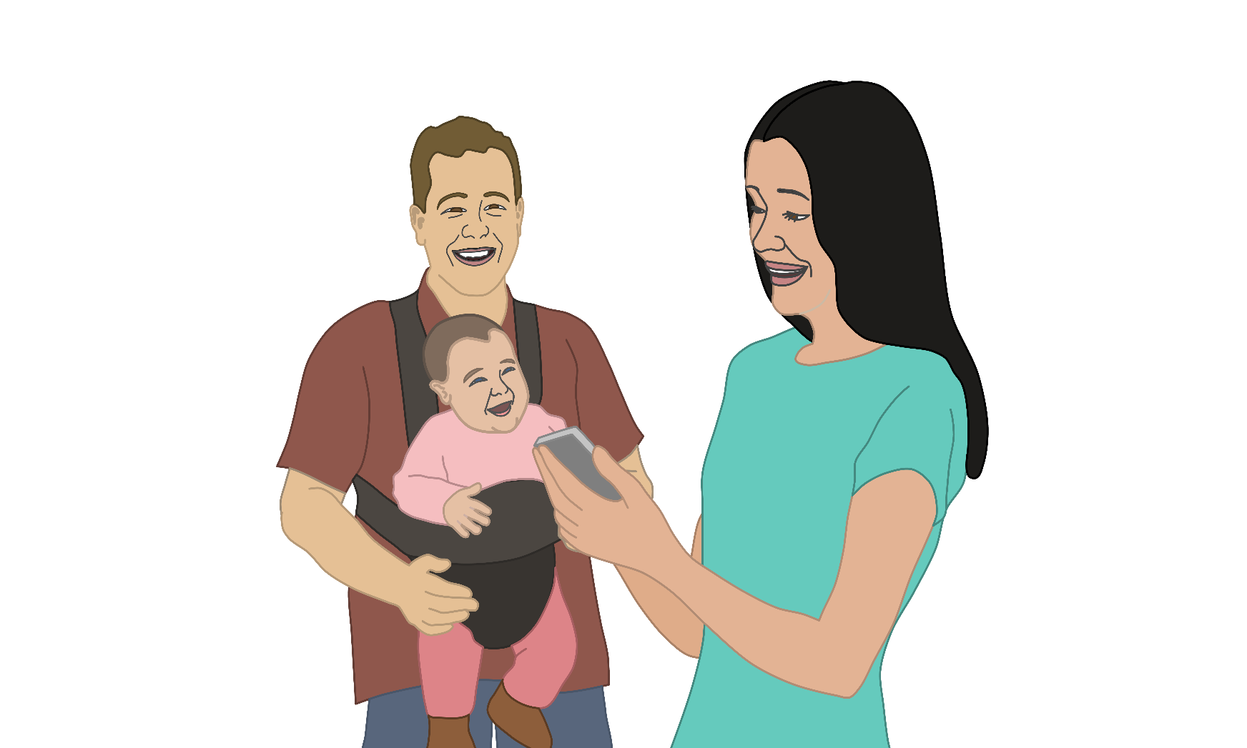
Be sure everyone knows about safe sleep for your baby
Be sure to tell everyone who cares for your baby about safe sleep practices that you are using.
If you are using child care for your baby, remember that - in Vermont - licensed child care providers are required to use safe sleep practices.
Thus, it will be easier for your baby have the same routine of safe sleep both at home and at child care.

Slide 33
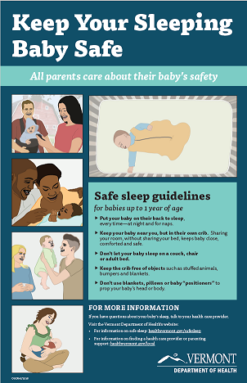
Resources
For more information on safe sleep:
Call your health care provider
Healthvermont.gov/safesleep
Vermont Help Me Grow dial 2-1-1 x 6
The Vermont Department of Health’s district offices can help in finding a health care provider or parenting support: healthvermont/local
HealthyChildren.org
MarchofDimes.org

