Slide 1
How to Promote Infant Safe Sleep: Key Messages from Vermont Research
Vermont Department of Health
Division of Maternal and Child Health
2018
Notes:
Notes:
This presentation, “How to Promote Infant Safe Sleep: Key Messages and Resources,” from the Division of Maternal and Child Health in the Vermont Department of Health, is designed to inform healthcare providers about the issue of infant safe sleep and information on how to address parental issues around the topic.

Slide 2
Introduction
The American Academy of Pediatrics (AAP) recommends a safe sleep environment that can reduce the risk of all sleep-related infant deaths.
However, these evidence-based recommendations are often misunderstood or rejected by parents, especially those receiving inconsistent messages from health care professionals.
Despite decades of research and parent education, each year in Vermont, about 4-6 infants die due to unsafe sleep environments.
Notes:
Many instances of safe sleep related deaths can be prevented. Nurses as trusted healthcare providers can help clarify and address concerns from parents and in doing so prevent infant deaths.
Reference: http://www.healthvermont.gov/sites/default/files/documents/pdf/HSVR_injury_SUID.pdf

Slide 3
Learning Objectives
By the end of this presentation, participants will be able to:
Recognize the trends in national and Vermont safe sleep data.
Be familiar with the current American Academy of Pediatrics (AAP) guidelines for infant safe sleep and underlying rationale.
Appreciate Vermont parents’ safe sleep experiences and needs for information and support.
Identify effective strategies and resources to educate and support parents on infant safe sleep.

Slide 4
The Importance of Nurses
Studies have indicated that parents listen to nurses and model their actions regarding the sleep position of their new infant.
Nurses are essential in influencing parents to place their babies in a safe sleep environment
Notes:
Reference: Heitman, R. et al. Improving safe sleep modeling in the hospital though policy implementation. Matern Child Health J (2017) 21:1995-2000.

Slide 5
What is SUID?

Slide 6
Defining SUID
Sudden unexpected infant death (SUID) is the death of an infant less than 1 year of age that occurs suddenly and unexpectedly, and whose cause of death is not immediately obvious before investigation. There are 3 types of SUID:
Types of SUID
Sudden Infant Death Syndrome (SIDS)
The sudden death of an infant less than 1 year of age that cannot be explained after a thorough investigation is conducted, including a complete autopsy, examination of the death scene, and a review of the clinical history
Unknown Cause
The sudden death of an infant less than 1 year old that remains undetermined because one or more parts of the investigation was not completed
Accidental Suffocation & Strangulation in bed
Suffocation by soft bedding
Overlay (a person rolls on top of infant while asleep)
Wedging or entrapment between two objects
Strangulation
Notes:
Notes:
Many people are familiar with the term Sudden Infant Death Syndrome (SIDS), but may not know how it relates to the broader term sudden unexpected infant death (SUID; also sometimes known as sudden unexpected death in infancy, or SUDI).
There has been confusion about the terms SUID and SIDS . The term SIDS is used when, after a thorough investigation by OCME and also law enforcement, no other cause of death can be determined.
Accidental Suffocation & Strangulation in Bed is sometimes abbreviated to ASSB.
For years there has been confusion for providers and parents, due to the term “SIDS” being used to refer to cases of infant death due to unintentional asphyxiation usually associated with an unsafe sleep environment.
For more information, see: National Institutes of Health. Common SIDS and SUID Terms and Definitions website. https://www1.nichd.nih.gov/sts/about/SIDS/Pages/common.aspx

Slide 7
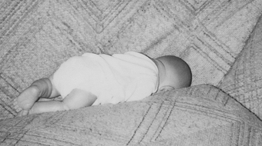
Determining Cause of Death
SUID cases are investigated to determine the circumstances and factors contributing to unexplained infant deaths. Unsafe sleep practices are a factor in a majority of cases diagnosed as SIDS, accidental suffocation, and unknown cause.
“Fig. 3. The infant mannequin is positioned where a 2-month-old infant was found dead on a couch... The infant had moved into the space between the cushion and back. He had been sleeping on the couch with a sibling. His death was attributed to accidental suffocation.”
Notes:
When there is an infant death in Vermont, the Office of the Medical Examiner (OCME) or the Assistant Medical Examiner (AME) will go to the family’s home and do a death scene reenactment using a life sized baby doll. Interviews with the parents are also conducted to better understand the circumstance as part of the investigation. In most of these instances, the parents are very willing to assist with the investigation – wanting to help to prevent future similar deaths in other families.
Pictures and captions are from: Kemp JS, Unger B, Wilkins D, Psara RM, Ledbetter TL, Graham MA, Case M, Thach BT. Unsafe sleep practices and an analysis of bedsharing among infants dying suddenly and unexpectedly: Result of a four-year, population-based, death-scene investigation study of sudden infant death syndrome and related deaths. Pediatrics. 2000 Sep; 106(3); E41.

Slide 8
Notes:
Another example of how the technique of death scene reenactment using a doll can inform our understanding of how the infant died within an unsafe sleep environment

Slide 9
Notes:
Another example of how the technique of death scene reenactment using a doll can inform our understanding of how the infant died within an unsafe sleep environment. This also illustrates the dangers of sleeping with an infant on a couch.

Slide 10
SUID in the United States
SIDS rates have decreased since the 1990s thanks to efforts like the Back to Sleep campaign, but thousands of preventable
sleep-related infant deaths still occur each year.
CDC website cdc.gov/sids/data/htm
Notes:
As mentioned the SUID rate declined during the 1990s, and it has fluctuated around 90 deaths per 100,000 live births since.
The distribution of types of deaths reported have shifted since 2000, with deaths reported as SIDS decreasing and deaths reported as Accidental Suffocation & Strangulation in Bed (ASSB) and unknown cause increasing. The reason for this shift is currently unknown, but may be attributable to stricter adherence to SIDS definitions and more complete death scene investigation and autopsy data.
SIDS remains the leading cause of death among infants under 1 year old – however researchers are continuing to work on increasing the accuracy of the findings in the manner of death.
More information on National Data and trends can be found at Centers for Disease Control. Sudden Unexpected Infant Death (SUID) website. https://www.cdc.gov/sids/pdf/sudden-unexpected-infant-death.pdf.

Slide 11
Vermont Specific Data and Recent Research

Slide 12
SUID in Vermont
The rate of SUID cases in Vermont has been consistently lower than the US rate, and the state of Vermont is on track to reach the Healthy Vermonters 2020 target value of .57 SUIDs per 1,000 live births.
From 2010-2014, there were 16 SUID cases in Vermont, half of which were due to ASSB.
Notes:
Graph from: Vermont Department of Health. Sudden Unexpected Infant Death Data Brief from VDH website. http://www.healthvermont.gov/sites/default/files/documents/pdf/HSVR_injury_SUID.pdf.

Slide 13
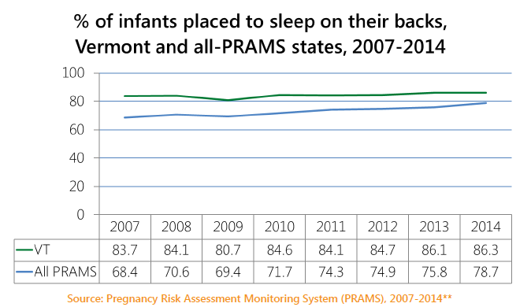
Safe Sleep Practices in VT
About 1 out of 5 babies are not sleeping in a supine position
Notes:
This graph represents data from the Pregnancy Risk Assessment Monitoring System (PRAMS) on the most common position babies are laid down to sleep in (response options were: on the side, back, or stomach).
For more information on PRAMS Methodology: Centers for Disease Control and Prevention. PRAMS website. 2018. Available at: https://www.cdc.gov/prams/methodology.htm#n2.

Slide 14
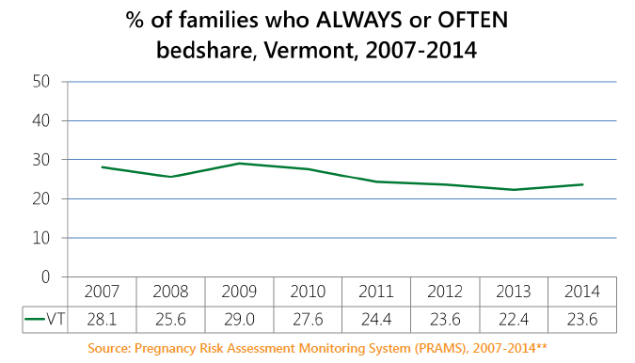
Safe Sleep Practices in VT
About 1 in 4 families report bed-sharing frequently
Notes:
This graph is also from PRAMS. How often the baby sleeps in the same bed with someone else (response options were: always, often, sometime, rarely, or never).
For ongoing updates on Vermont PRAMS data: http://www.healthvermont.gov/health-statistics-vital-records/population-health-surveys-data/pregnancy-risk-assessment-and
For more information on PRAMS Methodology: Centers for Disease Control and Prevention. PRAMS website. 2018. Available at: https://www.cdc.gov/prams/methodology.htm#n2.

Slide 15
The Vermont Department of Health contracted with John Snow, Inc. (JSI) to conduct formative research to inform a new Vermont infant safe sleep campaign. This research was conducted from March to November 2017.
The next several slides describe five key themes from four focus groups conducted with VT parents of infants under 1 year of age (Brattleboro, Burlington, Morrisville, St. Johnsbury; total N=55).
These themes, which may resonate with your experiences as providers and perhaps as parents, suggest ways healthcare providers can deliver safe sleep guidance more effectively.
Notes:
The Vermont Department of Health was concerned about the many confusing national and local messages that parents receive on infant safe sleep and so contracted with JSI to find out what Vermont parents think and understand about infant sleep and infant safe sleep environment. This research information would then assist the VDH, health care providers, and other partners to message infant safe sleep advice by directly addressing parents who live here in Vermont.

Slide 16
THEME 1
Parents worry about safe sleep.
“His place to sleep is safe but just that possibility that he could stop breathing and we don’t know why is scary to me.”
“I sleep better when he’s in my arms.”
“I’m an anxious person, so when I was nursing 4-5 times a night all through his newborn stage I was really serious about not sleeping with him because I was so afraid.”
“I used to worry about it when he was little but now we co-sleep.”
Notes:
The quotes on this slide were from focus groups with parents and caregivers.
Here are some additional quotes related to this theme:
“I’m an anxious person, so when I was nursing 4-5 times a night all through his newborn stage I was really serious about not sleeping with him because I was so afraid.”
“I used to worry about it when he was little but now we co-sleep.”
Most focus group participants described themselves as worried about infant sleep safety, regardless of their infant sleep practices (i.e. follow guidelines or not).
Parents viewed scare tactics such as death scene descriptions, unnecessary. They also felt that such methods presumed that they, the parents, were inadequately concerned. Those interviewed were clear that is not the case.

Slide 17
THEME 2
Parents are confused by the guidelines.
“Since the day my son was born he would sleep on his side. The doctor said it was fine.”
“After they can pick their head up, they should be able to have a blanket.”
“In 10 more years, they’ll say lay them on their stomachs again.”
“It switches all the time from back to stomach. I get information from different people – the doctor, the nurses, case workers, and the pediatrician – all different.”
“If crib bumpers are so dangerous why do they sell them? They should be illegal.”
Notes:
Again these are direct quotes from parents and caregivers around the AAP safe sleep guidelines.
The vast majority of parents knew the basic safe sleep guidelines, but some were confused about certain aspects, particularly around how developmental milestones fit into the guidelines around using blankets and crib bumpers.

Slide 18
THEME 3
Parents face challenges following the guidelines.
“My other baby will sleep on his belly on my chest and he won’t sleep any other way. I’ll just sit there with him on my chest for hours.”
“At 2-3 weeks old, we decided the bassinet didn’t work, so we took him in the bed.”
“My son sleeps with me, because of domestic violence.”
“I co-sleep. I never intended to co-sleep. He started in a crib, but late night feedings are awful. It’s conflicting because I know what’s best and I know he is supposed to be in his own crib, but he won’t sleep in a crib and will not sleep through the night. It’s hard for me going with what’s best and recommended, versus what’s best for me and the baby.”
“We had a bad experience with formula, sleeping on her back, she’d choke in her sleep (the nurse just pat her on the back) but she’d choke and turn blue.”
Notes:
Parents described having difficulty (baby will not sleep/stop crying) when attempting to follow safe sleep guidelines. They felt they had to choose between either getting sleep or needing to compromise on safety.
In many of those circumstances parents reported that they then developed their own quasi guidelines or ways they altered the safe sleep guidelines to fit their own personal logic and situation Theme 4).

Slide 19
THEME 4
Parents develop their own “safe sleep” practices.
“There’s ways around it. I put the pool noodles under the sheets to separate the baby and me.”
Notes:
Notes:
Here are some additional quotes related to this theme:
“He started out in a Pack ‘N Play next to me but late night feedings happened so we breastfed and coslept at the same time.”
“Every baby is different. They want to sleep in a certain way, and it can change. Next month maybe she will want to be in Pack ‘N Play. It’s based on what their needs are.”

Slide 20
THEME 5
Parents want assistance that is respectful and relevant to them.
“We switched doctors because we felt we couldn’t be honest with the doctor anymore… Why should you have a doctor you can’t be honest with if they are going to be judgmental?”
“I’ve put a lot of thought into it and I think it comes back to intuition about what is going to work. Even though there is pamphlet after pamphlet and wise tales, it comes down to a mom’s intuition.”
“One of my pediatricians said to let them cry it out and I don’t agree with that, so we switched.”
“You have to lie to the doctor. I agree so they leave me alone.”
Notes:
Parents felt they knew what the safe sleep guidelines were, but did not how to implement them successfully.
Parents asked for additional guidance and support that treated them as good, competent parents with unique babies and situations.

Slide 21
Interviews with families of New Vermonters
JSI, Inc. interviewed two New American mothers (one from Bhutan and one from Burundi)
These mothers had concerns similar to the focus group participants.
The mothers voiced concern and desire for the babies’ safety.
The mothers had a good understanding of the AAP guidelines, and described how they follow them, although with some modifications.

Slide 22
Interviews with families of New Vermonters
Co-sleeping was a cultural norm associated with safety and bonding, and leaving the baby to sleep alone was perceived as risky.
New American mothers felt they were not necessarily getting information or support from healthcare professionals.
Different messaging should be explored for non-native populations
Develop low-literacy level materials that are translated into key languages

Slide 23
SUID Prevention: Recommendations and Information
Notes:
The next several slides go over information about the risk for infants and the AAP recommendations for safe sleep.

Slide 24
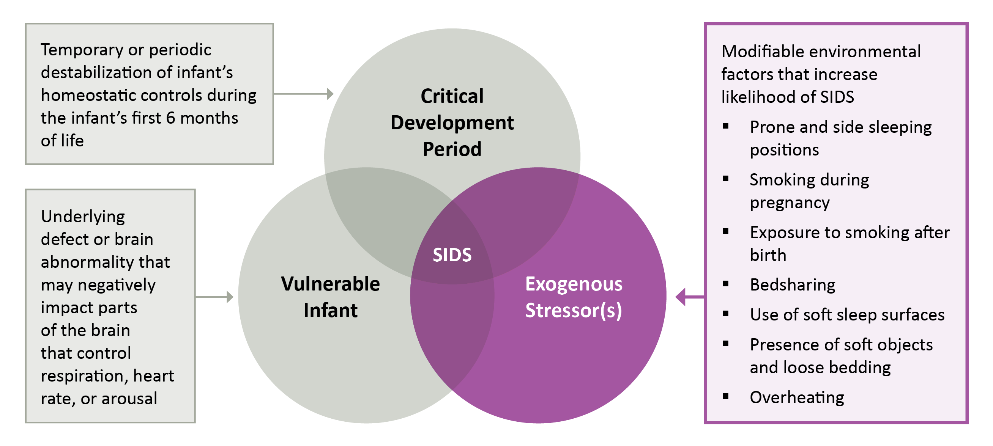
The Triple-Risk Model for SIDS
The Triple-Risk Model is the current consensus explanation for the multiple factors that may converge and lead to SIDS. Importantly, safe sleep practices can help prevent exogenous stressors and therefore SIDS.
Notes:
While most of the information shared so far focused on SUID or unintentional suffocation, SIDS is still a risk. This slide addresses the risk for SIDS in infants. It pertains to the first several months of an infant’s life, when their risk for SIDS and SUID in general is the highest.
More information can be found at the National Institutes of Health. Research on Possible Causes of SIDS website. https://www1.nichd.nih.gov/sts/campaign/science/Pages/causes.aspx.

Slide 25
AAP Recommendations are Based on Best Available Evidence
With ongoing research and greater understanding comes greater nuance, and therefore complexity.
Parents and caregivers need your help to understand that recommendations are based on best available evidence.
Notes:
Over time and with the knowledge gained form additional research, the American Academy of Pediatrics (AAP) has revised its recommendations. For many parents this has led to confusion and lack of trust in the recommendations. It is important to understand this and address this with parents.
The National Institute for Child and Human Development (NICHD) partners with the American Academy of Pediatrics (AAP) for their national Safe to Sleep campaign. For over twenty years, the American Academy of Pediatrics (AAP) has offered guidelines to help parents, caregivers, and providers to keep infants safe when they sleep.

Slide 26
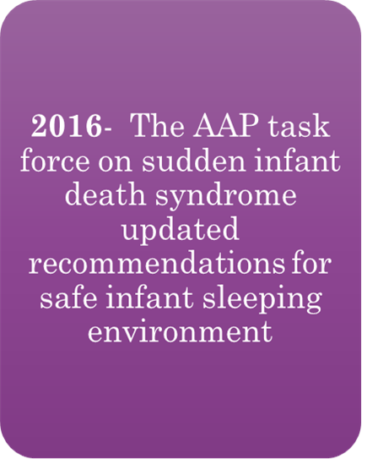
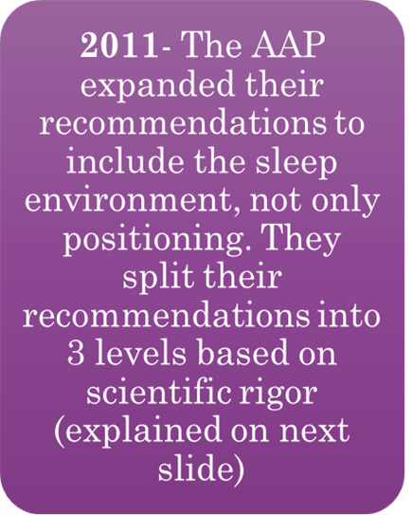
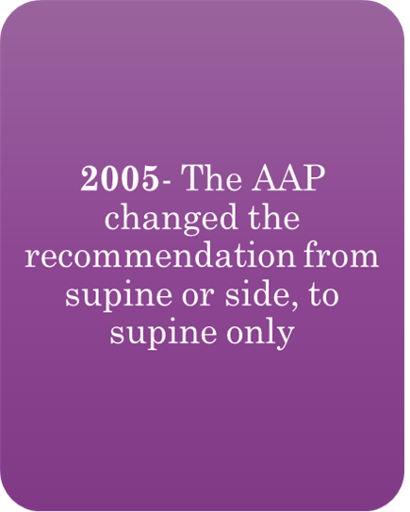
History of Safe Sleep Research and Recommendations
Notes:
This slide illustrates the changes in the AAP recommendations since 1992. These recommendations evolved to accommodate the knowledge generated by ongoing research.

Slide 27
AAP Guidelines: Levels of Evidence
The 2016 AAP recommendations are grouped into three levels:
Recommendations are based on high-quality scientific evidence indicating high certainty of substantial net benefit, and unlikely to change with future study.
Recommendations are based on evidence available to determine effects of recommendations, but there is limited confidence in the estimates.
Recommendations based on consensus and expert opinion.

Slide 28
AAP A-Level Recommendations
Back to sleep for every sleep.
Use a firm sleep surface.
Breastfeeding is recommended.
Room-sharing with the infant on a separate sleep surface is recommended.
Keep soft objects and loose bedding away from the infant’s sleep area.
Consider offering a pacifier at naptime and bedtime.
Avoid smoke exposure during pregnancy and after birth.
Avoid alcohol and illicit drug use during pregnancy and after birth.
Avoid overheating.
Pregnant women should seek and obtain regular prenatal care.
Infants should be immunized in accordance with AAP and CDC recommendations.
Do not use home cardiorespiratory monitors as a strategy to reduce the risk of SIDS.
Health care providers, staff in newborn nurseries and NICUs, and child care providers should endorse and model the SIDS risk-reduction recommendations from birth.
Media and manufacturers should follow safe sleep guidelines in their messaging and advertising.
Continue the “Safe to Sleep” campaign, focusing on ways to reduce the risk of all sleep-related infant deaths, including SIDS, suffocation, and other unintentional deaths. Pediatricians and other primary care providers should actively participate in this campaign.
Notes:
The AAP guidelines and supporting evidence can be found in their 2016 Policy Statement and Technical Report. A webinar describing the 2016 updated recommendations is also available.
2016 AAP Policy Statement: Task Force on Sudden Infant Death Syndrome. SIDS and other sleep-related infant deaths: updated 2016 recommendations for a safe infant sleeping environment. Pediatrics. 2016 Nov;138(5).
2016 AAP Technical Report: Moon RY, Task Force on Sudden Infant Death Syndrome. SIDS and Other Sleep-Related Infant Deaths: Evidence Base for 2016 Updated Recommendations for a Safe Infant Sleeping Environment. Pediatrics. 2016 Nov;138(5).
Webinar on SIDS and Other Sleep Related Deaths: American Academy of Pediatrics. SIDS and Other Sleep Related Infant Deaths: Updated Recommendations website. https://www.youtube.com/watch?v=sdWGmhCyAak&feature=youtu.be.
It is important that healthcare providers understand what the recommendations are and the science behind them so that clear guidance can be given to parents.

Slide 29
AAP B & C-Level Recommendations
B-level recommendations, 2016
Avoid the use of commercial devices that are inconsistent with safe sleep recommendations.
Supervised, awake tummy time is recommended to facilitate development and to minimize development of positional plagiocephaly.
C-level recommendations, 2016
Continue research and surveillance on the risk factors, causes, and pathophysiologic mechanisms of SIDS and other sleep-related infant deaths, with the ultimate goal of eliminating these deaths entirely.
There is no evidence to recommend swaddling as a strategy to reduce the risk of SIDS.
Notes:
In summary, there are many ways to reduce the number of sleep-related infant deaths. Some of these recommendations have a greater amount and higher-quality of research supporting their relation to reducing sleep-related infant deaths. Be aware that these recommendations are based in the most current evidence available, and that parents may need your assistance in navigating their varied and changing nature.

Slide 30
Healthcare providers are essential to promoting safe sleep and preventing SUID
The hospital is a critical opportunity for health care providers to model, fix, and reinforce safe sleep practices.
Research demonstrates that:
Parents who see their baby placed supine in the nursery are almost twice as likely to continue this practice at home.
When the correct behavior is modeled and followed up with a conversation on safe sleep recommendations, adoption of safe behaviors is increased even more significantly.
Notes:
References:
Colson ER, Joslin SC. Changing nursery practice gets inner-city infants in the supine position for sleep. Arch Pediatr Adolesc Med. 2002;156(7):717-20.

Slide 31
Florence Nightingale’s recommendation
“Baby must have a cot to itself; else it runs the risk of being overlaid or suffocated. Baby must not be covered up too much in bed, or too little.” Minding Baby 1861
Notes:
Florence Nightingale is viewed as a respected nurse leader who was a statistician, public health nurse, and advocate. She educated nurses and parents about safe sleep issues 150 years ago.
These writings from Nightingale follow the AAP safe sleep recommendations today – stating that the baby should sleep alone, not too hot, not overdressed.

Slide 32
Alternate sleep positions require a provider’s order
There are a few circumstances in which a health care provider might recommend that a baby should be placed to sleep on his or her stomach or side, such as upper-airway malformations or severe gastroesophageal reflux.
This will require a written order from the provider.
If there is an order for a stomach or side sleeping position, the nurse can advise parents and caregivers to reduce SUID risk in other ways, such as avoiding soft bedding, ensuring the baby does not overheat, etc.
Notes:
Notes:
here may be certain health conditions or concerns that would necessitate exceptions to following the AAP guidelines. Nurses need a formal MD order for these exemptions and can assist the parents in creating a safe sleep environment that addresses the baby’s needs.

Slide 33
Understanding and Addressing Parental Beliefs and Behaviors

Slide 34
Parental Behaviors and Knowledge
Understanding caregiver’s behaviors, and the barriers for either following, or not following, the recommendations is critical to addressing the issue of infant safe sleep.
A parent or caregiver’s behavior is influenced by his or her knowledge, but also by other factors including: situational care, preference, and safety misconceptions.
Parents who have had previous babies may have practices that worked for them in the past that may or may not have been entirely safe for the baby’s sleep.
Notes:
Parents most likely KNOW the recommendations, but for some or many reasons have difficulty following through with them – as nurses, we need to figure out WHY
This is where the VT information from the JSI research can be used to help craft meaningful message. Parents want assistance that is respectful and relevant to them. Talk to parents and caregivers. Find out what they think and listen to them. Summaries of the JSI research can be found at healthvermont.gov/safesleep

Slide 35
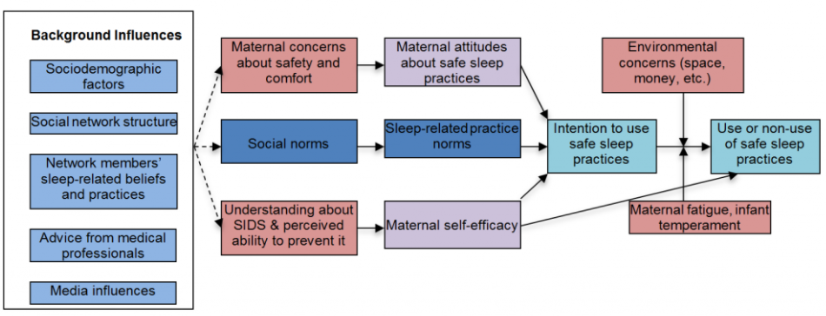
Many factors affect adherence to safe sleep practices
A theoretical model of what influences safe sleep practices
Notes:
When thinking about how to promote safe sleep, it can be helpful to think about what drives safe sleep behavior. Behavior change models, such as the example shown here, map out the relationship between different factors like knowledge, attitudes, social norms, self-efficacy, situational context, intention, and behavior. The purpose of the model shown here is to broaden how you think about the behavior of following safe sleep guidelines, and what as nurses you might be able to change.
References:
Model from: Moon, RY. Rachel Y. Moon, MD website. Available at: https://research.med.virginia.edu/chrc/current-projects/rachel-y-moon-md/. Accessed April 24, 2018.

Slide 36
Addressing the Misconceptions
Misconception: The safe sleep recommendations are anti-breast feeding and anti-bonding
Truth:
Room sharing instead of bed sharing, allows for the infant to remain close to his or her parents and helps to facilitate breastfeeding, while also protecting the infant from a potentially deadly sleep environment (suffocation, entrapment, and overlay).
Mothers can spend time in bed with the infant to breastfeed or bond, as long as the mother is fully awake. If she is feeling drowsy, the baby should be returned to the safety of their own crib.
Notes:
Appropriately acknowledging fears and misconceptions allows the parent to understand the situation, which then helps to empower them in making healthy decisions for their children.
The next several slides go over several common parental and caregiver misconceptions and truths that can be used as discussion points with parents that have these misconceptions.

Slide 37
Misconception: Infants will regurgitate and aspirate if they are put to sleep on their backs
Truth: There is no evidence that aspiration is more common among healthy babies sleeping on their backs than among healthy babies sleeping on their stomachs
Cases of fatal aspiration are very rare, except when associated with an underlying or comorbid medical condition; in most of the few reported cases of death related to aspiration, the baby was in a prone position.
Babies may actually clear secretions better when they are in a supine position.

Slide 38
Misconceptions Continued
Misconception: Infants are more comfortable and sleep better on their stomachs
Truth:
It is true that some infants who lie on their backs do not sleep as deeply as those who lie on their stomachs.
However, the absence of a very deep sleep is believed to help protect infants against SUID.
The bottom line is that safety is more important than comfort. The supine position should be used even if the infant seems to sleep less comfortably – thus the parents should be encouraged to work with their baby to get used to sleeping supine.

Slide 39
Misconception: Infants who are put to sleep on their backs have permanent flat spots in the back of their heads
In some cases, repeated external pressure on one area of the head from spending all of the time in the supine position can lead to a flattening of the back of the head, called positional plagiocephaly.
Notes:
Flat spots usually disappear in the months after the baby learns to sit up, and there is no evidence that this flattening is harmful to infants or that it is associated with permanent effects on head shape. The most effective way to combat flat spots is to allow daily Tummy Time, placing the infant on his or her stomach while awake and supervise. Regular times for Tummy Times can be after a nap or diaper change. It may be helpful for parents to know that Tummy Time can help prepare babies for when they start to slide on their bellies and crawl.

Slide 40
Cultural Challenges to SUID Risk Reduction
Infant care often has its roots in tradition and experience, more so than in science.
It is important that advice on SUID risk reduction be as clear and as culturally appropriate as possible.
Nurses may need to address specific cultural issues and concerns directly when discussing SUID risk reduction with families.
Notes:
All cultures have traditional practices for infant and child care, so the nurse can explore safe sleep practices along with the parents’ thinking on other infant care practices such as feeding, bathing, discipline, etc.

Slide 41
Hospital Data and Prevention Information

Slide 42
Alternate sleep positions require a provider’s order
There are a few circumstances in which a provider might recommend that a baby should be placed to sleep on his or her stomach or side, such as upper-airway malformations or severe gastroesophageal reflux.
If a health care provider writes an order for a stomach or side sleeping position, be sure to advise parents and caregivers to reduce SUID risk in other ways, such as avoiding soft bedding, ensuring the baby does not overheat, etc.
Notes:
Notes:
Healthcare providers should be aware that there are some health concerns that would necessitate exceptions to following the AAP guidelines.

Slide 43
In-Hospital Newborn Falls/Drops
Newborns experience in-hospital falls at a rate of approximately 1.6–4.14/10,000 live births, resulting in an estimated 600–1600 falls per year in the United States.
The most common reason for these falls is the mother (or partner or other adult) falling asleep and dropping the newborn.
The challenge during this time is to support mother-baby bonding and breastfeeding in the hospital while ensuring the safety of the newborn.
Notes:
Healthcare providers and nurses should also be aware of the risk of newborns falling while in the hospital. Families are often reluctant to report falls, and in some hospitals staff rarely discuss them, which means that accurate records of risk for falls is unknown.
More data available from: Helsley L, McDonald JV, Stewart VT. Addressing in-hospital ‘falls’ of newborn infants. Jt Comm J Qual Patient Saf. 2010;36(7);327-33.
See also: Ainsworth RM, Summerlin-Long S, Mog C. A comprehensive initiative to prevent falls among newborns. Nurs Womens Health. 2016;20(3);247-57.
Image from: Minnesota Hospital Association. Newborn Falls/Drops in the Hospital Setting website. Accessed April 23, 2018 at: https://www.mnhospitals.org/Portals/0/Documents/ptsafety/falls/MHA-6-20-11.pdf.

Slide 44
Healthcare providers are essential to promoting safe sleep and preventing SUID
The hospital is a critical opportunity for healthcare providers to model, fix, and reinforce safe sleep practices.
Research demonstrates that:
Parents who see their baby placed supine in the nursery are almost twice as likely to continue this practice at home.
When the correct behavior is modeled and follow up with a conversation on safe sleep recommendations, adoption of safe behaviors is increased even more significantly.
Notes:
References:
Colson ER, Joslin SC. Changing nursery practice gets inner-city infants in the supine position for sleep. Arch Pediatr Adolesc Med. 2002;156(7):717-20.

Slide 45
Potential Interventions to Prevent Newborn Falls/Drops
Educate healthcare providers and others on the unit and parents about the risk of newborn falls/drops.
Establish a no co-sleeping policy, reinforced through a parent contract and written and verbal reminders.
Assess maternal clinical status (e.g. limited mobility due to difficult delivery or Caesarean delivery, taking medication with sedative side effects).
Designate and implement level of supervision (constant, frequent, intermittent) based on risk.
Staff training with crib audits for QI.
Recommend naps to decrease caretakers’ fatigue.
Encourage continuation of safe sleep and fall prevention practices at home.
Notes:
Follow recommendations and best practices for reducing risks of infant falls and unsafe sleep practices while in the hospital.
For more information, see: Minnesota Hospital Association. Newborn Falls/Drops in the Hospital Setting website. Accessed April 23, 2018 at: https://www.mnhospitals.org/Portals/0/Documents/ptsafety/falls/MHA-6-20-11.pdf.
Nurses need to be aware of their hospital's patient safety and infant safe sleep policies and procedures and to incorporate them into their daily practice. Vermont hospitals are using a “crib audit” technique in which babies are observed for placement in a safe sleep environment during periodic formal observations by nursing or leadership staff. These crib audits can be used as a quality improvement tool to support nursing and other hospital staff to implement safe sleep policies for infants in all areas of the hospital (mother/baby unit/NICU/pediatric unit.)

Slide 46
What you, as a nursing professional, can do to prevent SUID.
Notes:
Remember that nurses are a respected voice and your education can influence parents and caregivers.

Slide 47
Parents want and need healthcare providers to help with safe sleep
Parents view healthcare providers as their most trustworthy information source on safe sleep.
Parents need help to understand the safe sleep guidelines, which can be confusing.
Parents have different knowledge, experiences, and challenges with regard to safe sleep practices, and seek guidance appropriate to their individual circumstances.
Parents perceive that providers disagree on the relative safety of bedsharing, particularly when discussing breastfeeding.
JSI research findings for Vt Department of Health, 2017: healthvermont.gov/safesleep
Notes:
Refer to findings from JSI research for Vt Dept. Health, 2017: healthvermont.gov/safesleep

Slide 48
How to Talk with Parents about Infant Safe Sleep
Use non-judgmental, open-ended questions to elicit parents’ safe sleep knowledge and practices.
Address the challenge of sleep by describing normal sleep patterns and offering tips to get the baby to sleep.
Discuss questions/concerns about the AAP guidelines, which are often beyond the ‘basics’.
Address the challenge of safe sleep by helping parents make a plan to overcome the barriers in implementing safe sleep practices.
Encourage parents to stick with it, by affirming their ability to work towards full implementation of safe sleep practices through a strengths-based approach.
Notes:
Besides implementing and following best practices in the hospital unit, as a nurse you can talk with parents about safe sleep. As mentioned previously, listen to what their concerns and questions are and address their misconceptions in a respectful and supportive manner.
The remainder of this presentation offers guidance to providers on how to talk with parents about safe sleep, based on the JSI focus group research results. This slide offers an overview of five tips for your conversations with parents.
The following slides will go into more detail about each of these five tips. In many cases the next set of slides summarizes the information form previous sections of this presentation.

Slide 49
Use a Nonjudgmental and Supportive Approach
Acknowledge and sympathize with struggles parents face in understanding and implementing safe sleep.
Affirm parents’ desire to be good, competent caregivers, and offer your support.
Be aware of, and sensitive to, cultural norms that may oppose the AAP guidelines – invite dialogue to the extent possible.
Use of the “Conversations” approach based on Ajzen’s Theory of Planned Behavior as described at ncemch.org/learning/building/.
Notes:
A good resource is: Bronheim, S. Building on Conversations: An individualized approach to helping families embrace safe sleep and breastfeeding. Washington, DC: National Center for Education in Maternal and Child Health. 2017. Available at: https://www.ncemch.org/learning/building/index.php. Accessed April 24, 2018. This is a free series of learning modules designed to help health professionals gain the knowledge and skills to promote safe sleep and breastfeeding effectively. This is a well researched resource: Building on Campaigns with Conversations is a new approach to supporting caregivers to help overcome barriers to safe sleep and breastfeeding. It is part of a greater trend in public health promotion—utilizing an individualized approach that takes into account each family’s needs, beliefs, and the context of their lives. This training on the Conversations Approach is based on Ajzen’s Theory of Planned Behavior and follows current recommendations from the American Academy for Pediatrics (AAP) for safe sleep and optimal breastfeeding for healthy infants. The technique involved engaging parents in a conversation that employs new approaches other than just “telling” them what to do. The provider works with them to make the right decisions for their child within the family’s parameters and supports them to meet the challenge of change in behavior.

Slide 50
Address the Challenge of Sleep
Give a realistic sense of sleep expectations (e.g. the normal variation there is in sleep patterns with babies, how long newborns sleep at a time, and when babies begin to sleep through the night).
Let parents know that babies need time to adjust to a regular sleep routine, especially if they are not used to a safe sleep environment, and that it will probably also take some trial and error to figure things out. Not all things will work all the time.
If the parents have older children, ask what worked for them in the past and how they addressed their baby’s sleep and sleep environment.
Notes:
Getting baby to sleep advice from AAP: https://www.healthychildren.org/English/ages-stages/baby/sleep/Pages/Getting-Your-Baby-to-Sleep.aspx

Slide 51
Address the Challenge of Sleep
You can offer some tips to help get baby to sleep:
Keep the lights low in the evening and dimmed during nighttime feedings.
Calm down with 30 min of quiet time before bed.
Create and follow a consistent bedtime routine: give baby a warm bath, read a book, sing a song to your baby.
Put the baby to bed while drowsy but still awake.
Use a white noise machine or soft music.
Wait a few minutes before responding to a baby’s fussing to see if they will be able to calm themselves.
Notes:
Refer parents to the informational website as listed at the end of this presentation and also https://www.healthychildren.org/English/ages-stages/baby/sleep/Pages/Getting-Your-Baby-to-Sleep.aspx

Slide 52
Discuss Concerns About Guidelines
Ask what questions or concerns they have about the guidelines – some common ones include:
Question/Concern | Potential response
“Won’t my baby choke if I put him/her on their back to sleep?” | “That’s a good question. Babies naturally swallow or cough up fluids, and may actually have an easier time when they’re on their backs. When in the back sleep position, their windpipe lies on top of their esophagus – so if anything comes up from their tummy, it has to work against gravity to get into their windpipe and cause them to choke.”
“I don’t want my baby to sleep without a blanket – it gets so cold in the winter!” | “Of course you want your baby to be snug and warm. However, blankets are a risk because they can cover your baby’s face and make it difficult for him/her to breathe. It’s safer to keep your baby warm (but not too warm) by dressing your baby in layers or using a sleep sack.”
“I don’t really see the point in following the guidelines because they change all the time.” | “I understand how they can be difficult to follow – I have to keep up with what the evidence says. The first big recommendation of ‘back is best’ started in the 1990s and led to a 50% drop in the SIDS rate. Since then, there have been updates based on research, like the need for tummy time. I’m happy to talk with you about what the key guidelines are.”
Notes:
References:
For other Frequently Asked Questions see: National Institutes of Health. Frequently Asked Questions (FAQs) About SIDS and Safe Infant Sleep website. Available at: https://www1.nichd.nih.gov/sts/about/Pages/faq.aspx. Accessed April 24, 2018.

Slide 53
Address Challenges of Safe Sleep
Help parents make a plan to address any challenges they are facing (or anticipating) – some common ones include:
Question/Concern | Potential response
“My baby starts crying as soon as I put them down in the crib.” | “I hear that a lot. Like I said, it takes time for babies to learn how to sleep in new environments, and you can help your baby get more comfortable sleeping in the crib with some of the tips we discussed. Can you start by getting the baby used to the crib during nap times?”
“Sometimes I’ll accidentally fall asleep while feeding my baby in bed.” | “Its hard sometimes to not fall asleep while feeding the baby because so often parents are really tired. Try as much as possible to stay awake during feedings because this is often the time when a parent inadvertently rolls over on a baby. Remember also that falling asleep on a couch or armchair can be just as dangerous as sleeping on a bed, because the baby can get stuck in the cushions. And if you do fall asleep, move the baby to a safe sleep environment as soon as you wake up.”
“I’m not sure we can afford a crib.” | “I know of a crib giveaway program at [community group, hospital, etc.]. Let me give you that information.”
Notes:
References:
For other Frequently Asked Questions see: National Institutes of Health. Frequently Asked Questions (FAQs) About SIDS and Safe Infant Sleep website. Available at: https://www1.nichd.nih.gov/sts/about/Pages/faq.aspx. Accessed April 24, 2018.

Slide 54
Encourage Parents to Stick with It
Encourage parents to follow the guidelines as fully and as long as possible (up to the 1-year mark) to keep the risk of SUID as low as possible.
Acknowledge that parents may encounter ‘hiccups’ in successful safe sleep practices, such as when the baby is sick/teething/traveling.
Affirm parents’ ability to continue/work towards full implementation of safe sleep practices through a strengths-based approach (i.e. focus on their potential and capacities rather than limits).
Notes:
Bronheim, S: Building on Campaigns with Conversations: An individualized approach to helping families embrace safe sleep and breastfeeding. Washington, DC: National Center for Education in Maternal and Child Health. 2017. Available at: https://www.ncemch.org/learning/building/index.php. Accessed April 24, 2018. This is a free series of learning modules designed to help health professionals gain the knowledge and skills to promote safe sleep and breastfeeding effectively. This is a well researched resource: Building on Campaigns with Conversations is a new approach to supporting caregivers to help overcome barriers to safe sleep and breastfeeding. It is part of a greater trend in public health promotion—utilizing an individualized approach that takes into account each family’s needs, beliefs, and the context of their lives. This training on the Conversations Approach is based on Ajzen’s Theory of Planned Behavior and follows current recommendations from the American Academy for Pediatrics (AAP) for safe sleep and optimal breastfeeding for healthy infants.

Slide 55
Vermont Infant Safe Sleep Campaign

Slide 56
VT Infant Safe Sleep Campaign
Parents need to feel that the AAP guidelines are important and achievable, even if they encounter difficulties. Health care providers need to be responsive to parents’ issues with the challenges of infant safe sleep.
VDH is reaching out to heath care providers, community organizations, parents and caregivers to support education on infant safe sleep.
Using the information from the JSI research project, VDH has created brochures, videos, an enhanced website, and other outreach tools for families, health care providers, and others who work with families: healthvermont.gov/safesleep
Notes:
Notes:
The Vermont Department of Health funded this formative research to inform a Vermont infant safe sleep campaign that would better address parents’ needs.

Slide 57
VT Safe Sleep Campaign Video
Notes:
NOTE: 30 second overview video

Slide 58
How would you make this sleep environment safe?
Notes:
30 second Video of a crib with no toys, bumper pads or other objects.

Slide 59
Bedsharing is risky
Be careful to not fall asleep on a couch or armchair – it can be as dangerous as a bed, because the baby can get stuck in the cushions.
Notes:
Notes: 30 second Video of baby asleep on couch and being moved by the mother
The fourth question was, “What’s risky about my baby sleeping in bed with me?”

Slide 60
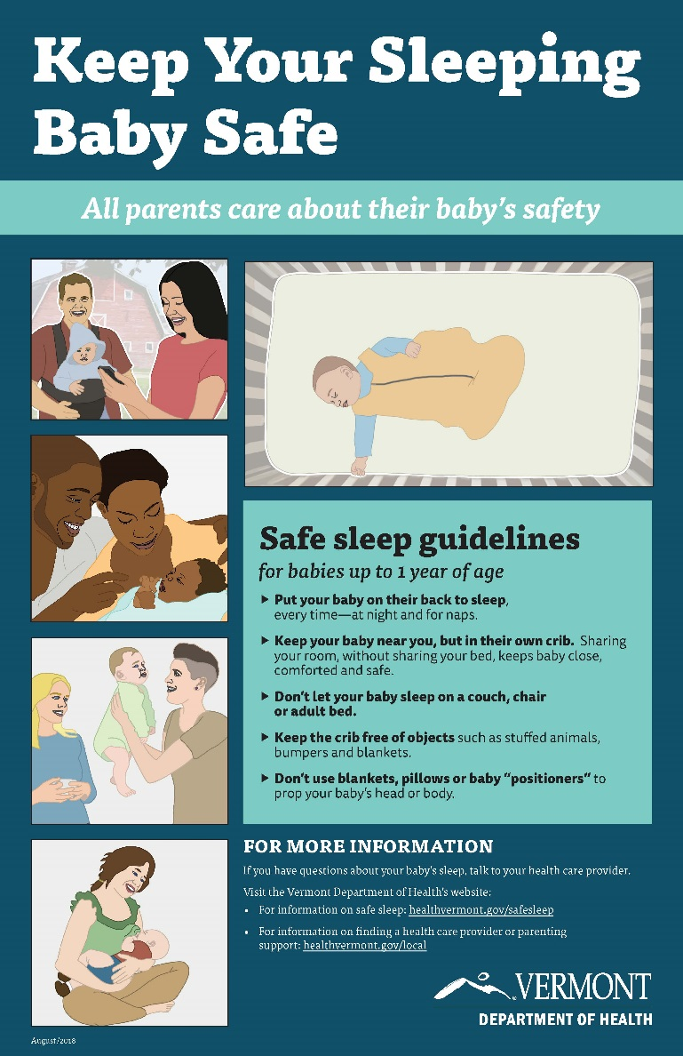
Elements of VT’s Safe Sleep Campaign
Brochures and posters for parents, hospital birthing units, and provider offices.
Revised VDH website and Facebook advertisements.
healthvermont.gov/safesleep
Slide decks for education of parents and health care providers.
Coordination with Vermont Birth Hospitals on in-patient policies and procedures for staff training and education of parents.
Evaluation using measures such as Facebook metrics (short term) and PRAMS survey (long term).
Notes:
PRAMS: Pregnancy Risk Assessment Monitoring System: http://www.healthvermont.gov/health-statistics-vital-records/population-health-surveys-data/pregnancy-risk-assessment-and

Slide 61
Professional Resources
“Building on Campaigns with Conversations: An Individualized Approach to Helping Families Embrace Safe Sleep & Breastfeeding” by the National Institute for Children’s Health Quality (NICHQ), is a free series of learning modules designed to help health professionals gain the knowledge and skills to promote safe sleep and breastfeeding effectively.
National Action Partnership to Promote Safe Sleep: NAPPSS
Vermont Department of Health: healthvermont.gov/family/babies/safe-sleep-health-professionals
American Academy of Pediatrics: aap.org
Notes:
Notes:
In addition to the guidance provided in this presentation, there are other resources you may find helpful to promote safe sleep.
References:
Bronheim, S. Building on Campaigns with Conversations: An individualized approach to helping families embrace safe sleep and breastfeeding. Washington, DC: National Center for Education in Maternal and Child Health. 2017. Available at: https://www.ncemch.org/learning/building/index.php. Accessed April 24, 2018. This is a free series of learning modules designed to help health professionals gain the knowledge and skills to promote safe sleep and breastfeeding effectively. This is a well researched resource: Building on Campaigns with Conversations is a new approach to supporting caregivers to help overcome barriers to safe sleep and breastfeeding. It is part of a greater trend in public health promotion—utilizing an individualized approach that takes into account each family’s needs, beliefs, and the context of their lives. This training on the Conversations Approach is based on Ajzen’s Theory of Planned Behavior and follows current recommendations from the American Academy for Pediatrics (AAP) for safe sleep and optimal breastfeeding for healthy infants.
National Action Partnership to Promote Safe Sleep https://www.nichq.org/project/national-action-partnership-promote-safe-sleep-improvement-and-innovation-network-nappss
Vermont Department of Health newly revised webpage for health care providers and parents and caregivers: healthvermont.gov/safesleep

Slide 62
Resources for Parents
Vermont Department of Health: healthvermont.gov/safesleep
Vermont Department of Health District Offices: healthvermont.gov/local
American Academy of Pediatrics: healthychildren.org
Help Me Grow VT: 2-1-1 x6, helpmegrowvt.org
March of Dimes: MarchofDimes.org
Notes:
www.healthvermont.gov/safesleep: Vermont Department of Health newly revised webpage for health care providers and parents and caregivers.
www.healthvermont.gov/local: Contact information for the local Vermont Department of Health District offices. There are twelve VDH offices statewide and each employ a Maternal and Child Health Public Health nurse who can assist with referrals for families for issues such as connecting with a medical home, services such as WIC, and parenting classes.
www.healthychildren.org is the official parenting website of the American Academy of Pediatrics
www.helpmegrow.vt: Help Me Grow Vermont is a statewide system for improving access to existing resources and services for expectant parents and families with young children through age eight. The HMG VT contact center is at Vermont 211, which is staffed M-F, 9AM – 6PM. 211 and HMG provide information for parents on overall parenting services (such as infant safe sleep) and also developmental screening and also Vermont’s Universal Developmental Screening Registry.
www.marchofdimes.org: March of Dimes website contains parenting advice and safe sleep information under “Caring for your Baby” section.

Slide 63
References
Ainsworth RM, Summerlin-Long S, Mog C. A comprehensive initiative to prevent falls among newborns. Nurs Womens Health. 2016;20(3);247-57.
American Academy of Pediatrics. SIDS and Other Sleep Related Infant Deaths: Updated Recommendations website. https://www.youtube.com/watch?v=sdWGmhCyAak&feature=youtu.be. Accessed April 18, 2018.
Bronheim, S. Building on Campaigns with Conversations: An individualized approach to helping families embrace safe sleep and breastfeeding. Washington, DC: National Center for Education in Maternal and Child Health. 2017. Available at: https://www.ncemch.org/learning/building/index.php. Accessed April 24, 2018.
Centers for Disease Control and Prevention. PRAMS website. 2018. Available at: https://www.cdc.gov/prams/methodology.htm#n2. Accessed April 24, 2018.
Centers for Disease Control. Sudden Unexpected Infant Death (SUID) website. https://www.cdc.gov/sids/pdf/sudden-unexpected-infant-death.pdf. Accessed April 18, 2018.
Centers for Disease Control. Sudden Unexpected Infant Death and Sudden Infant Death Syndrome website. https://www.cdc.gov/sids/data.htm. Accessed April 18, 2018.
Colson ER, Joslin SC. Changing nursery practice gets inner-city infants in the supine position for sleep. Arch Pediatr Adolesc Med. 2002;156(7):717-20.
Heitman, R. et al. Improving safe sleep modeling in the hospital though policy implementation. Matern Child Health J (2017) 21:1995-2000.
Helsley L, McDonald JV, Stewart VT. Addressing in-hospital ‘falls’ of newborn infants. Jt Comm J Qual Patient Saf. 2010;36(7);327-33.
Kemp JS, Unger B, Wilkins D, Psara RM, Ledbetter TL, Graham MA, Case M, Thach BT. Unsafe sleep practices and an analysis of bedsharing among infants dying suddenly and unexpectedly: Result of a four-year, population-based, death-scene investigation study of sudden infant death syndrome and related deaths. Pediatrics. 2000 Sep; 106(3); E41.
Minnesota Hospital Association. Newborn Falls/Drops in the Hospital Setting website. Accessed April 23, 2018 at: https://www.mnhospitals.org/Portals/0/Documents/ptsafety/falls/MHA-6-20-11.pdf.
Moon RY, Task Force on Sudden Infant Death Syndrome. SIDS and Other Sleep-Related Infant Deaths: Evidence Base for 2016 Updated Recommendations for a Safe Infant Sleeping Environment. Pediatrics. 2016 Nov;138(5).
Moon, RY. Rachel Y. Moon, MD website. Available at: https://research.med.virginia.edu/chrc/current-projects/rachel-y-moon-md/. Accessed April 24, 2018.
National Institutes of Health. Common SIDS and SUID Terms and Definitions website. https://www1.nichd.nih.gov/sts/about/SIDS/Pages/common.aspx. Accessed April 18, 2018.
National Institutes of Health. Frequently Asked Questions (FAQs) About SIDS and Safe Infant Sleep website. Available at: https://www1.nichd.nih.gov/sts/about/Pages/faq.aspx. Accessed April 24, 2018.
National Institutes of Health. Research on Possible Causes of SIDS website. https://www1.nichd.nih.gov/sts/campaign/science/Pages/causes.aspx. Accessed April 18, 2018.
Task Force on Sudden Infant Death Syndrome. SIDS and other sleep-related infant deaths: updated 2016 recommendations for a safe infant sleeping environment. Pediatrics. 2016 Nov;138(5).
Vermont Department of Health. Division Of Maternal & Child Health Brief: Safe Sleep. 2017. Available at: http://www.healthvermont.gov/sites/default/files/documents/pdf/DB.NPM5_.Safe%20sleep.pdf. Accessed May 31, 2017.
Vermont Department of Health. Sudden Unexpected Infant Death Data Brief from VDH website. http://www.healthvermont.gov/sites/default/files/documents/pdf/HSVR_injury_SUID.pdf. Accessed April 18, 2018.

