Slide 1
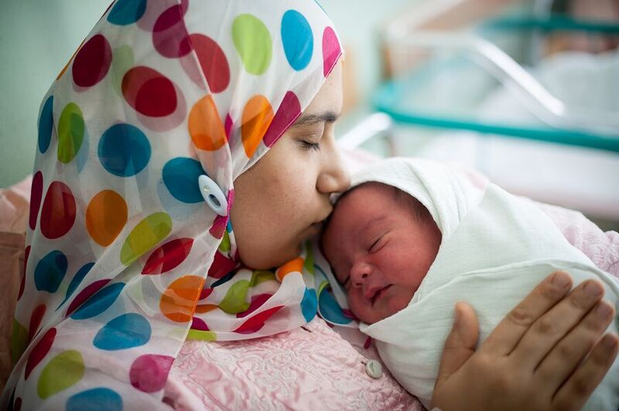
Connecting families to existing resources
and building resiliency
2018
Notes:
Slide 1. Our goal in Vermont is to have comprehensive, universal, developmental screening and improved school readiness for all young children. In an effort to narrow the gap and identify needs earlier in children, the UDS registry was created as an addition to the public health information system used for the immunization registry for Vermonters, as a means of sharing screening data across community settings and the health, education, and family support sectors.

Slide 2
Recognize the history and importance of efforts to improve Vermont’s system of universal, early and continuous developmental surveillance and screening
Learn about the Universal Developmental Screening (UDS) Registry and how it can benefit your program and improve child health outcomes
Get access to the registry and enhance Vermont’s System for Universal Developmental Screening
Notes:
Slide 2. Our objectives are to share a brief history of Vermont’s efforts to improve and ensure universal early and continuous developmental surveillance and screening, share how use of this Registry will support you and your program – whether you are an early educator or preschool teacher, home visitor, or child care provider. We want you to become an early adopter of our universal developmental screening registry and a local champion for our Help Me Grow system!

Slide 3
Notes:
Slide 3. Building ongoing developmental monitoring and periodic developmental screening into practices that routinely have contact with infants, toddlers, and their families allows professionals to monitor and support children’s development.
Partnerships between ECEP’s and health care providers can improve health and developmental outcomes for young children. Partnerships lead to: improved early identification of developmental concerns, better informed and empowered families, and timely coordination of needed services.

Slide 4
Developmental Trajectories
Toxic Stress
Domestic violence
Inaccessible health services
“Healthy” Trajectory”
Socioeconomic disparities
“At Risk” Trajectory
Neighborhood Safety and Support
“Ready to Learn”
Quality Early Learning and Development Programs
“Delayed/Disordered ” Trajectory
Medical Home
Parent education
Emotional health
Protective Home Environment
Birth
Late Infancy
Late Toddler
Late Preschool
Prenatal 6 mo 12 mo 18 mo 24 mo 3 yrs 5 yrs
Early Infancy
Early Toddler
Early Preschool
Graphic Concept Adapted from Neal Halfon , UCLA Center for Healthier Children, Families, and Communities
Notes:
Slide 4. In Vermont, intentional support of Every Child’s development is a whole population strategy to buffer against some of the environmental factors that could affect the course of development.
This is a graphic from the public health sector which illustrates the various risk and protective factors related to developmental outcomes for children. We know that education around child development reduces stress on families. In addition, having a child in an ECE setting where intentional, parent engaged developmental monitoring and screening is done can make the difference between that At Risk Trajectory and the Healthy Trajectory.
Some statistics to further make the case for universal developmental monitoring and screening are that:
Nationally 1 in 4 children experiences a developmental, behavioral or social delay. 1 in 6 children has a developmental disability- and only 20% to 30% of these children are identified as needing help before school begins.
Intervention prior to kindergarten has huge academic, social, and economic benefits. Children who receive early treatment for developmental and behavioral delays are more likely to graduate from high school, hold jobs, live independently, and avoid teen pregnancy, delinquency, and violent crime, which results in a savings to society of about $30,000 to $100,000 per child. (ASQ website)
Homeless infants and toddlers and young children who experienced pre-natal homelessness are 40% more likely to be in poor or fair health – children living in poverty is a real challenge for Vermont’s families particularly and a risk factor for less than optimal health and development.

Slide 5
AAP Developmental Screening Guidelines
Focus on Social Determinants of Health
Greater focus on lifelong physical/mental health
Strength based approaches
Updated developmental milestones, surveillance questions and screening guidelines
Notes:
Slide 5. When young children are not screened systematically, opportunities for early identification, intervention, and treatment may be delayed. Early identification of children at risk for developmental delays is an integral function of the primary care medical home. The American Academy of Pediatrics (AAP) recommends conducting developmental surveillance at every health supervision visit and conducting general developmental screening using evidence-based tools at 9, 18, and 30 months, or whenever a concern is identified. In addition, autism-specific screening is recommended at ages 18 and 24 months, and social-emotional screening is recommended at regular intervals.
AAP Bright Futures Guidelines: a national health promotion/ disease prevention initiative that addresses children's health-needs in the context of family and community.
In Vermont: these principles, guidelines and tools are implemented to strengthen connections among state and local programs, pediatric primary care, families, and local communities
The medical home - – an approach to providing Primary care in a holistic manner- is ideal platform to address the social components of child health. The environment in which children develop – family, extended family, neighborhood, community and culture – impact brain development, health and even genetics.
The newly released AAP Bright Futures guidelines have a revised recommendation for developmental surveillance: that observations by child care and early childhood professionals be incorporated by the pediatrician into surveillance. These best practice recommendations encourage collaboration and partnership among and between health care providers and all of the adults who may touch the lives of a child. A child’s home, school, neighborhood and community are integral to the medical home. Establishing or improving relationships can enhance and streamline the work that each team member is engaged in to provide the optimal level of care and support to each family.
The Developmental screening Registry is a tool which supports teams with implementing the BF recommendation

Slide 6
Universal Developmental Screening Registry
Did you know that Vermont has a statewide registry where developmental screening results can be safely shared across settings?
Did you know that you can use the registry to ensure the best outcomes for the children in your program?
Notes:
Slide 6. With help from key stakeholders, the Registry was built in an effort to advance developmental promotion, early identification and timely linkage to services. Use of this registry will support improved screening rates and help to identify young children with developmental concerns as early as possible.
Vermont has a statewide registry where Screening results are SAFELY SHARED across settings
Utilizing this tool can improve Early ID of concerns means increased likelihood of supports being offered at the time when they are the MOST effective!

Slide 7
No Wrong Door for Developmental Screening
Using the registry will…
1. Promote healthy development for ALL children
2. Reduce screening duplication
3. Contribute to a community of health
Notes:
Slide 7. Developmental screening is a shared priority and a shared responsibility across various sectors – Coordination and communication between these settings is vital.

Slide 8
Access Based on Permissions
As a registry user you can…
View developmental screening results of the children in your program
Enter screening results
Securely share screening results with the child’s healthcare provider, Children’s Integrated Services teams, public schools, and others
Notes:
Slide 8. Access to the online registry requires pre-approved user access.
Developmental screening users can view developmental screening data for any child they are working with. They can enter screening results, view screening results entered by users from their program, school or agency (or practice). Educators and community providers can print reports of individual patient’s history.
The various provider types who can access the registry are:
CIS
Health Department District Office
- Head Start
- Child Care
- Primary Care Health Providers
- Special Education professionals

Slide 9
Easy as…..1,2,3!
Step 1: Complete the Access and Confidentiality/ Privilege Agreement and return to the Health Department:
Scan and email to: AHS.VDHudsregistry@vermont.gov
OR
FAX: 802-951-1218
Step 2: Have your families complete and sign the Parental Release form and keep this for your records
Step 3: Start entering screening results!!
Notes:
Slide 9. Obtaining access to the registry can be done in 3 easy steps! <Read Bullets 1. Community Provider/Early educator version of the confidentiality agreement 2. your program will keep these forms at your program for your records. 3. permissions granted and start entering/viewing screening results!

Slide 10
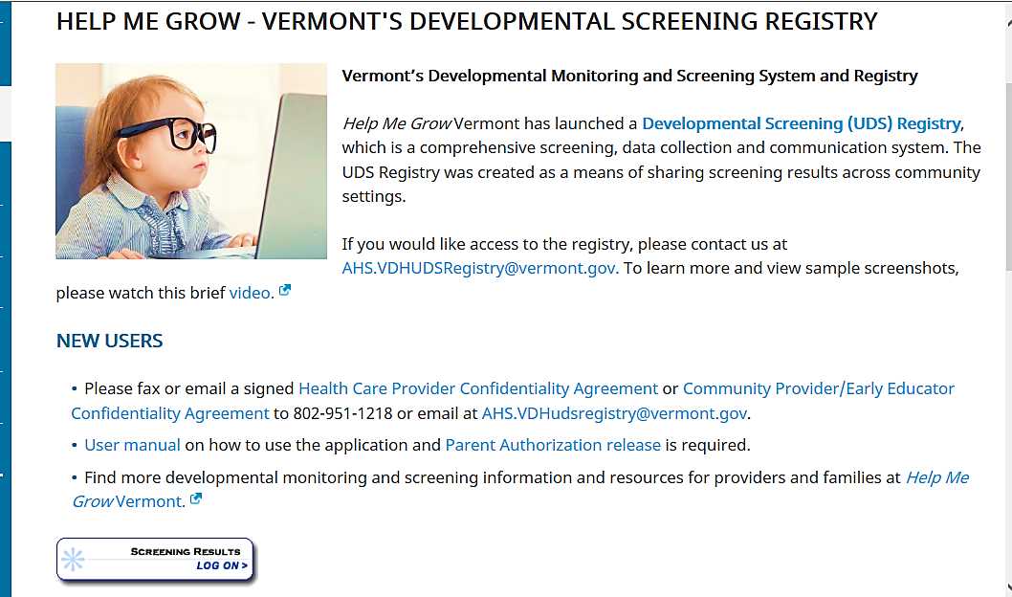
How Do I Access the Registry?
http://www.healthvermont.gov/family/babies/vermonts-developmental-screening-registry
Notes:
Slide 10. Here is a screenshot of the Developmental Screening Registry webpage hosted by the department of health. You’ll want to Book mark this page!
This page is a one stop shop where registry-related permission forms, contact information, related resources, and the portal to access the registry can be found in one place.

Slide 11
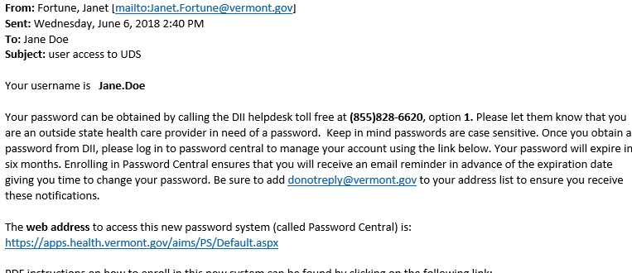
First-Time Registry Users
*Obtaining Access to the Immunization Registry can be done contacting: IMR@Vermont.gov
Notes:
Slide 11. There is one logon to navigate any of the of the 6 registries that exist in the health department’s system, but specific permissions must be granted to appropriate providers. Therefore, if you already have access to the immunization registry, your process for gaining access will look a little different that those users who have never accessed the registry. I will go through each scenario so you will know exactly what to expect as next steps after you submit your confidentiality agreement.
If you are a first- time registry user, be on the lookout for an an email from Jan.Fortune@Vermont.gov approximately 48 hours after you return your confidentiality form to the department of health. A sample “welcome email” is shown here. This email will contain your user name and temporary password. You will have to log on to password central to change your password. You will then have an account with the appropriate permissions for developmental screening. If you would like access to the immunization registry, you can request additional permissions. Please contact: IMR@vermont.gov

Slide 12
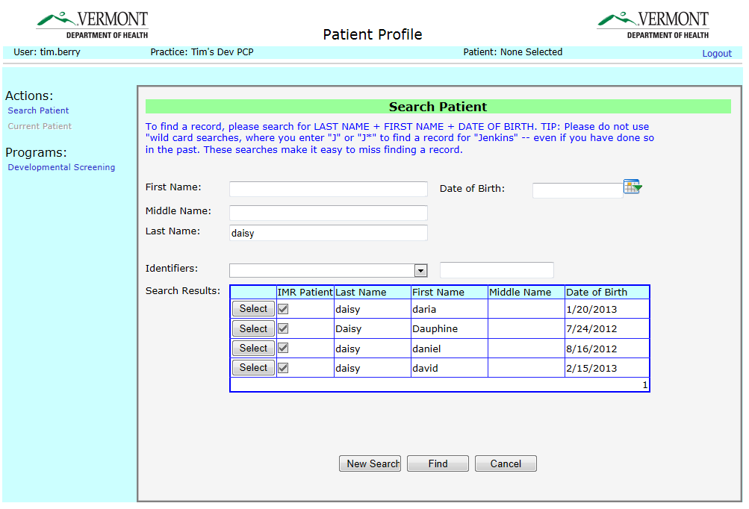
Existing Immunization Registry Users
Note: Only lists program areas to which user has permission.
Notes:
Slide 12. If you already have access to the immunization registry, you will use your same user name and password to access the developmental screening registry. Since the registries are all in the same program, you will not see an email confirming that your paperwork was processed and your permission to access the registry was granted. Rather you will need to log on – we recommend waiting 48 hours after you submit your confidentiality form – and check to see that developmental screening has been added as an option under PROGRAMS.
Once you have obtained access to the registry, you will be able to log in and search a child in your program by their first name, last name and DOB.
Here is a brief overview of the registry and actual screenshot - you will notice under the Programs section on the left side of the screen developmental screening will appear.

Slide 13
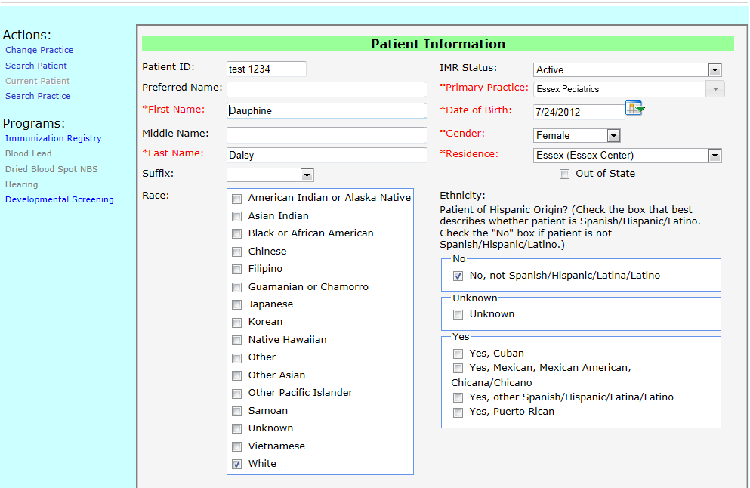
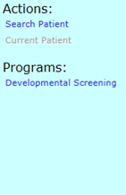
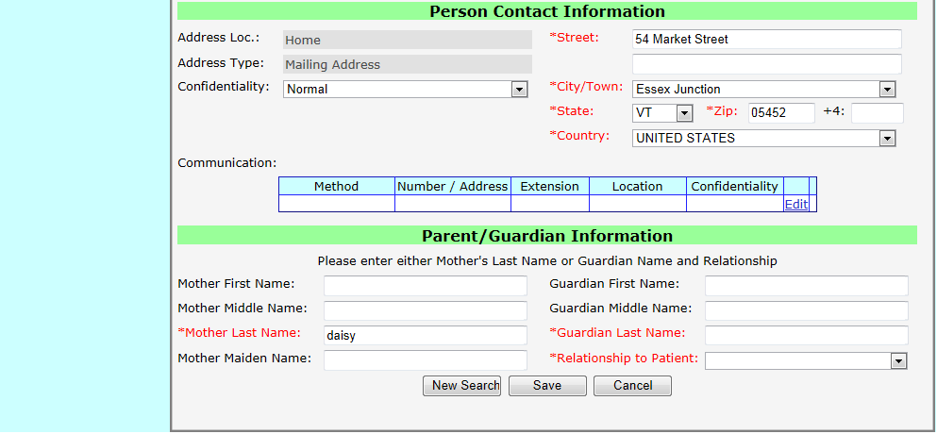
Note: Only includes Patient Profile program areas to which user has permission.
Notes:
Slide 13. You will continue to the patient profile page once a child has been selected. This patient info page allows you to see demographic information to ensure that you are searching the correct child.

Slide 14
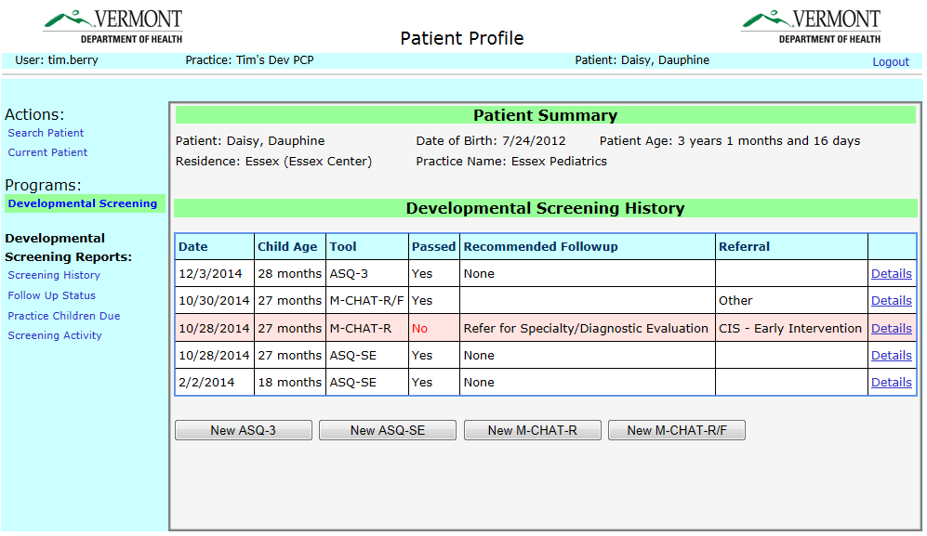
Notes:
Slide 14. Now that you have found the child you are working with in the registry, you can click the developmental screening tab on the left side of the screen & you will be viewing screening history for this child. Not all children will have screening history in the registry yet. Once screening data is entered by a provider, other providers with appropriate view level permissions, will be able to view a child’s screening history and click on the detail of the individual screening tool. This is how use of the Registry allows providers to communicate screening results across settings.
You can see on this page the current available options for developmental screening tools in the registry are: ASQ3, ASQSE2, the Modified Checklist for Autism in Toddlers (MCHAT) and the MCHAT revised with follow up.

Slide 15
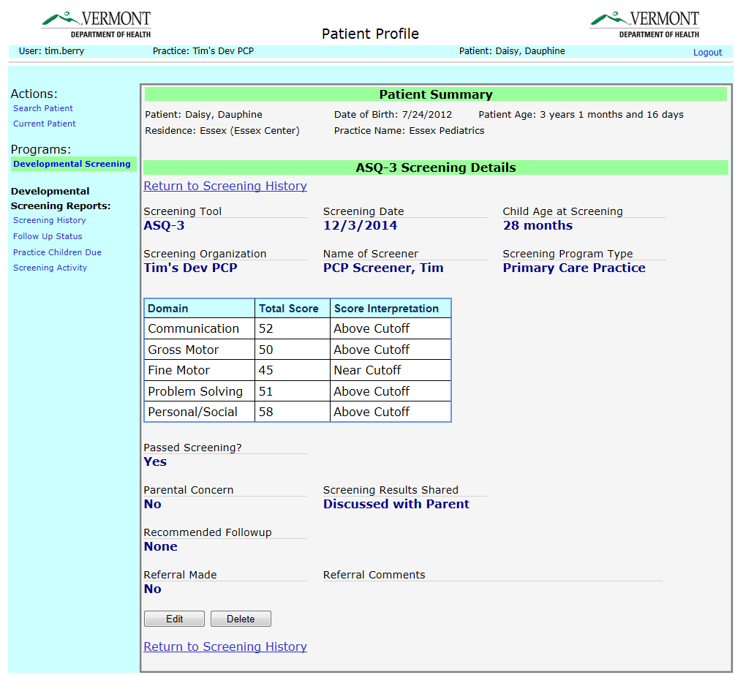
Notes:
Slide 15.
If you click on “details” for a particular screening, you will see the screening details for that screening event.
Here is a view of the ASQ 3. Built off of the Information summary sheet of the ASQ tool, this page provides a short summary of who completed the screening, the domain total scores, score interpretation, follow up activities and referral recommendations.
We hope that you will find this application a user friendly environment, and a valuable tool to support the incredible work that you are doing.
We truly appreciate your dedication to each and every child and family in Vermont!

Slide 16
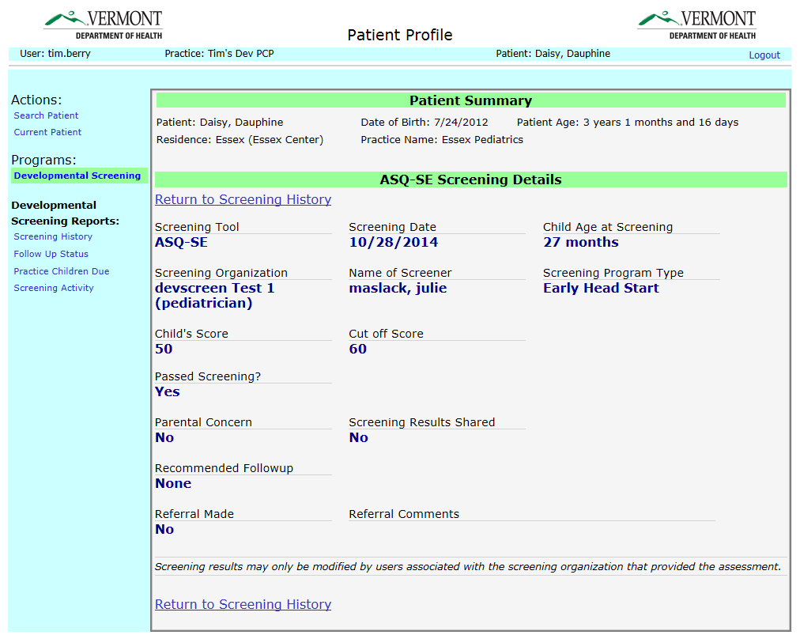
Notes:
Slide 16. A look at the ASQ-SE we have worked towards making this application a user-friendly environment.

Slide 17
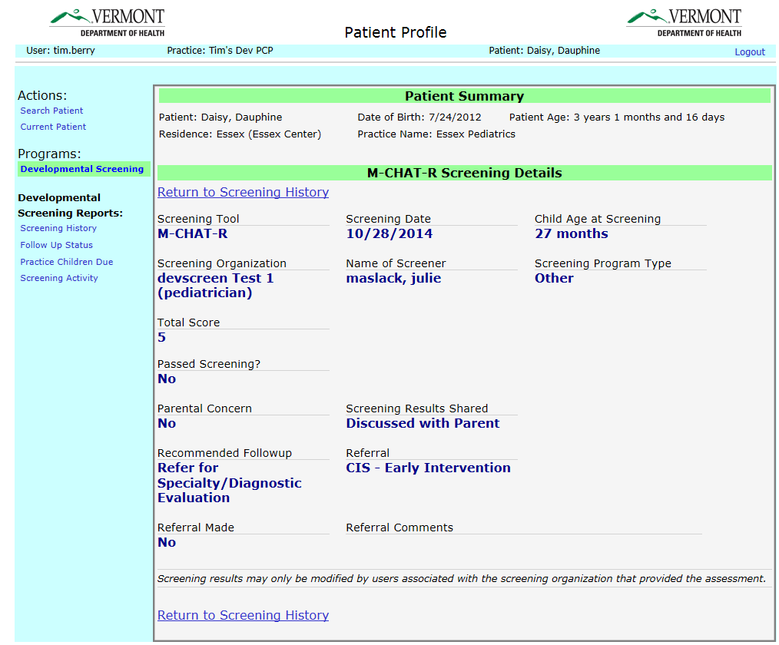
Notes:
Slide 17. A look at the MCHAT reporting screen

Slide 18
Thank you for your participation in universal
developmental screening!!
Complete a brief survey (click here) to receive FREE
materials to enhance your program! **While supplies last !!**
Complete and submit your Community Provider/Early Educator Confidentiality Agreement Form and receive a second GIFT! **While supplies last !!**
Log into the registry and begin entering screening results and be entered into a raffle to win a tablet!
Notes:
Slide 18. We appreciate all you do to promote the health of all of Vermont’s children! We have several supply-limited opportunities that we want you to know about.
READ 3 bullets!

Slide 19
Resources and Contact
Resources:
Shared Services Developmental Screening Toolkit (Family Engagement tab > Child Development)
Help Me Grow Vermont
Developmental Screening Registry webpage (all forms and registry log on are here!)
Lauren Smith Lauren.Smith@vermont.gov
Developmental Screening Registry Manager
ASQ-3/ASQ:SE2 Trainer (Chittenden County)
Registry Orientation Training and Technical Assistance (Statewide)
Notes:
Finally, I would like to share some additional resources to help support your efforts around developmental monitoring and screening.
The shared services site now has a dev screening toolkit available! It is located under the family engagement tab and under child development.
If you haven’t already, please check out the Help Me Grow Vermont website. There you can find multimedia resources and tools for both providers as well as for families that are all related child development.
And finally, the developmental screening registry webpage which we viewed earlier in this power point, is where you can find registry-related forms, resources and contact information – as well as where you log on to the developmental screening registry.
Please don’t hesitate to reach out to me personally at my email Lauren.Smith@Vermont.gov with any questions or needs related to ASQ training, tools, and the registry.
Thank you again!

