Slide 1
Non-Emergency Medical Transportation
Oh, The Fun We Have……..
Carla Vecchione, Melissa Van Buskirk, and Peter McNichol

Slide 2
What is NEMT?
Covered service for members enrolled in Medicaid and Dr. Dynasaur programs.
Statewide service for providing transports for eligible people to and from necessary, non-emergency medical services.
Provided through a Personal Services Contract between the State of Vermont, Department of Vermont Health Access (DVHA) and the Vermont Public Transportation Association (VPTA), which is comprised of a regional network of public transit providers

Slide 3
Physician Referral Form Requirements
DVHA helps people on Medicaid or Dr. Dynasaur with transportation to get to their Medicaid-billable appointments or pick up prescriptions.
If the requested trip is OVER 100 miles (one way) from a member’s home
the Physician Referral form needs to be completed and submitted to DVHA for review
If the requested trip is UNDER 100 miles (one way) from a member’s home
A phone call should be made to either VPTA or the member’s local transportation provider if you have that information
Visit https://vpta.net/my-area-provider if you are unsure of the member’s local transportation provider

Slide 4
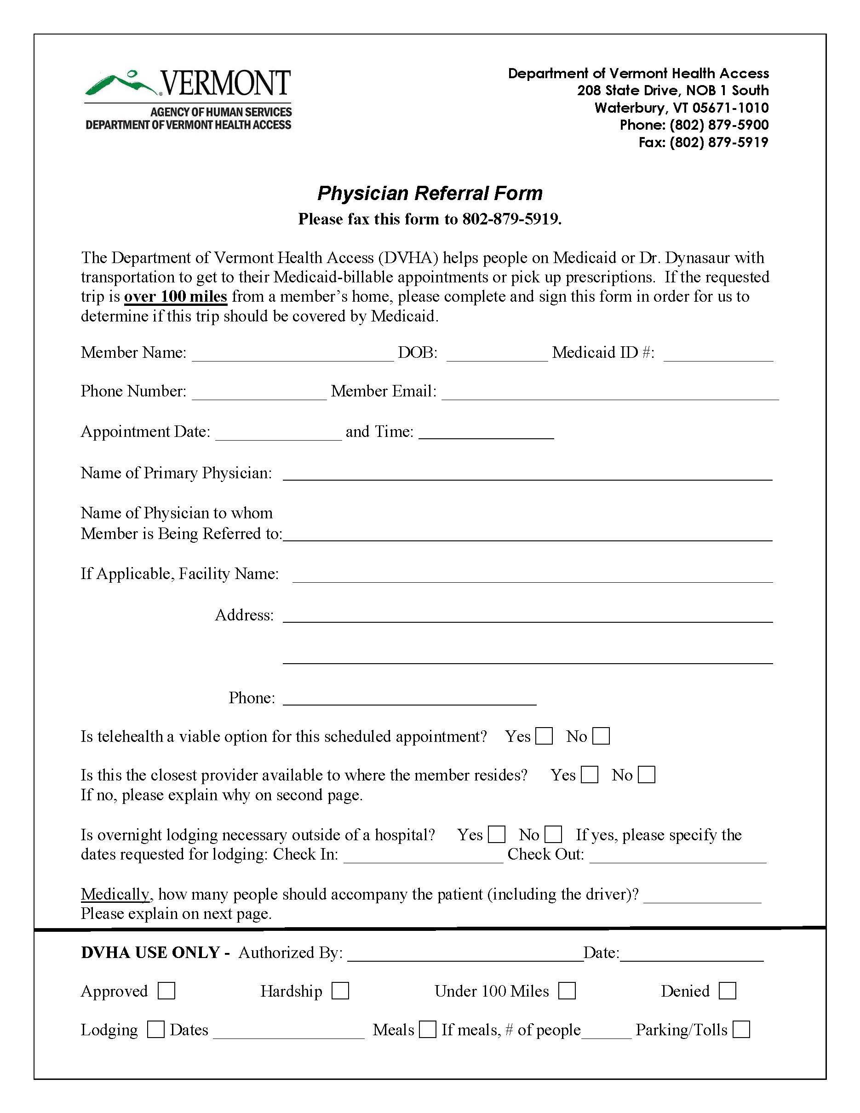
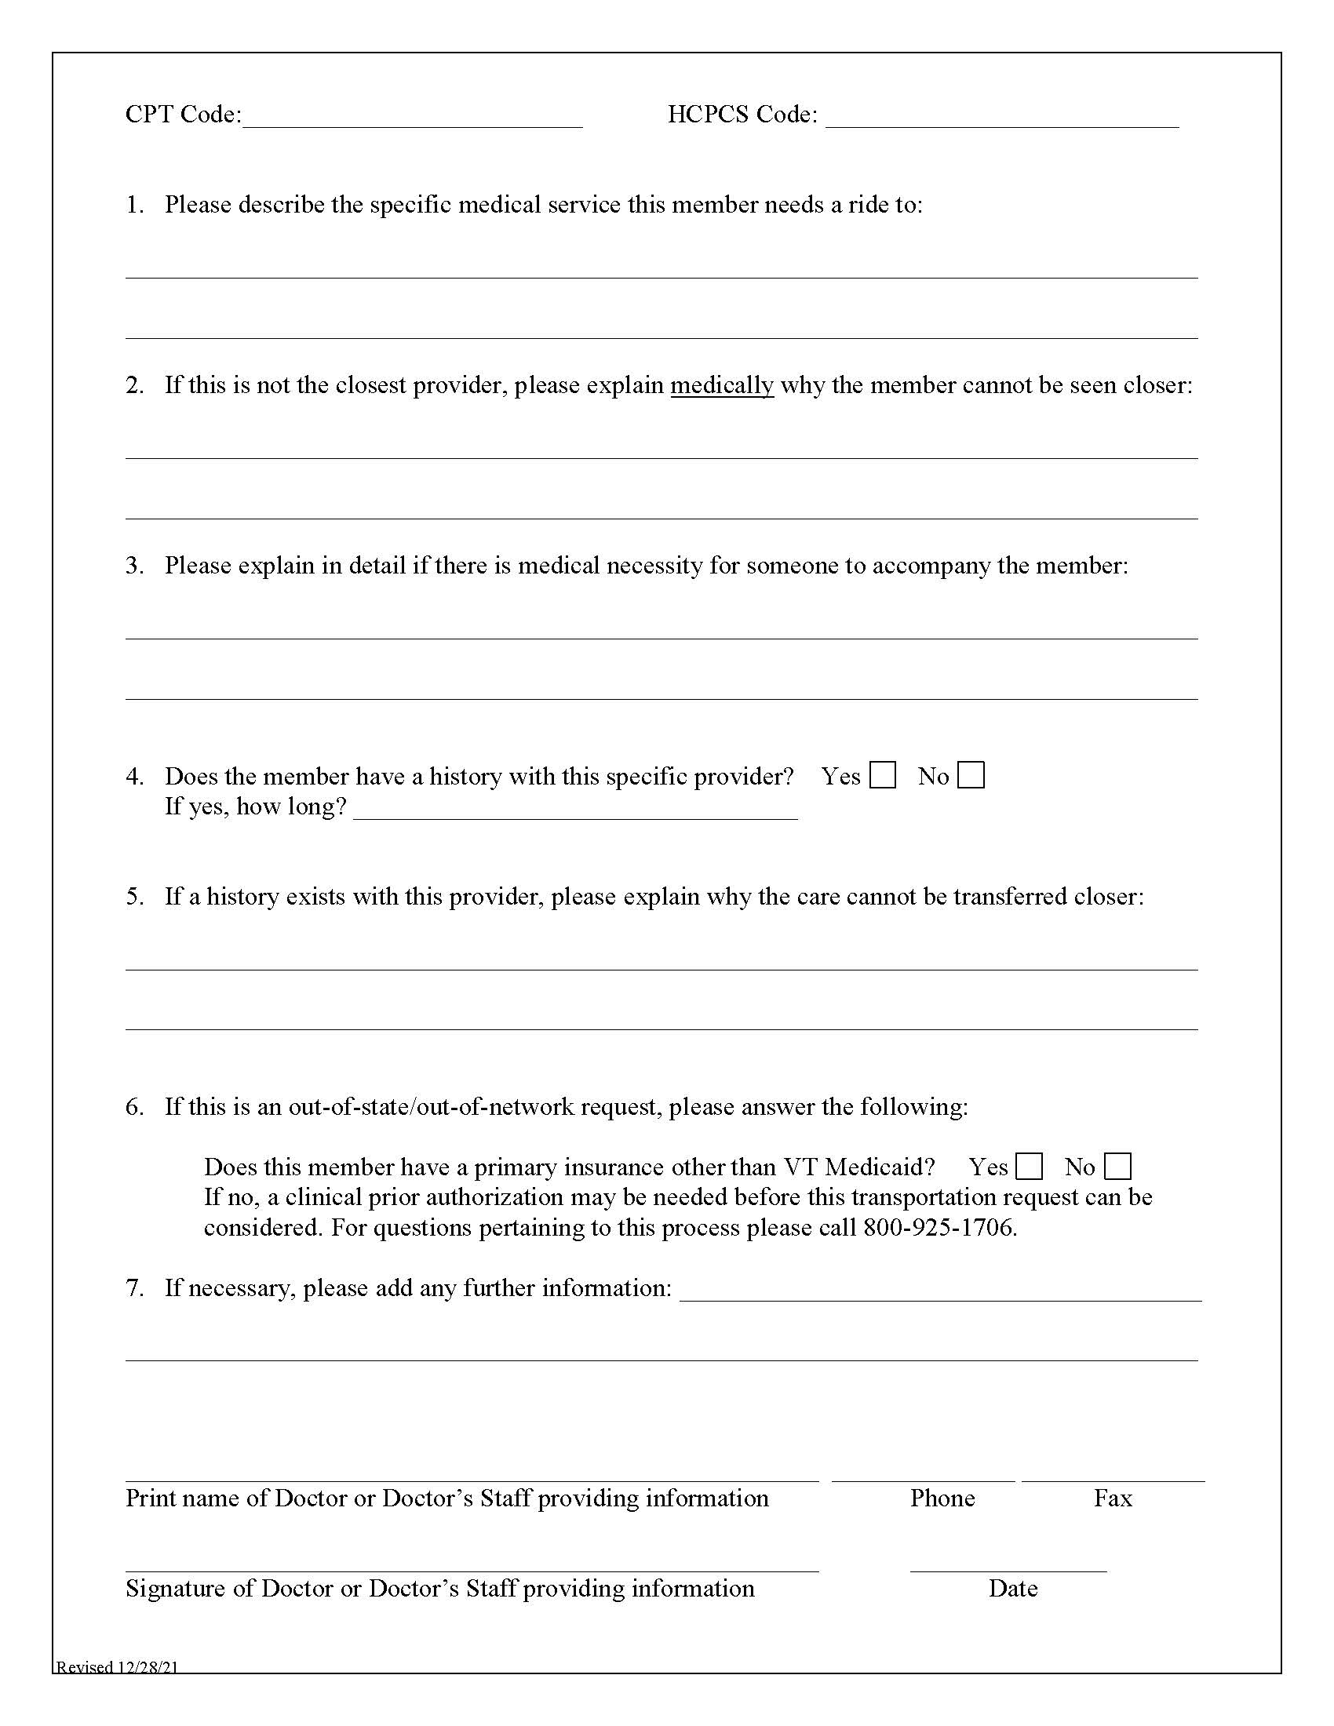

Slide 5
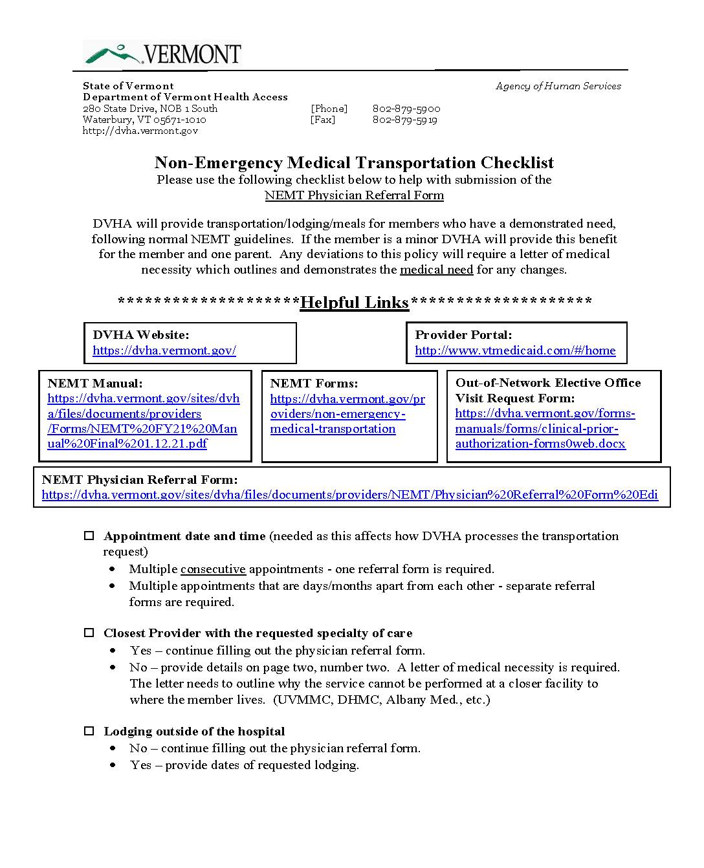
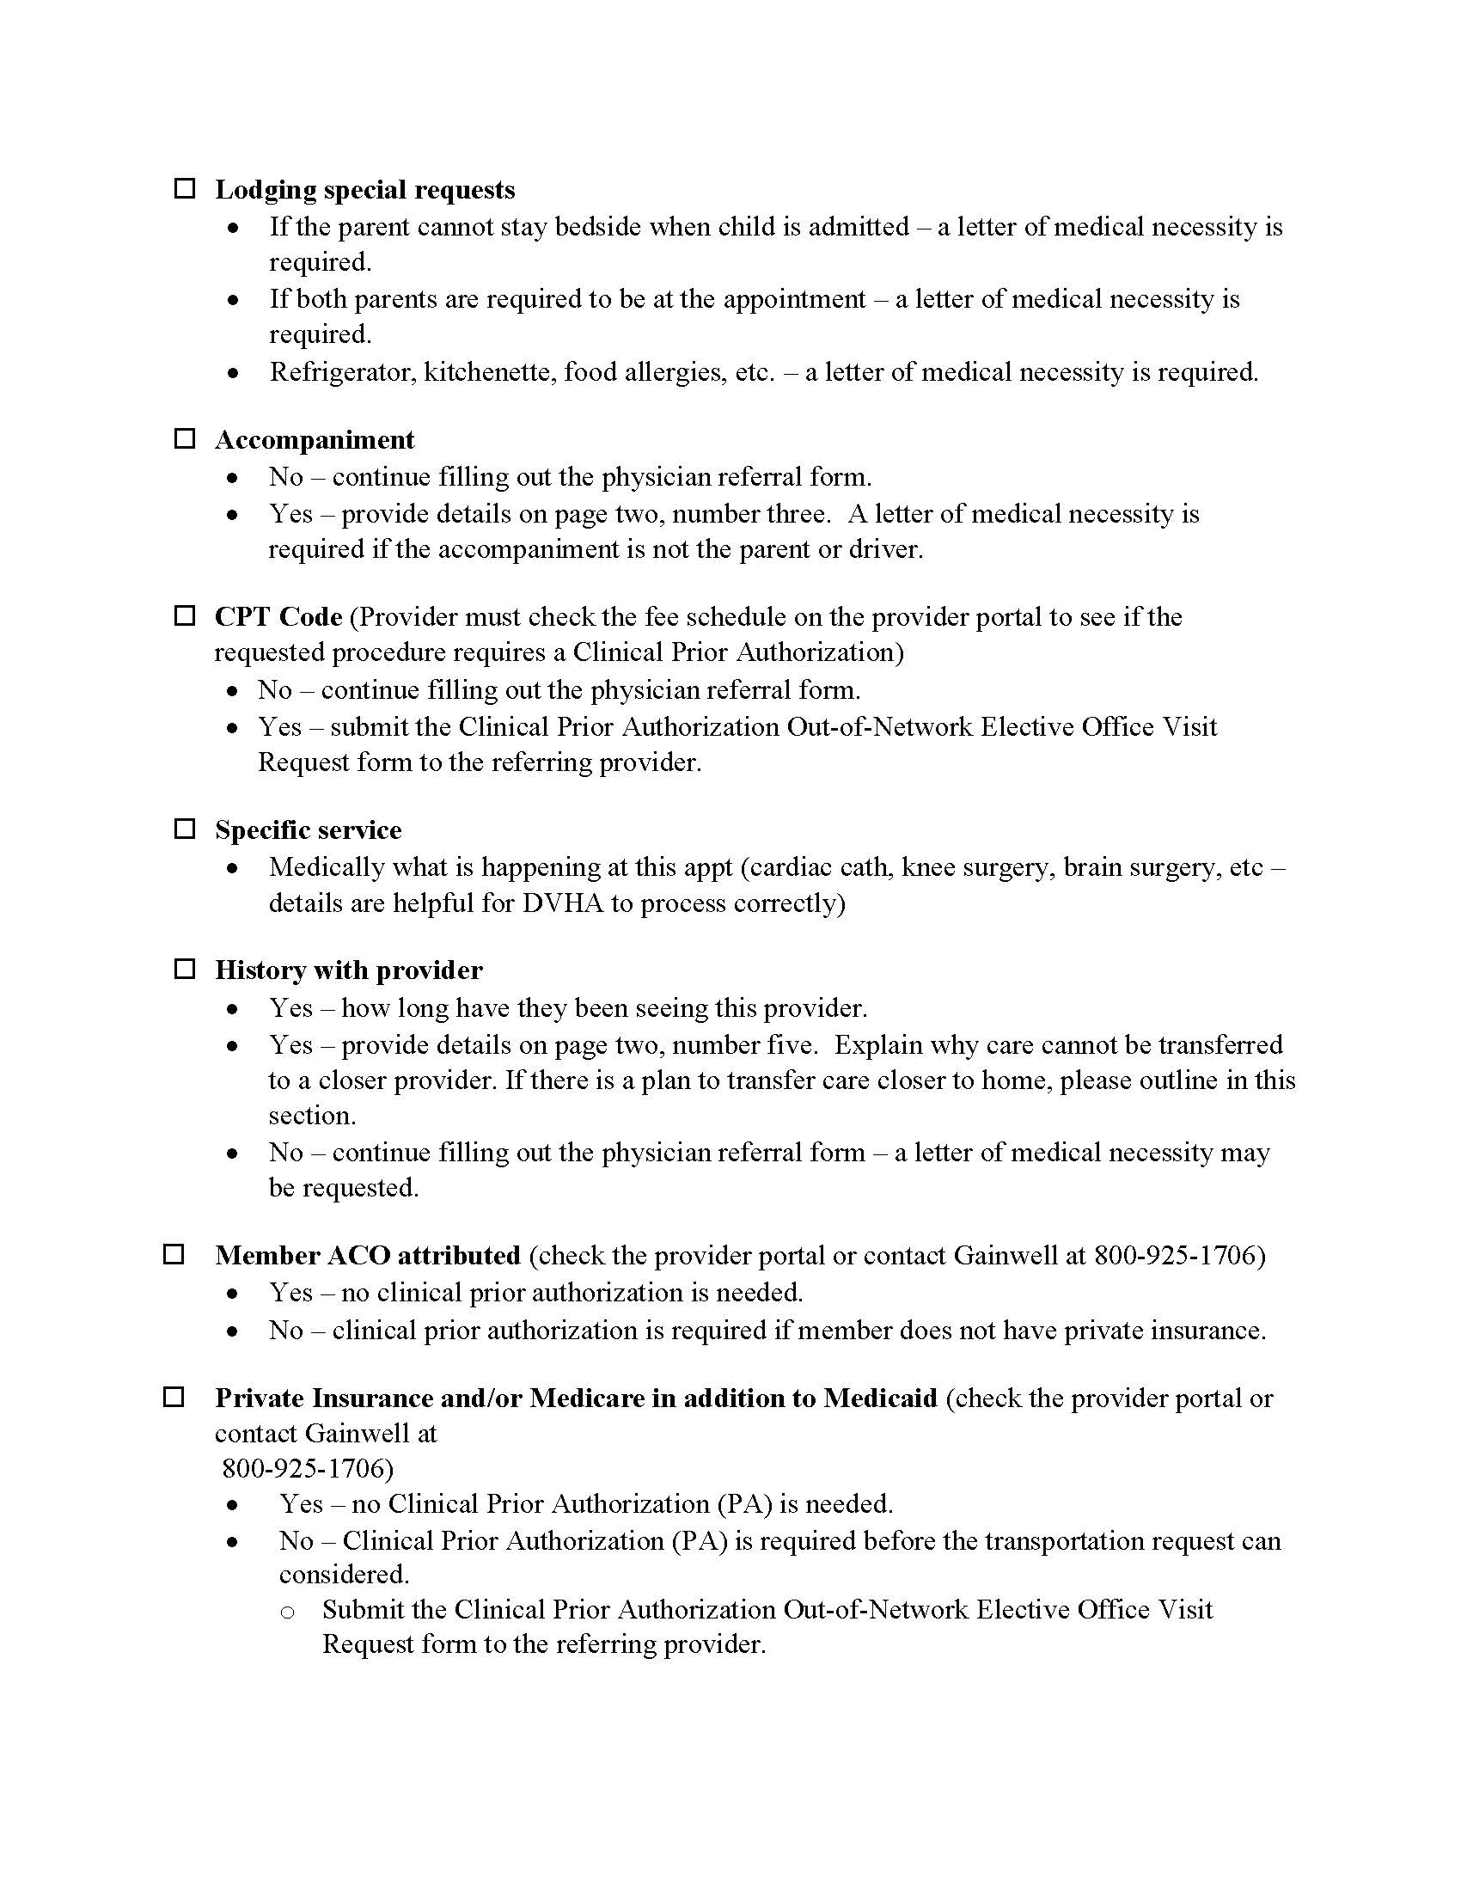

Slide 6
Websites
NEMT Manual, Forms and Checklists:
https://dvha.vermont.gov/providers/non-emergency-medical-transportation
VPTA:
https://vpta.net/

Slide 7
Contact Info
DVHA - phone: 802-241-9300 fax: 802-879-5919
Peter McNichol Peter.mcnichol@vermont.gov
Carla Vecchione Carla.vecchione@vermont.gov
Melissa Van Buskirk Melissa.vanbuskirk@vermont.gov
VPTA - 802-442-0629:
Elaine Haytko
Jen Ferris
Miriam Vega

Slide 8
Questions?

Slide 9
That’s all, folks…………………

