Slide 1
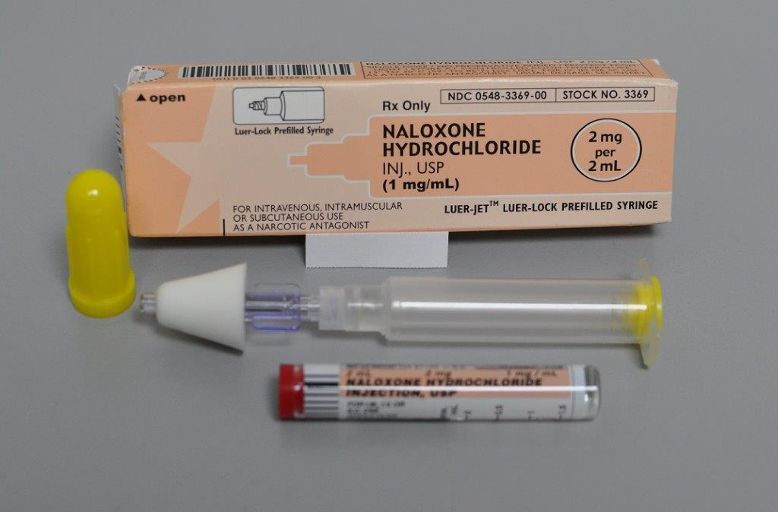
Overdose Response Training
Adapted with permission (2015): Massachusetts
Department of Public Health, Bureau of Substance Abuse Services and Office of HIV/AIDS
Notes:
Welcome participants to the training
Reiterate that the training is sponsored by the MA Department of Public Health

Slide 2
The Overdose Problem
Notes:
Note that there has been a significant amount of publicity around this topic recently, but that it has been going on for years.
Interactive: Ask participants to share their own experiences and interactions with people who use opioids

Slide 3
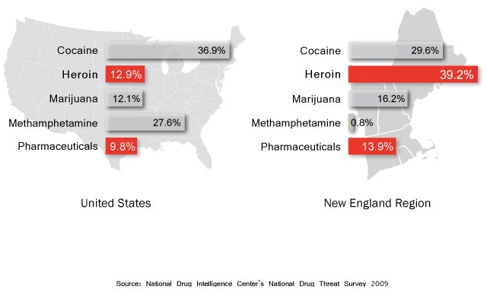
National & regional drug threat
Notes:
Key Point:
New England has a significantly large percentage of people using heroin and abusing pharmaceuticals compared to the national average.
Interactive: Ask people to name some of the most commonly abused pharmaceuticals and be certain to identify which of them are opioids.

Slide 4
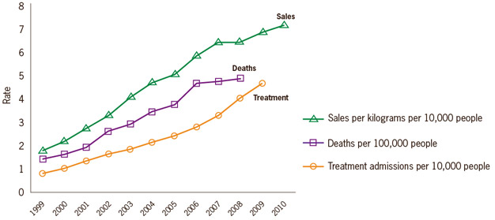
Prescription opioid sales, deaths and treatment: 1999-2010
National Vital Statistics System, 1999-2008; Automation of Reports and Consolidated Orders System (ARCOS) of the Drug Enforcement Administration (DEA), 1999-2010; Treatment Episode Data Set, 1999-2009
Notes:
Key Point: Sales of opioids and death rates have been on a steady incline since 1999, fortunately, so has treatment admissions.
Opioid addiction has been recognized as a problem and treatment for addiction has increased, naloxone is a form of harm reduction to prevent people from dying from an overdose and hopefully get them into treatment after.

Slide 5

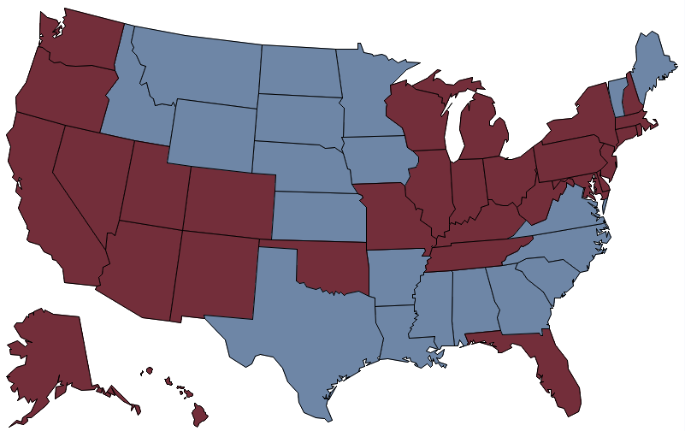
By 2010, drug overdose deaths outnumbered motor vehicle traffic deaths in 31 states
More deaths from
drug overdose
In 2012, 13 Massachusetts residents died each week from drug overdoses
CDC NVSS, MCOD. 2010
Notes:
Key Point: deaths due to drug overdoses is increasing rapidly throughout and the country

Slide 6
Slides Relevant only to Massachusetts
Deleted

Slide 7
Naloxone: Educational Materials
Vermont School Nurses may find this useful to update their own learning and may find portions useful when training others.

Slide 8
Vermont Contact information
Your local EMS station and local Police
Your local Designated Mental Health Agency
  http://mentalhealth.vermont.gov/DAlist
Michael Leyden, MPH, NREMT-P
    Vermont Department of Health
    Tel: 802-865-7735
    Email: mike.leyden@vermont.gov
Sharonlee Trefry, MSN, RN, NCSN
    Vermont Department of Health
    802-863-7348
    Sharonlee.trefry@vermont.gov

Slide 9
How Opioids Work and Overdose Risk Factors

Slide 10
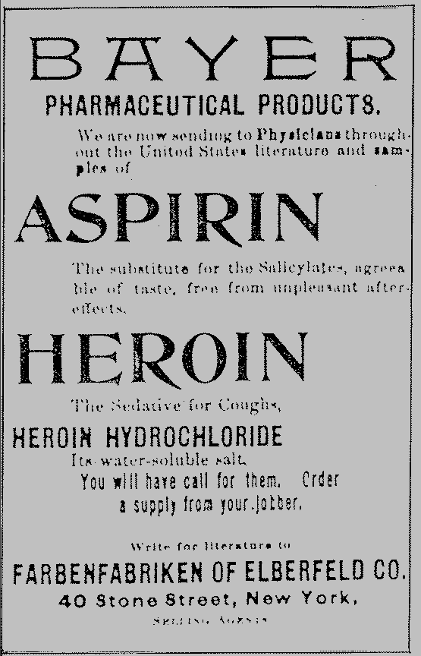
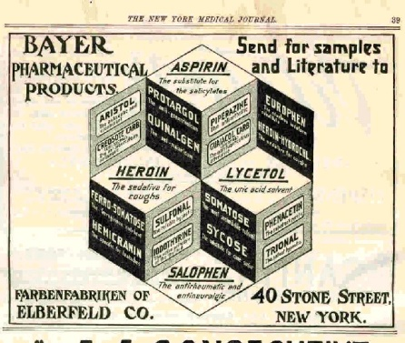
There were ads in papers and journals for Bayer’s many products, including aspirin and heroin.
10
Notes:
Key Point: Opioids are for medical purposes and even heroin was created by Bayer for a pharmaceutical remedy
10

Slide 11
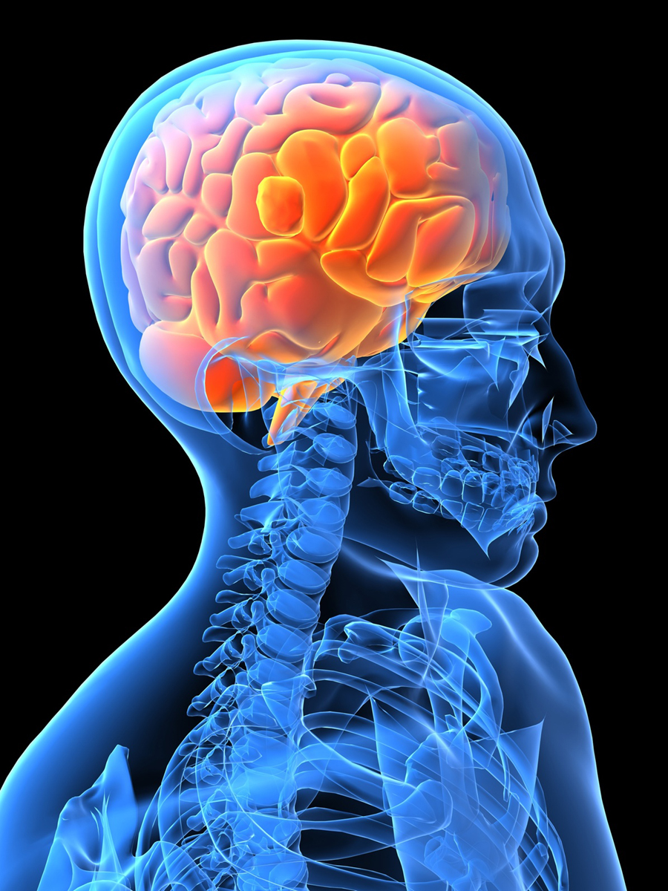
What are opioids/opiates?
Medications that relieve pain
Attach to the opioid receptors in the brain and reduce the intensity of pain signals reaching the brain.
Notes:
Key Point: Opioids attach to the receptors that block pain

Slide 12
Opioids
Natural Opiates
opium
morphine
codeine
Semi-Synthetic Opiates
heroin
hydromorphone
hydrocodone
oxycodone
Fully Synthetic Opioids
fentanyl
methadone
The term opiate is often used as a synonym for opioid, however the term opiate refers to just those opioids derived from the poppy plant either natural or semi-synthetic
All categories have overdose risk
Notes:
Key Point: There are many types of opioids but they all have similar affects

Slide 13

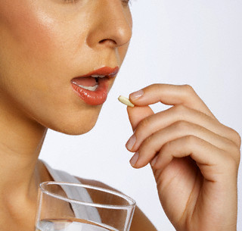
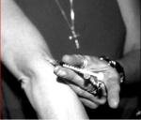
hours
days
opium
morphine
codeine
heroin
opium
heroin
hydrocodone
oxycodone
fentanyl
methadone
Demerol
fentanyl
morphine
hydrocodone
methadone
codeine
oxycodone
Demerol
Notes:
Key Point: Different opioids last for different amounts of time with varying strengths
When the state of the medication is altered the strength can increase

Slide 14
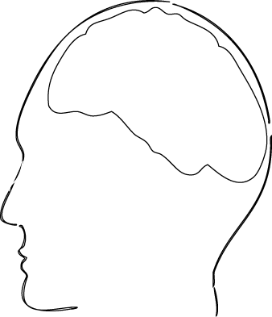



How do opioids affect breathing?
Opioid
Opioid Receptors
OVERDOSE
Notes:
Key Point: An overdose occurs when too much of an opioid, like heroin or Oxycontin, fits in too many receptors slowing and then stopping the breathing

Slide 15
How Overdose Occurs
Heart Stops
Death
Slow Breathing
Lack of oxygen may cause brain damage
Breathing Stops
Notes:
Key Point: Overdose process takes time as the breathing decreases, there is time to respond but not time to waste
15

Slide 16
What is Narcan® (naloxone)?
Narcan knocks the opioid off the opiate receptor, blocking opiate receptors from the opiate
Temporarily takes away the “high,” giving the person the chance to breathe
Narcan works in 1 to 3 minutes and lasts 30 to 90 minutes
Narcan can neither be abused nor cause overdose
  only contraindication is known sensitivity, which is very rare
Too much Narcan can cause withdrawal symptoms such as:
  nausea/vomiting
  diarrhea
  chills
  muscle discomfort
  disorientation
  combativeness
Notes:
16
Key Point: Narcan reverses an opiate overdose, to restore breathing
Withdrawal referred to as “dope sickness”
16

Slide 17
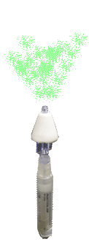

How does Narcan affect overdose?
Restores Breathing
Notes:
Key Point: Naloxone knocks the opioid off of the opioid receptor to restore breathing

Slide 18
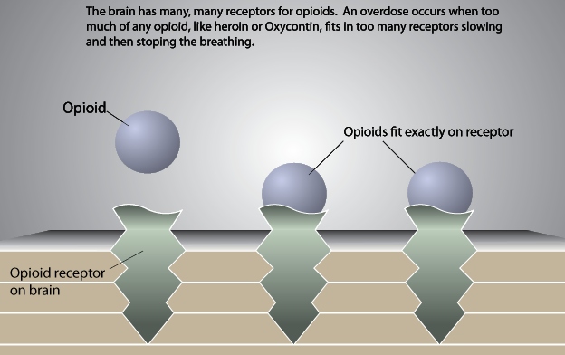
What is an Opioid OD?

Slide 19
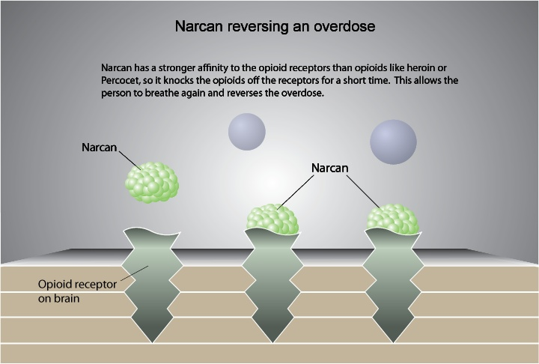
Naloxone Reversing Overdose

Slide 20
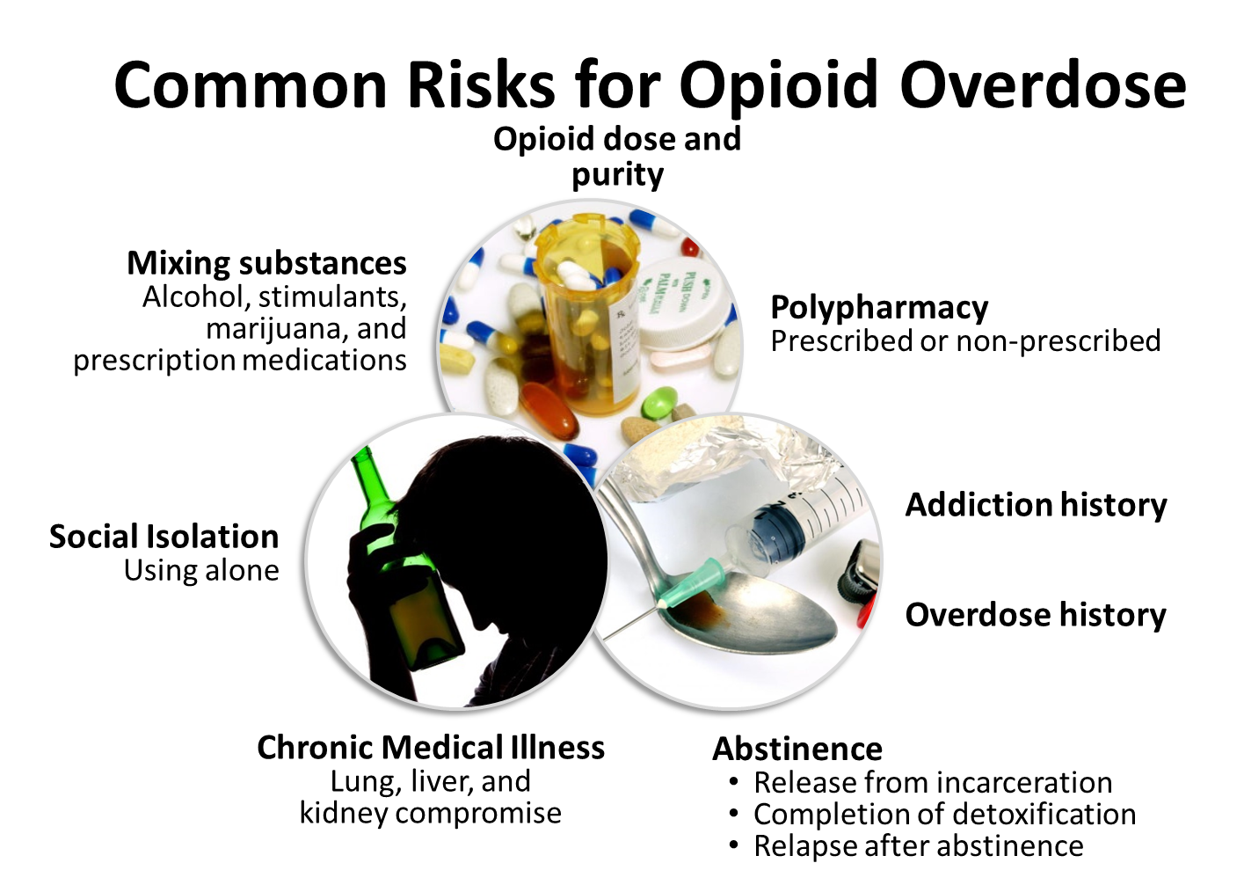

Slide 21
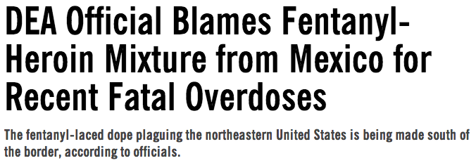
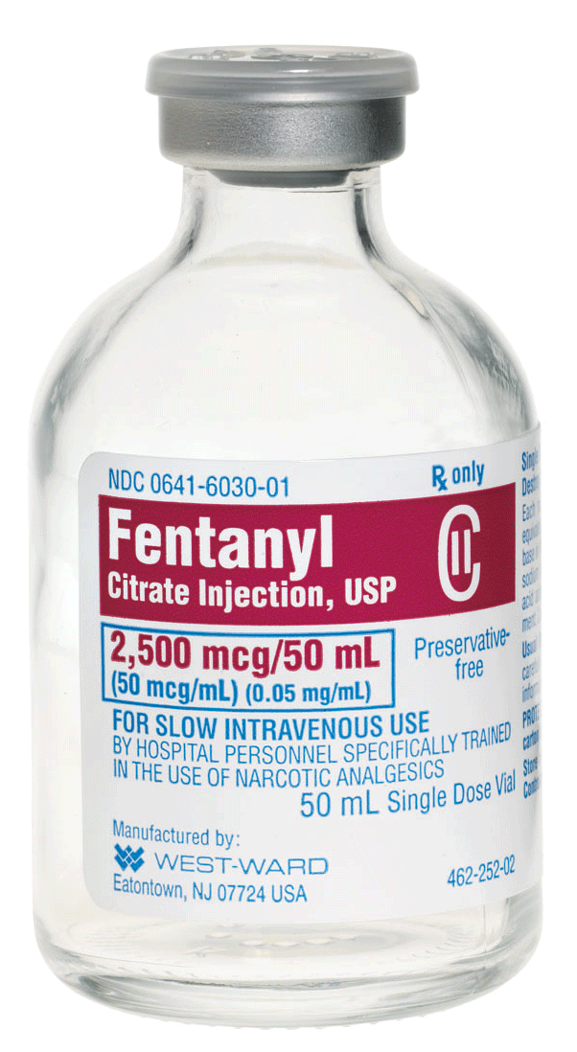
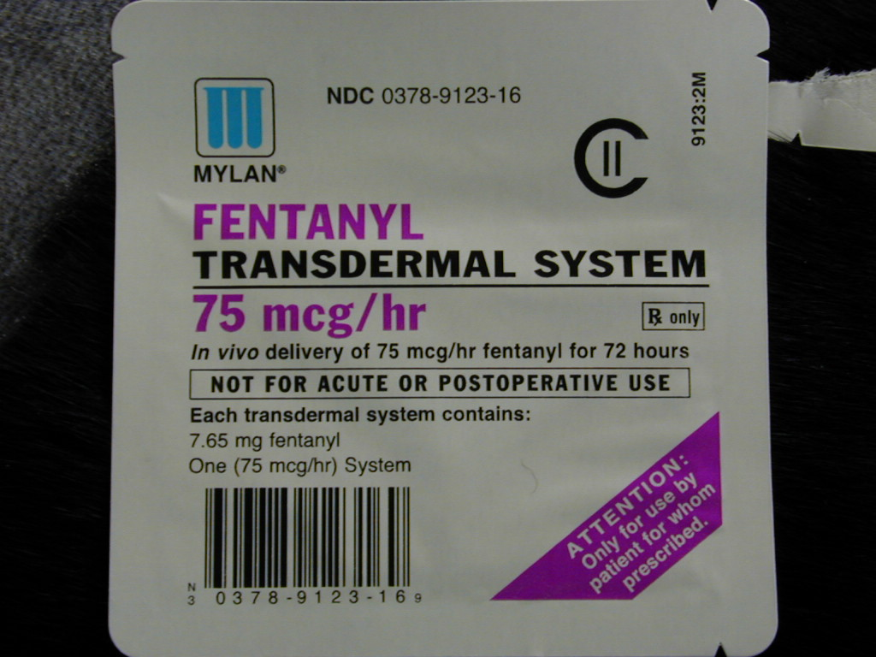
Notes:
Key Point: Right now in Massachusetts there are reports of Fentanyl-laced in heroin, causing an increase in overdoses because the strength of the heroin is stronger than the user is used to
21

Slide 22
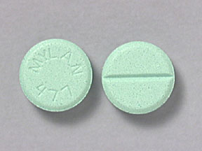
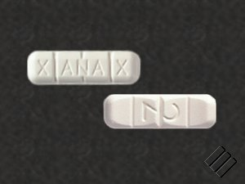
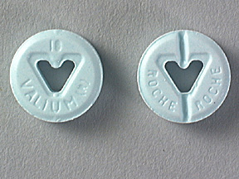
Mixing Opioids with Benzos
Combining opioids with benzodiazepines or alcohol leads to a worse outcome
Benzos are psychoactive drugs prescribed for sedation, anxiety, sleep and seizures
The most commonly used benzos are: Klonopin, Valium, Ativan, Librium, and Xanax
Notes:
Key Points: Also common in Massachusetts is mixing opioids with benzodiazepines
Note that narcan does not work on benzos
22

Slide 23
Medications for Opioid Overdose and Treatment
Narcan® = naloxone
  Reverses opioid overdose
  Short and fast-acting opioid blocker
Vivitrol® = naltrexone
  Treatment for opioid and alcohol addiction
  Long-acting opioid blocker
Suboxone® = buprenorphine + naloxone
  Treatment for opioid addiction
  The naloxone is added to discourage injecting or sniffing
Subutex® = buprenorphine only
  Treatment for opioid addiction in pregnant women
Methadone aka dolophine and methadose
  Treatment for opioid addiction or pain
No street value because they cause withdrawal symptoms
Street value because they can relieve
withdrawal symptoms
Notes:
Key Point: Medications for opioid overdose and treatment, some like subutex and methadone are more desired by active users because they can relieve withdrawal symptoms

Slide 24
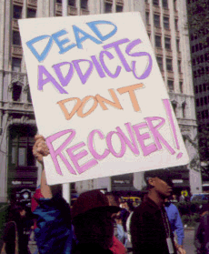
Revolving door???
As it is for tobacco and weight loss, it takes multiple attempts before achieving success
  By definition, addiction is a chronic condition where people make risky choices despite negative consequences
With time, treatment works and people get better

Slide 25
Administering Naloxone

Slide 26
Just high/overmedicated
Just high/overmedicated vs. overdose
Overdose
Small pupils
Drowsy, but arousable
  Responds to sternal rub
Speech is slurred
Drowsy, but breathing
  8 or more times per minute
Small pupils
Not arousable
  No response to sternal rub
Not speaking
Breathing slow or stopped
  < 8 times per minute
  May hear choking sounds or a gurgling/snoring noise
  Blue/gray lips and fingertips
>> Stimulate and observe
>> Rescue breathe + give naloxone
Notes:
Key Point: Someone who is really high and someone who is overdosed can look similar, it is an overdose if person is not arousable, and breathing is less than 8 times per a minute. Even if the person is really high and not overdosed they should not be left alone because they may slip into an overdose

Slide 27
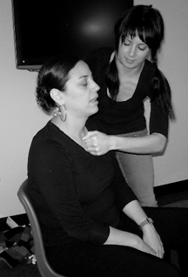
Recognize Overdose
If a person is not breathing or is struggling to breath: call out name and rub knuckles of a closed fist over the sternum (Sternum Rub)
Signs of drug use?
  Pills, drugs, needles, cookers
Look for overdose
  Slow or absent breathing
    Gasping for breath or a snoring sound
  Pinpoint pupils
  Blue/gray lips and nails
Ensure EMS is activated
Notes:
Key Points: Upon arrival to scene, to determine if victim has overdosed, call out persons name (If known) and sternum rub in an attempt to arouse the victim. Look for environmental clues of drug use, check victims breathing, and ensure that EMS has been activated.

Slide 28
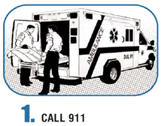
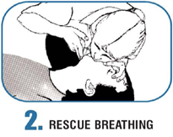
How to Respond to an Overdose
Call 911
Perform Rescue Breathing
to provide Oxygen
Administer Naloxone if available

Slide 29
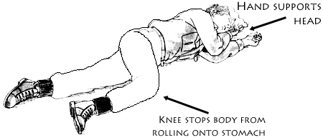
How to respond to an overdose
Place in the recovery
position
If possible stay with the
person until help arrives
Recovery Position

Slide 30
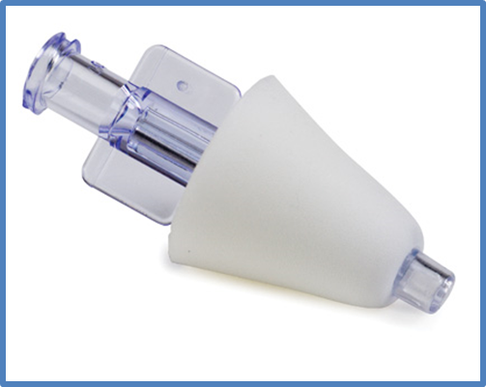
Intranasal Naloxone
The intranasal naloxone needs to be dispensed with the mucosal atomization device
If there is nasal trauma or bleeding, do not administer naloxone
Benefits of Intranasal Naloxone
Nose is an easy access point
Painless
Eliminates risk of contaminated needle sticks and needle dispensing
Notes:
Key Point: Benefits of intranasal naloxone

Slide 31
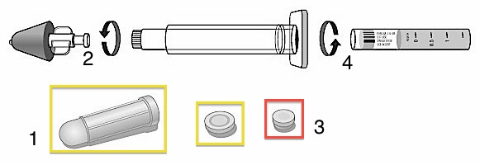
Give Naloxone: Intranasal
Remove both yellow caps from the ends of the syringe
Twist the nasal atomizer onto the tip of the syringe
Remove the purple cap from the naloxone
Twist the naloxone on the other side of the syringe
Notes:
Review how to put together naloxone kit.
Interactive: have participants put together demo naloxone kits if they are going to receive kits

Slide 32
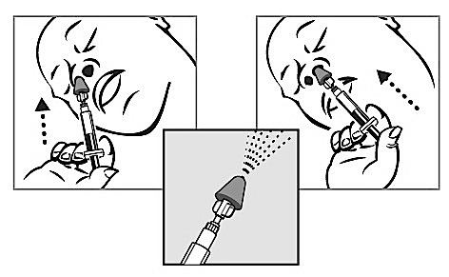
Give Naloxone: Intranasal
Push 1ml (1mg) of naloxone into each nostril
Administer the entire contents of the 2ml syringe with approximately one half (1ml) administered in each nostril
Administering one half in each nostril maximizes absorption

Slide 33
How does a person respond to Naloxone?
Scenarios:
Gradually improves breathing and becomes responsive within 3 – 5 minutes
Immediately improves breathing, responsive, and is in withdrawal
Starts breathing within 3 – 5 minutes but remains unresponsive
Does not respond to first dose and naloxone must be repeated in 3 – 5 minutes (keep rescue breathing)
Notes:
Very often those who become responsive won’t immediately realize they just overdosed

Slide 34
Reactions to Naloxone
Post-Naloxone Withdrawal Symptoms in First Responder Rescues: 2010-2013 | Total
None | 47 (40%)
“Dope Sick” | 27 (23%)
Irritable or Angry | 33 (28%)
Physically Combative | 6 (5%)
Vomiting | 16 (14%)
Other | 14 (12%)
Notes:
Key Point: Although many are concerned about severe withdrawal where the victim becomes physically combative, this is uncommon. The risk of combativeness can be reduced by administering only enough medication to re-start breathing.

Slide 35
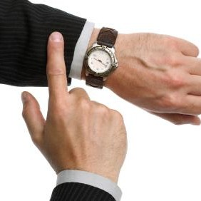
After Administering Naloxone
Continue rescue breathing with 1 breath every 5 seconds until emergency responders arrive
After 3-5 minutes, if the patient is still unresponsive with slow or no breathing, administer another dose of naloxone
Notes:
Key Point: Continue rescue breathing, if still unresponsive and EMS has not arrived administer second dose of naloxone after 3-5 minutes

Slide 36
If victim is breathing, but unresponsive place in recovery position
Notes:
If for any reason the victim needs to be left along place in recovery position

Slide 37
Questions and Answers
Will Naloxone work on an alcohol overdose?
  No. Naloxone only works on opioids
What if it is a crack/cocaine or speed/methamphetamine overdose?
  No. Naloxone only works on opioids
What is the risk period for an overdose to reoccur after giving Naloxone?
  Depends on how long acting the opioid is and how much they took
If the person isn’t overdosing and I give them Naloxone will it hurt them?
  No. If in doubt give naloxone.
Notes:
Answers:
Will be effective for opioid aspect only - if opioids were also used

Slide 38
Reminder
Naloxone is not a controlled substance but is a regulated substance (a prescription medication) that requires a licensed prescriber
Prescriptions for intra-nasal naloxone can be filled at many local pharmacies. Several pharmacies have standing orders for dispensing naloxone as well.
Notes:
We will go over how to comply and obtain a prescription a little bit later in presentation

Slide 39
Slides Relevant only to Massachusetts
Deleted

Slide 40
Good Samaritan & Naloxone Law
Passed August 2012
Notes:
The fact that people do not call for help is one of the reasons people are dying, so we want to address this specifically.

Slide 41
Vermont Good Samaritan Law: 12 V.S.A. § 519 (2015)
12 V.S.A. § 519. Emergency medical care
(a) A person who knows that another is exposed to grave physical harm shall, to the extent that the same can be rendered without danger or peril to himself or without interference with important duties owed to others, give reasonable assistance to the exposed person unless that assistance or care is being provided by others.
(b) A person who provides reasonable assistance in compliance with subsection (a) of this section shall not be liable in civil damages unless his acts constitute gross negligence or unless he will receive or expects to receive remuneration. Nothing contained in this subsection shall alter existing law with respect to tort liability of a practitioner of the healing arts for acts committed in the ordinary course of his practice.
(c) A person who willfully violates subsection (a) of this section shall be fined not more than $ 100.00.
HISTORY: 1967, No. 309 (Adj. Sess.), §§ 2-4, eff. March 22, 1968.

Slide 42
Importance of calling 911
Sometimes people are afraid to call 911.
However, an overdose is a medical emergency .
Remember:
Narcan only works on opioids
  not benzos, cocaine, alcohol or other drugs
Person overdosing may have other medical issues
Person can overdose again once narcan wears off
Notes:
The fact that people do not call for help is one of the reasons people are dying, so we want to address this specifically. It is extremely important that people call 911.

Slide 43
Slides Relevant only to Massachusetts
Deleted

Slide 44
Thank You
Any questions?

