Slide 1

Please note this meeting will be recorded
This recording and all paper and electronic copies of materials presented or shared on the screen will be subject to Vermont’s public records act, 1 V.S.A. §§ 315 et seq., and will be made available to the general public upon request.
Participants are responsible for ensuring that no confidential or proprietary information is presented or discussed in the meeting and associated materials.

Slide 2

Health Check-In: A Provider Call on What's Happening
Katie Mahuron, RN – Adult Nurse Coordinator
Meghan Carey, RN – Child & Adolescent Nurse Coordinator
Denise Kall – Public Health Analyst III
March 13, 2025
Notes:
Thank you for joining us today for this Health Check-In. My name is Meghan Carey, and I am a nurse with the Vermont department of health immunization program. With me today is Katie Mahuron, also a nurse with the program. Together we lead todays call. We also have another member of our team joining briefly to review the school vaccination dashboard. Since I just mentioned one of our agenda topics for today, lets look at the full agenda.

Slide 3

Today’s Agenda
On the Rise:
  Measles
  COVID-19
  Nirsevimab Administration
What We're Hearing
  ACIP
  Vaccines for Children Program
  CDC Website Changes
  Messenger RNA vaccines
Q&A
Notes:
Todays call will focus on things on the rise, such as vaccine preventable diseases and immunization efforts, as well as what we’re hearing from the news, partners and the community. For each of these, we will provide some context or grounding facts around what we know.

Slide 4
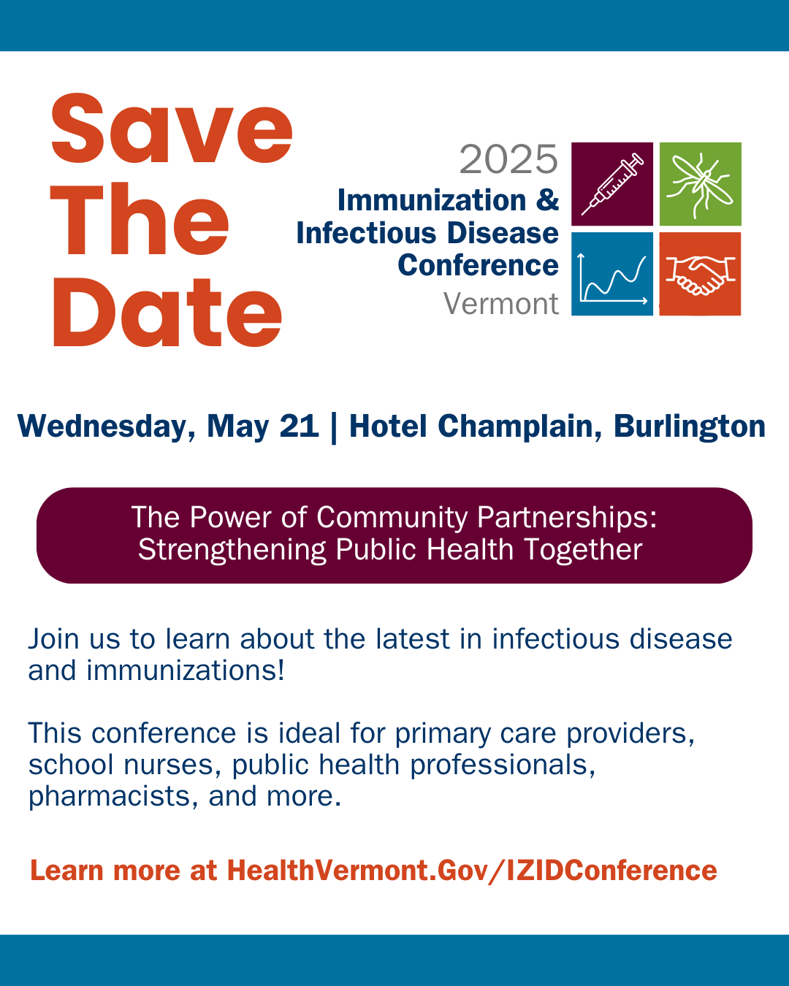
Notes:
But, first, important announcement. We would love everyone to join us on May 21st for the two thousand twenty-five Immunization and Infectious Disease Conference to learn about the latest in infectious disease and immunizations. Look for more information to come in future provider update emails and at the link in this Save the Date image. We hope to see you there as we believe it will be a day full of great information, networking and collaboration.

Slide 5

On The Rise
Notes:
Okay, lets jump into our ‘on the rise’ section. We will start with a topic you have likely seen in the news, through VDH emails and in health alert messages– the measles.

Slide 6
Measles

Slide 7
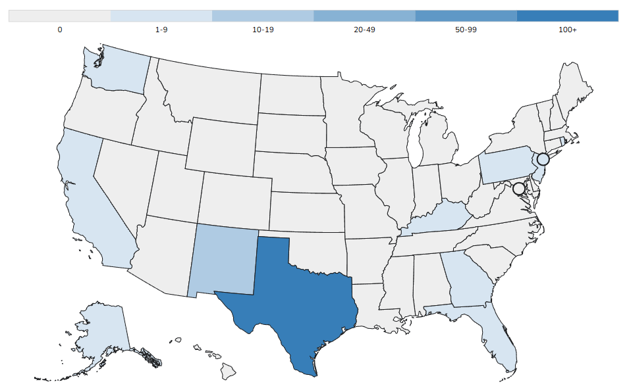
2025 Measles Update
CDC US case count: 222 (as of March 7, 2025)
  Updated weekly
  Number of current cases is much higher as cases increase daily
12 Jurisdictions: Alaska, California, Florida, Georgia, Kentucky, New Jersey, New Mexico, New York City, Pennsylvania, Rhode Island, Texas, & Washington
3 outbreaks reported
  93% of cases are outbreak related
Measles Cases and Outbreaks | Measles (Rubeola) | CDC
Notes:
As of March 7th, CDC reports 222 cases of Measles in the US. Reported cases were in 12 jurisdictions. The bolded states on this slide indicate the three jurisdictions that reported new cases to CDC between February 28th and noon on March 6th . For comparison, there was a total of 285 cases in 2024. As you have likely seen on the news and through other communications, measles cases are increasing at an alarming rate that is expected to soon surpass the total number of cases seen last year. CDC case and outbreak data is updated weekly, on Fridays, reflect cases reported as of noon on Thursdays. We know that this data is nearly a week old and not a reflection of the actual number of cases nationwide. We can expect to see an update tomorrow that will provide us with an accurate number of cases including those newly reported from the afternoon of March 6th through noon on March 13th. We encourage all of you to check the update.
Now back to the data. There have been three outbreaks reported this year with a majority of cases being outbreak related. Let’s dive deeper.

Slide 8
Measles Cases & Outbreaks
CDC reported measles cases primarily impacting children and adolescents who are unvaccinated, or have unknown vaccine status
Age | Case Count
Under 5 years | 76 (34%)
5-19 years | 99 (45%)
20+ years | 40 (18%)
Age unknown | 7 (3%)
Vaccination Status | % Cases
Unvaccinated or Unknown | 94%
One MMR dose | 4%
Two MMR doses | 2%
Measles Cases and Outbreaks | Measles (Rubeola) | CDC
Notes:
Most positive cases were among individuals 19 years and younger, with few cases occurring in the 20 plus year age group. This data demonstrates that individuals without vaccination, or with unknown vaccine status, are more likely to become infected, with very few cases among individuals who have completed the MMR vaccine series or have partial series completion. We can see that MMR vaccines provide protection from measles and want to emphasize the importance of making sure everyone is up to date.
Now I’d like to take a moment to discuss cases reported by health departments that are not yet included in the CDC data- but will hopefully be tomorrow with the update.

Slide 9

Measles Cases & Outbreaks
For accurate case count data, visit state health department websites
223 cases in Texas (as of March 11, 2025)
33 cases in New Mexico (as of March 11, 2025)
36 cases in Quebec (as of March 12, 2025)
2 reported deaths
  Texas: February 26, 2025
  New Mexico: March 6, 2025
Notes:
Among the jurisdictions currently reporting measles cases, Texas has the largest count -reporting 223 cases as of March 11th. Most of these are among unvaccinated school aged children. There have been 29 hospitalizations, a number that has steadily climbed throughout the outbreak and reminds us of the potential health risks of measles infection. On February 26th, texas reported the death of an unvaccinated child. Case updates are posted twice a week on their health department website- specifically on Tuesday and Fridays.
Another state with a large number of cases is New Mexico. They report 33 cases, and this includes a measles related death on March 6th.
We also want to note, that although not in the US, there have been 36 cases in Quebec. The Quebec outbreak is still active and expected to grow.
For more details and the most up to date case and outbreak data for each state, please visit state health department websites as many are reporting updates more frequently than the CDC.
Let's discuss additional cases not yet included in the CDC data.

Slide 10
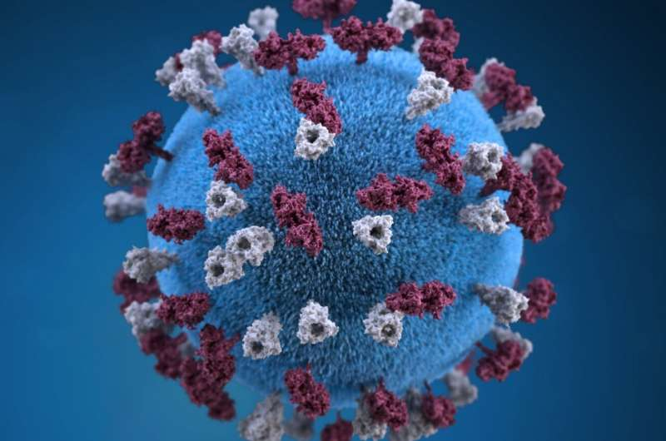
2025 Measles Update
Vermont reports first 2025 positive measles case
Press release: Vermont Department of Health Confirms Case of Measles | Vermont Department of Health
Health Alert: Confirmed Measles Case in Vermont
Notes:
Additional cases are popping in in neighboring states, including Maryland and as you may have heard, Vermont.
On March 11, the Vermont Department of Health confirmed a case of measles in a school-aged child in Lamoille County. The child became sick after returning with their family from traveling internationally in recent days. The risk to the public is believed to be low. This is the first case of measles in Vermont in 2025 and is not related to the ongoing outbreaks in the US. Addition details from the press release and health alert are available on our webpage.
Vermont does not currently meet the definition of an outbreak therefore we will continue to follow routine vaccine recommendations- and we are talking about those next.

Slide 11
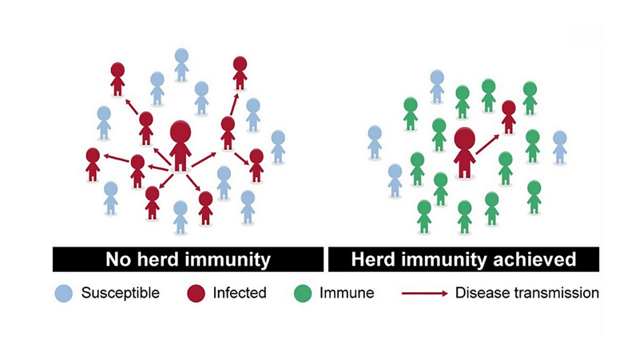
MMR Vaccine Effectiveness
MMR Vaccine
One dose is 93% effective
Two doses are 97% effective
Measles is very contagious; 95% vaccine coverage is needed to achieve community immunity.
Measles, Mumps, and Rubella (MMR) Vaccination | CDC
Notes:
In 2000, measles was officially eliminated from the United States. This means there was no measles spreading within the country and new cases are only found when someone contracts measles abroad and returns it to the US. Achieving this took a lot of work and in large was a result of successful vaccination efforts across the nation. MMR, the vaccine used to protect against measles, is very effective at providing long term immunity. One dose is 93% effective, and two doses is 97% effective. As we just showcased, measles is very contagious and spreads fast. If someone has measles, up to 90% of unprotected people close to them will also become infected. When more than 95% of people in a community are vaccinated, most people are protected through community immunity, also known as herd immunity. The MMR vaccine is our best protection against measles and measles spread.

Slide 12
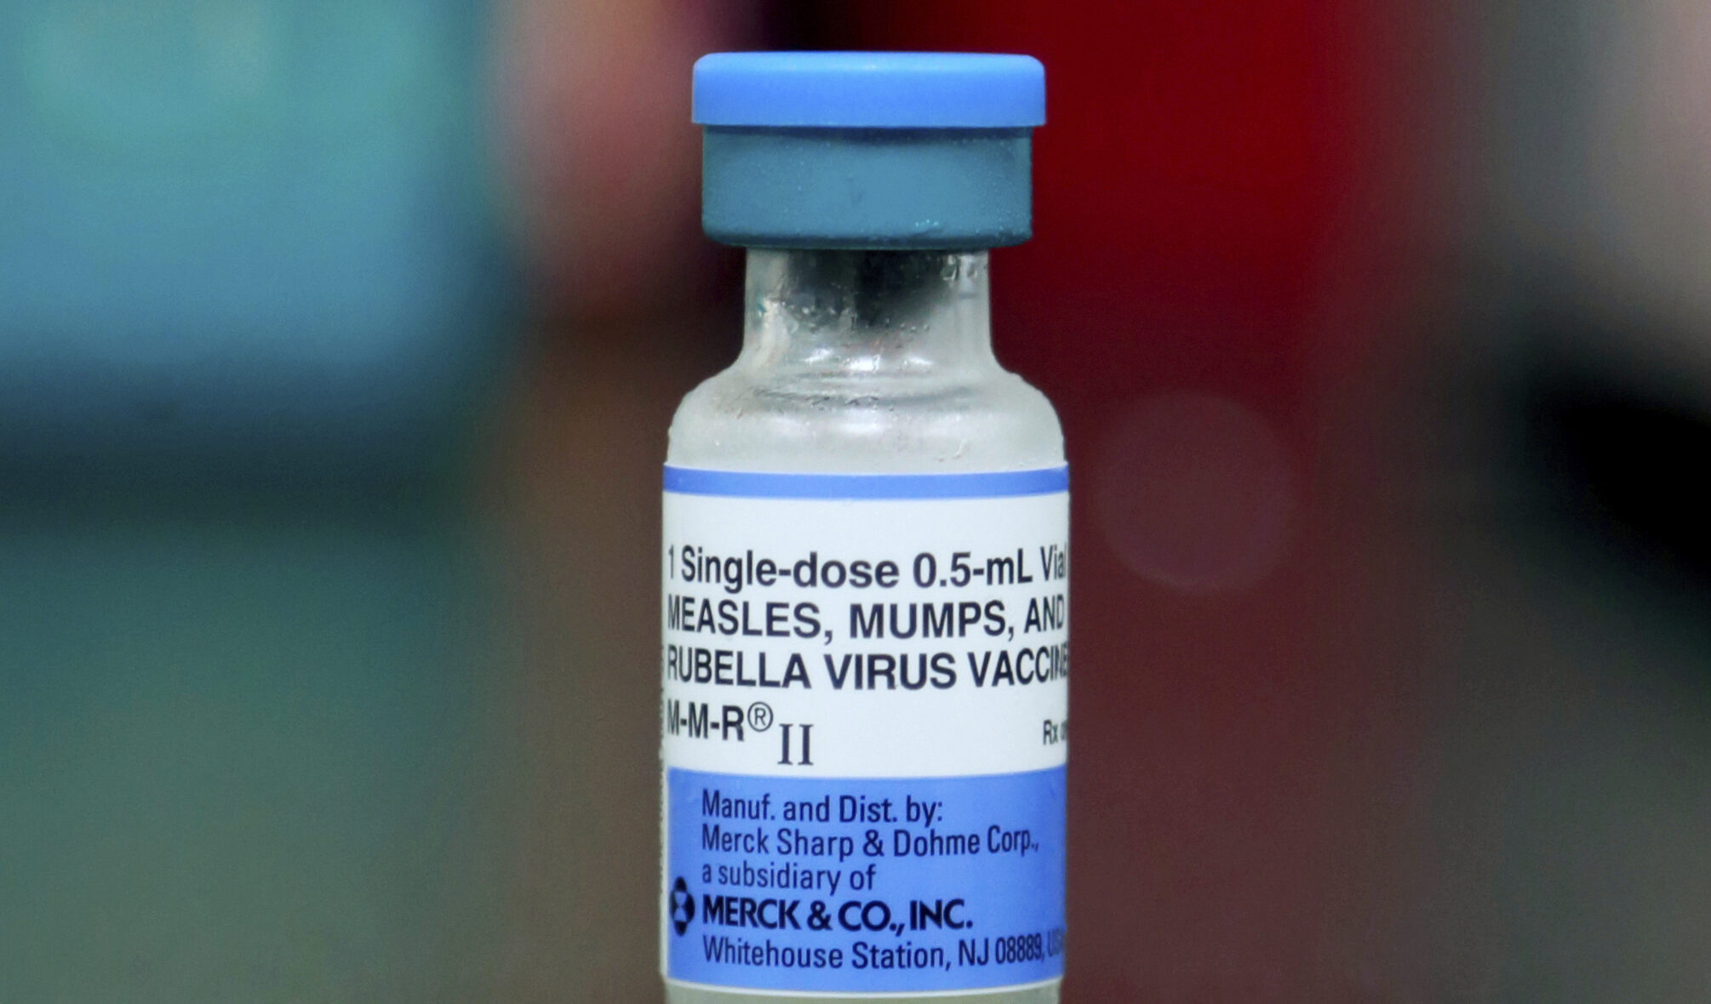
Measles, Mumps & Rubella (MMR) Vaccine- hide
Two measles, mumps and rubella (MMR) vaccines are available for use in the US
MMR II (Merck)
  IM or Subcutaneous
Priorix (GSK)
  Subcutaneous only
  Limited VVP supply
Fully Interchangeable for all indications for which MMR vaccination is recommended
Minimum interval between doses is 4 weeks (28 days)
Notes:
Here are the various MMR vaccine options that help us achieve 95%.
There are two MMR vaccines available for use in the US. They are MMR II and Priorix.
MMR II can be administered subcutaneously or intramuscularly. Priorix can only be administered via the subcutaneous route. The Vermont vaccine program primarily supplies MMR II although I believe we have a small supply of priorix available. M-M-R II and PRIORIX are fully interchangeable for all indications for which MMR vaccination is recommended and are both live vaccines.

Slide 13
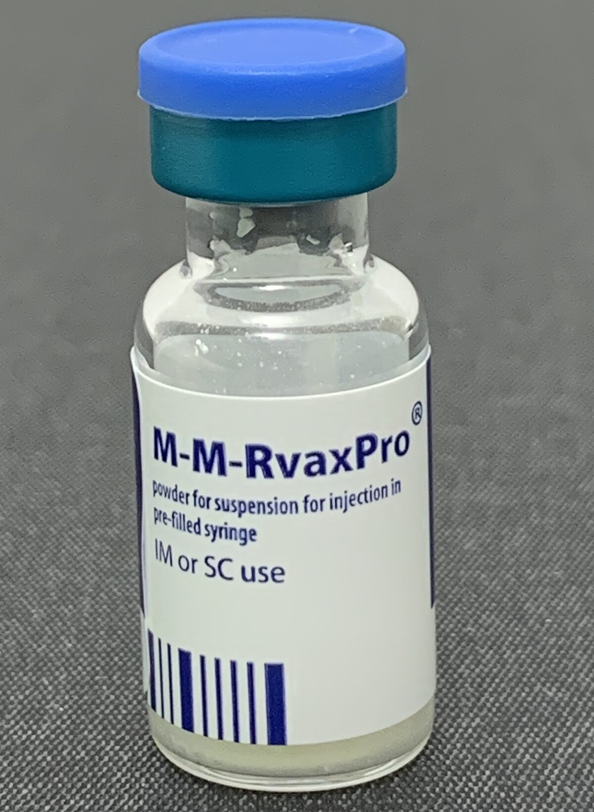
Measles, Mumps, Rubella and Varicella (MMRV) Vaccine-hide
Measles, mumps, rubella and varicella (MMRV) vaccine is also available
  Licensed for use in children 12 months through 12 years of age
  IM or Subcutaneous
Minimum interval between two MMRV doses is 3 months
Notes:
MMRV is also available as a combo vaccine consisting of measles, mumps, rubella and varicella. The minimum age for MMRV is 12 months and the maximum age for administration is 12 years. MMRV should not be administered to anyone 13 years of age and older. The minimum interval between MMRV doses is 3 months.

Slide 14
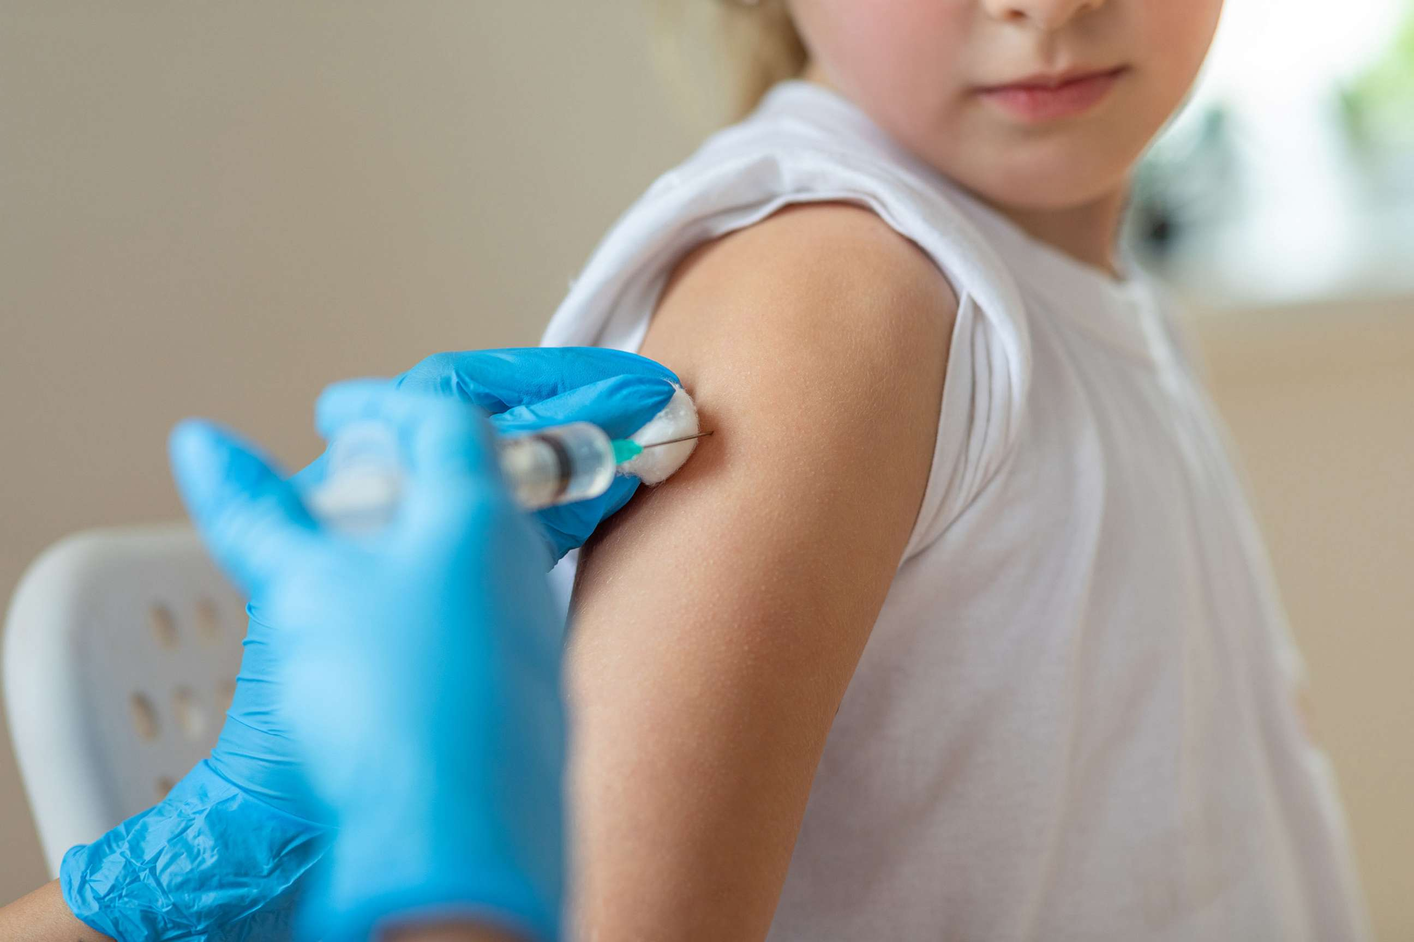
MMR Recommendations for Children and Adolescents
MMR Vaccine
Children should get two doses of MMR vaccine at least 28 days apart
  First dose at 12 to 15 months of age
  Second dose at 4-6 years of age
Adolescents not up to date on MMR vaccination should be caught up
  2-dose series at least 4 weeks apart
Notes:
There are two types of MMR vaccine-MMR II manufactured by Merck, and Priorix, manufactured by GSK. Both MMR vaccines are fully Interchangeable for all indications for which MMR vaccination is recommended. MMR vaccine is recommended routinely for all children 12 through 15 months, with a second dose at age 4 to 6 years. The second dose is not a booster but rather is intended to produce immunity in the small number of people who fail to respond to the first dose. Adolescents without evidence of immunity should receive the 2-dose series with at least 4 weeks between doses.
MMRV, a combination vaccine for measles mumps, rubella and varicella, is also licensed for use in children 12 months through 12 years of age. Some parents might consider vaccinating their child with MMRV for the first dose rather than administer two separate injections. In this situation, it is important for the provider to discuss the risk and benefits of both vaccines. Unless the parent or caregiver expresses a preference for MMRV vaccine, CDC recommends that MMR vaccine and varicella vaccine should be administered as separate injections for the first dose in children 12-47 months of age. We also want to remind everyone that MMRV should not be administered to children 13 years and older.
Were moving on to discuss more recommendations-specifically measles vaccine recommendations for travel.

Slide 15

FAQ: What are the MMR Vaccine Travel Recommendations
Infants 6-11 months travelling outside of U.S., or to an outbreak area, should receive a dose of MMR vaccine prior to travel.
  Will still need to get 2 additional doses at recommended ages
Children 12 months and older
  Unvaccinated: 2-dose series separated by at least 4 weeks
  Previously received 1 dose: administer dose 2 at least 4 weeks after dose 1
Adults- 2-dose series recommended for international travel, or to an outbreak area
Notes:
Children traveling internationally or to an outbreak area should be vaccinated against MMR at an earlier age than what is routinely recommended. Infants 6 to11 months should receive 1 dose before travel. Infants vaccinated before age 12 months still need to follow the routine recommendation and should receive another dose at 12 to 15 months and a final dose between 4 and 6 years of age.
We want to be clear that an outbreak is defined as 3 or more cases. In this definition, states with one or two positive cases would not meet definition for outbreak area. Outbreak areas currently include New Mexico, Texas and New Jersey.
Unvaccinated children 12 months and older should receive the 2-dose series with at least 4 weeks between each dose. Children who previously received 1 dose should complete the vaccine series by receiving a second dose at least 4 weeks after dose 1.
For adults traveling internationally or to an outbreak area, a two dose vaccine series is recommended.
We want to remind everyone that for the measles vaccine to work, the body needs time to produce protective antibodies in response to the vaccine. It usually takes 2 to 3 weeks to be fully protected. Travelers should plan accordingly and receive recommended vaccines at least two weeks ahead of their departure date. This will ensure they are protected for the duration of their trip and are less likely to bring measles back into the united states when returning home.

Slide 16
CDC HAN
Health Alert Network (HAN) - 00522 | Expanding Measles Outbreak in the United States and Guidance for the Upcoming Travel Season
Includes reminder regarding international travel vaccination recommendations
Requests healthcare providers “Ensure patients who reside in areas with an ongoing measles outbreak to follow state and local guidance”
Texas Department of State Health Services has issued recommendations for affected counties
  Infants 6-11 months receive an early dose of MMR vaccine
  Unvaccinated children should receive one dose immediately (and 2nd dose 28 days later)
  Children older than 12 months with one prior dose should receive an early second dose of MMR vaccine separated by at least 28 days.
  Teenagers and adults previously vaccinated with one dose of MMR should receive a second dose
Notes:
On March 7th CDC released a Health Alert Network message regarding the expanding measles outbreak in the united states and guidance for the upcoming travel season. The HAN includes reminders regarding international travel recommendations and requests that healthcare providers ensure patients who reside in areas with an ongoing measles outbreak to follow state and local guidance including vaccine guidance. As we mentioned, it is recommended that everyone planning to travel to an outbreak area or traveling internationally should be up to date on the MMR vaccine as this is the best tool we have against this outbreak and measles spread.
We just reviewed the measles vaccination recommendations for children, adolescents and travelers. Katie is now going to talk about measles vaccine recommendations for adults.

Slide 17
MMR Recommendations for Adults
Routine Immunization
No evidence of immunity to measles, mumps, or rubella: 1 dose
Evidence of immunity:
  Born before 1957 (except for health care personnel)
  Documentation of receipt of MMR vaccine
  Laboratory evidence of immunity or disease (diagnosis of disease without laboratory confirmation is not evidence of immunity)
  Special Situations
  HIV infection with CD4 percentages ≥15% and CD4 count ≥200 cells/mm3 for at least 6 months and no evidence of immunity to measles, mumps, or rubella: 2-dose series at least 4 weeks apart;
  Students in postsecondary educational institutions, international travelers, and household or close, personal contacts of immunocompromised persons with no evidence of immunity to measles, mumps, or rubella: 2-dose series at least 4 weeks apart if previously did not receive any doses of MMR or 1 dose if previously received 1 dose MMR;
  Health care personnel: Born before 1957 with no evidence of immunity, consider 2 doses; born in 1957 or later, 2-dose series
Notes:
Thanks, Meghan.
When it comes to most adults, for the routine recommendations, to be considered up to date, an individual needs one dose of MMR vaccine. There are some special situations in which two doses is recommended, including those with HIV infection, international travellers, students in post-secondary educational institutions, healthcare professionals, and household or close contacts of immunocompromised persons.

Slide 18
FAQs: Measles
What is the recommendation for adults who may have received a dose of inactivated (killed) MMR vaccine in the 1960s?
People who previously received a dose of measles vaccine in 1963–1967 and are unsure which type of vaccine it was, or are sure it was inactivated measles vaccine, should be revaccinated with either one (if low-risk) or two (if high-risk) doses of MMR vaccine. There is no need to draw titers.

Slide 19
FAQs: Measles – Vaccine or Titers?
If an adult does not have evidence of immunity, should we administer a dose of MMR or draw titers?
Considerations:
Cost of titer versus cost of vaccine
Patient preference
Commercial tests may lack sensitivity to detect vaccine-induced immunity
Time considerations for protection
Notes:
Another question we often get asked is if an adult does not have evidence of immunity, should we draw titers or administer a dose? The answer is that it is up to provider preference. Some factors that the provider may consider include patient preference, such as if you have a vaccine-adverse individual, or if it is unlikely for the patient to return
ACIP does not recommend serologic testing after vaccination because commercial tests may not be sensitive enough to reliably detect vaccine-induced immunity.
There is no harm in giving MMR vaccine to a person who may already be immune to one or more of the vaccine viruses. If you or the patient opt for testing, and the tests indicate the patient is not immune to one or more of the vaccine components, give your patient 2 doses of MMR at least 4 weeks apart. If any test results are indeterminate or equivocal, consider your patient nonimmune.

Slide 20
FAQs: Measles – Finding Vaccine Records
Q: Where can I find my immunization records?
A: Some suggestions on where to look include:
  your previous healthcare providers
  your home
  schools, colleges and other post-secondary institutions
  previous employers
Tips for Finding Vaccine Records | Vaccine Information
Notes:
Okay, here is a slide with some information about a slide we commonly see from the community, but also sometimes from providers asking on the behalf of their patients. Basically, the question, is what do I do if I don’t have my vaccine records. Obviously, ideally, everyone’s records would be in the IMR, but many adults may not have their MMR vaccine records in the IMR if their immunization pre-dated the IMR and historical data wasn’t entered. This link here from the CDC has some suggestions on how where you might suggest patients look for past vaccination records.

Slide 21
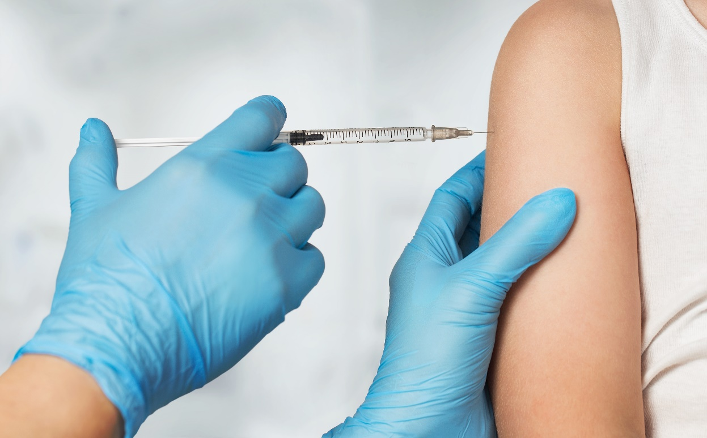
MMR Administration After Exposure
Must be given within 72 hours (3 days)
Can only be given to people aged 6 months and older
If a child 6 - 12 months receives a dose, they will still need follow routine schedule and receive 2 additional doses
Contraindications for PEP are the same as routine vaccination
Notes:
Okay, now I want to transition to a quick review of MMR administration as post exposure prophylaxis.

Slide 22
Post Exposure Prophylaxis
People exposed to measles who cannot readily show that they have evidence of immunity against measles should be offered post-exposure prophylaxis (PEP).
To potentially provide protection or modify the clinical course of disease among susceptible persons, either:
Administer MMR vaccine within 72 hours of initial measles exposure,
or
Immunoglobulin (IG) within six days of exposure.
Do not administer MMR vaccine and IG simultaneously, as this practice invalidates the vaccine.
Notes:
Do not give IGIM and measles vaccine at the same time. If a child is older than 12 months and has received IGIM, give measles vaccine about 5 months later when the measles antibody titer will have disappeared

Slide 23
School Vaccination Dashboard
Denise Kall, Public Health Analyst III
Notes:
Now that we’ve talked about the outbreak situation , and vaccine recommendations across all age groups, we’re going to talk about the data. Joining us today is Denise Kall, public health analyst with the Vermont department of health, who will be discussing the Vermont school vaccination dashboard. Denise, take it away.

Slide 24
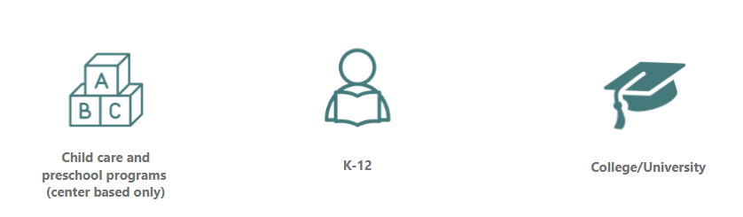
School Data
School vaccine coverage data not yet updated for 2024-2025 year
Current dashboard data is from 2023-2024
  School Vaccination Data | Vermont Department of Health
School nurses or administrators have the most up to date data
Notes:
Denise, thank you for showing us the dashboard today. As Denise mentioned, the dashboard is available on our webpage, also linked on this slide. We want to mention a few additional dashboard notes.
School vaccination data is collected annually from parents upon school enrollment and includes immunization details for students' kindergarten through 12th grade. The data is specific to a point in time and does not include homeschooled children or children not yet enrolled in school. The dashboard currently displays data from the 2023-2024 year. We don’t yet have updated data for this year, and we know many parents, schools and childcare facilities are outreaching with questions. We anticipate having new data in the coming months. It is important to note that the person with the most up to date data is the school nurse or administrator since they would have information on provisional admittance.

Slide 25

Statewide Coverage
89% of 2-year-olds in Vermont have received a dose of measles vaccine
83% of 6-year-olds in Vermont have received the recommended 2 doses of measles vaccine
We are below 95%
Notes:
We just discussed the school vaccination data collected from parents for students enrolled in school. Now lets dive into data from the Vermont immunization registry- more specifically measles coverage among 2- and 6-year-olds.
The IMR includes all vaccines administered in Vermont for adults and children, as well as vaccine data from residents receiving vaccinations at Dartmouth-Hitchcock medical center and some new York medical facilities.
Data from the Vermont immunization registry indicates 89% of 2-year-olds in Vermont have received one dose of measles vaccine. IMR data also demonstrates 83% of 6-year-olds in Vermont have received 2 doses of measles vaccine as routinely recommended. I’m going to take a pause here. As you may recall, we previously mentioned that 95% vaccine coverage is needed for community immunity to protect the greater population, and especially individuals that cannot get the routine measles vaccine including pregnant individuals and infants under 12 months of age.
This data is concerning. We are below 95% for one
This is concerning because measles we are below 95%. Now is a good time to ramp up vaccination efforts.

Slide 26

Call to Action
Use the IMR to identify patients not up to date and keep coverage rates accurate
Print the “Not Up to Date” report for patient recall and catch-up
Update primary practice when a patient moves out of state or goes elsewhere to an unknown practice
  Vermont Immunization Registry Tutorial: Patient status and moved or gone elsewhere
  That's Not My Patient IMR User Guide
Notes:
Practices can use the IMR to identify patients not up to date on vaccination and keep coverage rates accurate.
Support practices with identifying workflows for individuals not UTD/presumed not UTD
MOGE patients to keep state rates accurate
When a patient moves or goes to another practice elsewhere,
To keep your practice coverage rates accurate, you will need to indicate when someone is no longer your patient.
If the patient has moved or gone elsewhere and did not communicate where, you can use the IMR Status field to indicate their status, followed by clicking “save”
If the patient moves to another practice within Vermont, their primary practice will be automatically updated when they receive their next shot at the new location
Discuss your practice vaccine coverage at staff meetings
The Immunization Registry Team is excited to share the first videos in a new tutorial series that aims to help users get more out of the Registry. As of right now, two videos have been published to the website: first time login and troubleshooting common issues, and performing a patient search. New videos will be uploaded to the Medical Providers playlist, be sure to check in as more become available.

Slide 27
Call to Action
Discuss measles vaccination status with all adult patients
Identify pharmacies in your area that carry MMR vaccine for individuals 65+
Assess your own vaccine status to confirm evidence of immunity
Notes:
Consider calling pharmacies in your catchment area to assess MMR vaccine availability for adults 19-65 and individuals 65 years and older. This is part of building community capacity and
Assess the MMR vaccine supply at your district office to ensure you have doses on hand to use for gap filling vaccine administration and for provider practice transfer when applicable.
Develop prompts to assess measles vaccination status for adult patients

Slide 28
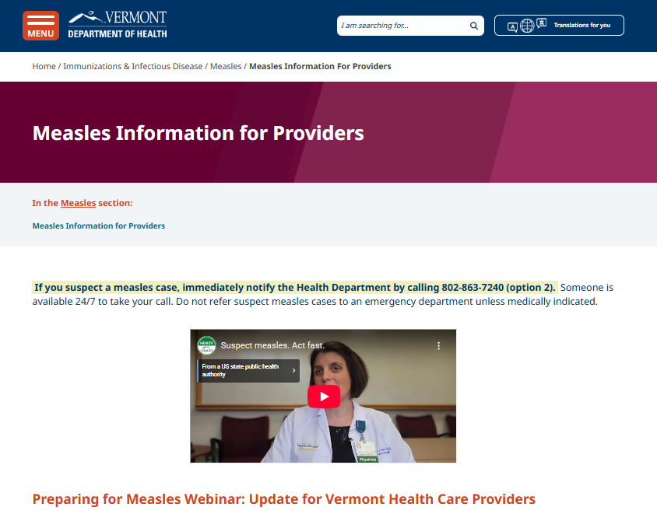
Vermont Department of Health Measles Resources
Measles Information for Providers page
  Measles Information for Providers | Vermont Department of Health
Measles Partner Messaging Toolkit for Schools and Child Care Facilities
  Messaging Toolkit for Schools and Child Care Facilities
What to Know About Measles Factsheet (will be updated soon with more adult content)
Notes:
The Department has developed a Measles Messaging Toolkit to support schools (and child cares [add as needed]) in understanding and responding to potential cases. The Measles Messaging Toolkit provides sample communication resources that can be shared with parents, caregivers, and staff. These materials include key information on measles, the importance of vaccination especially before traveling outside of the U.S., and guidance on what to do in case of exposure or if symptoms of measles occur. Please use and customize these resources as needed for newsletters, email lists, mailings, and other communication channels to help keep your school community informed and protected. For more information please visit the Vermont Department of Health website.
VDH has a Measles Information for Providers page that can be located by clicking the VDH hyperlink displayed on this slide. The Measles information for providers page has instructions for providers on how to report a suspected case, includes the “Preparing for Measles Webinar” led by the epidemiology and IZ teams in September 2024, and links to other resources such as MMR vaccine information, measles virus and disease transmission information and laboratory testing. We are currently working to update the VDH measles Partner Messaging Toolkit for Schools and childcare facilities. We are also in the process of updating the “what to know about measles” factsheet to include more adult content. Both resources will be available on the VDH measles for provider's page.

Slide 29

Translated Vaccine Information Videos
The Vermont Language Justice Project has created three new vaccine videos with translations in more than twenty languages
What to know about measles: A concise video about how measles is spread and protecting yourself and your kids with the vaccine.
Why is getting vaccinated important?: Explains the fundamentals of vaccine science and the role of vaccination in safeguarding your health.
Why do some vaccines require more than one dose to prevent a disease?: Covers the science behind the need for multiple doses, especially for children, and for boosters.
Notes:
And while we are on the topic of resources, the Vermont Language Justice Project has created three new vaccine videos with translations in more than twenty languages. We really want to highlight the what to know about measles video that may be a great resource for your practice.

Slide 30
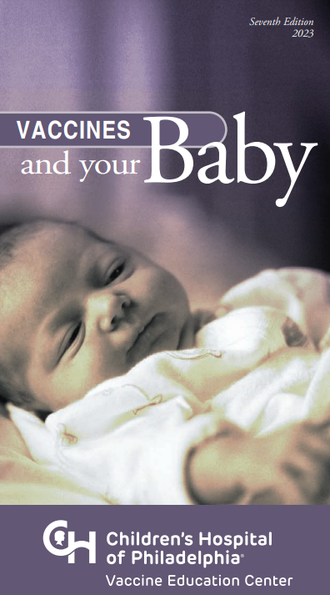
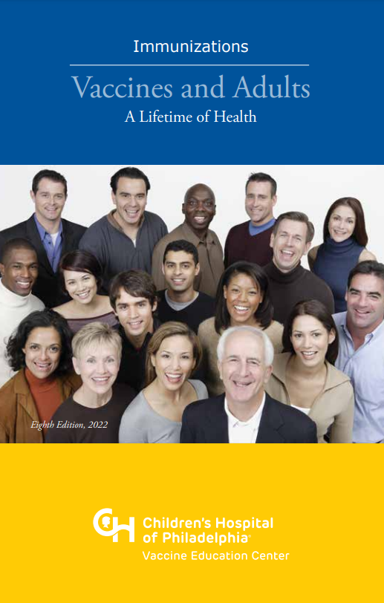
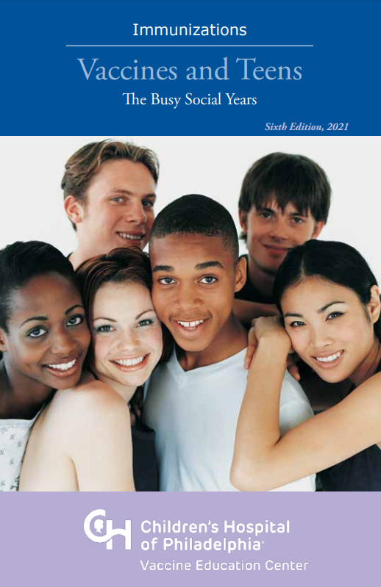
Printed Materials Ordering
The Immunization Program has received a vaccine confidence grant to supply printed materials to our vaccine provider partners. This survey will allow you to tell us what materials you want and where they would be used. We'll take care of ordering and having them shipped to your office.
Take the Survey
Notes:
Through CDC vaccine confidence funding, VDH is able to purchase resources for provider offices such as fliers, pamphlets, posters and books. You may have seen a link in a recent provider update asking about your office’s interest in a variety of sources. Please complete the survey to identify materials you would be interested in, and let us know if you have questions.

Slide 31
COVID-19 Vaccines
Notes:
Moving on from measles to a few other things that are ‘on the rise’, the first being COVID-19 vaccines.

Slide 32
Second COVID-19 Dose for 65+ and Immunocompromised Individuals
First vaccine dose | Second vaccine dose as early as recommended timing
September | November | March
October | December | April
November | January | May
December | February | June
January | March | July
February | April | August
Adults aged ≥65 years should receive 2 doses of 2024–2025 COVID-19 vaccine, and persons aged ≥6 months with moderate or severe immunocompromise should receive ≥2 doses to protect against severe COVID-19.
Notes:
Actually, we would love to see our COVID-19 vaccine coverage rates on the rise. As a part of making sure everyone is up to date, we want to quickly remind folks that anyone 65 years and older as well as those 6 months and older with moderate or severe immunocompromise, is recommended to receive 2 doses of 2024-25 COVID-19 vaccine. These individuals can receive their second dose as early as two months after the first dose, but the recommenced timing is to receive a second dose 6 months after the first dose of this years vaccine. As you can see by this chart, this means you likely have a number of patients that will be needing that second dose in late March, in April or May. Now is the time to start educating patients about the importance of the second dose and having conversations with them about making a plan to get it.

Slide 33
MMWR Released on COVID-19 Vaccine Effectiveness
Interim Estimates of 2024–2025 COVID-19 Vaccine Effectiveness Among Adults Aged ≥18 Years — VISION and IVY Networks, September 2024–January 2025 | MMWR
2024-2025 COVID-19 vaccine provides protection against COVID-19 associated emergency department/urgent care encounters and hospitalization
Notes:
In February, CDC released interim estimates of this years covid-19 vaccine effectiveness among adults 18 years and older. In summary, findings indicate the 2024-2025 COVID-19 vaccine provides protection against COVID-19 associated emergency department/urgent care encounters and hospitalization .

Slide 34
Flu

Slide 35
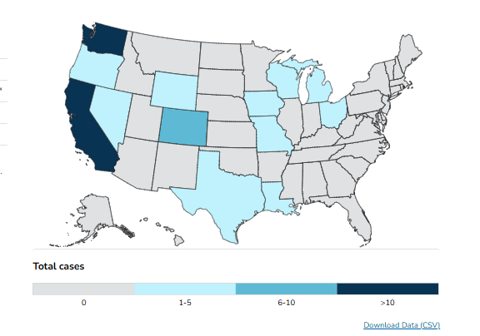
H5N1 Updates
70 human cases in the US with various exposure sources (as of March 10, 2025)
  41- dairy herds
  24-poultry farms/ culling operations
  3-unknown exposure source
  2-other animal exposures
Risk to general US population remains low
Moderate to high risk for US populations with contact with potentially infected animals/ contaminated surfaces and fluids
Notes:
And speaking of the flu, here is an H5N1 update. There has been 70 confirmed H5N1 cases in the US since April of 2024 with various exposure sources. 41 cases were due to exposure with dairy herds and dairy cattle, 24 from exposure at poultry farms and culling operations, 3 cases had no known source of exposure, and 2 cases were due to backyard flock/ wild bird exposures. CDC reports the current risk to the general U.S. population is low. The risk to populations exposed to potentially infected animals, including through contaminated surfaces or fluids, is currently assessed as moderate to high. On a positive note, there have been no additional cases of H5N1 in humans over the last week. This map displays H5N1 cases in humans across the US.

Slide 36
Nirsevimab Administration
Notes:
Next, we will talk about Nirsevimab administration – something we have seen on the rise this year.

Slide 37
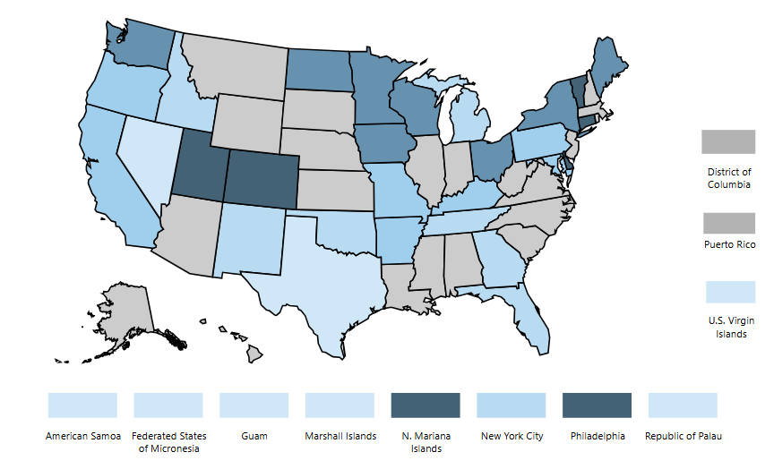
Celebrating: Nirsevimab coverage rate
Vermont currently had the highest nirsevimab coverage rate in the country for children 0 to 7 months at the end of December. As of the end of January, we are the fourth highest at 44.9 percent coverage.
Thank you for contributing to this success!
https://www.cdc.gov/rsvvaxview/dashboard/nirsevimab-coverage-jurisdiction.html
Notes:
This particular ‘on the rise’ topic is something exciting that we can celebrate – Vermont has been among those with the highest nirsevimab coverage rates in the country per CDC. You hopefully already saw this in the provider update newsletter, but just want to give a huge shout to all those on this call who have educated patients and community members on nirsevimab and who have contributed to this outcome. This is great news as we know this means more babies are protected from severe RSV disease.
Thank you for all for the work you are doing to protect these infants – we know it matters and is making an impact.

Slide 38
RSV Immunization Products Timeline
 | Abrysvo (Pfizer) | Nirsevimab (Beyfortus) | Abrysvo (Pfizer) Arexvy (GSK) mResvia (Moderna)
Who receives product? | Pregnant individuals 32-36 weeks gestation | Infants (birth to 8 months) for 1st RSV season; high-risk 8-19 months for 2nd RSV season | Universal recommendation: 75 yrs+ Risk-based recommendation: 60-74 yrs.
What type of product? | Vaccine | Monoclonal antibody (passive immunization) | Vaccine
What time of year administered? | September 1 – January 31 | October 1 – March 31 | Year round (1 dose per lifetime)
What is the plan for availability? | No longer available for administration; will be available through VFC/VFA for 2025-2026 season | Administered in birthing hospitals and provider offices | Available through VAVP for individuals 60-64 years
Notes:
Keeping on our RSV products theme, just want to draw attention to the fact that Abrysvo should no longer be administered to individuals who are pregnant. The administration period ended January 31. Babies who are born to pregnant individuals, who did not receive Abrysvo, should instead receive nirsevimab. And, of course, just a reminder nirsevimab administration ends March 31 and that for our older adults, RSV vaccine administration is year round
Next up Katie will discuss what we’re hearing.

Slide 39
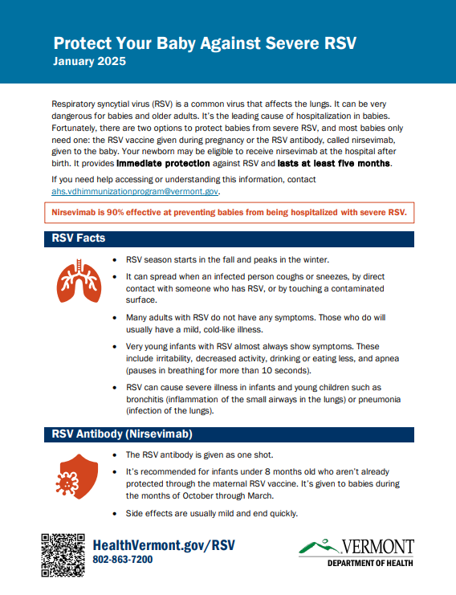
New- Nirsevimab Parent Handout
New VDH parent handout for birthing facilities
Provides parents and caregivers with education about RSV and nirsevimab and protecting their baby against severe disease.
Protect your baby against severe RSV fact sheet
Translated versions available
Notes:
The Vermont Department of Health has created a new parent guide for birthing facilities that aims to provide parents and caregivers with education about Respiratory Syncytial Virus and the monoclonal antibody, Nirsevimab. This one-page handout includes information about RSV symptoms, seasonality, and how Nirsevimab can protect their baby from severe disease. This was created in response to requests from birthing centers and providers for something beyond the Immunization Information Sheet. There are also translated versions available as linked.

Slide 40
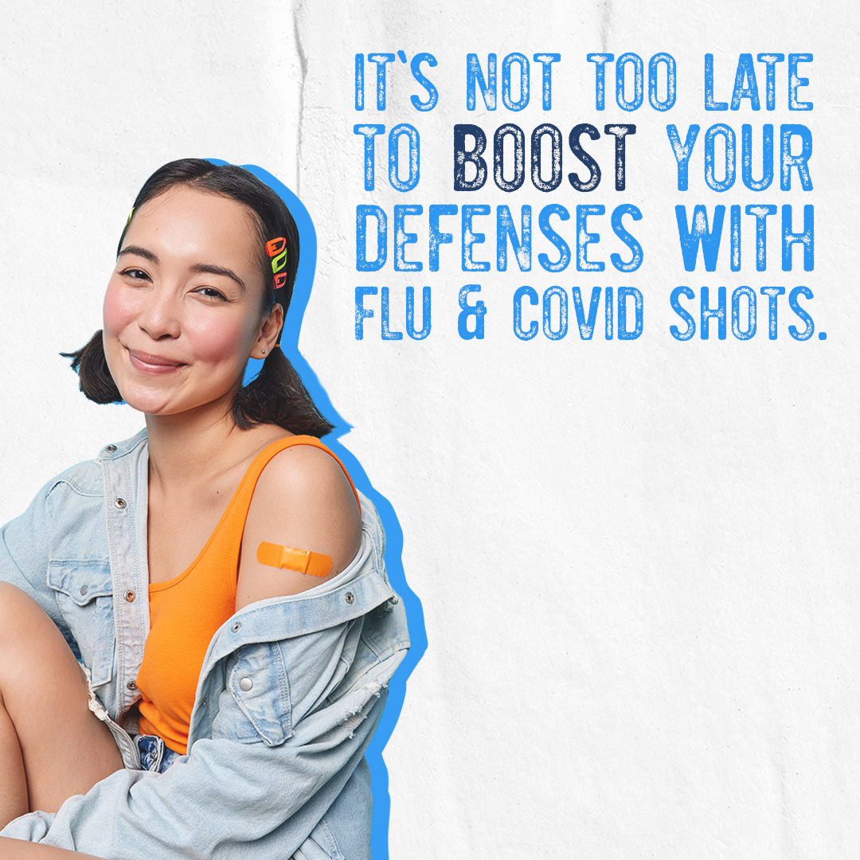
Not too Late to Vaccinate
Still appropriate to vaccinate for flu and COVID-19
Infants can still receive nirsevimab
Older adults can still receive RSV vaccination
Notes:
Again, takeaway message – it’s not too late to vaccinate
Flu Rates Still High: Schedule 2nd Dose of Flu Vaccine for Kids
Children 6 months to 8 years old need two doses of flu vaccine this season if:
They are getting the flu vaccine for the first time.
They have previously received only one dose of flu vaccine, or
Their flu vaccination history is unknown.
Recall pediatric patients who still need their second dose.
Nirsevimab Administration Ends March 31st
.

Slide 41

What We’re Hearing
Notes:
As mentioned at the beginning of today’s call, for the next part of the call we are going to focus on things we’re hearing on social media, from providers, from the community, and in the news. We will then provide some grounding facts to try to help provide context. That doesn’t mean we will have solutions or a crystal ball, but our goal is try to inform folks on how some things that have heard may impact the immunization landscape as a whole, and particularly within Vermont.

Slide 42

Ground Rules (Katie)
Notes:
So before we dig in, I want to put together some ground rules. We are not seeking to disparage any specific political view or specific government official. Some of the slides in this section feature screenshots from news headlines and they include government figures’ names, but the purpose is solely to share some headlines you have likely seen. The focus is not on the individuals mentioned in the headline – we are not here to provide political commentary.
The things we want to address are those that we have specifically been seeing cropping up in news and sometimes for analysis in trusted sources that I’m sure many of you also receive, like Your Local Epidemiologist. So we want to add some state context to that information. Or there are statements we have heard directly from partners, colleagues and community members.
Our goal is to be open and transparent. Much of what we will be talking about are things in which we don’t have a crystal ball to know what will happen, including the exact impacts of some of these potential actions – we are walking in uncharted territory.
And, we aren’t legal experts so none of this is any type of legal analysis.
And, hopefully this goes without saying but since we don’t have a crystal ball and we aren’t legal experts, none of this should be taken as concrete fact – we are attempting, with guidance from partners, to keep up with the potential changes and interpret how they may impact us – we could be wrong as lots of things could come down to someone’s interpretation of policies or statutes, such as in a court case.
Anyway, given all these caveats, in the next few slides we will focus on sharing information with you about the federal vaccine infrastructure as well as the Vermont immunization infrastructure to help provide context for the headlines.

Slide 43
ACIP Changes
Notes:
Next, we will talk about Nirsevimab administration – something we have seen on the rise this year.

Slide 44

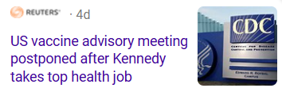
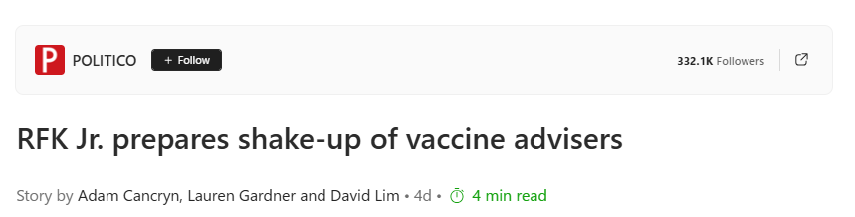
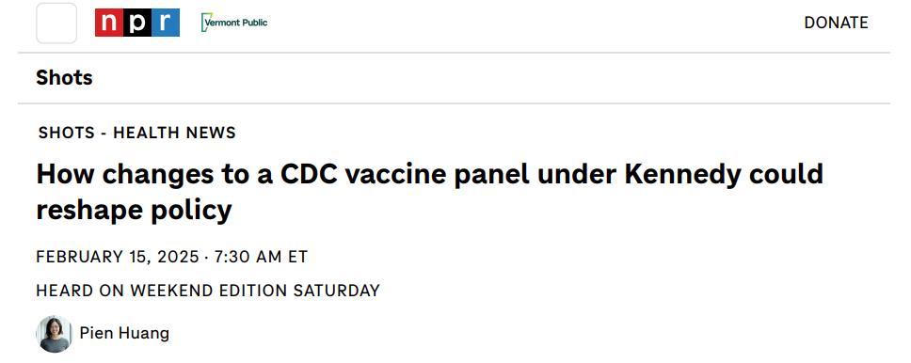
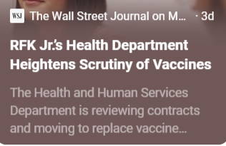
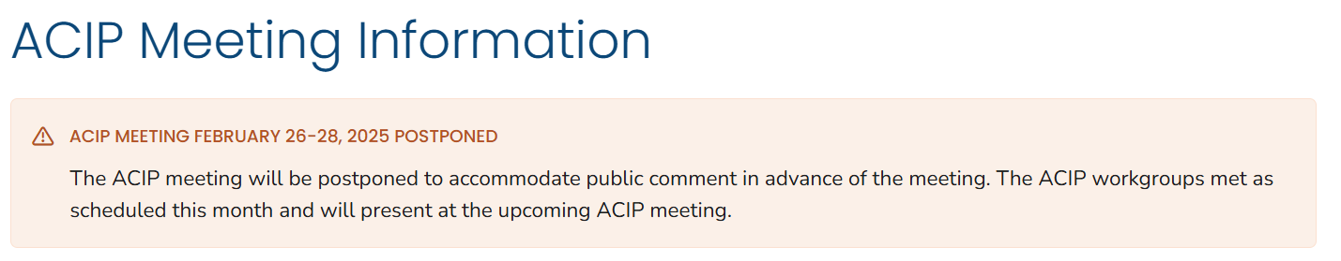
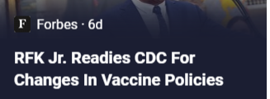
ACIP Changes
Notes:
Okay, let’s start with what may seem the obvious thing we are hearing as it directly impacted today’s content and that is some form of “What is going on with the ACIP?” Some of this may be related to recent events such as the ACIP meeting being postponed or related to headlines about the ACIP such as membership possibly being changed.

Slide 45
ACIP Changes: What we know
Role of ACIP (Advisory Committee on Immunization Practices)
Make immunization recommendations that comprise the vaccine schedule
  Insurers must cover vaccines on the schedule under the Affordable Care Act
Determine which immunizations are included in Vaccines For Children
Update vaccine recommendations based on regular review of safety and effectiveness data.
ACIP Membership
The ACIP includes up to 19 voting members responsible for making vaccine recommendations. The Secretary of the U.S. Department of Health and Human Services (DHHS) selects these members following an application and nomination process.
Notes:
So, here’s what we know. The ACIP normally meets 3 times at a year to the make recommendations and obviously the meeting that was scheduled for February was postponed.
Just to make sure everyone has the same information, it is important to know the role of the ACIP. First, we know that the ACIP is responsible for creating immunization recommendations that comprise the vaccine schedule. The ACIP-approved vaccine schedule is used by insurers as well as they are required to cover ACIP recommended vaccines under the Affordable Care Act. Second, the ACIP determines which immunizations are included in the federal Vaccines for Children program. Third, ACIP regularly updates vaccine recommendations as they are reviewing the safety and effectiveness data of immunizations. A recent example is the updates they made this year for the recommendations for RSV vaccines for adults.
We have heard rumors of different approaches that may happen in terms of ACIP changes, including potentially not calling ACIP to meet, letting its charter expire, disbanding it, or changes to membership. Each of these would have a different type of impact as you can imagine.
In terms of membership, it is important to know that the Secretary of HHS can appoint or replace ACIP committee members, which may lead to new sets of CDC recommendations. Changes could look like a move to shared clinical decision making, changes on who is recommended to receive vaccines, or removing a vaccine altogether.
Before we really talk a bit more about the implications of this and what this means for Vermont, I want to also go to two other ‘what we are hearing topics’, immunization schedules and Vaccines for Children program, because they are intrinsically linked as shown by what we just reviewed in terms of the ACIP’s role .

Slide 46
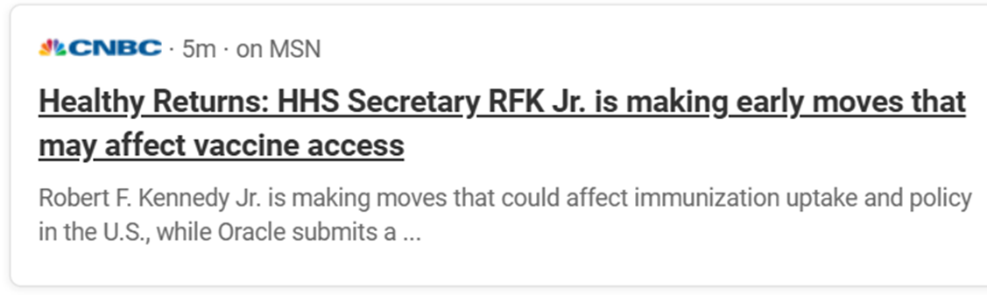
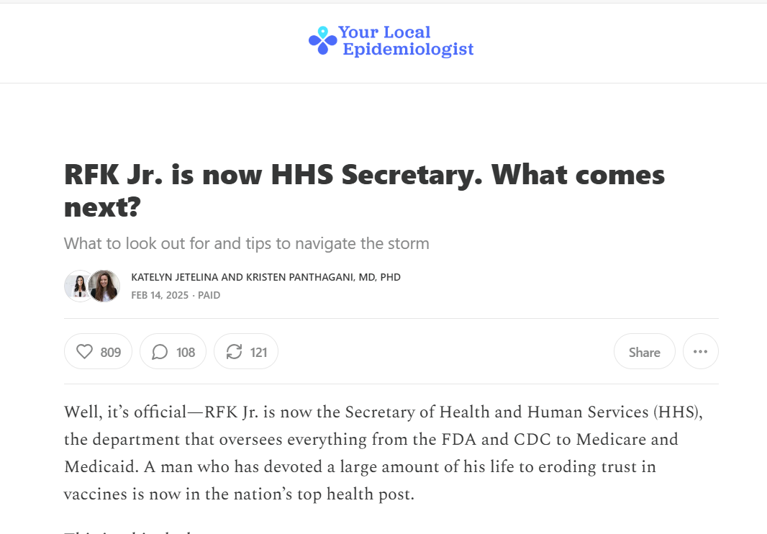
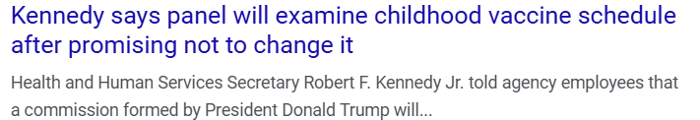
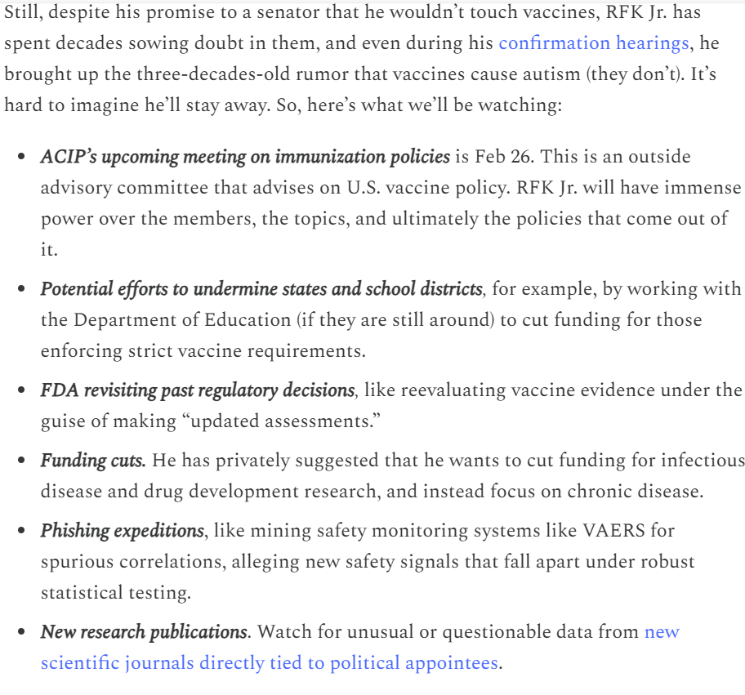
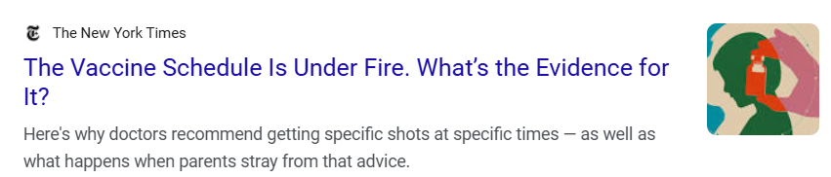
Childhood Vaccine Schedule Overhaul
RFK Jr. is now HHS Secretary. What comes next?
Notes:
First, we know there have also been things in the news and concerns heard among community members about an overhaul of the vaccine schedule, with the childhood vaccine schedule sometimes being particularly called out as being at risk. This is intrinsically linked to concerns about ACIP changes because when we are talking about the childhood vaccine schedule we are essentially talking about the ACIP recommendations.

Slide 47
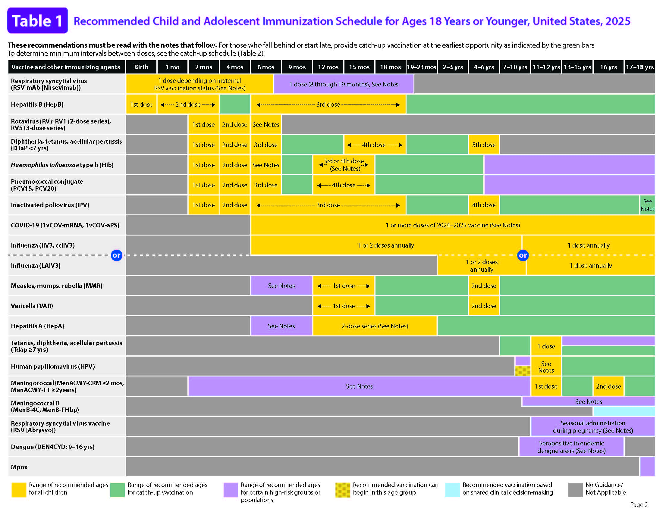
Notes:
What we commonly refer to as the childhood immunization schedule (seen here) is essentially the recommended schedule where the CDC director has adopted the recommendations of the ACIP. When we talk about the child immunization schedule that is generally used as shorthand for the ACIP recommended schedule that as we said in the last slide is also used by insurers to determine which vaccines are covered under insurance.

Slide 48
Childhood Vaccine Schedule Overhaul: What we know
CDC director must accept ACIP recommendations for them to become official CDC policy and a part of the immunization schedule.
CDC Director can choose to decline, amend or overrule them.
  In 2021, CDC Director Dr. Rochelle Walensky overruled ACIP and approved COVID-19 booster shots for people who work in high-risk environments.
Childhood and adolescent schedules are also approved by:
American Academy of Pediatrics (AAP)
American Academy of Family Physicians (AAFP)
American College of Obstetricians and Gynecologists (ACOG)
Adult schedule is also approved by:
AAFP
ACOG
American College of Physicians
American College of Nurse-Midwives
Notes:
So, just a few quick, grounding pieces of information about the childhood vaccine schedule. The CDC director must accept the ACIP recommendations for them to officially become a part of the schedule and there is precedent where the director has chosen to amend or overrule them. For example, it happened in 2021 with the COVID-19 boosters. Additionally, it is important to know that national partners, such as AAP and AAFP, also approve the vaccine schedules.

Slide 49
Vaccines for Children Program
Notes:
Next, we will talk about Nirsevimab administration – something we have seen on the rise this year.

Slide 50
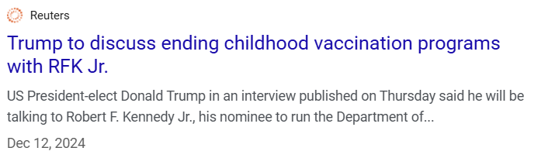
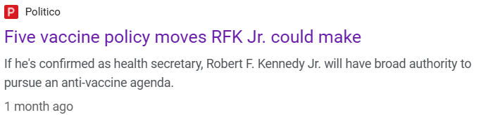
Vaccines for Children Changes
Notes:
And, finally, the third area that we have seen some messaging around is the possibility of changes to the Vaccines for Children Program.

Slide 51

Vaccines for Children: What we know
The VFC federal vaccine program created by Congress in 1993
Entitlement program (a right granted by law)
Allows the CDC to purchase discounted vaccines and distribute them to state and local health agencies
Goal is to prevent vaccine-preventable diseases by removing cost barriers
VFC Program eligibility includes: younger than 19 years of age and one of the following: uninsured, Medicaid-eligible or Medicaid-enrolled, American Indian or Alaska Native, or underinsured
Federal government leadership has ability to add/remove vaccines to Vaccines for Children Program
Notes:
The Vaccines For Children (VFC) program is a federal program established under Section 1928 of the Social Security Act. It is an entitlement program that removes cost barriers for children and adolescents who are uninsured, Medicaid-eligible or Medicaid-enrolled, American Indian or Alaska Native or underinsured. This federal program allows CDC to contract with pharmaceutical companies to buy discounted vaccines to distribute to VFC-enrolled providers across the country through state immunization programs.

Slide 52
Vermont Immunization Landscape
Vermont is a universal vaccine state (birth - 64 years), providing vaccines to enrolled providers at no cost for use with all patients, regardless of insurance status.
  Made possible by the Vermont Vaccine Purchasing Program (VVPP)
Insurer funding is combined with federal funding to support the purchase of vaccines from the CDC federal contract at the lowest price.
Vermont Vaccine Purchasing Program, per statute, is to administer an immunization program to ensure universal access to vaccines
  Immunizations is defined in statute as ACIP recommended vaccines
Notes:
Okay, so now I’ve given a bit of an overview of these three interconnected areas -- the ACIP, childhood vaccine schedules and the Vaccines for Children Program.
So I want to provide some context to how this could impact the vaccine landscape, particularly in Vermont. I think most people know this but Vermont is a universal vaccine state allowing vaccines to be provided at no cost to providers for all patients birth to 64 years regardless of insurance status. This program is established per statute and is funded through insurer funding. Insurers pay a fee per insured individual that goes into a pool of funding to support vaccine purchases.
I will note that in the statute immunizations are defined as ACIP recommended vaccines.
It’s important to think about the context of these changes for Vermont in the context of being a universal changes because that means for some possible federal actions we would be somewhat more insulated and for other possible actions there may be more of an impact.

Slide 53
Immunization Program funding comes from multiple sources
Program Funding (including staff)
Federal: CDC 70%
State: Medicaid, General Funds 5%
Health insurers - Vermont Vaccine Purchasing Program 25%
Vaccine Funding
CDC
  Vaccine for Children – 54% of all pediatric vaccine costs
  317 –adult uninsured (approx. 10% of adult vaccine cost)
VVPP
  46% of pediatric
  90% of adult (19-64) vaccine costs
Notes:
The main takeaways from this slide are 1) the Immunization Program itself is primarily federally funded, but that there are other funding sources which is different than some other states. And the second main takeaway, when you look at vaccine funding you can see that nearly all adult vaccine and nearly half of pediatric vaccine is funded through the Vermont Vaccine Purchasing Program through insurer funding. So this is good news in terms of thinking of sustainability if there were to be funding cuts to federal immunization funding or even more specifically to the Vaccines for Children federal program.

Slide 54
What we know
Immunization Program is proactively planning and preparing
Collaborating with national partners
Working with Vermont Department of Health Leadership
Keep in mind…
Many insurers covered vaccines prior to the Affordable Care Act.
AAP, ACOG, AAFP and other national partners are vaccine champions.
Vermont has a long history of a strong state immunization program.
Notes:
Vermont is actively participating in conversations with national partners, such as the Association of Immunization Managers (AIM), on how to have a coordinated, unified approach to address potential changes to ACIP. We want there to be a unified approach with a singular source so that if someone lives in New Hampshire or New Mexico they aren’t hearing something completely different than Vermont. Conversations are happening at a national level and within specific states on leaning on AAP and potentially AAFP for recommendations if ACIP were to quit making recommendations or start rescinding recommendations in an alarming manner.
Vermont already belongs to a purchasing group for vaccines that we use for purchasing employee vaccines that we have identified as a potential access point if CDC starts to drop specific vaccines from the VFC program and thus potentially drops the contracts for those vaccines.
Merideth Plumpton, our Immunization Program Manager, is regularly meeting with national partners, the Department leadership and state partners and advocating hard to make sure we have clear plans for how to pivot if needed.
I also just want to add that we want to keep in mind that on a national level, many insurers covered vaccines prior to the Affordable Care Act. So even before the Affordable Care Act mandate to cover ACIP recommended vaccines there was strong support for vaccines. Vaccines make economical sense for insurers as a cost savings. Also, as was mentioned earlier, we have national partners that are incredible vaccine champions, including being a part of the process in the development and approval of the vaccination schedule. We have seen this advocacy replicated on the state level as well with the Vermont chapter of AAP and other state professional organizations.
Finally, Vermont itself has a history of having a strong immunization program that has used creative means like the universal vaccine program to ensure access. Our goal regardless of federal changes is to maintain an universal program and vaccine access for Vermonters.

Slide 55
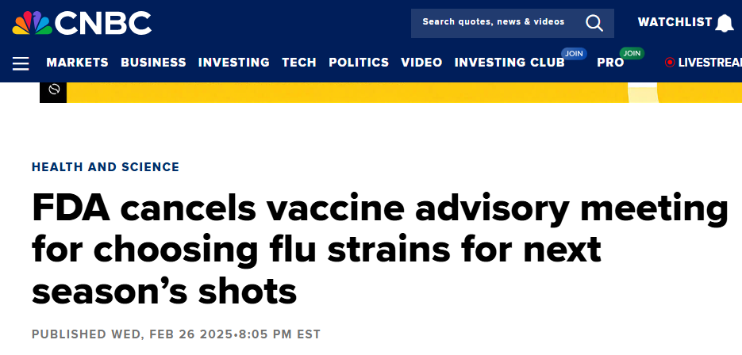
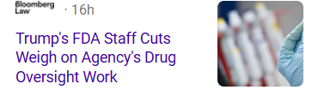
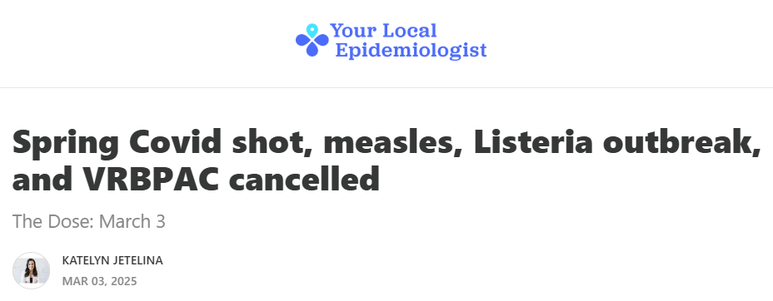
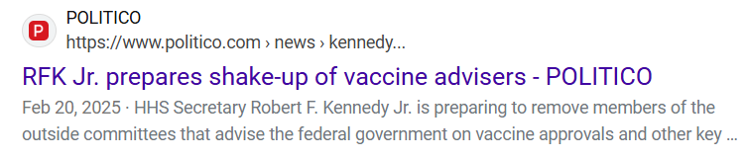
FDA Changes
Notes:
Next, we want to address what you may have heard in the news about potential changes for Food & Drug Administration, or the FDA. You may have seen some of these headlines about potential changes to FDA committee members or perhaps the cancellation of the VRBPAC. VRBPAC, or the Vaccines and Related Biological Products Advisory Committee, is the FDA Committee.

Slide 56
FDA Changes: What we know
Role of FDA (Food and Drug Administration):
Ensure the safety, efficacy, and security of human and veterinary drugs, biological products, and medical devices
Help speed innovations to make medical products more effective, safer and more affordable
Help public get accurate, science-based information
Vaccines:
Oversees review of the safety and efficacy of candidate vaccines
Authorized to determine whether vaccines are approved for use
Notes:
The Food and Drug Administration, or the FDA, has a number of roles listed here, including being responsible for protecting the public health by ensuring the safety, efficacy, and security of human and veterinary drugs, biological products, and medical device.
In terms of vaccines, the FDA oversees the review of the safety and efficacy of possible vaccine products and only vaccines that have been FDA-approved can be legally administered in the U.S. (Although FDA can also provide emergency use authorization for select vaccines under certain circumstances, as was done during the COVID-19 pandemic).

Slide 57
FDA Changes: What we know
Vaccines and Related Biological Products Advisory Committee (VRBPAC)
Advisory body of external experts to provide input into vaccine policy decisions during vaccine reviews. (Link to VRBPAC Charter)
Reviews and evaluates data concerning safety, effectiveness and appropriate use of vaccines and related biological products
Considers “quality and relevance of FDA’s research program which provides scientific support for the regulation of these products and makes appropriate recommendations to the Commissioner of Food and Drugs”
VRBPAC Membership
VRBPAC has a core of 15 voting members including the Chair. FDA Commissioner or designee selects VRBPAC members and has ability to replace members.
Notes:
Just like CDC has the ACIP as an external advisory body, the FDA has an external advisory body called VRBPAC that reviews and evaluates data on the safety, effectiveness and appropriate use of vaccines. VRBPAC has a charter that is renewed every two years and has a core of 15 voting members who are selected by the FDA Commissioner. Like the HHS Secretary and CDC Director, the FDA Commissioner is a position that is nominated by the president and confirmed by the Senate.

Slide 58
FDA Changes: What we know
VRBPAC Cancellation and 2025-2026 Flu Vaccine:
FDA has issued a statement assuring people that necessary manufacturing processes to develop the 2025-2026 flu vaccines will continue in a timely fashion.
Additional FDA/VRBPAC Vaccine Landscape Context:
Only vaccines that have been FDA-approved can be legally administered in the U.S.
FDA is a regulatory agency
  Standards in regulations beyond the Commissioner’s unilateral control
  More opportunity for legal review of major regulatory changes than ACIP
  FDA’s budget is set by Congress
Notes:
All right, so the last two slides gave some overview of FDA and perhaps may have you panicking a bit and feeling close to an existential crisis, or at least some sort of vaccine crisis. Here is what I will just call the final breakdown.
So when we are speaking specifically to the recent cancellation of VRBPAC in terms of the flu strain selection, we have seen FDA issue a statement assuring people that the necessary manufacturing process will not be impacted and will continue in a timely manner for the 2025-2026 flu vaccine strain selection. So that is reassuring.
What else do we want to emphasize? I said this earlier but it bears repeating even if it is disheartening and that is that only vaccines that have been FDA-approved can be legally administered in the U.S. This is important because if a licensure was to be revoked for a specific vaccine it would have significant impacts on accessing that vaccine in terms of just basic supply as well as the legal ramifications of administering an unlicensed product.
The other point to emphasize is a bit of distinction from ACIP. FDA is a regulatory agency with drug and vaccine approval standards set in FDA regulations beyond the Commissioner’s unilateral control. We have been advised by our national partners that there is more opportunity for legal review of major regulatory changes than there is with ACIP. Additionally, FDA’s budget is set by Congress, and significant funding changes need Congressional approval. So these are all important pieces of the puzzle, and hopefully somewhat comforting.

Slide 59
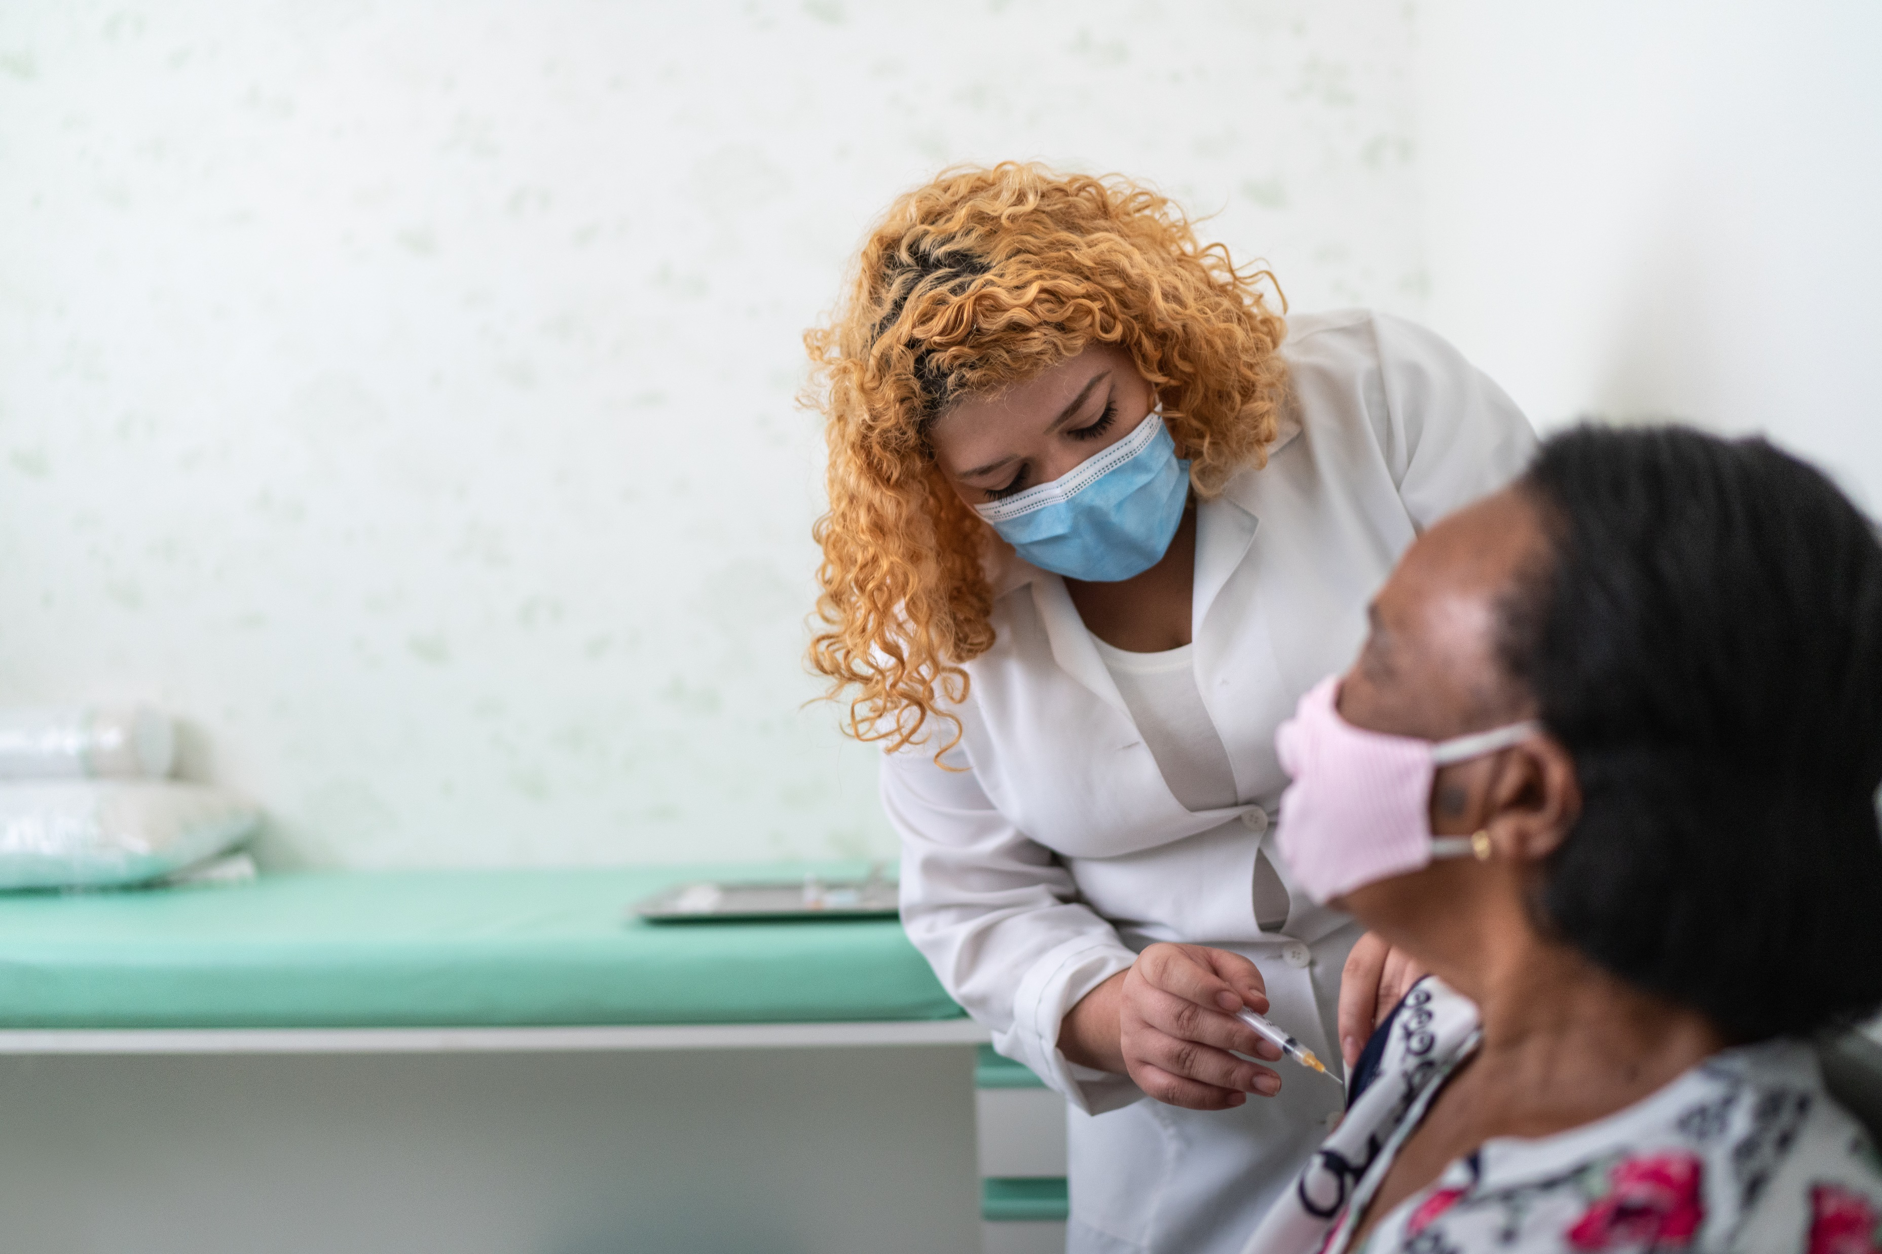
Vaccines are still the social norm
74% of American voters believe the U.S. should prioritize ensuring FDA-approved vaccines are widely available for everyone.
81% of voters say it is important for the U.S. to remain a leader in developing new vaccines.
Nearly 70% of respondents expressed concern over declining vaccination rates among children.
New Poll: Majority of Americans Support Keeping Vaccines Widely Available to Protect Children and Communities
Notes:
What I want to say next is important. Vaccines are still the social norm. We regularly see evidence of this in Vermont in not only the questions and engagement we have from the community around vaccines, but also in our high coverage rates. Even though we were saying that we want higher MMR coverage rates earlier, we were also looking at rates that were telling us that nearly 9 out of 10 parents of 2 years has chosen to vaccinate their child against measles. We also have some recent national polling here that I won’t go into detail, but that shows there is strong support for vaccines nationally. We are hearing a vocal minority that is driving the public conversation about vaccines. And, yes, there are lots of parents that have questions about vaccines or may express some hesitancy or concerns as a part of their vaccine journey. But, we should expect to be in dialogue with parents and families about their child’s care.
The point here is that what this is telling us is that we have a majority who want access to vaccines and we would expect to see that silent majority become vocal if vaccine access is curtailed through vaccine licenses being revoked.
Partnership to Fight Infectious Disease released results of a public opinion poll that revealed most American voters support continued availability of FDA approved vaccines. In fact, 74% of American voters believe the US should prioritize having FDA vaccines widely available. In that same poll, 81% of voters felt that it is important for the US to remain a leader in developing vaccines, and about 70% of those who responded to the poll voiced concern over declining vaccine rates among children.

Slide 60
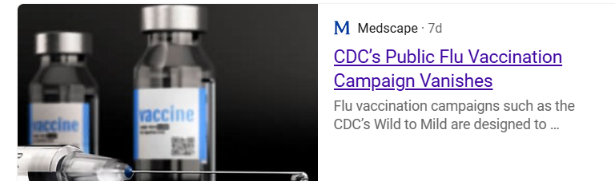
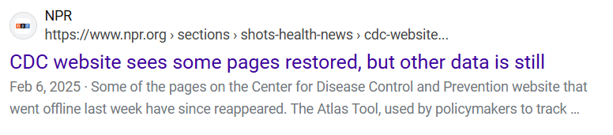
CDC Resources Removed from Website
Notes:
I’m sure you are all aware through your own visits to CDC’s website as well as well as through headlines like those shown here that there have been some changes in CDC’s website.
For example, we saw this happen with the mpox interim clinical considerations. I just want to point out that we have identified that it won’t necessarily accurately reflect the date of change either at the bottom of the page which I this image on the bottom right hand corner or in the summary of recent changes as you see in the top right hand corner. It seems as if the banner that we have a screenshot of here is the forewarning that any page may be changed.

Slide 61
CDC Changes
Notes:
Next, we will talk about Nirsevimab administration – something we have seen on the rise this year.

Slide 62
CDC Resources Removed from Website: What we know
ACIP Recommendations (as outlined in MMWRs) and Vaccine Information Statements (VISs) available on Immunize.org
Reach out if there are resources missing that you need or if you have questions due to any changes in wording on the clinical guidance pages.
Notes:
It’s important to note that if it were to be necessary, one of our national partners, Immunize.org, has all VISs and MMWRs downloaded and available if needed.
If you find resources or information is missing that you need due to any changes in the wording on clinical guidance pages, please reach out to us.

Slide 63
Reputable Vaccine Websites
VaccineInformation.org | Vaccination Saves Lives!
HealthyChildren.org - From the American Academy of Pediatrics
Vaccine Education Center | Children's Hospital of Philadelphia
AIM Connecting the Dots: Vaccine Confidence
Vaccinate Your Family
Voices For Vaccines | credible vaccine information for families, from families
VaccineInformation.org | Vaccination Saves Lives!
American Academy of Pediatrics: Immunizations
Home | Immunize.org
American Immunization Registry Association: Home
Home | Your Local Epidemiologist
Notes:
Considering some of the uncertainties around future availability of CDC vaccination resources, we wanted to share other reputable immunization websites. This is not a comprehensive list, but it is a fair start.
Your local epidemiologist, the last link on this slide, has an email subscription option.

Slide 64
Messenger RNA Vaccines
Notes:
Next, we will talk about Nirsevimab administration – something we have seen on the rise this year.

Slide 65
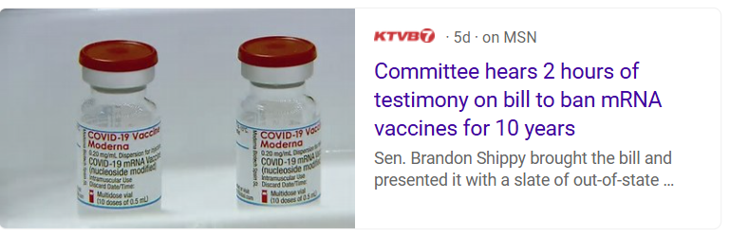
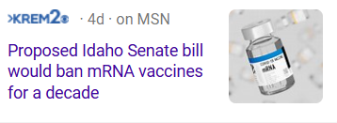
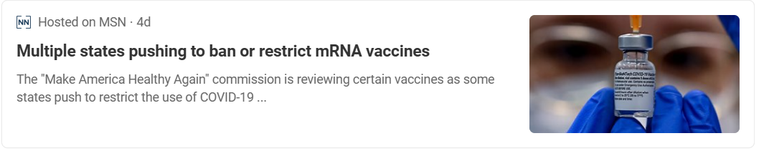
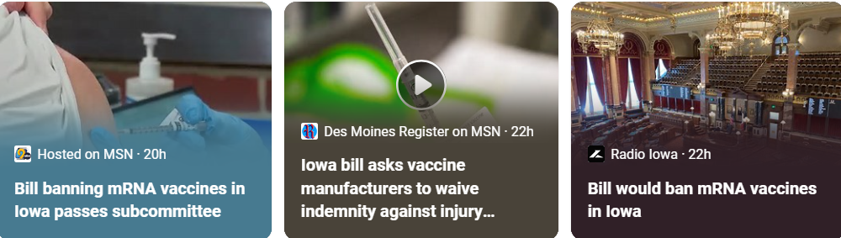
Messenger RNA Vaccines
Notes:
You may have seen recently in the news a number of stories about states restricting messenger RNA vaccines and may have even heard rumors about messenger RNA vaccine access being curtailed federally. And, it is true, there are a number of states that have bills that are being debated on messenger RNA vaccines. What we often see is that once one state has a bill that several other states will follow with a similar bill. There are lobbying groups that provide the template for the bill and freely share it across the country trying to find someone in each state to sponsor the bill. So we will likely continue to see these bills. We have not seen this bill in Vermont at this time and hopefully will not.

Slide 66
Messenger RNA Vaccines: What we know
COVID-19 messenger RNA vaccines for 12+ are licensed (Biologics License Application/BLA)
Pediatric vaccines (6 months – 12 years) remain under EUA (Emergency Use Authorization)
“Before FDA can issue an EUA, the HHS Secretary must declare that circumstances exist justifying the authorization. An EUA declaration is based on specific types of determinations, also under section 564 of the FD&C Act, of emergencies/threats or potential emergencies/threats by the Secretaries of HHS, Homeland Security, or Defense.”
    FAQs: What happens to EUAs when a public health emergency ends? | FDA
Notes:
But, I do want to provide context to the rumors at the federal level. There have been some rumors that the intention is to ban messenger RNA vaccines at the federal level. For what we know, we need to start with understanding that there is currently two different ways these vaccines are available – some messenger RNA vaccines, particularly those for 6 months – 11 years, are available under EUA, or emergency use authorization. Those for 12 years and older, or Spikevax and Comirnaty, are licensed and available under BLA or Biologics License Application like any other routine vaccine.
If we are trying to think of ways these vaccines may disappear from the market or be inaccessible we have a couple of different potential options. The first few are some of those we discussed earlier. One option is the ACIP recommendation for these vaccines could be changed to be for a smaller, more specific population, become shared clinical decision making or could be removed. Second, the vaccines could be removed from the Vaccines for Children list. Third, CDC contracts for messenger RNA vaccines could be pulled.
But, I want to place special attention at this time on the fact that the COVID-19 pediatric vaccines are available for EUA. As you can see here, the type of EUA, the pediatric vaccines are under is a specific type that exists after a public health emergency ends, and it is dependent on the HHS Secretary determining that circumstances exist to justify the authorization.
Now to be clear, we haven’t heard anything specific that causes us to have immediate fear of these EUAs being pulled, but we wanted to provide the context in which these rumors are occurring. And the context is that these pediatric COVID-19 vaccines are perhaps a bit more vulnerable based on their availability under EUA.
Products under EUA:
COVID-19 messenger RNA vaccines for 6 months – 11 years (Moderna, Pfizer)
Novavax COVID-19 vaccine
Jynneos vaccine (mpox prevention) for under 18 years

Slide 67
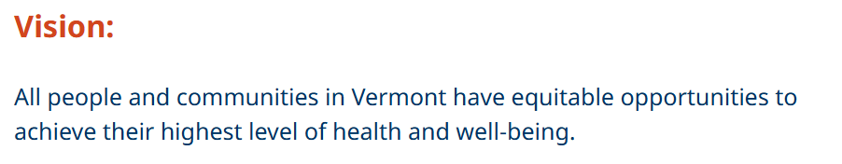
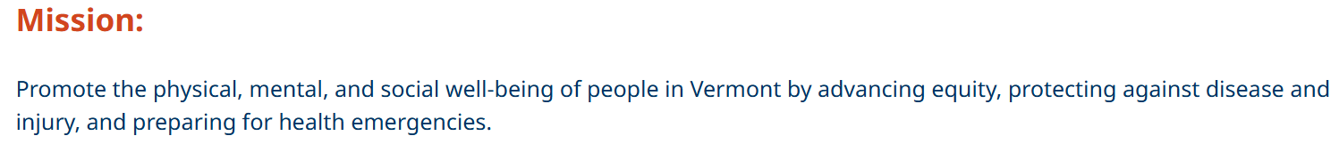
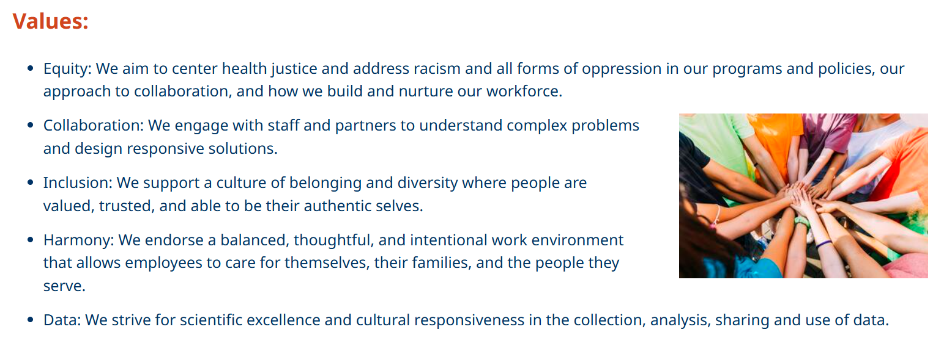
Vermont Department of Health
Notes:
Finally, I want to end by saying, regardless of what is happening on the national level,

Slide 68
Notes:
Before we open it to questions, we want to end by again saying, please come join us in Burlington on May 21 for a day of learning and connection.

Slide 69

Questions and Open Conversation

Slide 70
Thank you!
Let’s stay in touch
Email:
AHS.VDHImmunizationProgram@vermont.govhsAHS
Web:
healthvermont.gov
Social:
@healthvermont

