Slide 1
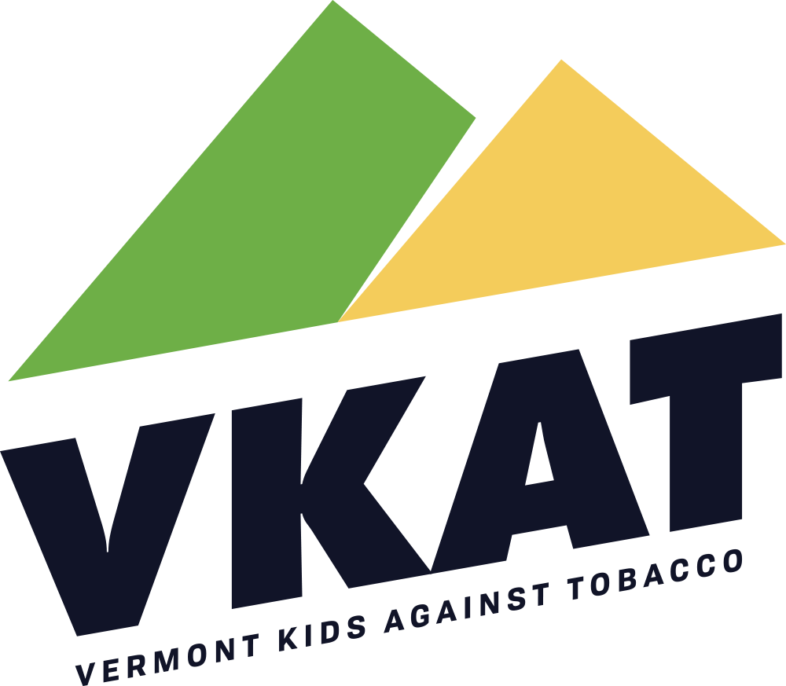
Our Voices Xposed and Vermont Kids Against Tobacco Project Highlights
FY2024

Slide 2
Our Voices Xposed and Vermont Kids Against Tobacco
Our Voices Xposed (OVX) high school youth and Vermont Kids Against Tobacco (VKAT) middle school youth work to educate and inform their school peers, community members and local and state decision makers on the manipulative and deceptive marketing tactics tobacco and vape companies use to target youth and addict the next generation of consumers.
The Vermont Department of Health Tobacco Control Program has partnered with the Agency of Education since 2016 to support student OVX and VKAT chapters to end tobacco’s influence on youth.
Students lead community events, such as the Annual Youth Statehouse Rally, and work on projects that prevent youth tobacco initiation. Example projects are highlighted in this presentation.
For more information on OVX or VKAT, or assistance implementing a chapter in your community, please contact the Vermont Tobacco Control Program at tobaccovt@vermont.gov.

Slide 3
OVX Allen Street Campus Chapter
Allen Street Campus, located in Rutland, OVX members used grant funding and worked with Partners for Prevention, a youth prevention organization, to conduct prevention presentations, hold discussions, and education about the harms of smoking, vaping and other tobacco use during the 2023 – 2024 school year.
OVX members engaged with an artist in resident to create an Outdoor Art Wall, pictured left, where students can creatively use spray paint to share a personal tobacco and nicotine prevention message with peers.

Slide 4
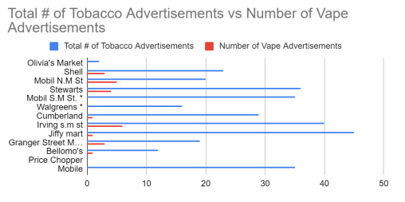
OVX Allen Street Campus Chapter, continued
Rutland’s Allen Street Campus OVX students worked alongside school staff on a research project to examine tobacco advertisements to determine how many vaping products were sold in Rutland City stores and how many would have been banned under passage of Bill S.18, the flavor tobacco product ban. The bill passed the Vermont house and senate but was vetoed by Governor Phil School. See graph, left.

Slide 5
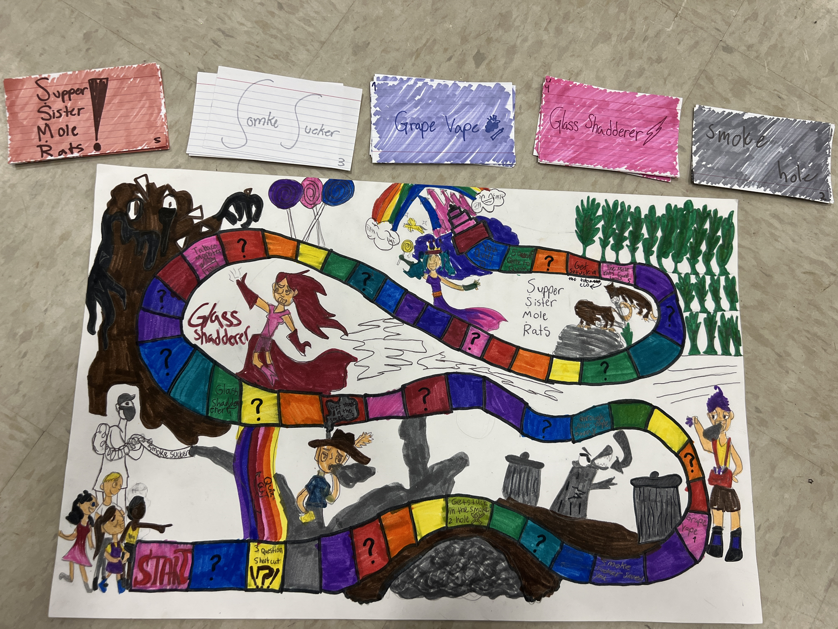
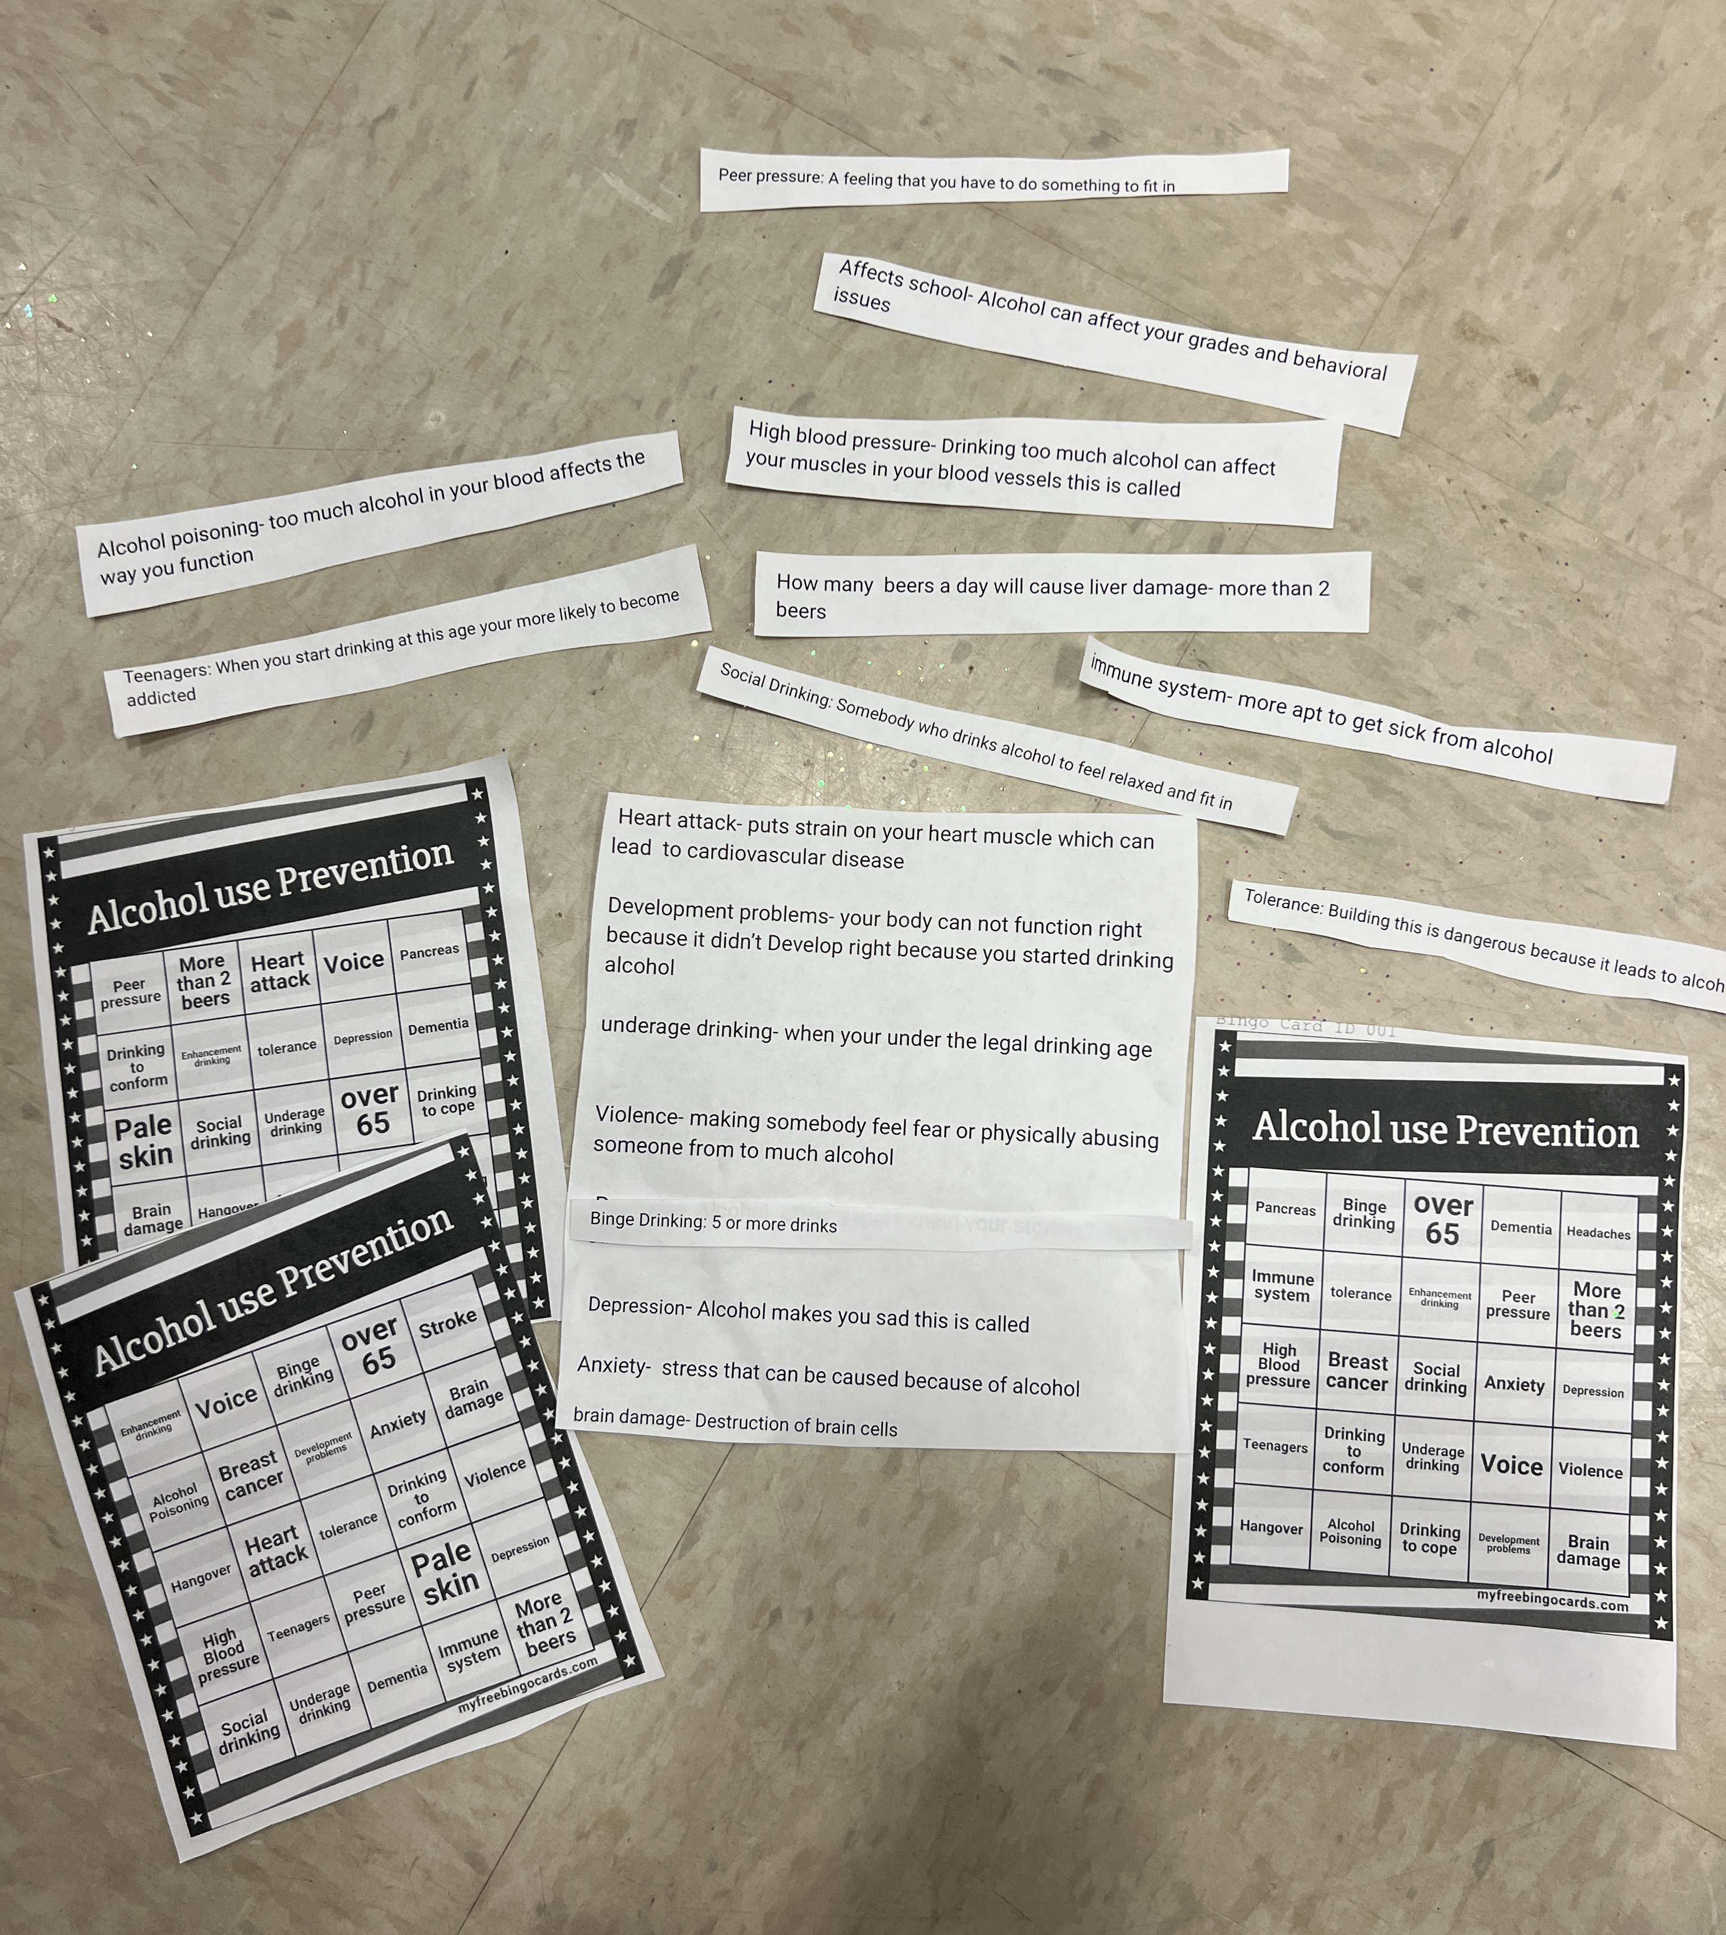
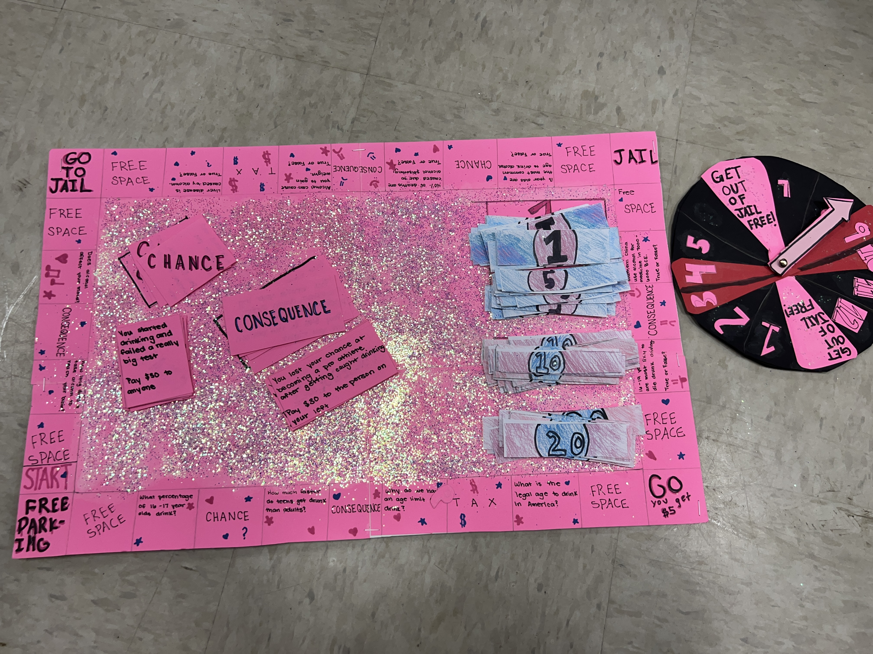
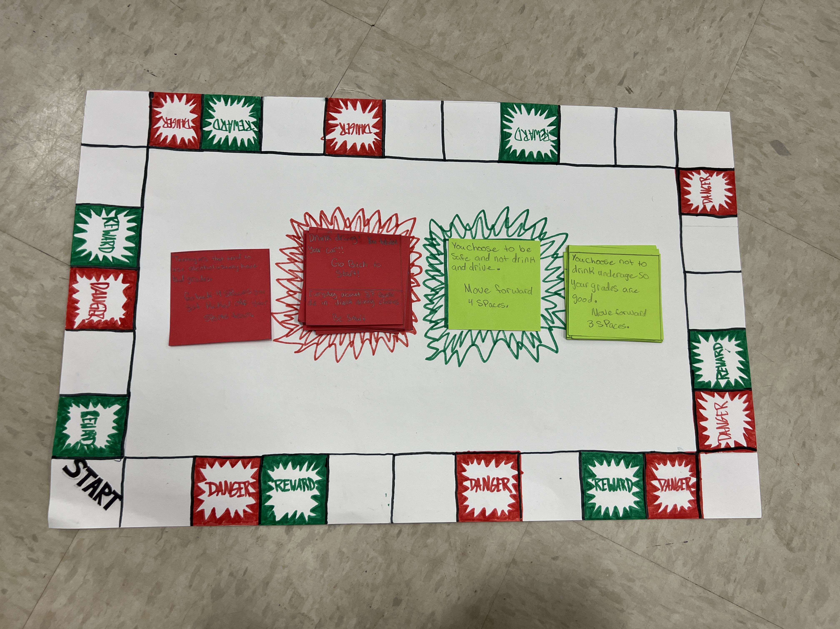
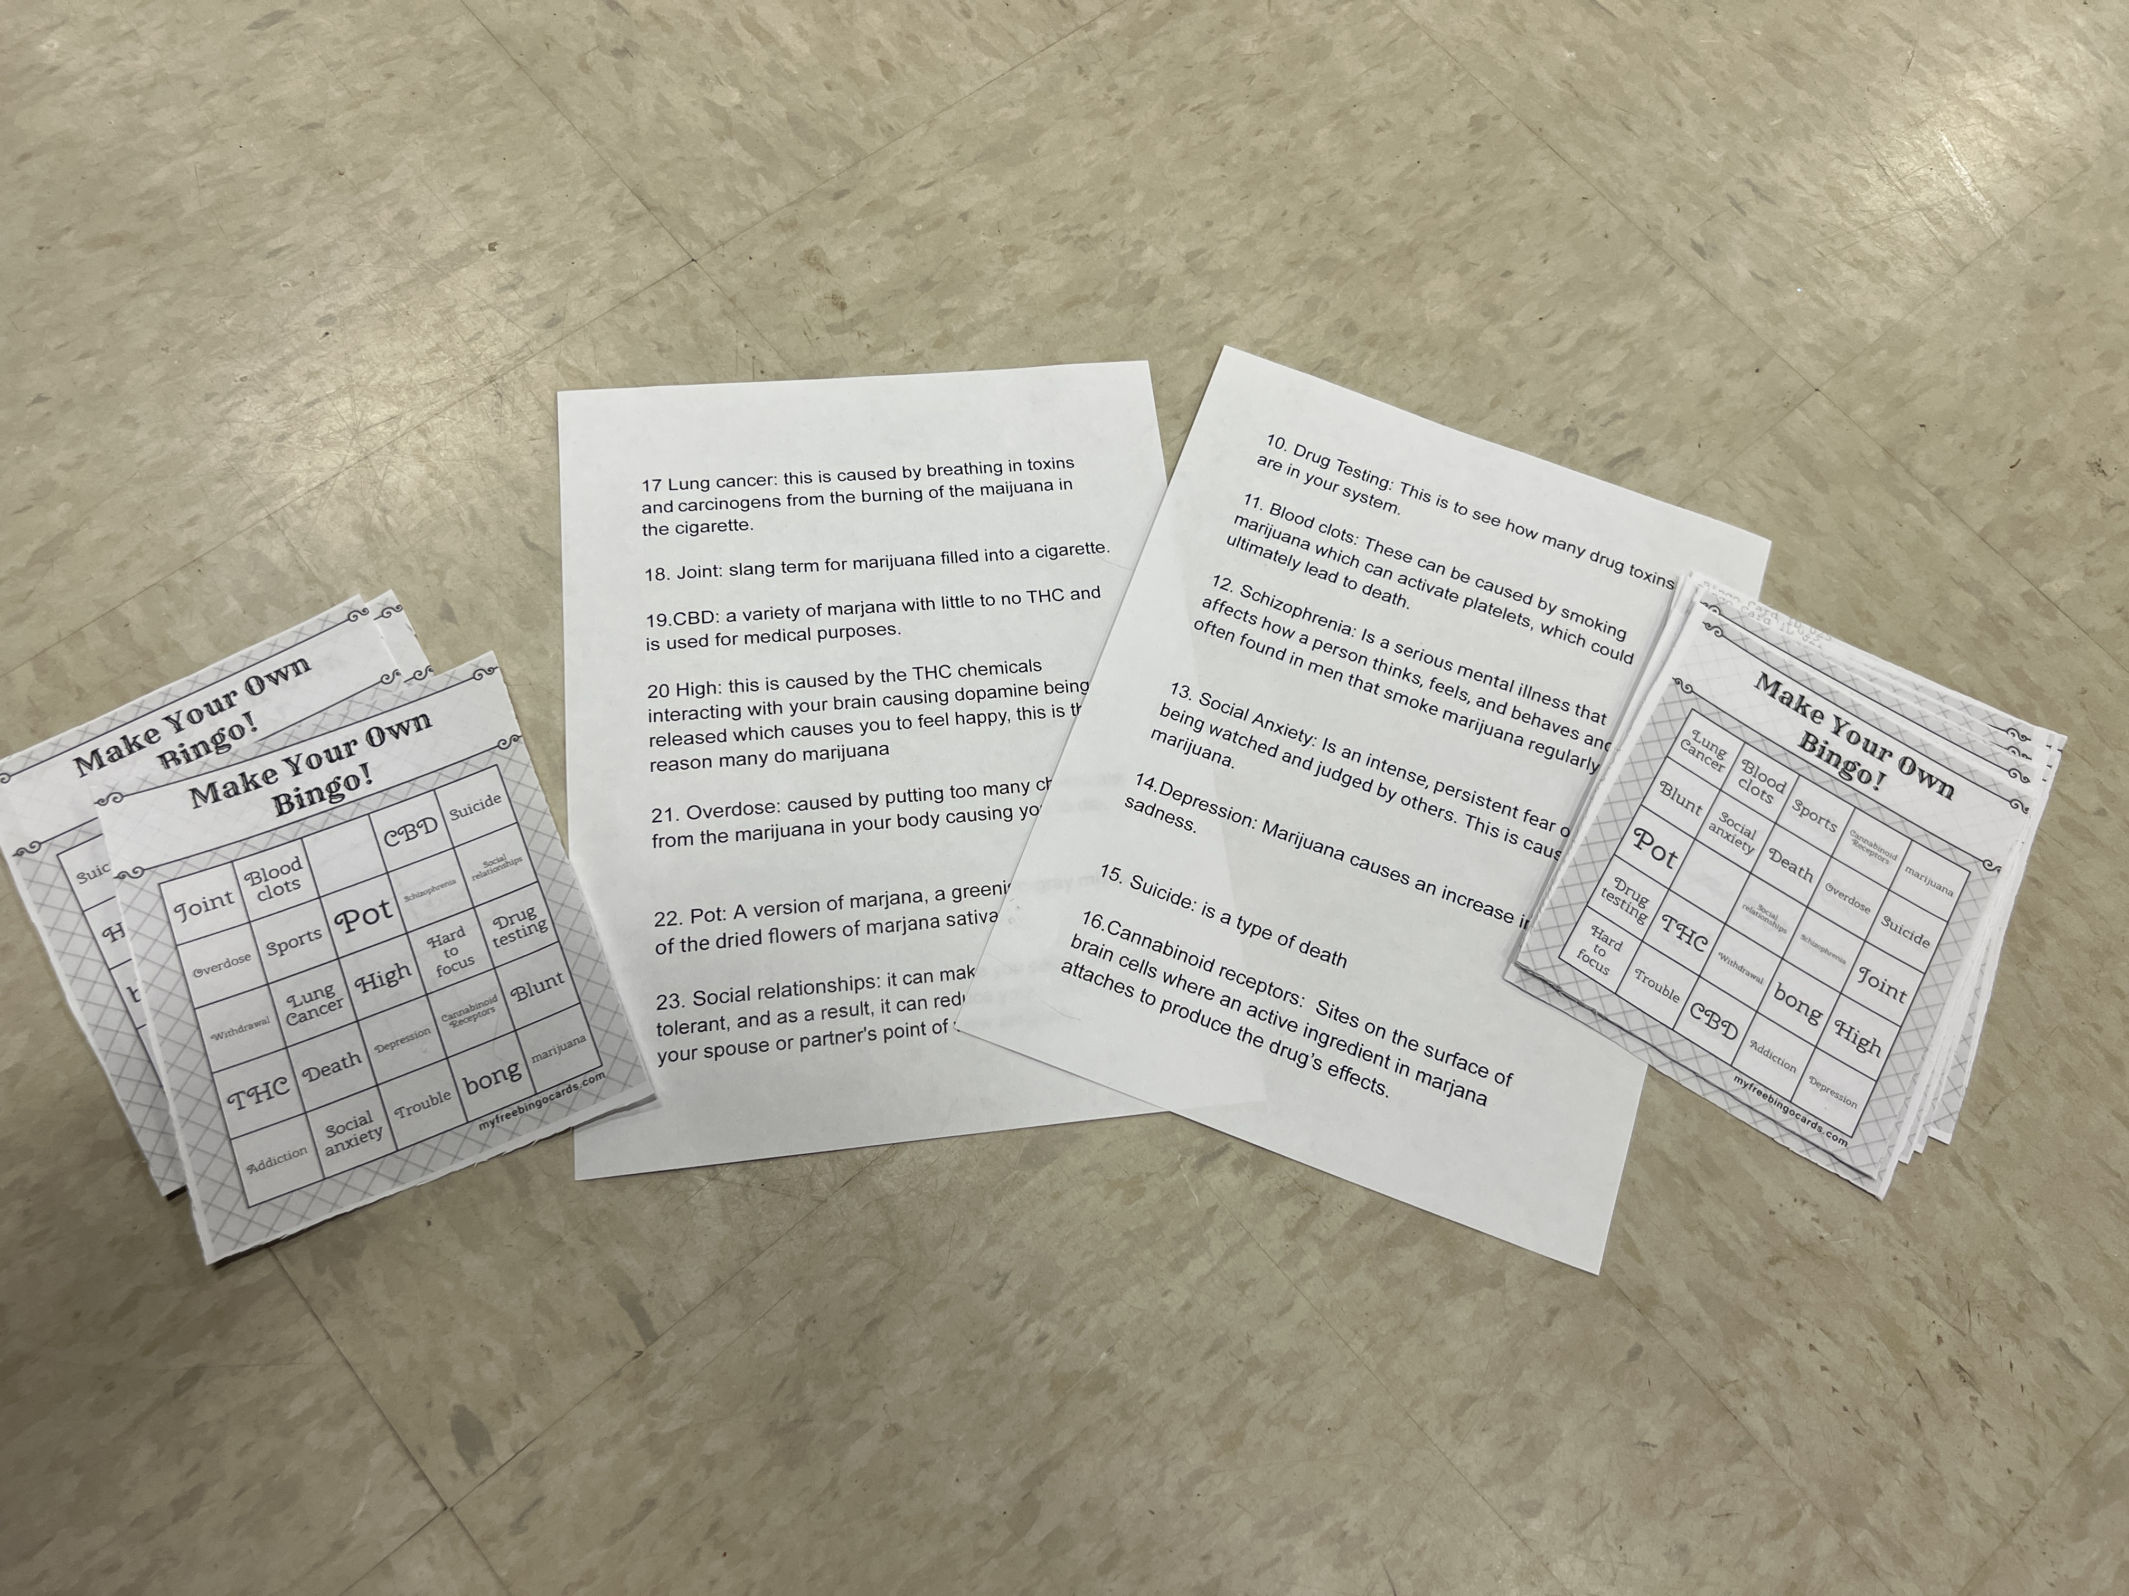
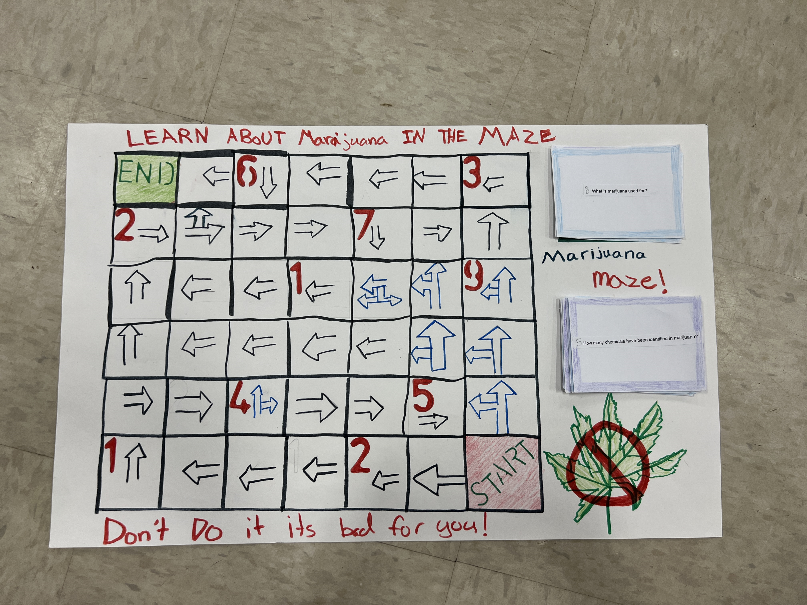
VKAT Waterford Chapter
Waterford School VKAT students created various tobacco prevention board games for fun, educational peer learning on the harms of tobacco and nicotine use.

Slide 6
VKAT Williston Chapter
Williston Central School VKAT members produced a video public service message on the harms of youth vaping to educate and prevent teens from using these high nicotine products.
This important communication work will continue into the 2024 – 2025 school year.

Slide 7
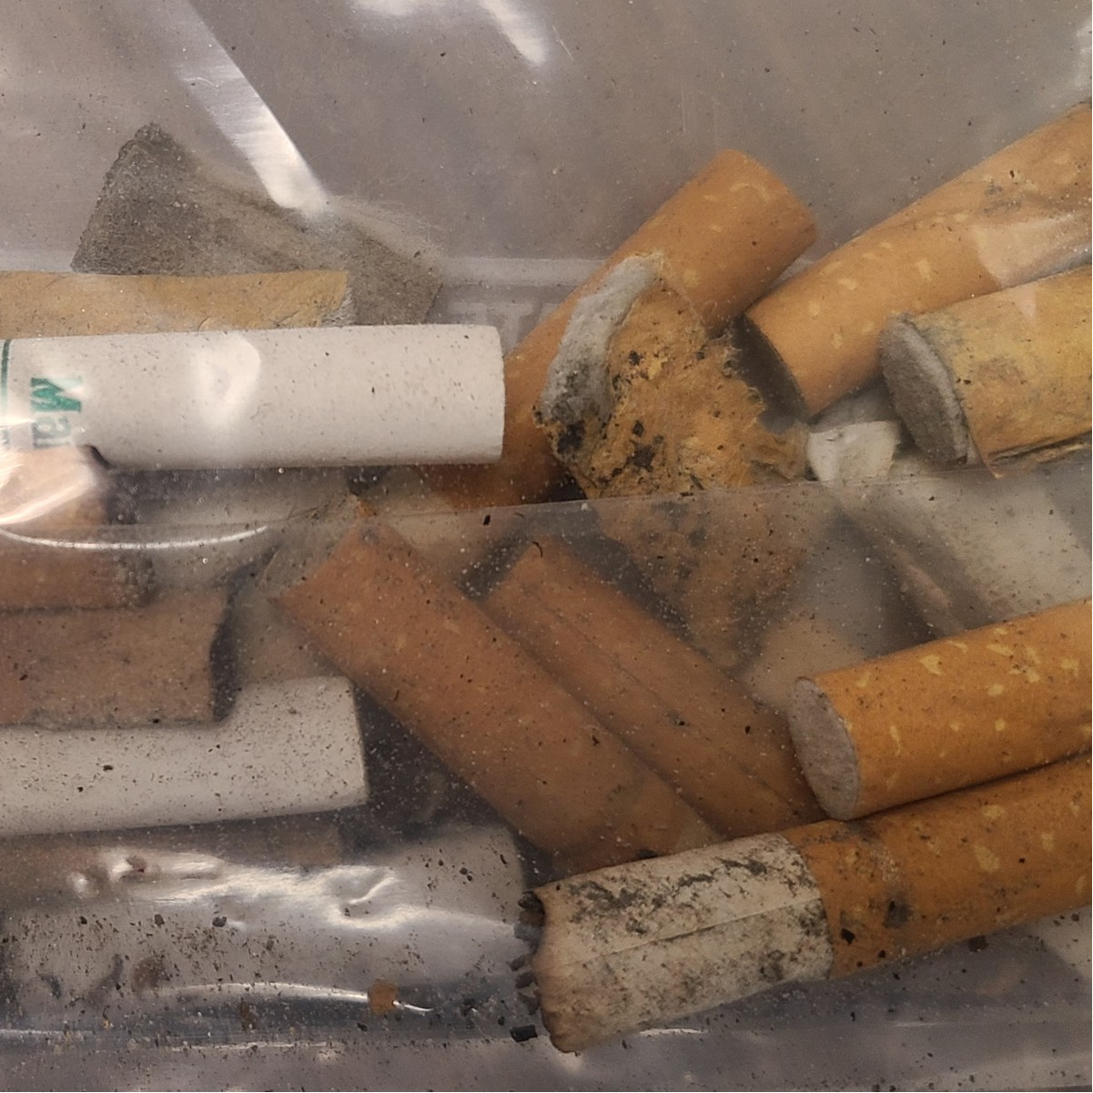
VKAT Woodstock Chapter
Woodstock youth conducted a tobacco litter cleanup on the Town Green, which is a smoke-free space. This policy measure includes tobacco products, tobacco substitutes, and cannabis products. VKAT students found 54 cigarette butts and one cigarillo plastic tip in the park.
Cigarette butts are primarily made of plastic, the most found plastic waste in the world.

