Slide 1

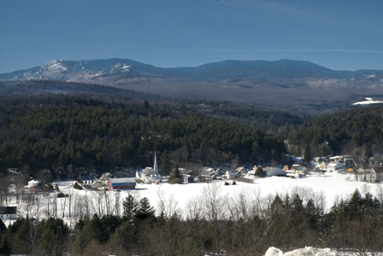
Logic Model Templates
Fillable logic model templates that can be used when applying for funding.
Vermont Department of Health
Division of Substance Use Programs
October 2023

Slide 2
DSU Logic Model Template
Logic Model for Program Name
Date created:
Last updated:
Goal Statement
Inputs
Processes
Outputs
Effects
Short term: what we expect to accomplish Intermediate: what we want to accomplish Long term: what we hope to accomplish
Outcomes
Context
Diversity, Equity, Inclusion

Slide 3
Additional logic model template 1
Goal Statement What do we want to achieve?
Inputs What do I need? | Activities What do I want done? | Outputs What will we measure? | Outcomes What are the desired results?

Slide 4
Additional logic model template 2
Goal
Resources | Activities | Outputs | Short-term Outcomes | Mid-term Outcomes | Long-term Outcomes

Slide 5
Additional logic model template 3
Inputs
Outputs
Outcomes
What we need
What activities will be done
Who will participate in activities
Short-term results
Intermediate results
Long-term results
Goal

