Slide 1
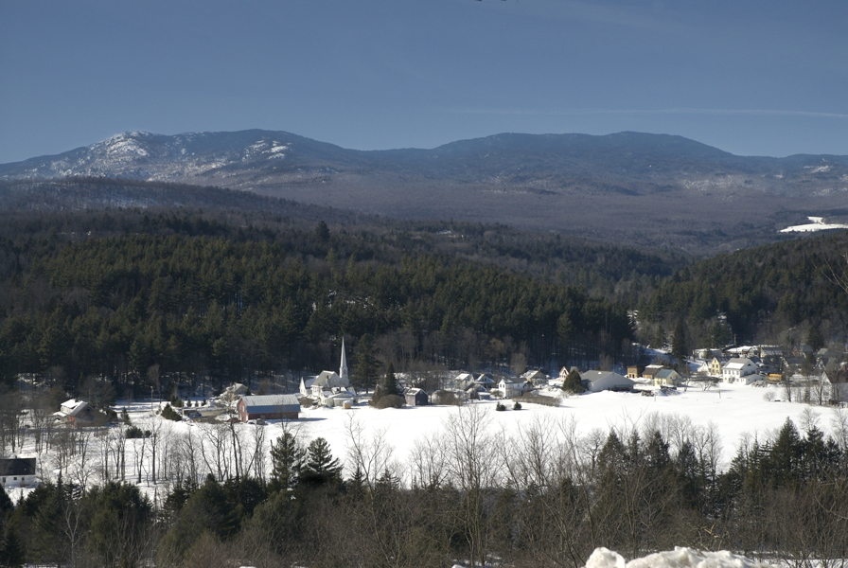
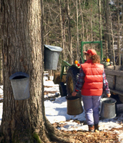
The Pediatric Palliative Care Program Children with Special Health Needs
Introduction to the Pediatric Palliative Care Program

Slide 2
PRESENTATION INDEX
Click on each number below to learn more:
Click the ladybug to end presentation, see contact info,
and complete the evaluation:
1: Overview of Pediatric Palliative Care
2: The Pediatric Palliative Care Program Services
3: Eligibility and Referral Process.
Notes:
Jess-How to make this slide more clear-change to objectives? Add words like “understand” and “review” to goals? Is that too wordy?
Home slide or index
Combine eligibility and referral process

Slide 3
Overview of Pediatric Palliative Care
Click each rectangle below to learn more:
What is Pediatric Palliative Care?
What is Concurrent Care for Children?
What does the World Health Organization (WHO) say?
Why Palliative Care?
Click here to return to the INDEX page.
Notes:
Change goals on blue button

Slide 4
What is Pediatric Palliative Care?
Click here for the NEXT SLIDE.

Slide 5
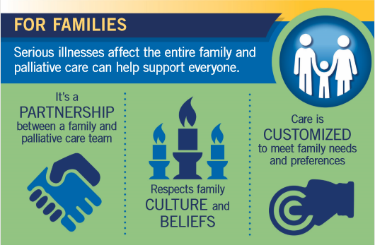
What is Pediatric Palliative Care?
Click the link below to access a pdf copy of the brochure.
https://www.ninr.nih.gov/sites/files/docs/ConversationsMatter-Inforgraphic2020-508c.pdf
Click here for the NEXT SLIDE.
Notes:
Reference concurrent care here.

Slide 6
What is Pediatric Palliative Care?
Click the link below for this brochure and additional free palliative care resources.
https://www.ninr.nih.gov/newsandinformation/conversationsmatter/palliative-care-for-children
CONGRATULATIONS! You’ve completed this section. Click here to return to the Overview slide and complete the next section.

Slide 7
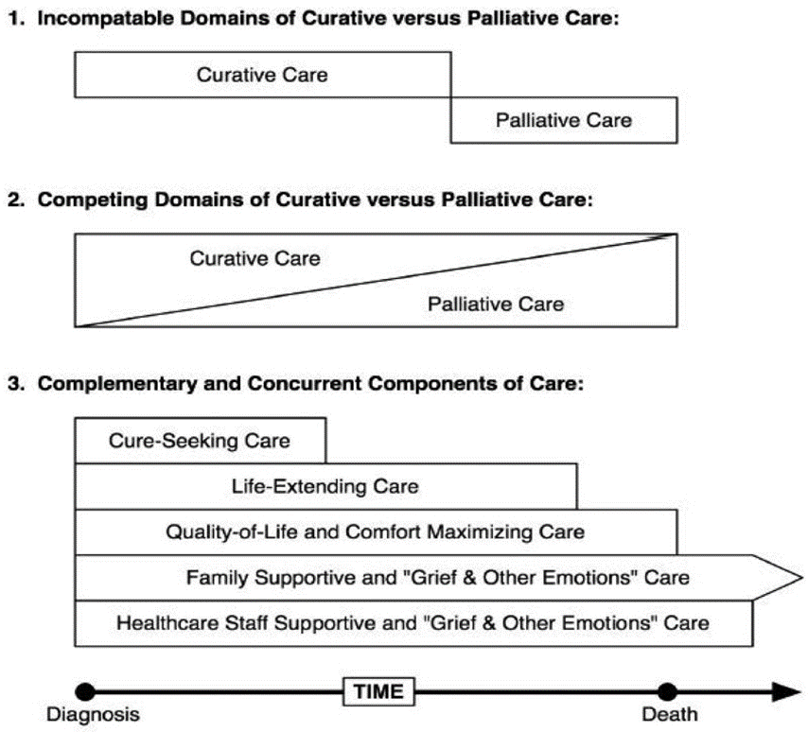
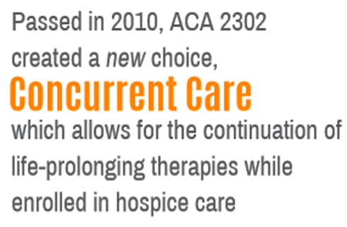
What is Concurrent Care?
CONGRATULATIONS! You’ve completed this section. Click here to return to the Overview slide and complete the next section.
(Feudtner, C. and Hexem, K., 2011)

Slide 8
World Health Organization
WHO Definition of Palliative Care for Children:
Total care of mind, body and spirit
Initiated at diagnosis
Continues regardless of curative treatment
Involves a multidisciplinary team
Click the logo below to access the WHO webpage on pediatric palliative care
Click here to return to the Overview Slide

Slide 9
Why Palliative Care?
Click on the link below to access the full 2019 State-By-State Report Card on Access to Palliative Care
Palliative Care Improves Quality Care
Reduces symptoms and suffering
Improves quality of life
Addresses needs of caregivers
Improves communication
Reduces crisis care utilization
IMPROVES SURVIVAL
Click here for NEXT SLIDE.

Slide 10
Why Palliative Care?
Click on each phrase below to access videos of family stories about palliative care.
Click the logo above to access the full Courageous Parents Network website.
Click here for the NEXT SLIDE.

Slide 11
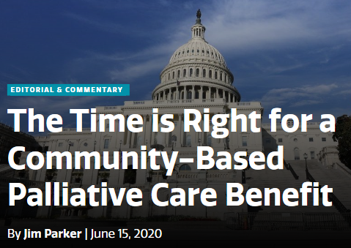
Why Palliative Care?
Click title picture on the left for access to full article.
“The time is right.
The need is great.”
Community-based palliative care (cbpc) :
Can reduce ER visits by 35%
Can reduce Hospitalizations by 50%
Can reduce total health care costs by 36%
CONGRATULATIONS! You’ve completed the Overview section. Click here to go back to the INDEX page and complete item #2.

Slide 12
The Pediatric Palliative Care Program Services
Family Training
Care Coordination
Family Grief and Bereavement Counseling
Expressive Therapy
**Skilled Respite Care, Where Available
Click here to return to the INDEX page.
Notes:
Add a slide for skilled respite care

Slide 13
Care Coordination
A nurse designated as the family’s key contact
~Coordinates all PPCP services
~Collaborates with community partners
~Facilitates and guides appropriate service coordination on behalf of the child/family
~Supports better health outcomes and prevention of unnecessary institutionalization
A nurse designated as the family’s key contact
Coordinates all PPCP services
Collaborates with community partners
Facilitates and guides appropriate service coordination on behalf of the child/family
Supports better health outcomes and prevention of unnecessary institutionalization
Click here to return to the SERVICES page.

Slide 14
Family Training
Education to empower families with skills and knowledge, so they can care for their child with confidence.
Education provided by a nurse to support and empower families with skills and knowledge so they can sufficiently care for their child with confidence.
Notes:
Look at phrasing in info sheets to make them consistent

Slide 15
Expressive Therapy
Provided by a certified therapist in art, music, dance, or play therapy or a Certified Child Life Specialist.
Provided by a certified therapist in art, music, dance, or play therapy. Or a Certified Child Life Specialist.
Helps the family meet the challenges of the child’s illness through creative and kinesthetic treatment modalities.
Helps the family meet the challenges of the child’s illness through creative and kinesthetic treatment modalities.
Notes:
Switch text boxes- Helps the family….child’s illness.

Slide 16
Family Grief and Bereavement Counseling
Anticipatory grief/counseling for the family in the home.
Supports the physical, psychological and spiritual well-being associated with the child’s illnesses

Slide 17
Skilled Respite Care
Short-term relief for family members from the demanding responsibilities of caring for
a child with a complex medical condition.
For the family to attend to personal or other family needs
Clinically eligible children may qualify for up to 10 days of respite per year.
**May not be available in all regions. Check with your Care Coordinator
for details.
CONGRATULATIONS! You’ve completed this section.
Click here to return to the INDEX page and complete item #3.

Slide 18
Who is Eligible?
To be considered for the PPCP, the child must meet all eligibility requirements listed below:
Under age 21
Vermont Resident
Medicaid Beneficiary
Diagnosed with a Life-Limiting Illness and at risk of not surviving into adulthood
Click here for the NEXT SLIDE.

Slide 19
Referral Process
Referral from MD to PPCP Coordinator (CSHN)
Program eligibility determined
HHA notified
Referring MD and family notified via mail
RN Care Coordinator contacts family for intake
Referral can be submitted by an MD, PA, or NP.
Click HERE to access the online PPCP referral form.
CONGRATULATIONS! You’ve completed the presentation. Please click here to access contact information and evaluation.
Notes:
Question: Do we need the top text box? Is there anything else about the referral process that needs to be added? Maybe something targeted to the family?

Slide 20
Contact
Jessica Boyea
Pediatric Palliative Care Program Coordinator
Children with Special Health Needs
Vermont Department of Health
108 Cherry St., Burlington, VT
Jessica.boyea@vermont.gov
Phone: (802) 865-1312
Fax: (802) 863-6344
Click HERE for the Pediatric Palliative Care Program Website
Click HERE for the evaluation

