Slide 1
Substance Use Disorder services: UVM Clinical Psychology Phd program and Vermont Psychological Services
University of Vermont

Slide 2
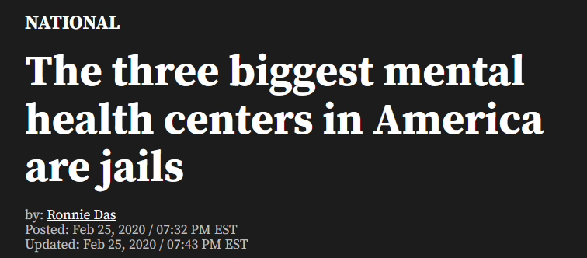
Substance use and the justice system
Estimated that 13% of incarcerated people used heroin regularly upon arrest
People incarcerated suffer from SUDs at 2x-3x the rates of the general population
Similar numbers for those on parole or probation
The majority of people with OUD have a co-occurring mental illness (27% with severe mental illness)

Slide 3
Substance use and the justice system
Only about 11% of incarcerated people receive treatment for a substance use disorder
Only around 5% of treatment referrals made by parole or probation agencies for opioid use disorder result in MOUD
35-75% of individuals who begin MOUD discontinue their treatment in just the first year of treatment
Chances of overdose skyrocket post-release
Estimates as high as 129x hazard ratio

Slide 4
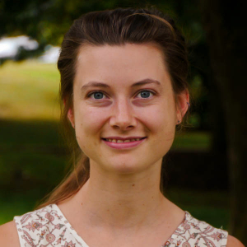
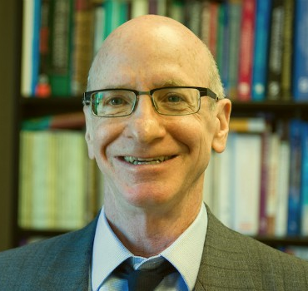
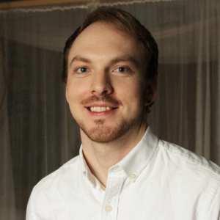
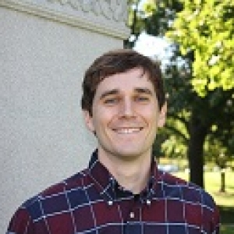
The Vermont Correctional Addiction Treatment Program (V.C.A.P.)
Established in 2016
Our Current Team:
Rachel Gehman, MA
Tim Stickle, PhD
Nathan Moxley-Kelly, MS
Thomas Geist, MS MA

Slide 5
V.C.A.P. patients
Historically, primarily pre-trial federal detainees
A time of transition and uncertainty
Recently including state and federal cases
Variety of charges, violations
Highly diverse, motivated, and engaged
SUD and co-occurring mental health disorders

Slide 6
V.C.A.P. Services
Assessment
Full understanding of presenting problem & comorbidities
Context of history, goals, and strengths
Evidence-Based Treatment
Individual and Group
CBT; ACT; MI
Advocacy
Coordinate with Marshalls and Probation

Slide 7
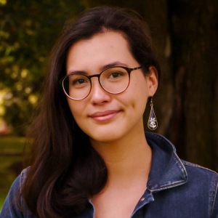
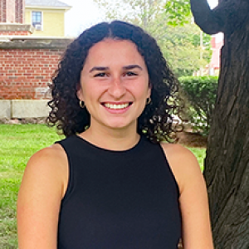
The SUDSS Team!
Nathan Moxley-Kelly, MSc
Rachel Gehman, MA
Rhiannon Wiley, MA
Jill Giannini, BA
Tim Stickle, PhD

Slide 8
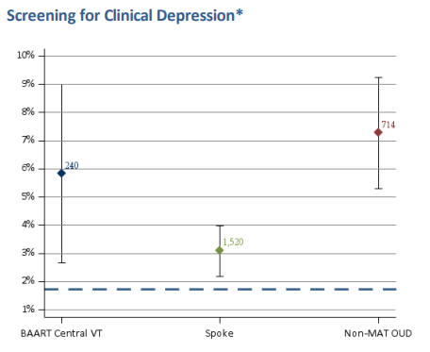
Substance Use Disorders Specialty Service (SUDSS)
Designed to facilitate student’s interest and motivation to help!
Student’s passion
Clinical supervisors and researchers with expertise
Material resources (E.g., office space, assessment tools, etc.)
How do we figure out how to help?
Reached out to providers and program directors
Expressed our desire to help
Described our resources
Asked what was needed
Providers discussed issues related to:
Waitlists for treatment
Siloing
Insufficient time
A lack of screening and assessment
Then began developing a service to address the identified needs!

Slide 9
How does SUDSS work?
Treatment
Approach the work with a non-judgmental, harm-reduction mindset
Clinicians will help clients accomplish their goals
Abstinence, improved functioning, reduced suffering, etc.
Clinicians use evidence-based interventions
Motivational interviewing (MI)
Cognitive-behavioral therapy (CBT)

Slide 10
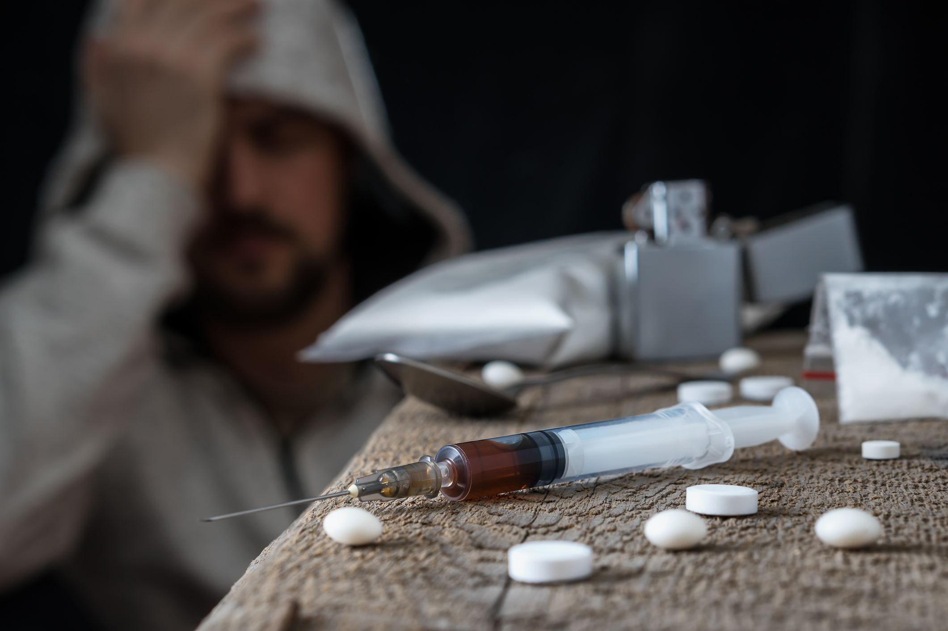
Recurrence of use
Hospitalization
Incarceration
Genetic Risk
Adverse Childhood Experience
Trauma
Early
Peer
Parental
Substance Use
Depression
Anxiety
PTSD
ADHD
MOUD
Housing Stability
Social Support
Employment
Improved Mental Health and Coping Skills
Recovery!

Slide 11
How does SUDSS work?
Evaluation and Referral
Structured and semi-structured interviews
Diagnosing DSM-5 disorders
Differential diagnosis
Functioning (e.g., cognitive)
Treatment targets
Treatment plans
Assessment is collaborative!
Reports
Access special services (e.g., services for persons with disability)
Guide intervention
Referral to an appropriate care provider
Including providers of MOUD

Slide 12
Stepdown service - Goals
Increase post-release treatment retention for MOUD
Some evidence suggests psychosocial adjuncts increase MOUD retention
Treat co-occurring mental health disorders across a continuum of care
Associated with non-compliance, drop out, overdose, etc.
Prioritize Harm reduction
Build trust and break down barriers in the mental health system
Provide Training for future clinicians
A future workforce in Vermont
VCAP
2016-
SUDSS
2022-
Stepdown Service
2023-

Slide 13
Stepdown service – Resources
SUDSS service resources:
Telehealth prescribing of MOUD by Tildabeth Doscher MD, MPH
Network of community providers (e.g., UVM’s Addiction Treatment Program)
Fentanyl Testing Strips
Narcan
Clinical supervisors and researchers with expertise
Material resources (e.g., office space, assessment tools, etc.)
Trained clinicians

Slide 14
Opioid settlement advisory mandate
18 V.S.A. § 4774
(b) Expenditures from the Opioid Abatement Special Fund shall be used for the following opioid prevention, intervention, treatment, recovery, harm reduction, and evaluation activities:
(5) addressing the needs of criminal justice-involved persons
18 V.S.A. § 4774
(6) treating incarcerated populations, specifically:
(A) providing evidence-based or evidence-informed treatment and recovery support, including medication-assisted treatment for individuals with opioid use disorder or co-occurring substance use or mental health disorders while transitioning out of the criminal justice system; and
(B) increasing funding for correctional facilities to provide treatment and recovery support to inmates with opioid use disorder;

Slide 15
Opioid settlement advisory mandate
18 V.S.A. § 4774
(5) expanding the availability of warm handoff programs and recovery services, specifically:
(C) broadening the scope of recovery services to include co-occurring substance use disorder or mental health conditions;
18 V.S.A. § 4774
(10) supporting efforts to provide leadership, planning, coordination, facilitation, training, and technical assistance
(12) implementing other evidence-based or evidence-informed programs or strategies that support prevention, harm reduction, treatment, or recovery of opioid use disorder and any co-occurring substance use or mental health disorder; and to abate the opioid epidemic;

Slide 16
Funding
VCAP and SUDSS meet specific needs related to the Opioid Settlement Committee’s recommendations
In line with statewide initiatives to provide efficacious intervention for OUD
To continue to provide care and to expand its services additional funding is needed
Administrative costs
Graduate Student stipend
Supplies
Travel Vouchers for Clients
Training Materials
Therapy Materials (e.g., client workbooks)

Slide 17
Questions?
Contact:
Thomas.Geist@uvm.edu

